Slide 1
Impact of oral hygiene on the presence of oral pathologies in HIV infected patients
Eriselda Simoni, Leonard Simoni, Laureta Flaga,
Arjan Harxhi, Najada Como

Slide 2
Background and Aim
Oral manifestations remain common in people living with HIV and are influenced by immunological status, systemic comorbidities, and behavioral factors such as oral hygiene. The independent contribution of oral hygiene to the presence of oral diseases, alongside clinical and immunological determinants, remains incompletely defined in real-world settings.
To evaluate the independent predictors of oral pathologies in HIV-infected patients, with particular focus on oral hygiene practices, using multivariate logistic regression analysis.

Slide 3
Materials and methods
We conducted a retrospective observational study including HIV-positive patients with available clinical, immunological, and oral health data. The primary outcome was the presence of at least one oral pathology (candidiasis, hairy leukoplakia, periodontal diseases, Kaposi sarcoma, non-Hodgkin lymphoma, xerostomia, ulceration NOS, parotitis). Multivariate logistic regression analysis was performed, including demographic variables (age, sex), clinical comorbidities, HIV disease stage (Stage 1–2 versus Stage 3), immunological parameters, and oral hygiene indicators (tooth brushing frequency: <1/day, 1/day, >1/day). Adjusted odds ratios (OR) with 95% confidence intervals (CI) were calculated.

Slide 4
Results
In multivariate analysis, poorer oral hygiene was independently associated with a higher likelihood of oral pathologies. Compared with patients who brushed more than once a day (OR 1.9, p = 0.03), those who brushed once daily or less than once daily (OR 3.1, p < 0.01) had a significantly increased risk of presenting oral disease. Advanced HIV disease (AIDS Stage) showed a positive in univariate analysis (OR 5.3, p=0.003), but a non-independent association after adjustment for oral hygiene and clinical covariates (OR 1.2, p = 0.89).

Slide 5
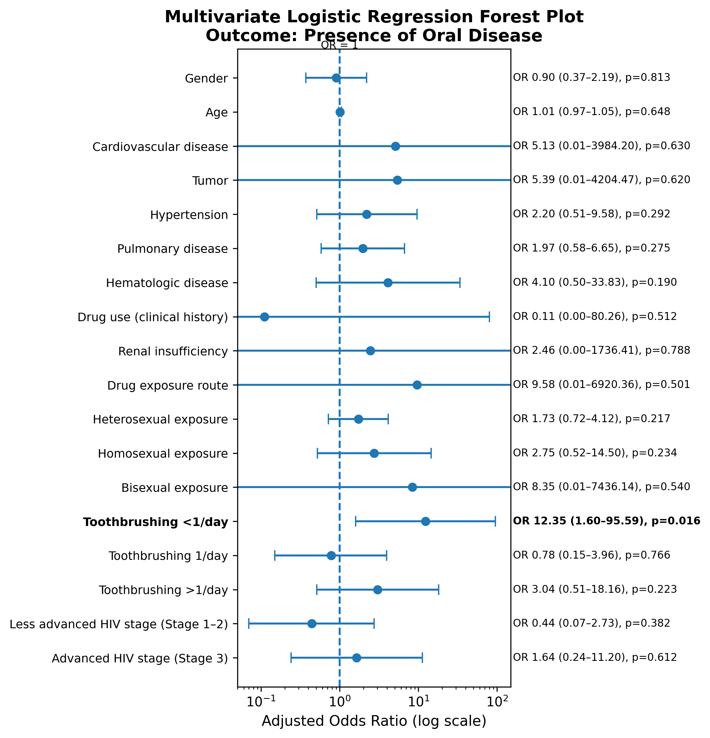
Results

Slide 6
Discussion and conclusion
Oral hygiene practices represent a key independent determinant of oral pathologies in HIV-infected patients, outweighing the effect of HIV disease stage when adjusted for in multivariate analysis. These findings emphasize the importance of integrating structured oral hygiene assessment and education into routine HIV care, alongside immunological monitoring, to reduce oral disease burden.

Slide 7
Thank You

