Slide 1


From Awareness to Action:
Evaluating Mental Health First Aid Implementation Across Australian Dental Schools
A/Prof Roisin McGrath (University of Melbourne)
A/Prof Matt Hopcraft (University of Melbourne)
A/Prof Melanie Aley (University of Sydney)
Ashleigh Ayo (University of Sydney)
Evidence and Empathy as the focus in oral health professionals' education

Slide 2

Acknowledgement of Country

Slide 3


University of Melbourne, Parkville Campus

Slide 4
Mental health and wellbeing in dental education
High levels of psychological distress among dental students
Students encounter patients experiencing mental health challenges
Many feel unprepared to respond
Mental health education often focuses on awareness rather than practical action
Notes:
How do we prepare graduates who can support both their patients—and themselves?

Slide 5

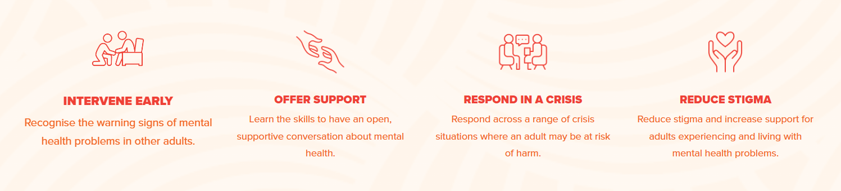
Mental Health First Aid
MHFA originated in Melbourne, Australia
Initial support given to someone experiencing a mental health problem or mental health crisis until appropriate professional help is received or the crisis resolves
Evidence-based and informed by people with lived experience, their caregivers, and mental health professionals
Notes:
Mental health first aid (MHFA) is the initial support given to someone experiencing a mental health problem or emotional crisis until appropriate professional help is obtained or the crisis resolves. It is not a substitute for clinical treatment, but rather practical, compassionate assistance to reduce distress and keep the person safe.
9 million trained worldwide – 1.6 million in Au
50+ countries
Mental Health First Aid is no longer an Australian innovation - it is an internationally recognised, evidence-based program delivered in more than 50 countries, including many across Europe.
England Scotland Wales Northern Ireland Republic of Ireland Netherlands Denmark Finland Sweden Norway Portugal
Mental Health First Aid (MHFA) originated in Australia in 2000 and has since become a global program coordinated by Mental Health First Aid International, which is also based in Australia. As of 2026, MHFA is delivered through 36 licensed partners across 51 countries, with more than 8.6 million people trained worldwide.
Our project is evaluating how it can be effectively embedded within dental curricula.
Learning outcomes:
Recognise the signs and symptoms of mental health problems in adults
Use an evidence-based action plan to initiate a mental health first aid conversation
Know the barriers to help-seeking and how to overcome these
Assess for a range of crisis situations and provide initial support
Understand the prevalence and impact of mental illnesses, risk factors and treatments and supports available
Apply self-care practices as a Mental Health First Aider

Slide 6
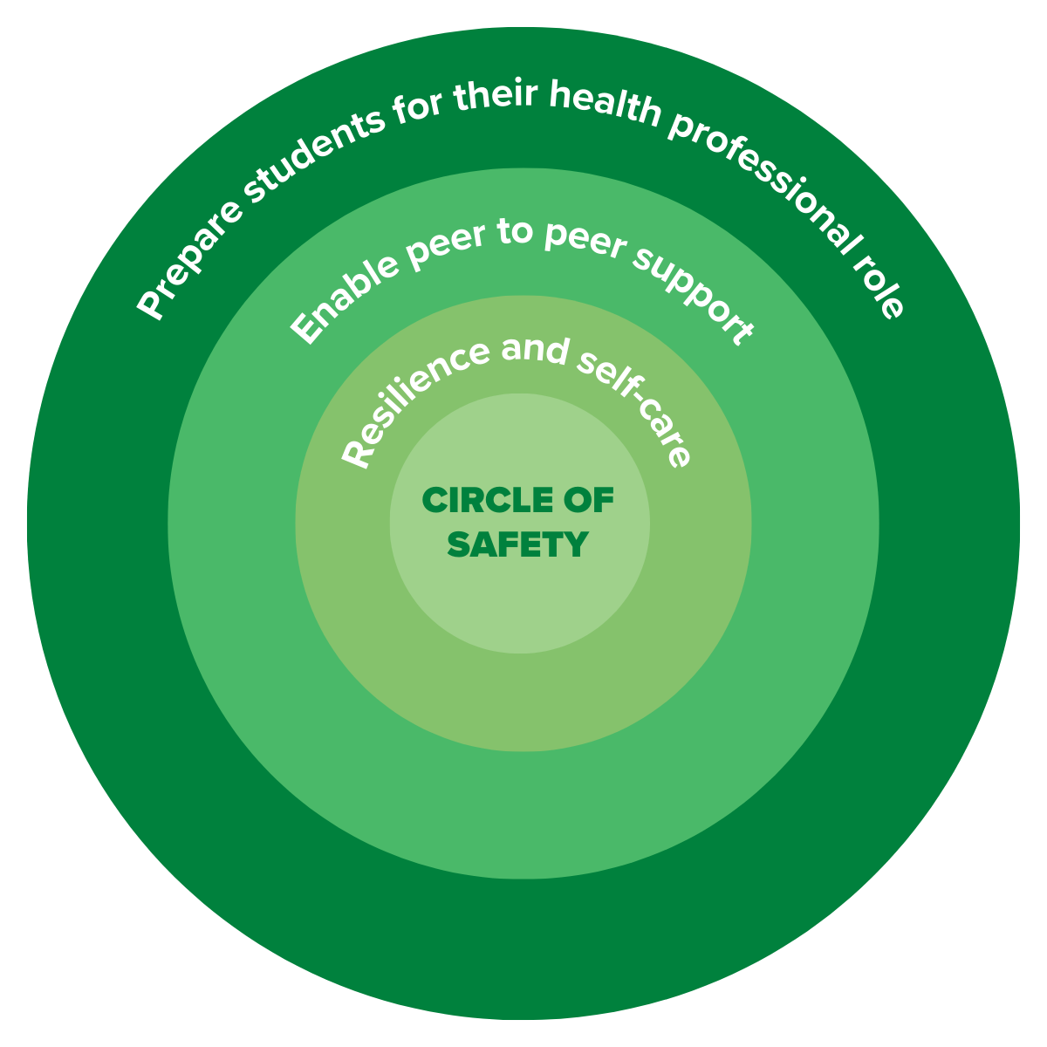

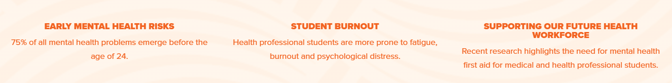
An Australian response: Mental Health First Aid for Health Professional Students
Specifically designed for health professional students – fully funded
Teaches students how to recognise early signs of a mental health problem
Provides practical skills to keep themselves and peers safe
Training includes:
    Real-world experiences of health professional students
    Contextualised content
    Advanced learning pathways:
      eLearning modules (6-8 hours)
      Blended learning (eLearning + instructor led sessions 2x3 hours)

Slide 7
What are we evaluating?
Instead of asking...
‘Does MHFA work?’
We're asking
How can it be implemented in dental schools?
How does it operate in different contexts?
What influences student engagement?
What supports sustainable curriculum integration?
Evaluation approach (ethics UoM HREC):
Implementation mapping
Student feedback surveys
Student focus groups
Academic perspectives
Notes:
Implementation science rather than effectiveness alone
Variation in
delivery model
curriculum placement
compulsory vs optional participation
local implementation

Slide 8
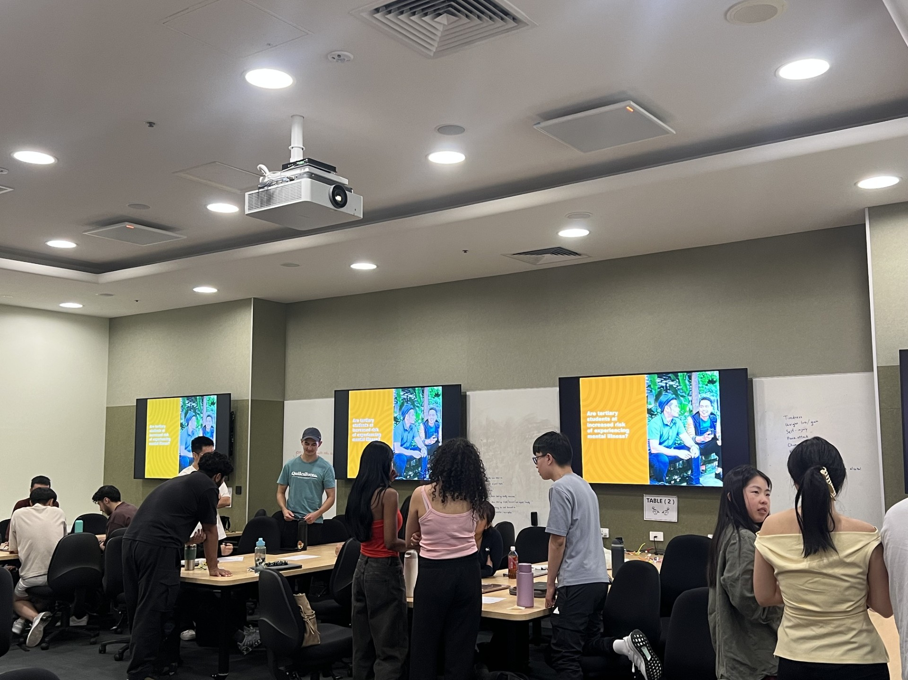
MHFA-HPS implementation
Nationally funded course implementation
      eLearning modules
Offered to all 13 Australian dental school members of the Australasian Council of Dental Schools (ACODS)
Seven (54%) chose to participate in 2026
      530 eLearning vouchers requested
      303 completed as of July 2026
      3 schools made it mandatory
Notes:
Curriculum innovation rather than extracurricular activity

Slide 9
MHFA International data – all health professional students
3,780 completed pre- and post-eLearning surveys
      169 could be identified as dental students (not previously possible)
Confidence seeking and providing mental health support significantly increased
      87% in highest confidence categories
      351% improvement for ‘extremely confident’
Satisfaction with the eLearning was overwhelmingly positive
      Content clarity and relevance
      Information presentation and accessibility
      Quizzes and assessments
      Interactivity and engagement

Slide 10
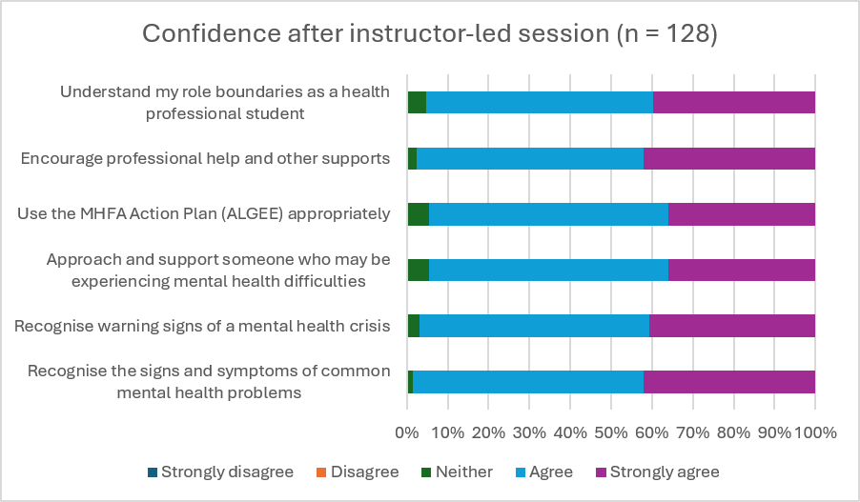
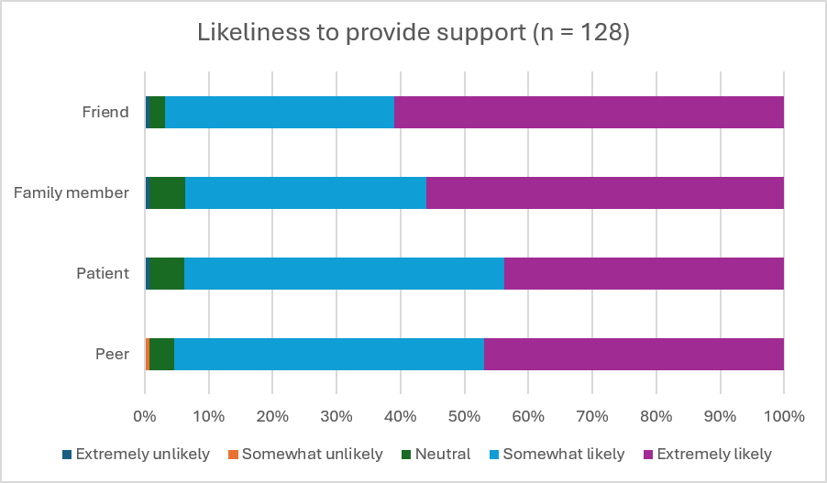
University of Melbourne – feedback survey
200 UoM students participated
      mandatory
BOH2 50
BOH3 44
DDS2 106
Notes:
19 completed eLearning in 2025
The instructor created a safe, respectful, and supportive learning environment
4.55
The session complemented and reinforced the MHFA eLearning content
4.48
Examples and discussions were relevant to health professional students
4.41
The content was appropriate for dentistry students and future dental practice
4.23
The pace and length of the session were appropriate
3.40

Slide 11
Free text responses
"It was extremely valuable to know how to approach ppl with potential mental problems and suicidal thoughts."
"Knowing what to say and how to act in difficult situations such as an individual going through a mental health issue."
Most valuable aspects of the instructor-led session
      Highly interactive
      Practical skill development – applying ALGEE to scenarios
      Safe, inclusive learning environment
    How could be improved
      Shorten or condense the session
      Schedule earlier in the course
      Include more disorder examples
“It would be more beneficial if it had been given in first week of DDS2 where we have a bit more time and availability and is before clinic starts as I think it would prepare us better.”
“I feel like the session itself is very valuable, but the duration is a little bit long, and it’s hard to concentrate at the end of the session.”
“No improvements needed, I loved every moment! Thank you for the great session!”
Notes:
Some wanted split 2x days others in single day

Slide 12
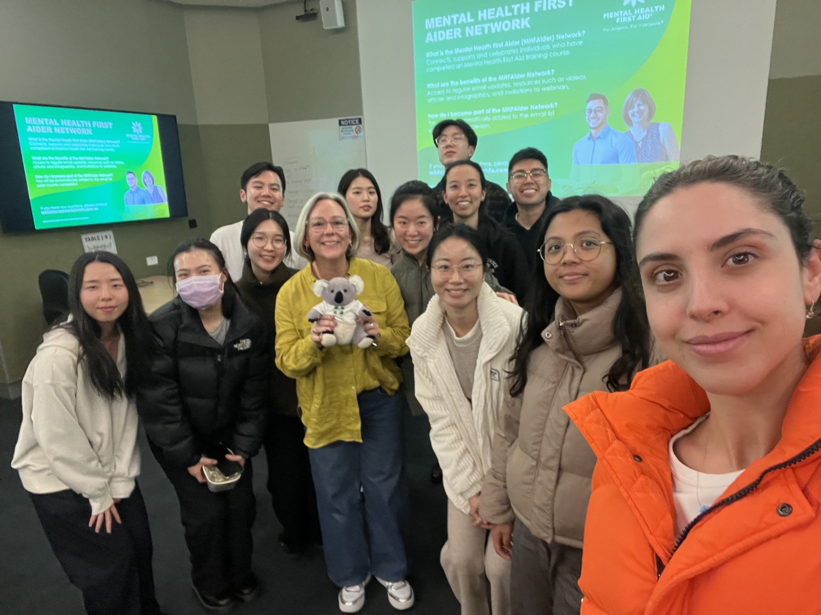

Early observations
Students
✓ Highly relevant
✓ Increased confidence
✓ Applicable to future practice
✓ Supports personal wellbeing
Institutional variations in
Delivery model
Curriculum placement
Compulsory vs optional participation
Local implementation

Slide 13

Questions we don't yet have answers to
Should MHFA be compulsory?
Where should it sit within the curriculum?
Is the instructor-led session worth the additional resources?
How often should skills be refreshed?
What outcomes matter most?
      confidence?
      behaviour?
      student wellbeing?
      patient care?

Slide 14
Questions for you?
Where would mental health and wellbeing fit best within your curriculum?
Would your students engage if training were optional?
How would you measure ‘success’?
How would you teach and assess ‘wellbeing’?
Notes:
Many European countries already offer MHFA, but often only Adult and Youth programs. As dental educators, should we be developing discipline-specific MHFA pathways for oral health professionals, or is a generic health-professional program sufficient?

