Slide 1
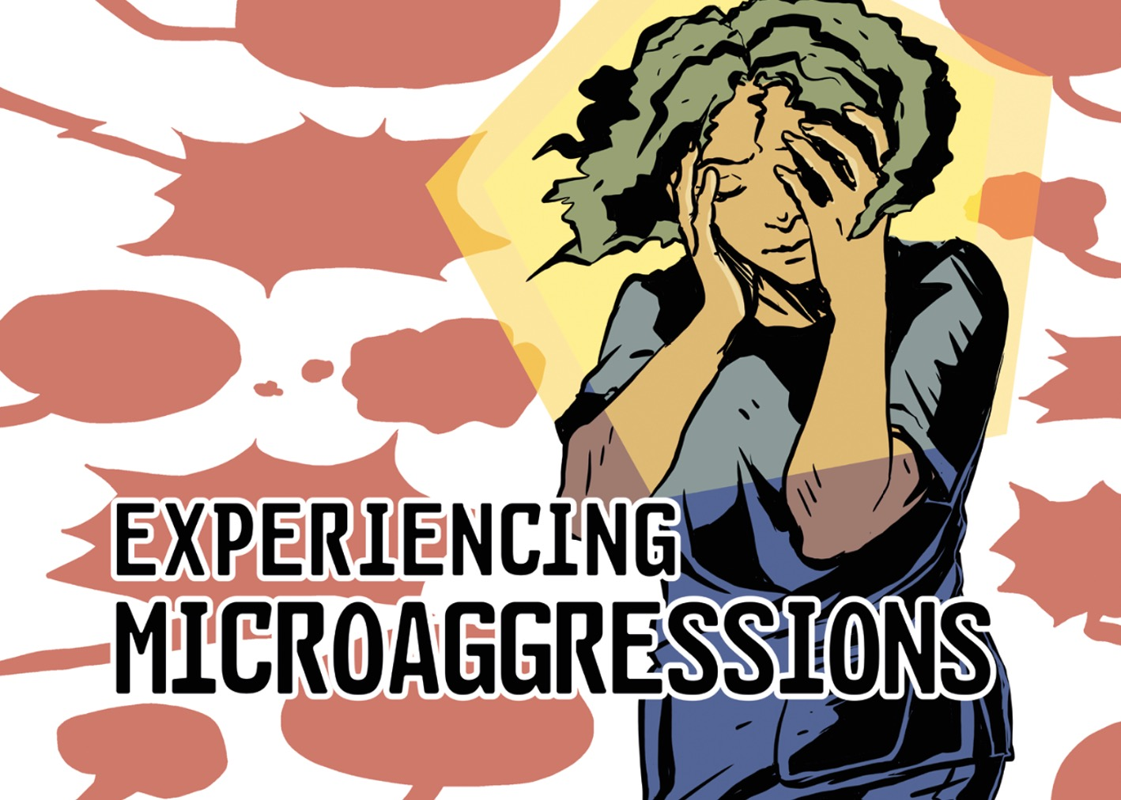
Utilisation of a comic book approach, to teach on racial microaggressions.
-Leila Ben Fredj (Dental Core Trainee)
-Kitty Guo (Restorative Registrar and Clinical Lecturer)

Slide 2
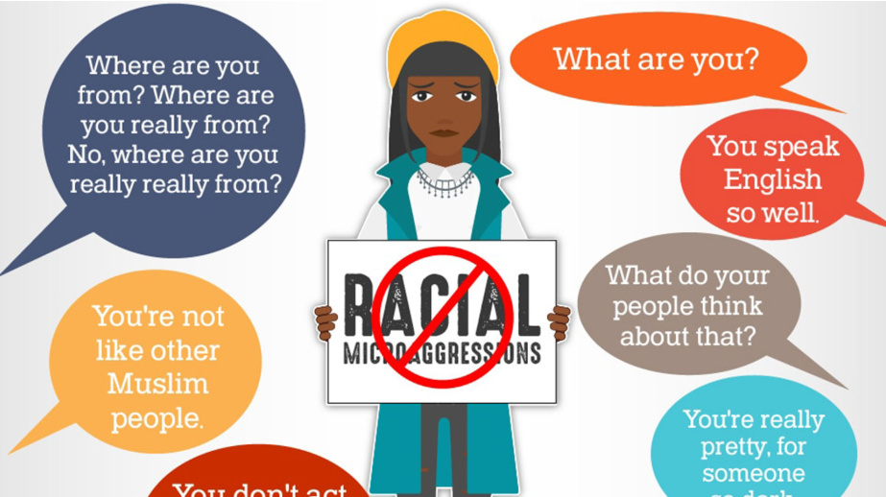
Racism
Modern itineration racism-Microaggressions: subtle act of exclusion
6 out 10 ethnic minority Dentists in the UK have experienced racism
GDC Curriculum
Racial Battle fatigue
Notes:
Racism: (Oxford English Dictionary): one racial group is deemed superior resulting in inferior treatment of other group
Prejudice, discrimination or antagonism
By an individual, community or institution
Against a person or people on the basis of their membership to a particular racial or ethnic group
Typically one that is a minority or marginalised
Oxford English Dictionary
Microaggressions: statement, action or incident regarded as an instance of indirect, subtle or unintentional discrimination or prejudice against members of group such as a racial minority” Oxford English Dictionary
Subtle acts of exclusion
Statistic reported by BDA co-chair of EDI committee, following 2021 survey distribution (www.gdc-uk.org, n.d.)
Dental students likely to under-report racist incidents (Ahmadifard et al., 2022)
GDC Curriculum-"Proactively address discriminatory language, behaviour and microaggressions from colleagues, patients and other professionals"(GDC-Professionalism, Sub Domain Ethics and Integrity P(B)13)(gdc-uk.org, 2018)
Racial Battle fatigue : diminishes mental, emotional and physical energy (Ester et al., 2025)

Slide 3
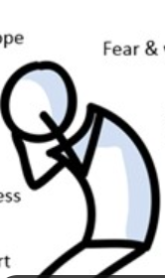
Background
Impact racism:
Psychological
Work performance
(Racial battle fatigue)
Colleague relationships
Staff retention
Aim project: -development educational comic that addresses racial microaggressions.
Notes:
Psychological: Estacio + Sadia Khan report on migrant nurses UK experience isolation + distress
Racial battle fatigue: emotional + mental strain
Colleague relationships: erodes trust + communication=fractious work environment affects pt care
Staff retention: burnout, decreased job satisfaction + commitment (Firi and Baryeh, 2024)
Aim: develop a comic which 1)Informs 2)Equips 3) Empowers

Slide 4

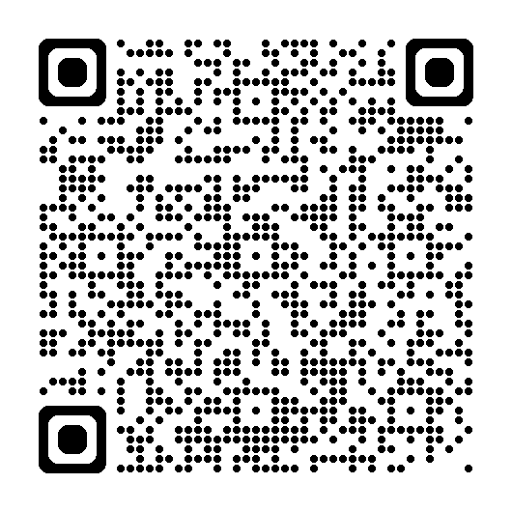
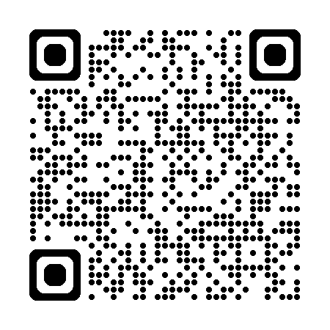

Methods
Qualitative data demonstrating promotion empathy through graphic novels (Sutherland, Choi and Yu, 2021)(Wang, Houlden and Yu,2019)
Questionnaire Dental students +staff
Anonymisation and Amalgamation of experiences
Publication comic
QR code- comic
QR code- article
Notes:
Impact comic book
Visual examples aided empathy + understanding( (Sinervo and Freedman, 2021)
Communication of subtle, insidious nature microaggressions
Highlighted "grey area" disparity between intention(occasionally benign) and effect(often cumulative +profound)
Online questionnaire-sent staff and students collecting examples racism experienced on clinic.
Comic book-(Collaboration between Comic Studies Creative Research Hub and Dundee Dental School )

Slide 5
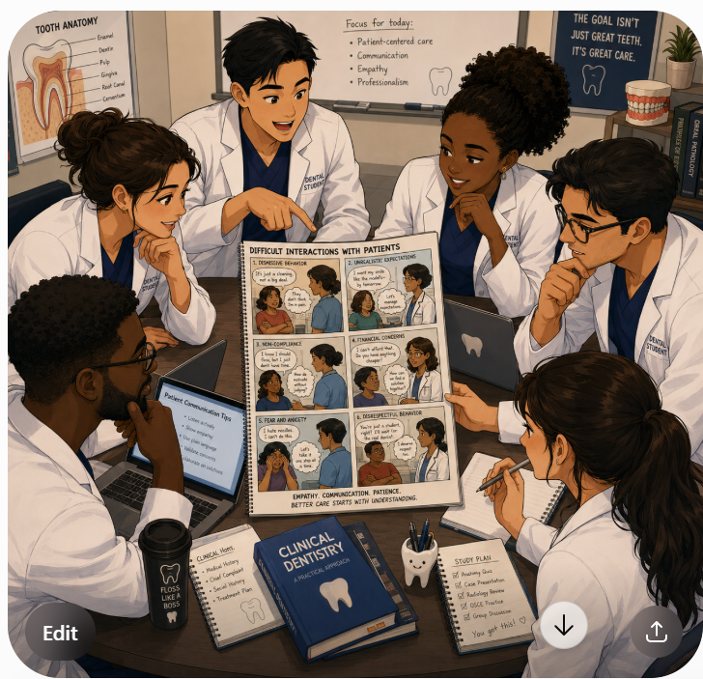
Materials and Methods
Interactive workshop
Pre and post workshop surveys
Participants:-
Students, recently qualified Dentists and Dental staff
Notes:
Surveys- to assess initial understanding and impact of teaching on this. Post workshop surveys to collect quantitative and qualitative data on success/failure of approach
Group discussions- facilitated by comic book scenarios, engagement with audience.
Practising assertive, professionally appropriate responses.

Slide 6

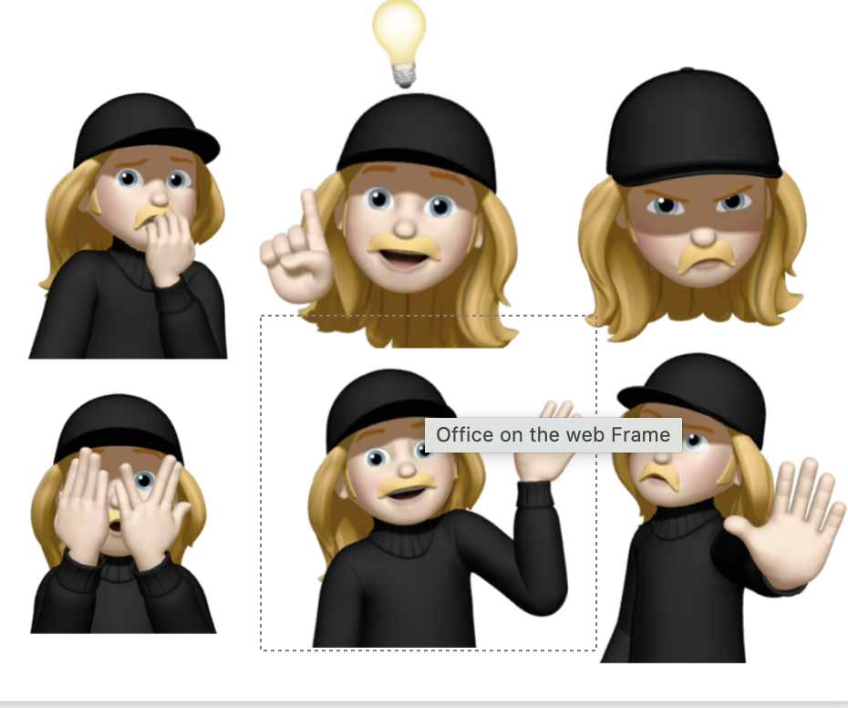
Delivery teaching
Interactive 90 minute workshop.
Didactic teaching + group discussions (facilitated comic).
Delivered ->undergraduate students, Dental Hospital staff, newly qualified Dentists and Dentists in postgraduate training.
Outcome-response.
Notes:
Response: Discussed cost-benefit ratio, in terms of making decision on whether to respond. Discussed impact of choosing not to respond vs responding. Taught framework on development of assertive, professionally appropriate response.

Slide 7
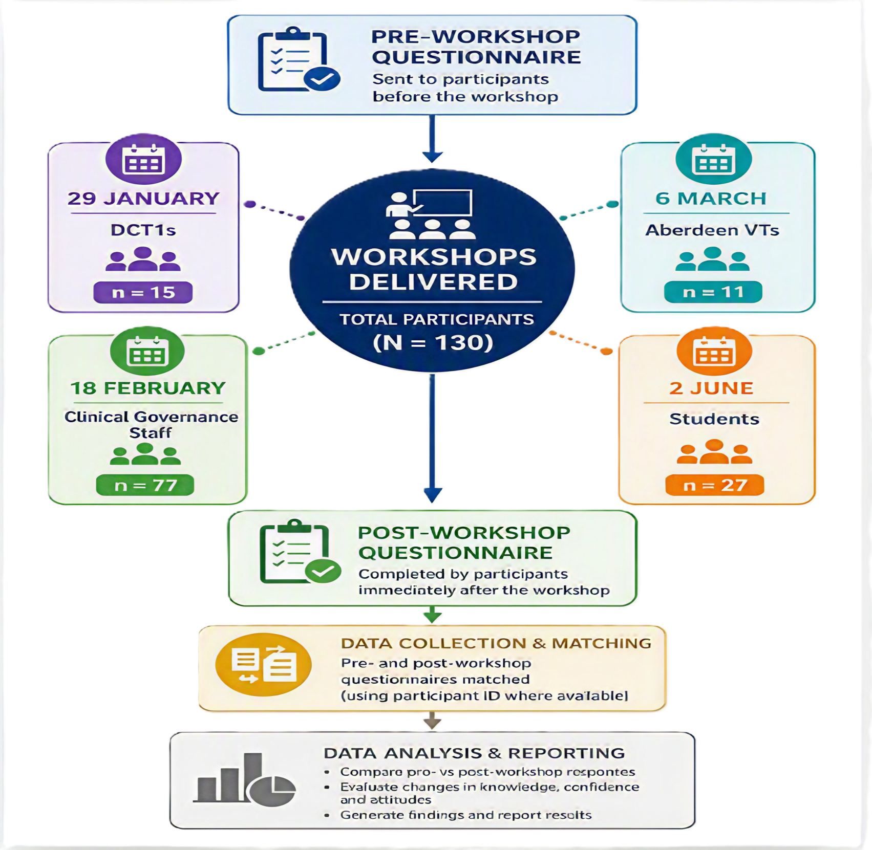
Evaluation

Slide 8
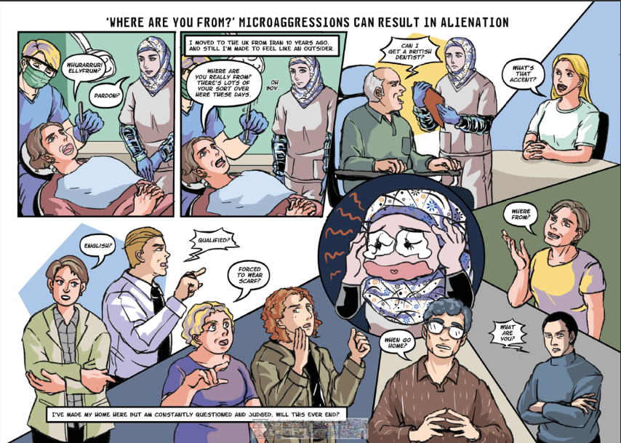
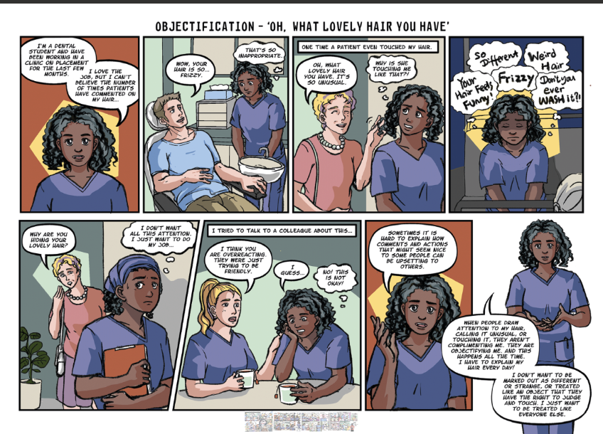
Results-why comic worked
Notes:
Thought bubbles superimposed over scene helps participants consider emotional and psychological impact of relatively "harmless, throwaway comment/action".
Comic strip gives background: Emphasises cumulative effect rather then focusing on single incident. Repeated attacks. Context often not available to witnesses of incident. This demonstrates history of repeated experiences.
Speech bubble effective at building entire picture, verbal dialogue enhances pictures displaying body language and expressions and builds more comprehensive account of experiences for recipients of microaggressions.

Slide 9
Reach of the programme
4 workshops
27 undergraduate students
11 VTs Aberdeen
15 DCTs
77 staff
Total participants
Workshop participants | Postgraduate Dental Trainees | Recently qualified Dentists | Dental Hospital Staff | Undergraduate Students | Total participants
Number participants | 15 | 11 | 77 | 27 | 130

Slide 10
Questionnaire results
Recognition and understanding of racial microaggressions

Slide 11
Recipient's confidence responding

Slide 12
Bystander confidence responding

Slide 13
Overall Results

Slide 14
Comparison between participant groups.

Slide 15

Participant Feedback
“Visual examples make it much easier to imagine and relate to the situation”
"Allowed me to understand how people experiencing them can perceive comments"
“It is easy to display key findings and recurrent themes that resonate better”
“It's great to see some validation and a comic’s always a great way to illustrate ideas”
“It reframed the issue in a more descriptive way compared to lecture slides”
Notes:
Student feedback on comic book use within workshop
Appeals to visual learners
Different method of communicating information which could otherwise appear pedagogic and dry
Insight into experience of individual different from yourself (encourages sympathy for others)
Validated personal experience
Publicised what can be a hurtful, internalised, isolated experience

Slide 16
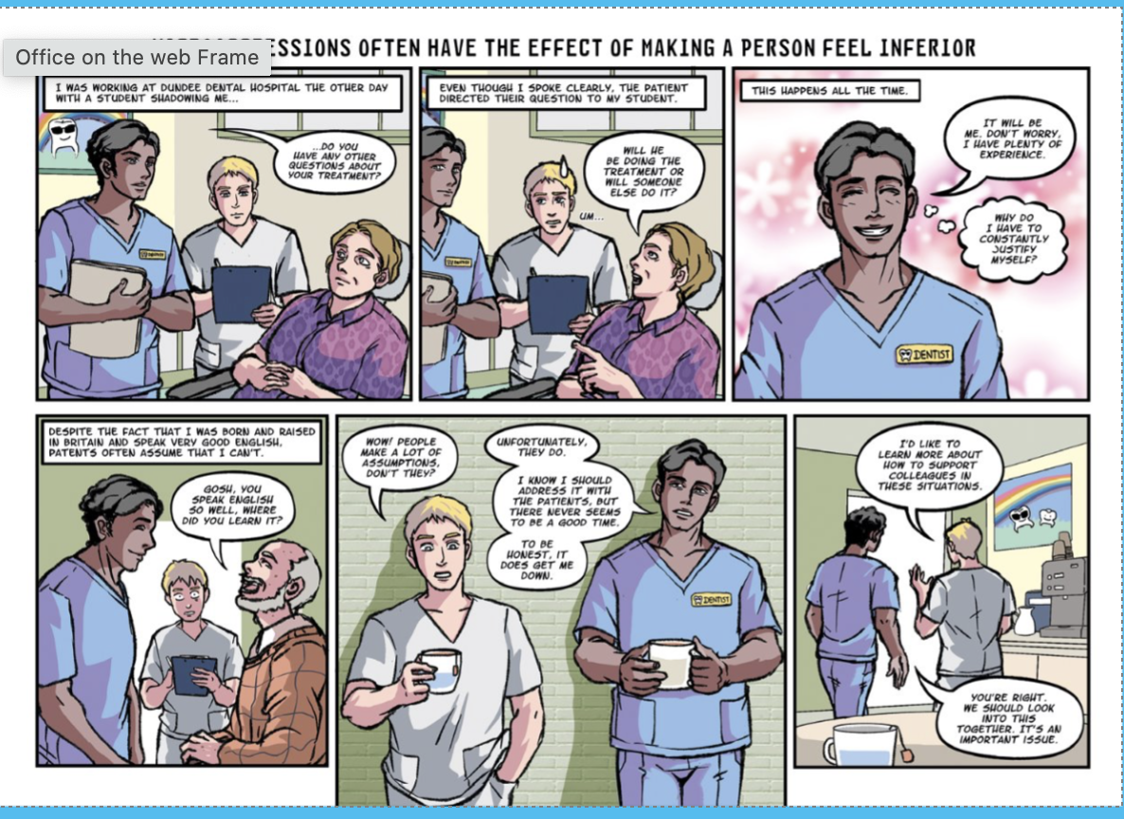
Comic book as educational vessel​
Dual coding theory
Graphic pathographies
Patricia Gauch author of children’s books, “Art, when it’s really good, doesn’t imitate or mirror the text. Rather, it adds a new dimension that goes way beyond the words”
Notes:
Graphic pathograhies-used medical settings(comic strip type representation of disease) giving Drs insight into patients personal experience of disease/illness.(Green and Myers, 2010)
Communicate what cannot be communicated with text alone. Implied meaning portrayed more clearly. Centralises emotion and inner thoughts. Allows insight into background and context.
Evidence that diagnostic skills can be improved in medical training, through viewing and describing fine art (Dolev, Friedlaender and Braverman, 2001)
Dual coding theory: when information is presented in two forms contiguously, visual+ verbal for example, learner builds internal verbal and internal visual meaning from represented verbal and visual information and creates referential links between the two allowing better problem solving and long term retainment /memory.(Mayer and Sims, 1994)

Slide 17
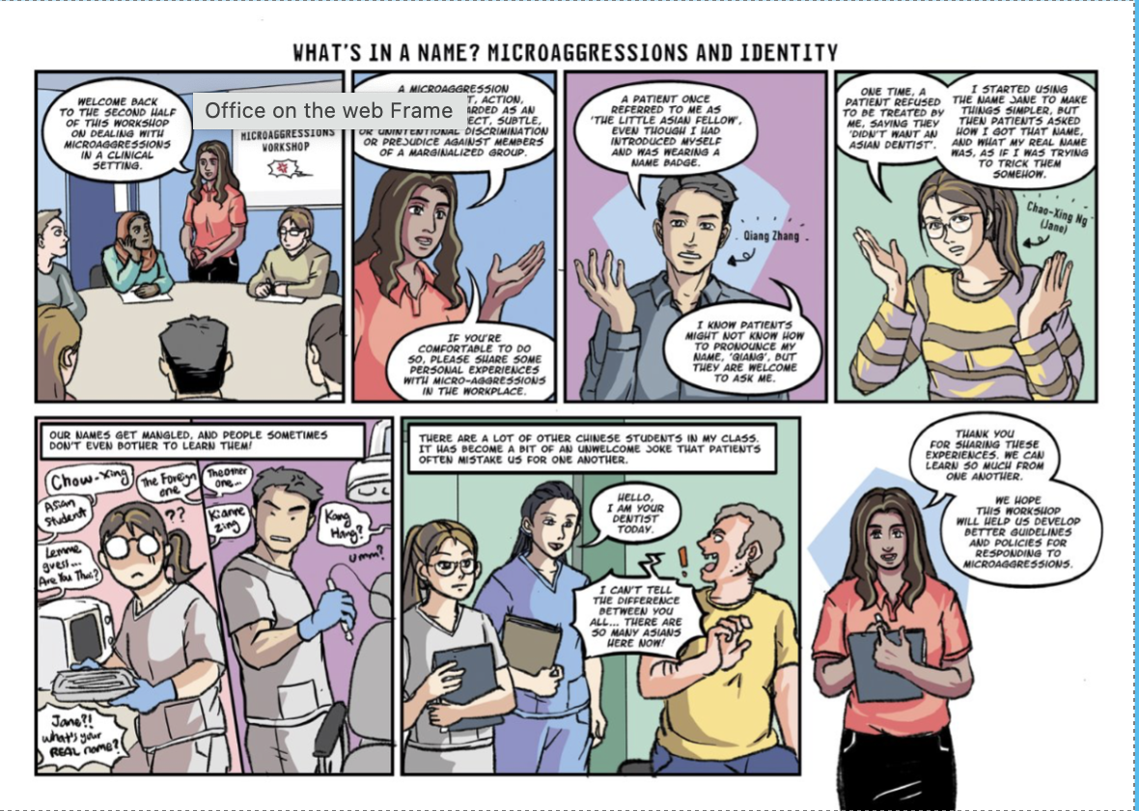
Conclusions
Merits of approach
Complexity and subtle nature of microaggressions.
Stimulates conversation.
Visual approach -> evoke empathy.
Comic based teaching -> awareness and confidence tacking racial microaggressions
Successful approach -> varied cohort
Transferable ->healthcare fields
Learner wellbeing
Notes:
Improves resilience and sense inclusion, making learning environment more conducive towards educational goals
Visual approach-provides context
Recognition microaggressions and enable confident, supported, aware, self-advocating clinicians

Slide 18
References
Agency for Healthcare Research and Quality (2023). Tool: DESC | Agency for Healthcare Research and Quality. [online] www.ahrq.gov. Available at: https://www.ahrq.gov/teamstepps-program/curriculum/mutual/tools/desc.html [Accessed 6 July 2026].
Ahmadifard, A., Forouhi, S., Waterhouse, P. and Muirhead, V. (2022). A student‐led qualitative study to explore dental undergraduates” understanding, experiences, and responses to racism in a dental school. Journal of Public Health Dentistry, 82(S1), pp.36–45. doi:10.1111/jphd.12514.
Carney, R.N. and Levin, J.R. (2002). Pictorial Illustrations Still Improve Students” Learning from Text. Educational Psychology Review, 14(1), pp.5–26. doi:10.1023/a:1013176309260.
Cid-García, A. and Ramírez-García, A. (2026). Comics as a Tool for Advancing Inclusivity in the Physical Education Classroom. Education Sciences, [online] 16(3), p.470. doi:10.3390/educsci16030470.
Crouch, E. (2021). Racism in dentistry: Denial is not an option. [online] British Dental Assocation. Available at: https://www.bda.org/news-and-opinion/blog/racism-in-dentistry-denial-is-not-an-option/ [Accessed 6 July 2026].
Dolev, J.C., Friedlaender, L.K. and Braverman, I.M. (2001). Use of Fine Art to Enhance Visual Diagnostic Skills. JAMA, [online] 286(9), pp.1020–1021. doi:10.1001/jama.286.9.1019.
Estacio, E.V. and Saidy-Khan, S. (2014). Experiences of Racial Microaggression Among Migrant Nurses in the United Kingdom. Global Qualitative Nursing Research, 1, p.233339361453261. doi:10.1177/2333393614532618.
Ester, T.V., Smith, C.S., Cain, L. and Ramaswamy, V. (2025). The impact of role and race on overall climate in dental schools. Journal of Dental Education, [online] 89(5), pp.722–730. doi:10.1002/jdd.13730.
Gdc-uk.org. (2018). Standards of education. [online] Available at: https://www.gdc-uk.org/education-cpd/dental-education/quality-assurance/review-of-education/review-of-education-2022-23/standards-of-education_2223 [Accessed 6 July 2026].
Green, M.J. and Myers, K.R. (2010). Graphic medicine: use of comics in medical education and patient care. BMJ, 340(mar03 2), pp.c863-c863. doi:10.1136/bmj.c863.
Guo, K., Murray, C., Bartle, M., Nabizadeh, G., Islam, M. and Ding, C. (2025). Tackling racial microaggressions in dental training: a novel approach using comics. British dental journal, [online] 238(12), pp.943–948. doi:10.1038/s41415-025-8387-y.
Mayer, R.E. and Sims, V.K. (1994). For whom is a picture worth a thousand words? Extensions of a dual-coding theory of multimedia learning. Journal of Educational Psychology, 86(3), pp.389–401. doi:10.1037//0022-0663.86.3.389.
microaggression, n. meanings, etymology and more | Oxford English Dictionary. (2023). Oed.com. [online] doi:10.1093\/OED\/8073937729.
Nih.gov. (2026). Checking your browser - reCAPTCHA. [online] Available at: https://pmc.ncbi.nlm.nih.gov/articles/pmc7380147/ [Accessed 6 July 2026].

Slide 19
References
Promise Firi and Kwaku Baryeh (2024). Racial microaggressions within the UK Healthcare System: a narrative review. JRSM Open, 15(8). doi:10.1177/20542704241232861.
Sinervo, K.A. and Freedman, A. (2021). Feeling your pain: empathy in comics. Journal of Graphic Novels and Comics, pp.1–17. doi:10.1080/21504857.2021.1951786.
Standards for Education. (2025). [online] Available at: https://www.gdc-uk.org/docs/default-source/about-us/gdc-standards-for-education-september-2025.pdf?sfvrsn=ecc2702b_1 [Accessed 6 July 2026].
University of Dundee. (2023). University of Dundee. [online] Available at: https://www.dundee.ac.uk/news/using-comics-highlight-microaggressions-clinical-teaching-areas [Accessed 6 July 2026].
www.gdc-uk.org. (n.d.). Racism in dentistry: the scale and nature of the problem. [online] Available at: https://www.gdc-uk.org/news-blogs/blog/detail/blogs/2022/01/06/racism-in-dentistry-the-scale-and-nature-of-the-problem [Accessed 14 July 2026].
Sutherland, T., Choi, D. and Yu, C. (2021). “Brought to life through imagery” – animated graphic novels to promote empathic, patient-centred care in postgraduate medical learners. BMC Medical Education, 21(1). doi:10.1186/s12909-021-02491-4.
Wang, R., Houlden, R.L. and Yu, C.H. (2018). Graphic Stories as Cultivators of Empathy in Medical Clerkship Education. Medical Science Educator, 28(4), pp.609–617. doi:10.1007/s40670-018-0590-x.

