Slide 1

Design and Usability Testing of a Digital Serious Game for Improved Empathy in Dental Students
Ruaridh Dall | PhD Student | University of Aberdeen, UK

Slide 2
Acknowledgments
Dr Daisy Abbott, Glasgow School of Art
Dr George Cherukara, University of Dundee
Prof. Jaya Jayasinghe, University of Aberdeen

Slide 3

Introduction
Clinical empathy
Serious games
The power of narrative
Empathy game design
Usability testing results
Notes:
Let me present a whistlestop tour of my PhD project. I am very happy to chat in person about any of the concepts that I fly through today if you want to know more.

Slide 4
Clinical empathy
“A predominantly cognitive (rather than an affective or emotional) attribute (brain mechanism) that involves an understanding (rather than feeling) of the patient’s pain and suffering, combined with a capacity to communicate this understanding (behavioral component), and an intention to help (outcome component)” (Hojat et al., 2023, p3)
Notes:
In common with other areas of healthcare, reduced patient anxiety. and increased compliance and satisfaction in dentistry are linked to practitioner empathy (L. Jones & Huggins, 2014)

Slide 5
Empathy as a trainable skill
By acknowledging, absorbing, interpreting and acting on the stories and plights of others, medical professionals can practice humane and effective narrative medicine (Charon, 2001).
The current cohort of dental students learns differently from those that have come before.
Learning strategies that encourage active participation and reflection are suited to Gen Z dental students (Piglionico & Presti, 2025).
Notes:
Narrative medicine is a means of using stories to make healthcare students ally with the suffering of patients and treat them holistically.
Studying literature can enhance the use of the imagination to put oneself in the shoes of another.
Learning experiences are more sensory if viewed through environments, characters, narratives and multimedia elements such as those found in game-based learning.

Slide 6
Serious games
Serious games are games created for reasons other than for the sole purpose of entertainment (Abt, 1970), such as to educate, train or inform (Michael & Chen, 2005).

Slide 7
Attitudinal change
Narratives are disruptive and reveal new insights (Charon, 2006)
The reflection process involves negative experiences such as disruption, surprise and failure to trigger the critical analysis necessary to undo earlier beliefs (Khaled, 2018)
Games can portray people and situations in different lights to trigger this process, potentially acting as a medium that can undo harmful stereotypes (Danilovic, 2024)
Player beliefs will change only if a game promotes cognitive and affective empathy (Belman & Flanagan, 2010)
Notes:
Serious games may be suitable in narrative medicine teaching as they can induce attitudinal change
While we want to develop clinical empathy in dental students, the affective components of empathy need to be activated with a game’s story along with the cognitive components to induce attitudinal change.

Slide 8
Empathy game design
Literature review
Use of serious games to increase healthcare student empathy
Mechanics from commercially available games to elicit empathy
Dental student attitudes questionnaire
Barriers to empathy identified
Triadic game design
Game design philosophy that links reality, meaning, and play
Notes:
Scoping review of games and empathy published in the European Journal of Dental Education
Limited use of serious games for empathy promotion in healthcare, and none in dentistry
Discussions of commercially available empathy games focus on the strength of their writing, the slow reveal of plot that requires player interaction and synthesis of meaning, embodiment, and their plots often feature illness, marginalisation, or bereavement.
Dental student barriers to empathy identified included lack of perspective towards health conditions.

Slide 9
Triadic game design
Meaning | Reality | Play
Dentists should have more empathy for those with mental health conditions. | Mental health conditions affect oral self-care and access to oral healthcare. | Text-based adventure game with player choice affecting the narrative told.
Notes:
Triadic Game Design
Meaning – the underlying message of the game. What we want players to take away.
Reality – the representation of the world in the game space
Play – the interaction system that provides affordances for player actions
Balance is required to impart meaning inspired by reality through play by linking learning mechanics to game mechanics

Slide 10
Learning mechanics – gaming mechanics
Explore
Discover
Reflect/discuss
Imitation
Ownership
Uncover narrative by selecting options
Search for information
Reflect on the slow drip of the narrative
Perspective taking
Response to input feeds knowledge construction
Movement
Goods/information
Cascading information
Roleplay
Quick feedback
LM
GM
(Arnab et al., 2015)
Notes:
The LM-GM framework (Arnab et al 2015) allows learning behaviours to be paired with game actions.
The game utilises a constructivist approach to learning and game mechanics often seen in the commercially available titles.

Slide 11
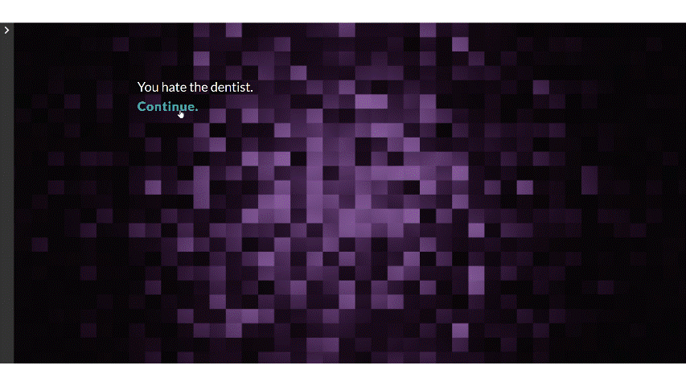
Three narratives for dental students
Game design tool
Twine – www. https://twinery.org/
Branching narrative
Elicits cognitive, affective, and reactive empathy
Three narratives
Dental anxiety
Grief
Depression and its impact on self-care
Notes:
The Twine markup tool allows for the production of browser-based, hypertext games.
Decision making with consequences evokes affective empathy while narrative related mechanics, especially branching narrative has been found to elicit cognitive, affective, and reactive empathy
Three narratives inspired by what students told us they struggled to empathise with, and the themes found in commercially available empathy games

Slide 12
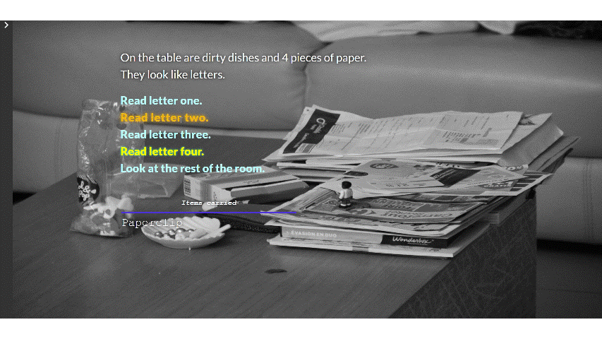
usability
User experience questionnaire (UEQ)
Adapted from Moizer et al. (2019)
4 dimensions of serious games assessed
Gaming experience
Learning experience
Usability
Fidelity
Qualitative feedback
Open feedback section
33 responses (67.3% response rate)
10 participants left qualitative feedback

Slide 13
Notes:
Affect can influence attitudes held by individuals and can be a type of learning outcome in serious games (Garris et al., 2002).
The production of positive affect in a player by a game can lead to increased engagement (Barzilai & Blau, 2014) and on perceptions towards learning with games (Riemer & Schrader, 2015).
The overall experience was positive (30.3% strongly agreed, 39.4% agreed)
The game had achievable goals (60.6% strongly agreed, 24.2% agreed).

Slide 14
Notes:
The act of play in a serious game should draw on the knowledge that the game is meant to foster, promoting reflection about or use of the skills in real situations.
The learning experience findings suggest that there was potential for reflection as participants found the game to be representative of lived experiences.
Students believed the game had value as a learning tool (36.3% strongly agreed, 51.5% agreed) and clear learning goals (42.4% strongly agreed, 33.3% agreed).
There was strong agreement that the game required participants to empathise with the experience of others (51.5% strongly agreed, 33.3% agreed).
There was also strong agreement that the game scenario had relevance to the issue of patient perspectives on illness and access to oral health (48.4% strongly agreed, 42.4% agreed)
These attributes (integration and content appropriateness) suggest that the game will lead to reflection after play on the reality the game represents.

Slide 15
Notes:
Usability describes satisfaction with a game’s interactive components (Hersh & Leporini, 2013).
Ease of exploration can enhance the player’s sense of autonomy and motivation to play (Westera, 2019).
Players may feel emotionally drained by story content and lack the cognitive ability to attain the desired learning outcome (Huang & Tettegah, 2010). Lowering cognitive load with simple presentation and the ability to explore at one’s pace helps counteract this.
Slow serious games propose that slow paced movement, interactions and play allows for focussed attention and concentration, while providing spaces for reflection, contemplation, deep thinking and learning (Marsh, 2016).

Slide 16
Notes:
Fidelity in a serious game is the presentation of the level of realism within a game environment.
It is challenging to recommend the correct balance between no fidelity or too much fidelity (Harteveld, 2011a).
The analysis of the fidelity dimension suggests that verisimilitude was a more important factor than visual appeal or the ability for players to identify with the game characters in terms of a positive user experience
Verisimilitude, or the quality of appearing true to life, is said to be important to serious games as in triadic game design there is a model of reality to be shown to players

Slide 17
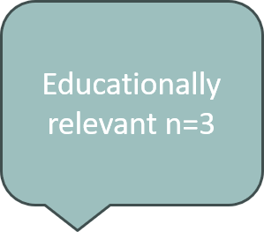
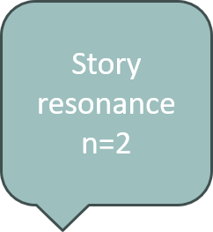
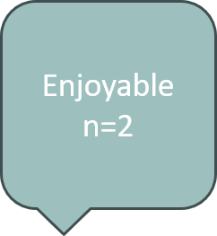
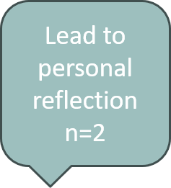
Qualitative themes

Slide 18

Qualitative Feedback
“I thought the experience was very useful. I felt very emotionally involved in the roll the dice game. I will take this experience forward into my career and empathize with patients. As I don't know their situation and I will endeavor [sic] to do my best to not judge patients in terms of their oral health. Overall I enjoyed the experience” – Participant ORBAJA11
“Surprisingly hooked me in with the glioblastoma case and made me reflect on my response to people coming in during bad mood and how I react” – Participant YEWADE9.
“Brilliant & deffo needed for dental students” – Participant PIBAJU6.
Notes:
One of the key things to note is that there is indication that the game has led students to reflect on how they treat patients. A measure of a serious game’s success is if it causes players to take something learned in the game and apply it to the real world. This demonstrates that the meaning the game wanted to impart has some evidence of success.
The promotion of both affective and cognitive empathy is necessary for games that wish to change attitudes in players (Belman & Flanagan, 2010) and the feedback suggests that for some users the emotional story led to a change in perspective.

Slide 19
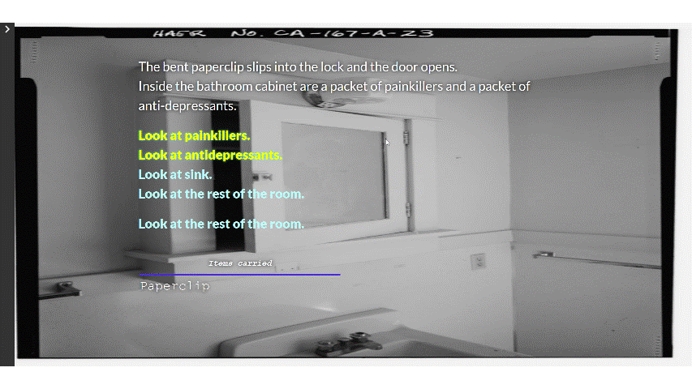
Qualitative Feedback
“Was unsure what the orange spreading out text was trying to signify - a more important answer, or encouragement to choose this answer?. The dental reference in the escape room seemed a bit irrelevant to the story” – Participant GRSTJA4
“The escape room game could've been laid out better e.g with arrows as I didn't know what the next step was” – Participant PIBAOC6.
“The scrolling text is not conducive to easy readying and made it more difficult to click thought as you had to wait for it to scroll through” – Participant MAJU10.
Notes:
Not all glowing praise though.
The issues with the user interface could be rectified in future. Game development is an iterative process and feedback like this is very helpful. Co-design with the learners is discussed in the serious games literature.

Slide 20


Conclusion
Game mechanics from commercial empathy games such as roleplay and environmental storytelling, and narrative themes such as bereavement and marginalisation can be integrated into serious games.
Dental students find serious games useable and acceptable for describing lived experience of mental health conditions.
Students find that serious games help them empathise with others and can lead to personal reflection while being an enjoyable educational tool.
This study provides evidence that digital game-based learning tools could take a role in developing empathy in undergraduate dental students.

Slide 21

Delivering with confidence
Play the game!
Password: aberdeen
Ruaridh Dall​
r.dall.21@abdn.ac.uk
@ruaridhdall.bsky.social
www.linkedin.com/ruaridh-dall

