Slide 1



PRECISION DENTAL MEDICINE
Immersive Haptic Virtual Reality as Preclinical Training for Removable Prosthodontics
Rita Bornes · Pedro Lopes · Maria José Correia · Nélio Veiga · Cristina Figueiredo
Faculty of Dental Medicine, Universidade Católica Portuguesa, Viseu, Portugal
Center for Interdisciplinary Research in Health, Viseu, Portugal

Slide 2
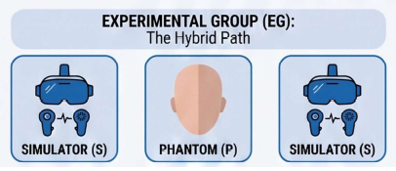
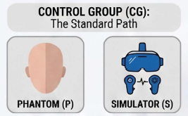
Why This Matters — And How We Tested It
!
The Problem
Two Learning Pathways
Traditional phantom-head training for occlusal rest preparation offers limited tactile fidelity and carries high financial and environmental costs.
EXPERIMENTAL (n=15)
Simulator
Phantom
Simulator
?
Study Aim
Evaluate the impact of an immersive haptic virtual reality simulator (HVRS), used as preclinical pre-training, on technical performance and efficiency in occlusal rest preparation among undergraduate dental students.
CONTROL (n=15)
Begins immediately with traditional physical models — no simulator pre-training
Occlusal rests on premolar & molar teeth, scored 0–5 by two calibrated, blinded examiners; execution time recorded.
Randomized controlled preclinical study: n = 30 fourth-year dental students
Analysis: t-test · repeated-measures ANOVA · Cohen's d

Slide 3


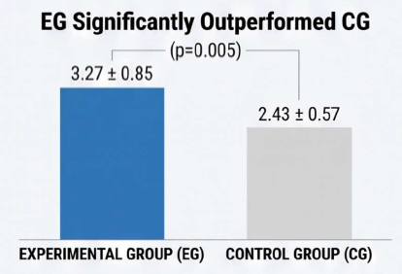
Results: Faster, More Accurate, Larger Effect
Simulator Score (0–5)
Execution Time
Effect Size
50.3%
reduction in execution time for the experimental group
d = 1.00
4.67 min
→
2.33 min
Cohen's d
Control
Experimental
Haptic simulation lets students reach higher efficiency much faster than traditional methods alone.
p = 0.005 · significant advantage for the experimental group
A large effect — a clinically relevant difference in the quality of dental preparations.
Favorable trend also on physical phantom work: 4.25 vs 4.00 (p=0.056)

Slide 4



Conclusion
Early immersive HVRS training significantly improves the quality and efficiency of occlusal rest preparation, and promotes bidirectional transfer of psychomotor skills between virtual and physical environments.
These findings support curricular integration of HVRS as a structured preclinical pedagogical strategy for complex fine-motor tasks in dental education.
Pedagogical Impact
Reduced Cognitive Load
Immediate Feedback
Unlimited Deliberate Practice
A safe environment for sensory familiarization, lowering mental burden in early preclinical stages.
Objective, real-time performance metrics remove instructor fatigue and subjectivity.
Students repeat complex fine-motor tasks without the cost of disposable resin teeth.

Slide 5
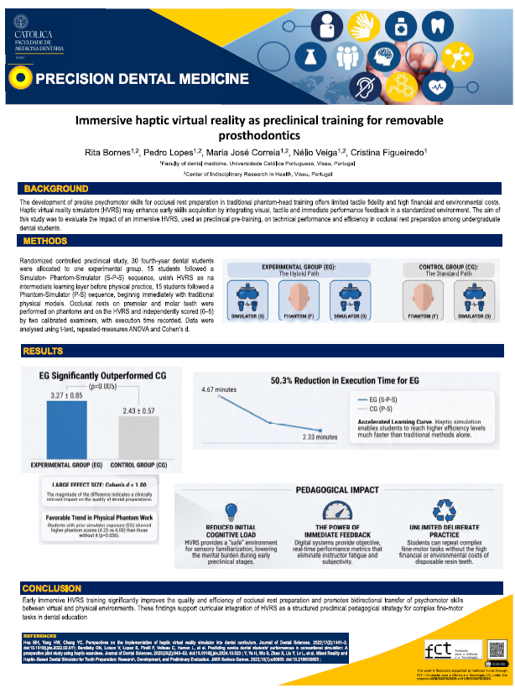
Thank you
Questions & discussion are very welcome
Nélio Veiga
Faculty of Dental Medicine, Universidade Católica Portuguesa · Viseu, Portugal
nveiga@ucp.pt
Notes:
[~15-30s buffer] Thank you very much for your attention. I would be happy to take any questions.

