Slide 1

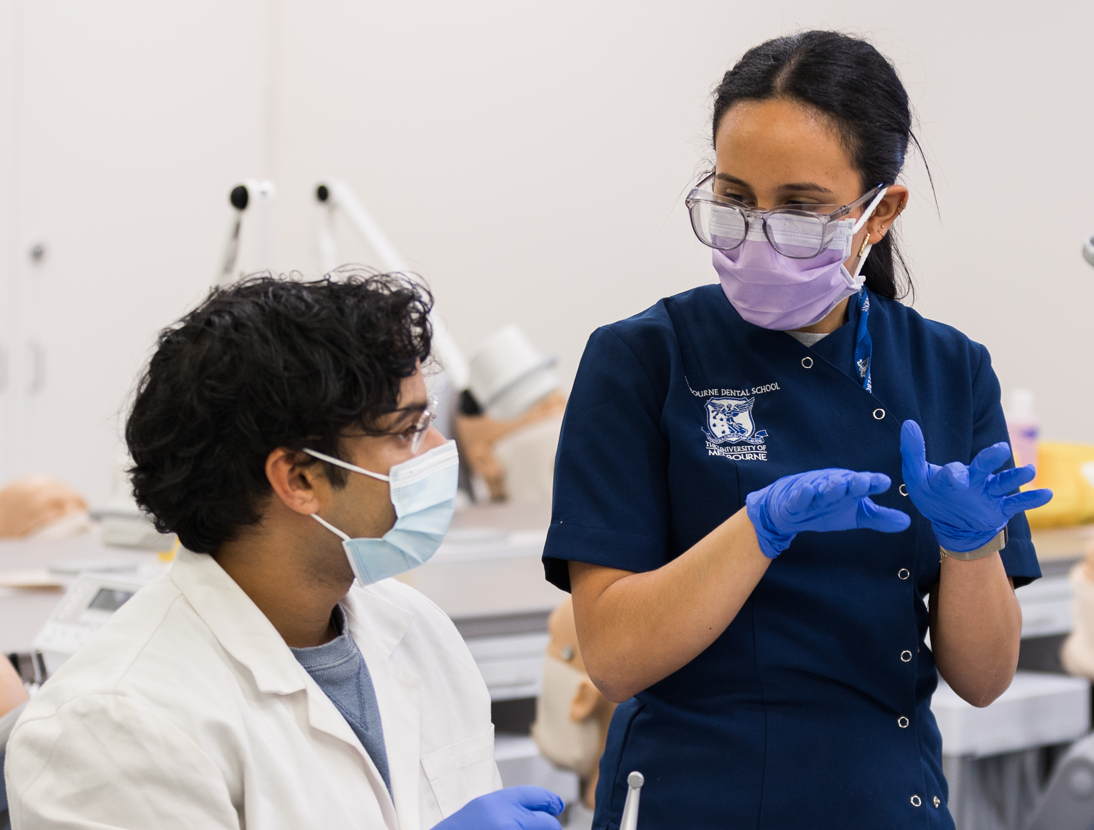

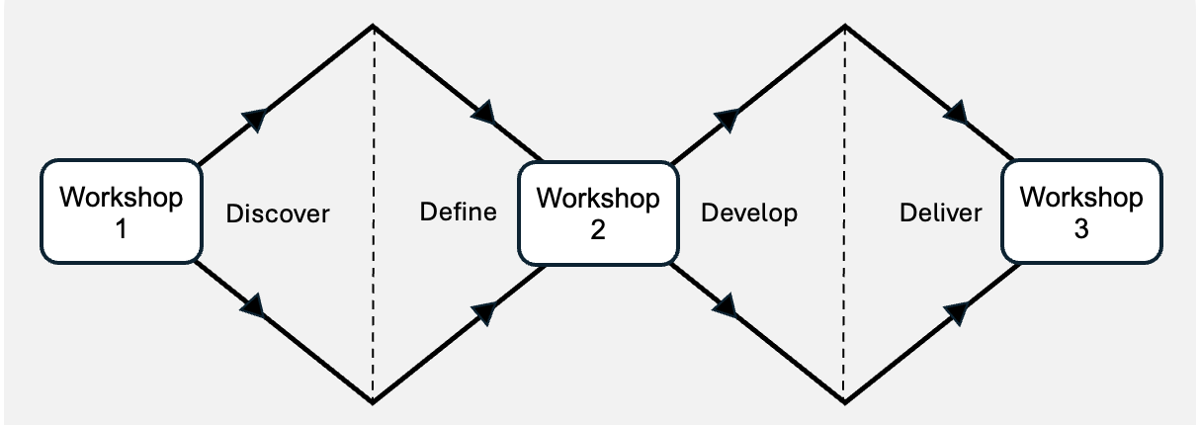
How should we design AI role-play for communication skills development?
“What communication challenges do you (dental students) encounter in clinical education, and how might GenAI support the development of your communication skills?”
Jones, B., Aditya, D., & Honig, C. (2025). Artificial Intelligence Chatbots as Virtual Patients in Dental Education: A Constructivist Approach to Classroom Implementation. European Journal of Dental Education.
Hong, H., & Shin, S. (2024). Effects of the use of a conversational artificial intelligence chatbot on medical students’ patient-centered communication skill development in a metaverse environment. JMLS , 21(3), 92–101
Design Council. (2015). The Double Diamond. Www.designcouncil.org.uk; Design Council.
Notes:
Good morning. My name is Dr Bree Jones from the Melbourne Dental School.
Effective communication is fundamental to safe, person-centred dental care. Yet dental students have limited opportunities to develop and practise these skills before treating patients in clinical settings.
Generative AI has the potential to provide a low-stakes, realistic, and engaging environment for communication practice. However, there is limited evidence to guide how these learning experiences should be designed to best meet students' needs.
To address this gap, we partnered with dental students to co-design Generative AI role-play scenarios. Today, I will present findings from the discovery phase of this co-design project.
The aim of the first co-design workshop was to explore the communication challenges students encounter during clinical education and identify how Gen AI could support the development of their communication skills.
Following ethics approval, twenty dental and oral health students participated in the workshop to answer the research question in small groups. Responses were recorded in Miro Board and analysed using inductive thematic analysis.

Slide 2
What students told us….
Fig 1: Visual representation of Workshop 1 findings showing what students wanted to practise, how practice should be supported, and desired features of GenAI simulations.
CRICOS 00116K
Notes:
The analysis generated nine themes. For this presentation, we have interpreted and synthesised these findings into ten categories, organised around three practical questions that guided the translation of the findings into GenAI role-play scenarios: What do students want to practise? How do they want practice to be supported? And what should GenAI-supported communication practice look like?
Students consistently described communication as extending well beyond routine patient conversations. They wanted opportunities to practise emotionally complex, unpredictable and context-dependent situations, including responding to patient refusal, communicating uncertainty, breaking bad news, seeking support from supervisors, and adapting communication for diverse patient needs.
Importantly, students also identified how they wanted to learn. They valued realistic clinical scenarios, personalised and actionable feedback, opportunities for repeated practice, and a low-stakes, safe environment where they could make mistakes without fear of judgement.
These findings directly informed the next phase of the project.

Slide 3








Translating findings into protypes
Breaking bad news
Rapid handover to a
busy supervisor about a medically complex patient
Patient refusal of treatment recommendations and becoming angry
Managing an adverse event and maintaining open disclosure
Protypes - clinically authentic, emotionally demanding and highly time-sensitive
Design Council. (2015). The Double Diamond. Www.designcouncil.org.uk; Design Council.
CRICOS 00116K
Notes:
We used the findings from Workshop 1 to develop four draft scenarios based on communication challenges students identified as authentic and difficult to practise.
In Workshop 2, students co-designed each scenario by identifying key decision points, refining the interactions, determining how and when feedback should be delivered, and selecting the technology formats that would create the most realistic learning experience.
These specifications were translated into four GenAI prototypes, each incorporating different interfaces and flexible feedback approaches tailored to the communication task. The prototypes are now being piloted with students in Workshop 3 to evaluate their usefulness and inform further refinement.
The contribution of this work extends beyond demonstrating student interest in AI. It provides learner-informed design principles for developing GenAI-supported communication simulations.
Thank you for listening. I'm happy to take any questions.

