Slide 1
A Qualitative Study of Learning Spaces in Undergraduate Dental Education: Development of a Thematic Framework
Dr Siobhán Lucey
Consultant/Senior Lecturer in Paediatric Dentistry
Cork University Dental School & Hospital

Slide 2
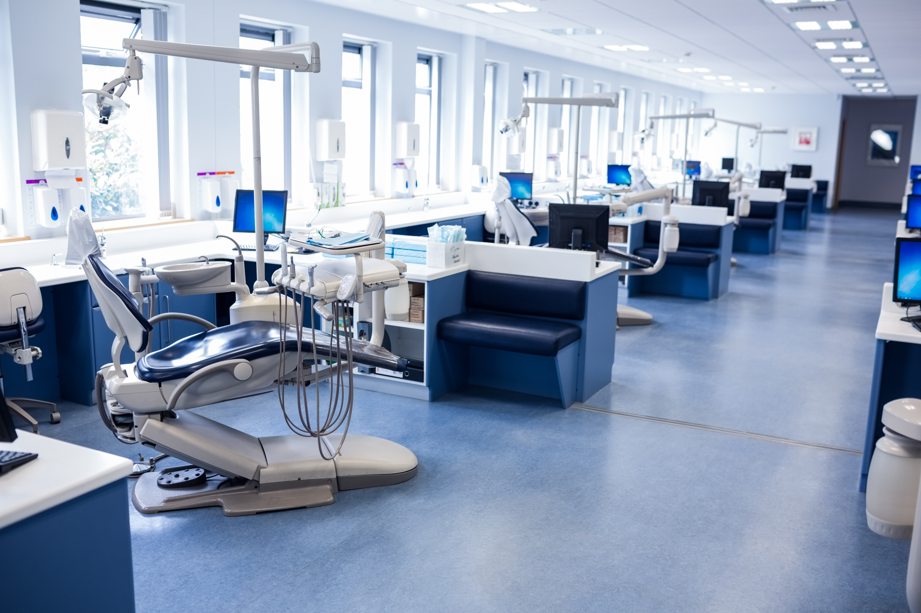

Background: Learning Spaces in Dentistry
Psycho-social aspects
Spatial?
Material?
Ambient?
Orlikowski, 2010;
Gruppen et al., 2019
Notes:
Gruppen et al., 2019, defined the learning spaces as the physical and virtual spaces in which learning and practice occurs.
Clinical learning environments play a central role in dental curricula, yet the role of the physical learning spaces remains under-explored.
Conceptually, existing theoretical framing has predominantly focused on psycho-social elements; less attention has been given to the physical elements, that is until 2019 when Gruppen and colleagues developed a conceptual framework, based on socio-materiality concepts by Orlikowski, 2010, which included a material element. Emerging evidence suggests that the physical dimension i.e. spatial, ambient and material factors influence learning experience.
Given the unique nature of dental learning spaces, in which patient safety & wellbeing must be balanced with students’ educational needs, as well as the significant cost of developing and maintaining clinical spaces, it is important to understand how the physical infrastructure of dental clinics influences learning, teaching and practice in dental education programmes.

Slide 3
Aim & Objectives
Aim:
To explore the impact of learning spaces on dental professional students and teachers in clinical dental education.
Objectives:
To examine how participants experience clinical learning spaces;
To identify key dimensions of learning spaces which influence learning and teaching;
To develop a thematic framework to advance conceptual understanding of the impact of clinical learning spaces in dental education.
Notes:
The overall aim…
The objectives were three-fold –
This objective is viewed through a pedagogical lens – exploring participants’ lived experience of clinical learning
The 2nd objective looked at the dimensions of space which come to the fore in dental education
To advance conceptual understanding by developing a thematic framework

Slide 4
Data Analysis & Interpretation
Social constructivist
interpretive framework
Participants
Undergraduate dental professional students [P] (n=15)
Clinical teaching staff [TP] (n=14)
Method: Qualitative Research Design
Six focus groups
Topic guide: Learning Space Rating System
Ethical approval
NVivo 15 (Lumivero)
Six-phase reflexive thematic analysis
Braun & Clarke, 2006; EDUCAUSE, 2020
Notes:
A qualitative study was designed, and ethical approval confirmed, by the university ethics committee.
6 focus groups were conducted, 3 with teachers and 3 with students. A topic guide based on the elements of the LSRS V3 from EDUCAUSE was designed.
LSRS-now in V3 – is a framework to measure the potential performance of learning spaces. Part A focuses on institutional readiness, planning, operations and evaluation process. Part B addresses specific features and affordances of physical spaces – environmental quality, layout & furnishings, technology & tools, inclusion. These were the elements that informed the exploration of the material dimension of the learning space.
Participant summary
Flexible, inductive coding
Reflexivity maintained researcher positionality acknowledged

Slide 5
Results
Notes:
And now results, which will be discussed as we go through.

Slide 6
How participants experience clinical learning spaces
Supervision
Pedagogical relations
Practice
Professional team-working
“you mightn’t be too confident, but even just having that space to lay it out so in your head you’re not trying to organise it …you can follow step by step, it really helps.” [P3.4]
“…we can see if someone needs our help in the paediatric room. But that has its downsides as well from a confidentiality point of view.” [TP1.3]
“Essentially you have almost a little teaching triangle inside in these spaces. You've got the patient, who is central to the learning for the student, you've got the clinician and you've got the student.” [TP1.1]
“I think it’s my favourite space just because it’s very open, there’s lots of room for you and your assistant and parents and sometimes your supervisor to move around.” [P3.1]
Boys, 2010; Gibson, 1979; Greeno, 1994; Temple, 2008
Notes:
Through the data, we saw that the space influenced practice, supervision, pedagogical relations, professional team-working.
Mediated by the spatial affordances of the learning space (Gibson, 1979; Greeno, 1994)
Looking at practice first – students are novice practitioners, honing and developing their skills, the space around them can act as a barrier or facilitator
The teachers communicated their skill at balancing both student-centred education and patient-centred care
The influence of the space in establishing team-working dynamics in a professional setting also came through
Finally, in the last element, we see a spatial pedagogy, which emphasises the ways in which the organisation and design of educational spaces shape patterns of teaching and learning. From this perspective, space is not simply a passive location in which educational activities occur but rather an active element that structures interaction, visibility and participation within learning environments (Boys, 2010; Temple, 2008)
***
Other Practice quote option: there's a lot more space for each unit and I think it gives that, like the calmness to it. I think that helps the patient as well [P1.5}
Pedagogy - Thomas (2010) contends that space and learning are inextricably linked, to the point that a particular learning space becomes integral to the definition of that kind of learning. Consider dental spaces – signature pedagogy – chairside teaching.

Slide 7
Key dimensions of learning spaces which influence learning and teaching
Social
Supervision
Pedagogical relations
Practice
Professional team-working
Individual
Institutional
Physical & Virtual
Notes:
The elements which came through in the data are in keeping with the conceptual framework of Gruppen at al, noted earlier.
Individual – wellbeing, student voice (uncertainty, appreciation, sometimes indifference); teacher voice (intuition, goodwill, their lived experience as students)
Social – teamwork, learning from peers, development of professional relationships, negative impacts through potential for animosity
Institutional – silo-based thinking, scheduling, allocation of space/units
Physical – design, configuration, lighting, connection to outside, acoustics, equipment
Virtual – technology as both facilitator and barrier to practice, learning and teaching

Slide 8
Themes which emerged
Balancing patient care and learning in clinical spaces
Shaping learning through spatial affordances and constraints
Organising teaching and learning through clinical space
Facilitating social interaction in clinical learning spaces
Experiencing clinical learning spaces at an individual level
Structuring clinical learning through institutional systems
Notes:
In steps 3-5 of B&C, themes began to emerge, tested, refined…
6 substantive themes were finalised, which bring together the data gained in the experience of participants and dimensions of the spaces from the first two objectives…
The first of these encompasses the simultaneous activities of balancing patient care with students’ clinical educational needs
In theme 2,

Slide 9

OUTCOMES
What emerges?
LEARNING AND EXPERIENCE OUTCOMES
      Student learning and competence
      Wellbeing and emotional experience
      Professional development
EDUCATIONAL PROCESSES
What space shapes?
SPATIAL PEDAGOGY
Teaching practices
Observation
Demonstration
SOCIAL DYNAMICS
Collaboration
Belonging
Identity formation
PATIENT CARE
Balance of patient safety and student learning
MECHANISM
How space
works?
AFFORDANCES AND CONSTRAINTS OF CLINICAL LEARNING SPACES
    Visibility
    Access to teachers
    Opportunities for interaction
Workflow efficiency
Inclusion / accessibility
FOUNDATION
What exists?
MATERIAL & SPATIAL ENVIRONMENT
Spatial configuration
Sensory environment
Infrastructure
Technology
INSTITUTIONAL CONTEXT
Organisational systems
Resource allocation
Curriculum
Notes:
In order to then understand the relationship of the themes to eachother, a thematic framework was developed as shown here…

Slide 10
FOUNDATION
What exists?
MATERIAL & SPATIAL ENVIRONMENT
Spatial configuration
Sensory environment
Infrastructure
Technology
INSTITUTIONAL CONTEXT
Organisational systems
Resource allocation
Curriculum
Notes:
We start with the foundations – what exists? The learning environment has a physical presence and sits within a broader institutional context

Slide 11
MECHANISM
How space works?
AFFORDANCES AND CONSTRAINTS OF CLINICAL LEARNING SPACES
Visibility
Access to teachers
Opportunities for interaction
Workflow efficiency
Inclusion / accessibility
Notes:
The environment then works to influence education by the affordances and constraints offered by the space.

Slide 12
EDUCATIONAL
PROCESSES
What space
shapes?
SPATIAL PEDAGOGY
Teaching practices
Observation
Demonstration
SOCIAL DYNAMICS
Collaboration
Belonging
Identity formation
PATIENT CARE
Balance of patient safety and student learning
Notes:
These then affect educational processes i.e. what happens?

Slide 13
OUTCOMES
What emerges?
LEARNING AND EXPERIENCE OUTCOMES
Student learning and competence
Wellbeing and emotional experience
Professional development
Notes:
Lastly, we consider the learning and experience outcomes of the process.

Slide 14
OUTCOMES
What emerges?
LEARNING AND EXPERIENCE OUTCOMES
      Student learning and competence
      Wellbeing and emotional experience
      Professional development
EDUCATIONAL PROCESSES
What space shapes?
SPATIAL PEDAGOGY
Teaching practices
Observation
Demonstration
SOCIAL DYNAMICS
Collaboration
Belonging
Identity formation
PATIENT CARE
Balance of patient safety and student learning
MECHANISM
How space
works?
AFFORDANCES AND CONSTRAINTS OF CLINICAL LEARNING SPACES
    Visibility
    Access to teachers
    Opportunities for interaction
Workflow efficiency
Inclusion / accessibility
FOUNDATION
What exists?
MATERIAL & SPATIAL ENVIRONMENT
Spatial configuration
Sensory environment
Infrastructure
Technology
INSTITUTIONAL CONTEXT
Organisational systems
Resource allocation
Curriculum
Notes:
This study offers a theoretically-informed framework to enhance conceptual understanding of clinical learning spaces. This theoretical underpinning is a foundation for the advancement of more intentional, evidence-based design and evaluation approaches for dental and clinical education environments. Future research may be conducted to support the attainment of improved learning outcomes, delivery of optimum clinical care and facilitate professional identity formation.

Slide 15
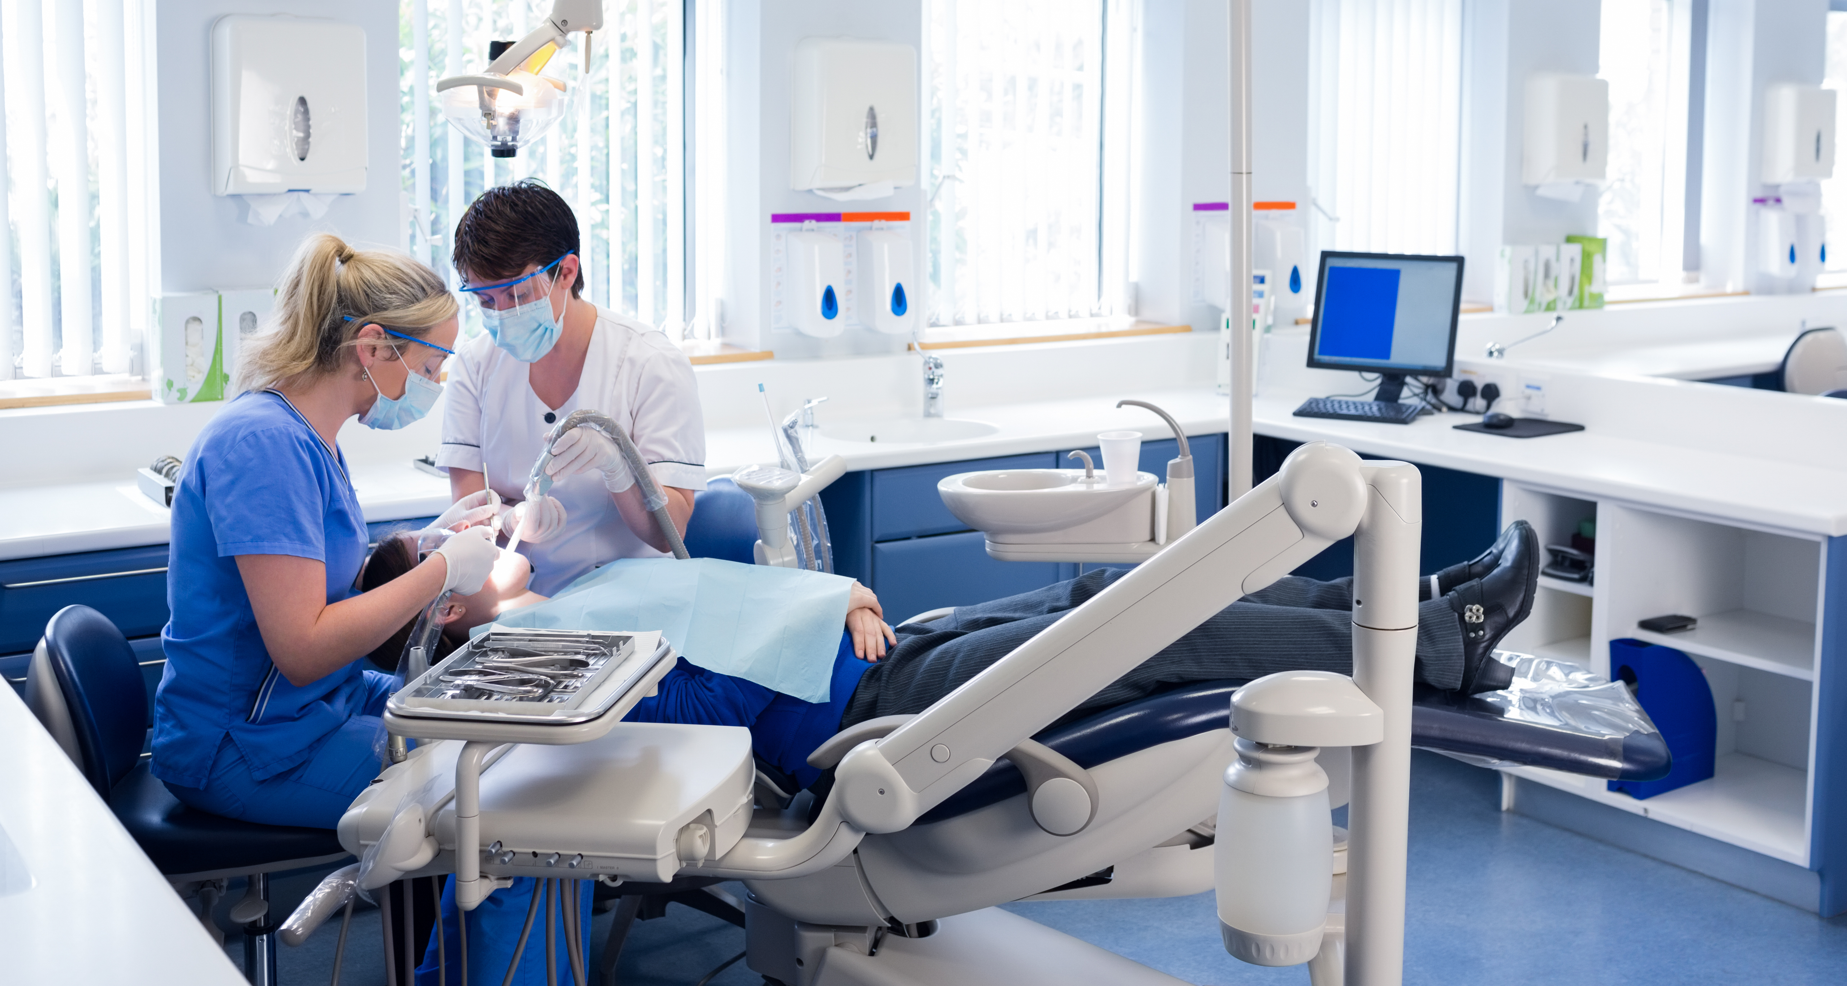

Learning spaces play an active role in dental education —
framing practice, supervision, professional development and team-working.
Clinical learning spaces are multi-dimensional, complex environments.
The development of a thematic framework supports conceptual understanding of the impact of learning spaces in dental education.
Conclusions
Notes:
Learning spaces are not passive as evidenced by the voices of the students and teachers who experience them. They frame…
In keeping with existing learning space theory, learning spaces are multi-dimensional spaces, with constant interplay between the various elements –personal, social and organisational, and, crucially, in this study, the material aspect, also playing a key role in learning and teaching.
A thematic framework for understanding the impact of learning spaces in dental education has been developed and can be used to inform future research in this area.

