Slide 1
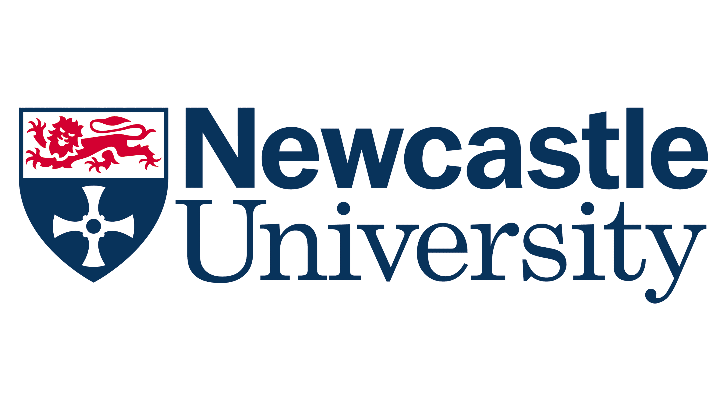



Exploring Generational Differences in Dental Education
“Are our students and new graduates not as good as they used to be?” (Bell & McColl, 2025)
Conversations within institutions about the comparative quality of today’s students and graduates.
Research in the workplace reveals shifts in attitudes and behaviour towards career expectations, feedback and working environments, leading to intergenerational disconnects.
  What’s the situation in dentistry?
Method: one-to-one semi-structured interviews with clinical teaching staff at the School of Dental Sciences, Newcastle University
Data analysis: reflexive thematic analysis
Personal reflexivity: 3 researchers with generation Z, Millennial and Generation X backgrounds.
Results:
9 interviews from January-June 2026
Participants from millennial (6), generation X (2) and baby boomer (1) backgrounds
3 overarching themes:
Changing world
Changing minds and needs
Changing routes to knowledge
Dr Zahra Khalaf, Dr Rachel Green, Dr Emma Robinson Newcastle University, United Kingdom

Slide 2
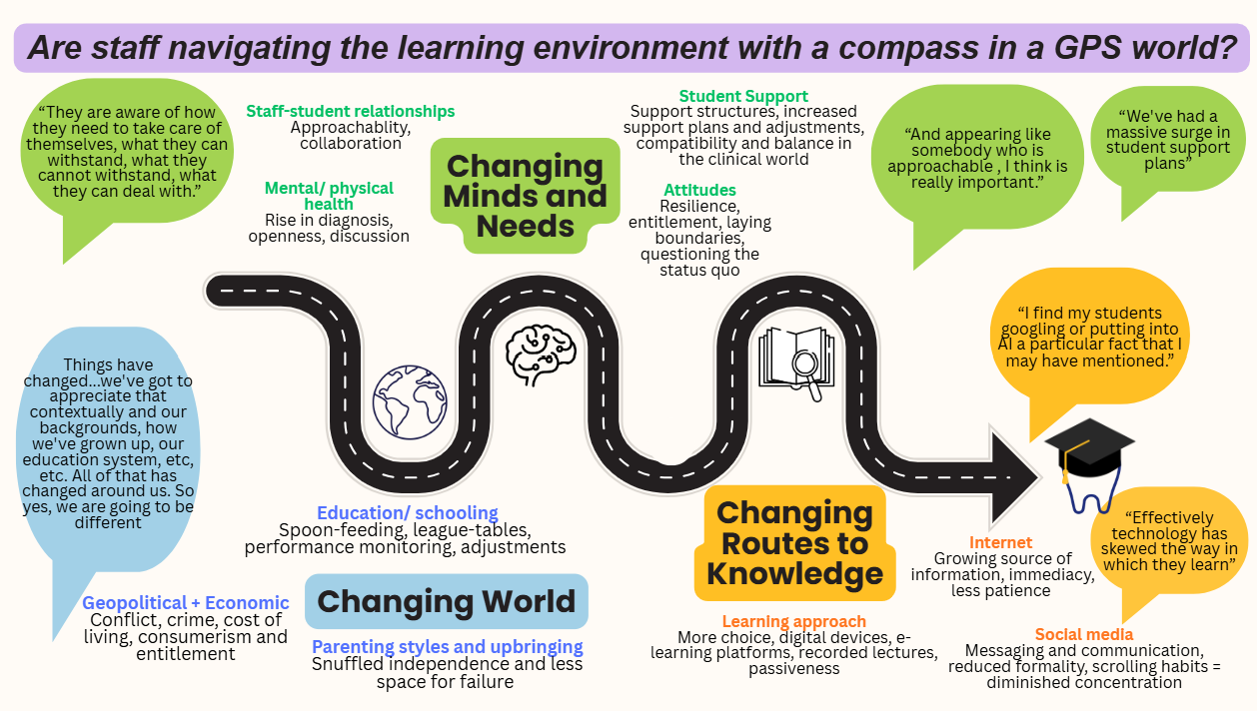
Findings

Slide 3
Discussion and Next steps
Changes over time, including within broader societal shifts
Changes have influenced attitudes, behaviours and interactions within the dental learning environment – students have difference needs leading to different attitudes and routes to knowledge
Next steps: seek student input to understand first-hand their perceptions
Deepen understanding of generational differences and harmonise educator-student interactions and the overall dental educational environment.
Dr Zahra Khalaf, Dr Rachel Green, Dr Emma Robinson
Newcastle University, United Kingdom

