Slide 1
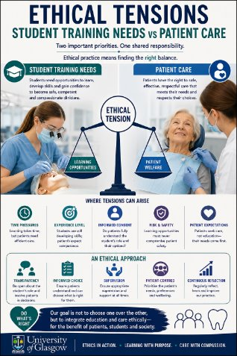
Why Ethics Extends beyond Procedures

Slide 2
Responsibility for treatment outcomes needed:
Treating a dental patient as a means to an end violates the ethics principle of respect for persons.
This means using a patient only for profit, teaching, or practice without regard for their own goals, health, or well-being.

Slide 3

Teaching Professionalism
Has to extend beyond procedures
Link responsibility for patient outcomes to required behaviours
Risk teaching professionalism on a transactional basis

Slide 4
Culture change from patients as:
Series of competencies and procedures
TO:
Responsibility to facilitate outcomes for patient goals
Treatment staggered across BDS3 to BDS5 training

Slide 5
Patient Centred Outcomes Teach students by example the real meaning of Professionalism

Slide 6

How does your university balance the needs of students in training with managing patient care outcomes ?

