Slide 1



Diploma Program in Dental Simulation: Faculty Development in Latin America and the Caribbean
Olivia Espinosa- Vázquez
Francisco Marichi- Rodriguez
Marvin Rivera- Jiménez
Andrea Naranjo- Salazar
National Autonomous University of Mexico | Mexico
Medical Shapes | Colombia
August | 2026

Slide 2





Background
Faculty development in innovative topics in dental education is essential, as it allows educators to engage in formal and structured pedagogical experiences that enrich their teaching practice and support the regional harmonization of educational trends.
A review of the literature reveals a limited number of reports on structured dental simulation programs at a regional level in Latin America and the Caribbean.
August | 2026

Slide 3

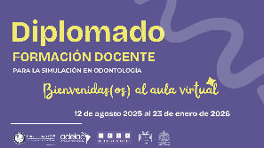


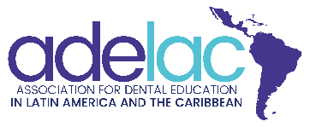

#01
Aim
To describe the educational experience of a faculty development Diploma program in dental simulation, promoted by the Association for Dental Education in Latin America and the Caribbean (ADELAC), aimed at faculty members from member dental schools, from its planning and design to its implementation and evaluation.
August | 2026

Slide 4
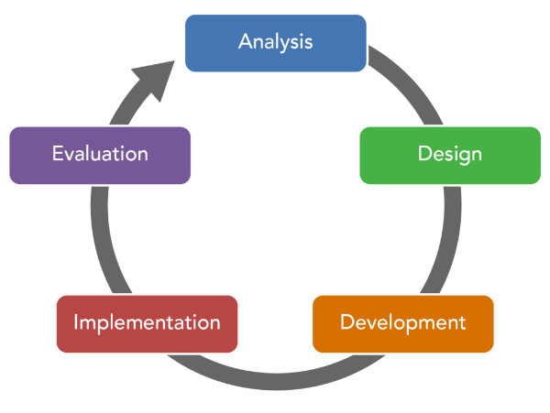
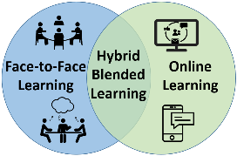
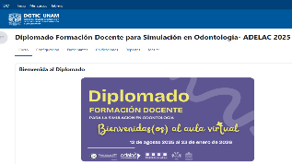

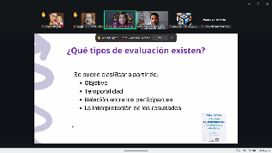
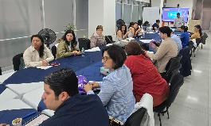

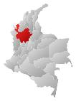

#02
Materials and Method
An educational design study using a hybrid model was conducted, encompassing the phases of planning, design, development, implementation, and evaluation.
August | 2026

Slide 5
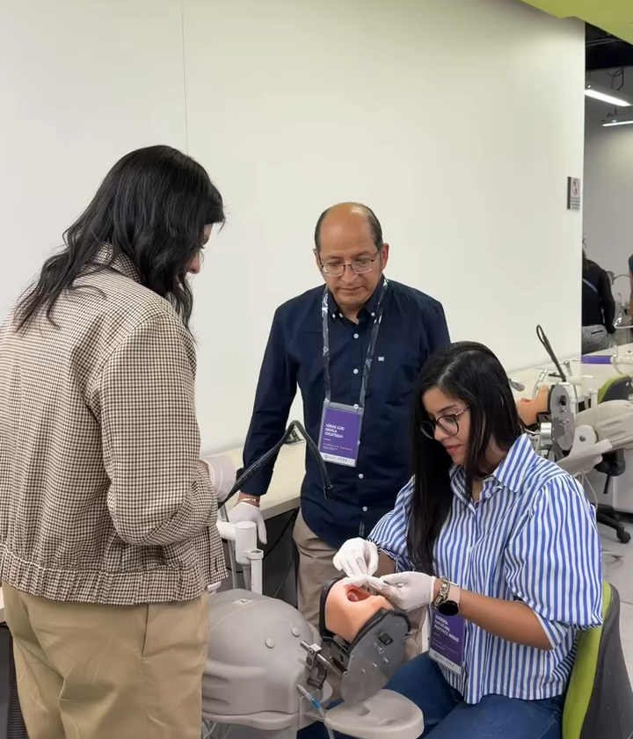
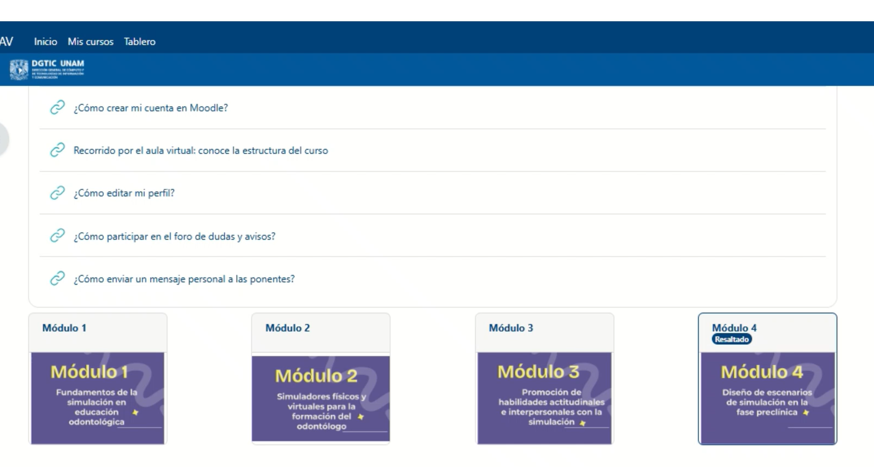
#02
Materials and Method
Various pedagogical elements were considered during the planning and design stages; active learning strategies were applied in the virtual component, while experiential and situated learning approaches were used in the face-to-face component.
August | 2026

Slide 6

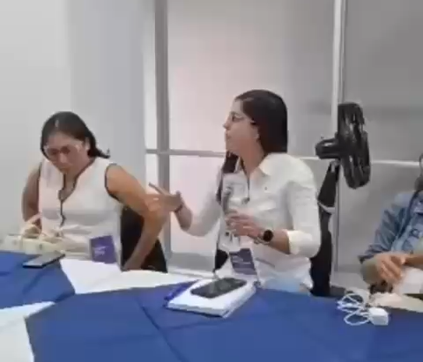
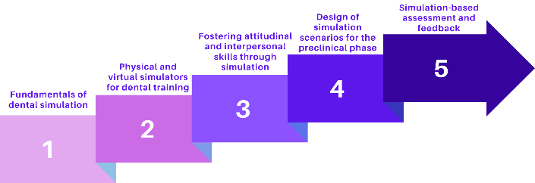


#02
Materials and Method
The diploma program consisted of five modules, totaling 130 hours of virtual and presential work delivered over a five-month period. Weekly synchronous virtual sessions were conducted, and face-to-face sessions took place at the facilities of Universidad CES in Medellín, Colombia.
130 hours
5 months
Virtual and presential sessions
August | 2026

Slide 7
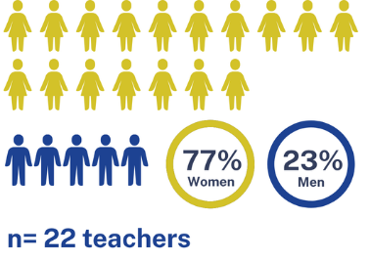
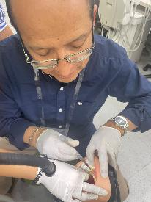
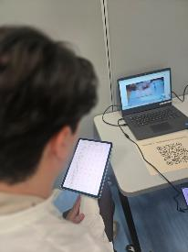
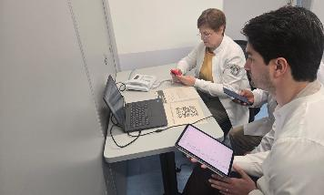

#03
Results
22 faculty members from seven countries in Latin America and the Caribbean were trained in dental simulation, covering topics ranging from the historical foundations of simulation to the assessment of clinical competence.
Learning activities demonstrated participants’ achievement of competencies related to the planning and design of educational dental simulation scenarios.
August | 2026

Slide 8


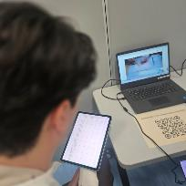
#03
Results
At the end of the program, a reflective exercise using the Six Thinking Hats method was conducted to evaluate satisfaction, content relevance, learning activities, transfer to practice, and the virtual learning environment.
Participants considered the diploma program useful and identified opportunities for improvement in the virtual component.
August | 2026

Slide 9
#03
Results
Six Thinking Hats method
1. White Hat: Conceptual and Factual Learnings
Concept of Simulation
Importance of Formative Assessment
Practical Application
Assessment Techniques
2. Red Hat: Emotions and Feelings
Emotional Range
Positive Anxiety
Teacher Empathy
Emotional Challenge
Initial Overload
Participant Support
Innovative Vision
August | 2026

Slide 10
#03
Results
3. Black Hat: Criticisms and Areas for Improvement
Virtual platform glitches
Absence of or delays in assignment feedback
Excessive duration of virtual sessions
Clarity of activities
4. Yellow Hat: Positive Aspects and Benefits
Networking
Program Organization
Practical Implementation
Dynamic Methodology
Infrastructure and Realism
Dual Perspective
August | 2026

Slide 11
#03
Results
5. Green Hat: Creative and Innovative Ideas
Adaptation of the OSCE (ECOE)
Inter-institutional Support Groups
6. Blue Hat: Action Plans and Future Challenges
Knowledge and Knowledge Transfer
Curriculum Modification
Overcoming Resistance to Change
Leadership and Collaboration
Infrastructure Development
Continuous and Deliberate Practice
August | 2026

Slide 12


Simulation in the health sciences does not replace the care of real patients; rather, it prepares professionals so that their first contact with a real patient is not the first time they perform a procedure. o
-Dr. Amitai Ziv-

Slide 13



Thanks
Does anyone have any questions?
Olivia / Espinosa
oliviaeducisal@fo.odonto.unam.mx

