Slide 1
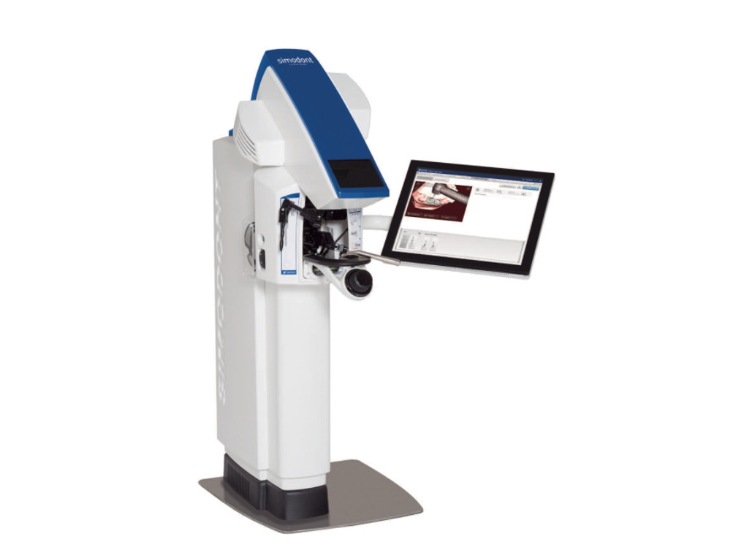



A Questionnaire-Based Evaluation
Curriculum-Aligned VR Haptic Simulation for Partial Crown Preparation
Alina Mohr, Sarah Rampf, Simona Schick
in Dental Education
ADEE Annual Meeting Budapest | 26th August 2026 | Alina Mohr

Slide 2

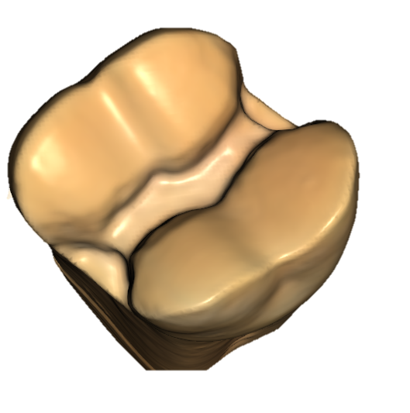
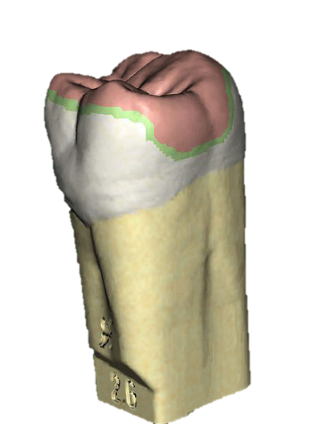


Background
Partial crown preparation = one of the most demanding preparations
reflect Heidelberg-
specific guidelines
Creation of a curriculum-aligned case for the Simodont Dental Trainer
3rd year students in phantom year
Student perceptions?
ADEE Annual Meeting Budapest | 26th August 2026 | Alina Mohr

Slide 3
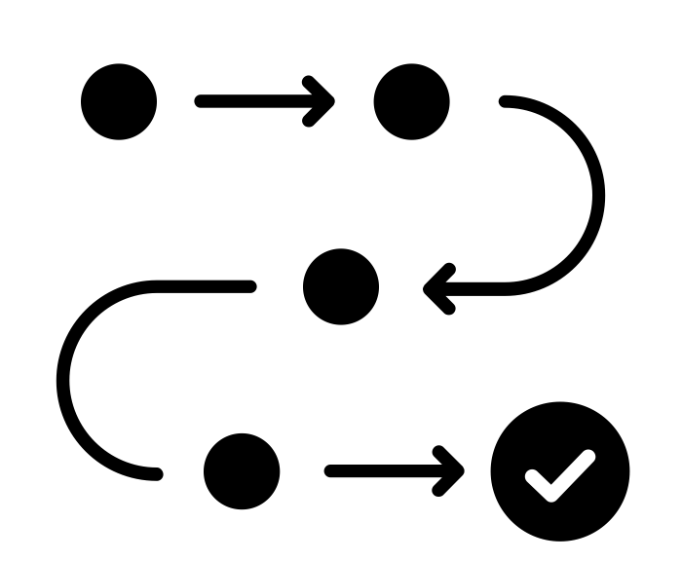

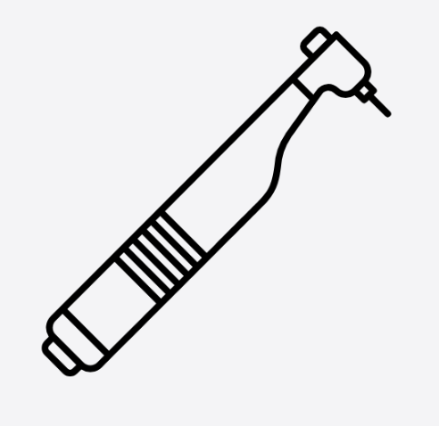
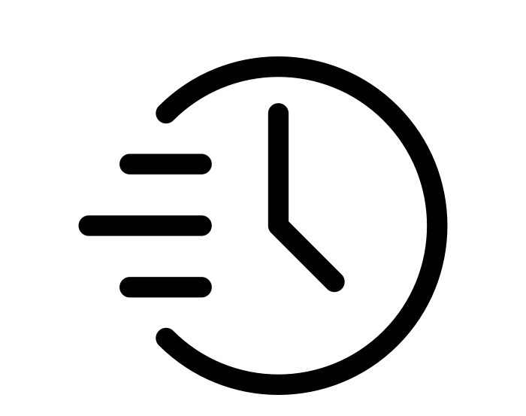

Materials and Methods
66
3rd year dental students
43
used the Simodont before
23
first-time users
2x 45 min
After phantom preparation
12 Likert scale questions
3 open ended questions
Additional to regular phantom head training
practiced with the
Simodont case
ADEE Annual Meeting Budapest | 26th August 2026 | Alina Mohr

Slide 4
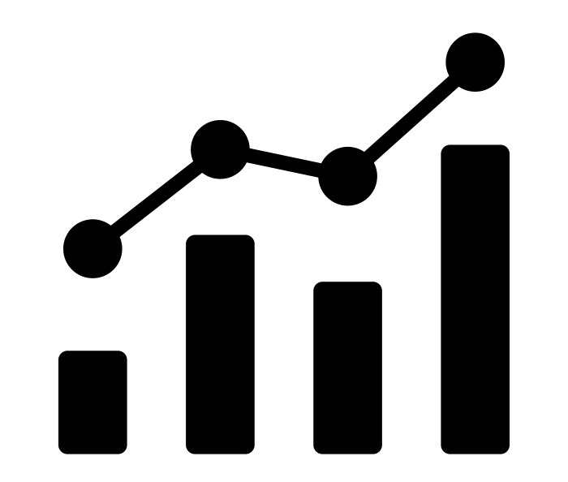

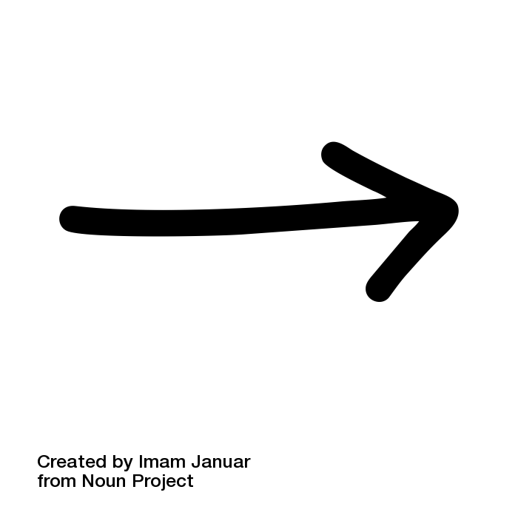






Results
97% response rate (64/66)​
12 Likert Scale Items
1=strongly agree
1
2
3
4
5
5=strongly disagree
Agreement (%)
3 open-ended questions
Most relevant topics
ADEE Annual Meeting Budapest | 26th August 2026 | Alina Mohr
PERCEIVED LEARNING BENEFIT
TRAINING CONDITIONS
AND MOTIVATION
Improved preparation technique
2.72
1.89
2.39
2.49
50
75
58
53
Sufficient time
Interest in further VR training
Positive learning atmosphere
1.48
2.42
1.94
89
62
78
Improved visual understanding
Confidence and preparation for phantom model
Meaningful preparation for real patients
USABILITY AND
TECHNICAL PERFORMANCE
FEEDBACK AND INSTRUCTION
Intuitive operation
Instrument selection
Haptic realism
2.16
2.10
3.17
71
68
31
Simulator feedback comprehensibility
Instructor feedback
2.0
1.23
73
100
Notes:
Agreement erklären

Slide 5
Results
97% response rate (64/66)​
12 Likert Scale Items
1=strongly agree
1
2
3
4
5
5= strongly disagree
Agreement (%)
3 open-ended questions
Most relevant topics
PERCEIVED LEARNING BENEFIT
TRAINING CONDITIONS
AND MOTIVATION
Mean
Agr (%)
2.72
1.89
2.39
2.49
50
75
58
53
Mean
Agr (%)
Improved preparation technique
Sufficient time
Interest in further VR training
Positive learning atmosphere
1.48
2.42
1.94
89
62
78
Improved visual understanding
Confidence and preparation for phantom model
Meaningful preparation for real patients
USABILITY AND
TECHNICAL PERFORMANCE
FEEDBACK AND INSTRUCTION
Intuitive operation
Instrument selection
Haptic realism
2.16
2.10
3.17
71
68
31
Simulator feedback comprehensibility
Instructor feedback
2.0
1.23
73
100
ADEE Annual Meeting Budapest | 26th August 2026 | Alina Mohr

Slide 6
1 - Suggestions for Improvement
2 – Helpful for Learning Progress
Haptic feel / lack of realism
Feedback & supervision
Surface finishing
Underst. of substance removal / guidelines
Limited visibility
Practice without pressure / repetition
Instrument selection
Visual / digital support
Diffic. controlling prep outcome
General understanding / introd.
Desire for greater realism
3 – General comments
Appreciation for supervision and practice
Technical notes / simulation performance
Meaningful timing within curriculum
Group size / workflow
ADEE Annual Meeting Budapest | 26th August 2026 | Alina Mohr

Slide 7

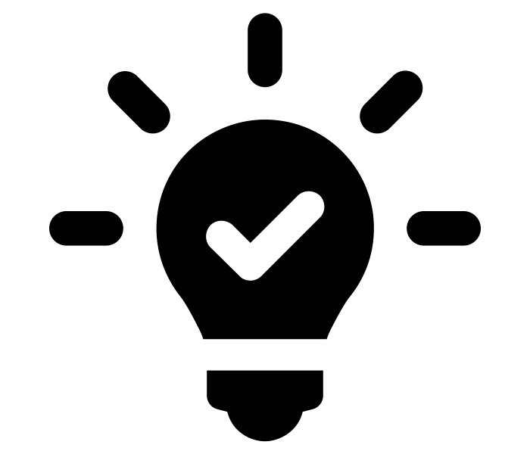

Conclusion
1
Customized case is feasible
& well accepted
>
Integration into preclinical curriculum successful,
mean score 2.0 across all items
2
Strong ratings: Visualization & Training Conditions
>
VR could be helpful as an early stage introduction
to build conceptual understanding
3
Realism & perceived skill improvement rated lowest
>
For complex tasks VR may be most valuable at
beginner stage
Instructor feedback rated
helpful by 100%
>
VR complements, but does not replace supervised teaching, always pair simulator feedback with
additional instructor feedback
4
5
Next step?
>
Objective performance measures
ADEE Annual Meeting Budapest | 26th August 2026 | Alina Mohr

Slide 8
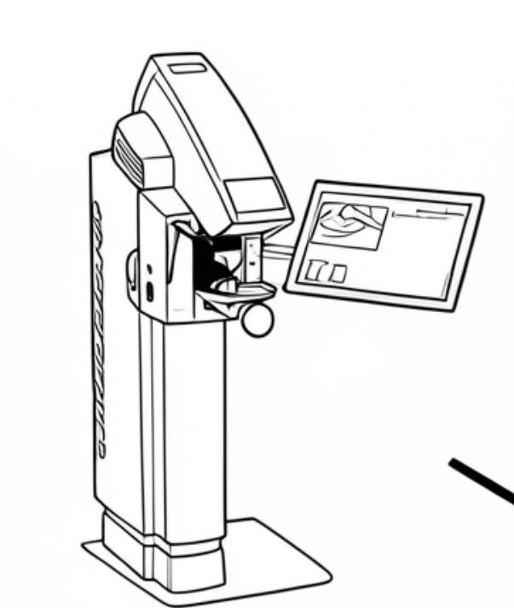
Contact
Alina Mohr
Im Neuenheimer Feld 400
69121 Heidelberg
alina.mohr@med.uni-heidelberg.de
ADEE Annual Meeting Budapest | 26th August 2026 | Alina Mohr

