Slide 1



QUB Logo
Belfast
Trust
NIMDTA
A Novel Digital Dexterity
Assessment and its Relationship
with Clinical Performance
in Dental Students
A Mixed-Methods Pilot Study
Dr Maya Fahy | Dental Core Trainee Oral Surgery/Oral Medicine
Rebekah Milligan | Specialty Trainee Oral Surgery
Mr Jamie Toole | Consultant Oral Surgeon
ADEE Budapest 2026
Notes:
Good morning.
My name is Maya, and I'm a Dental Core Trainee in Oral Surgery and Oral Medicine in the school of dentistry, in Belfast.
Today I'd like to share a mixed-methods pilot study asking a fairly simple question with potentially significant implications: can a short digital test of manual dexterity tell us anything useful about how a dental student will perform clinically?

Slide 2

Background
Current recruitment into dental schools across the UK is heavily focused on academia.
At Queen’s invitation for interview is based on A-Level/IB, GSCEs and UKCAT scores.
Successful candidates will attend a MMI style interview with 9 stations; 4 role play and 5 questions.
Manual dexterity is not assessed as part of the recruitment process for dental students.
2
Notes:
Let me start with the problem.
Currently, recruitment into dental schools across the UK is heavily weighted towards academic performance.
At Queen's, an invitation to interview is determined by A-Level or International Baccalaureate results, GCSEs, and UCAT scores. Candidates who are successful at that stage then attend a Multiple Mini Interview — nine stations in total: four role-play and five question-based.
This effectively assesses academia, communication, ethical reasoning and professionalism.
However, manual dexterity is not assessed at any point during the selection process. This is significant as dental undergraduates are expected to perform procedures that require fine motor control from very early on in in their training

Slide 3
Aim
To assess whether a simple digital manual dexterity test can predict how well dental students perform clinically?
If yes — two applications:
Admissions
Select students on dexterity, not just academics
Early support
Identify who needs help in Years 1-2
2
Notes:
Our aim was straightforward:
To assess whether a simple digital manual dexterity test can predict how well dental students perform clinically.
And if the answer is yes, there are two clear applications.
The first is admissions. If dexterity carries predictive value, there is an argument for using it for selection, rather than relying on academics alone, and for widening the profile of students we admit.
The second — and the more immediately achievable — is early support. If we can identify, in Years 1 and 2, the students who are likely to struggle with the fine motor demands of the course, we can intervene early, with targeted teaching, rather than waiting for difficulty to emerge in the clinic in Year 3 or 4.

Slide 4
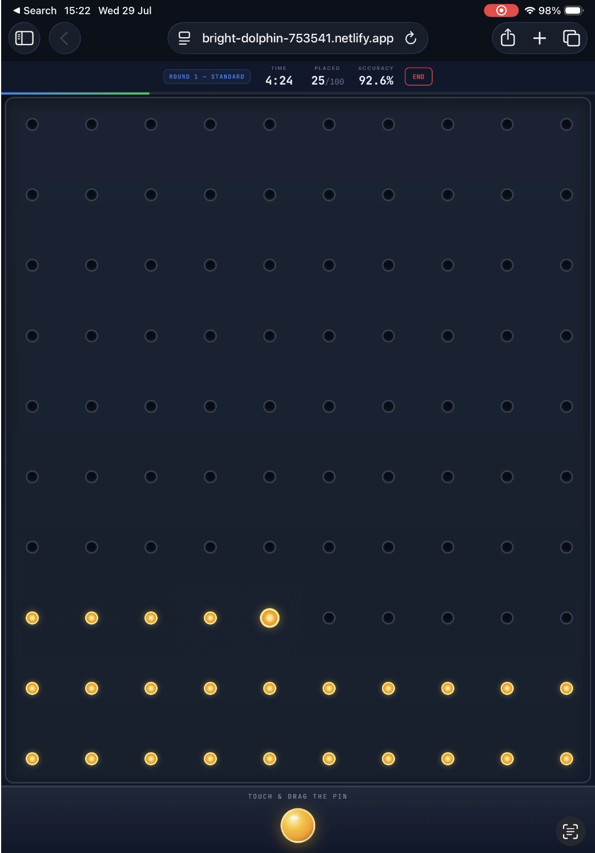
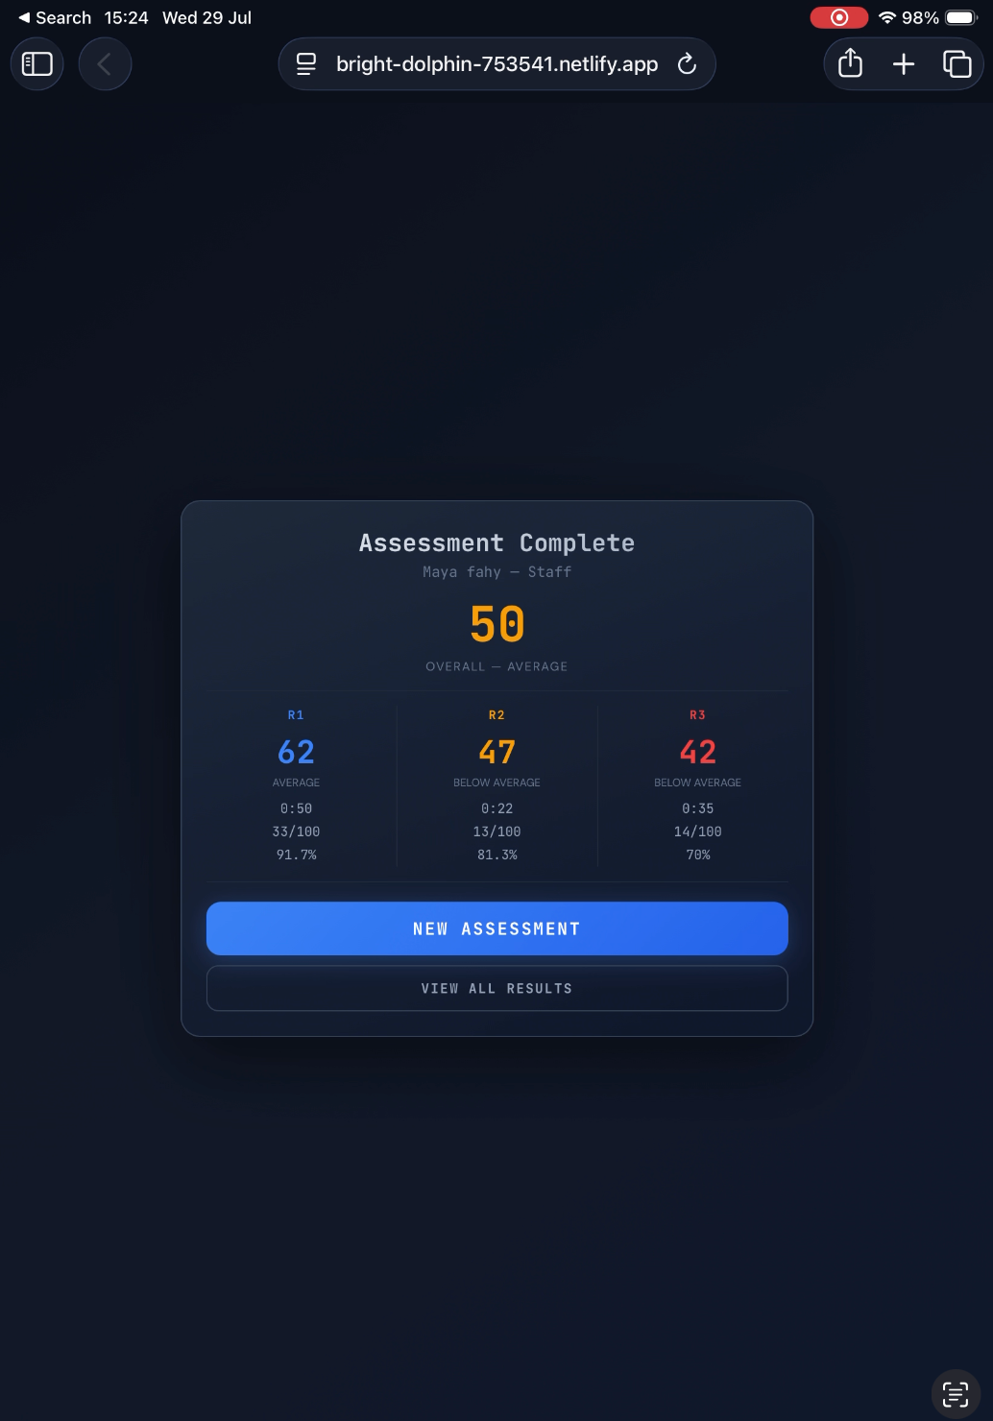
Methodology
28
dental students
3 rounds
increasing difficulty
LiftUpp
clinical assessment
3
Notes:
Our methodology was as follows:
We recruited 28 dental students across year groups at Queen's University Belfast.
Each participant completed a digital dexterity assessment consisting of three rounds of increasing difficulty as demonstrated on the slide. The task required participants to drag and drop pins into holes, using a stylus and an ipad.
We recorded 2 metrics: the accuracy of the pin placement and time taken to place the pins. This was combined to assign each participant an overall dexterity score.
Clinical performance was measured using LiftUpp, a longitudinal clinical assessment platform used across a number of UK dental schools. It grades student performance in the clinical environment, broken down by discipline.
We then correlated dexterity performance against LiftUpp scores — both overall and by specialty.
A feedback questionnaire was given to the participants to capture qualitative feedback.

Slide 5
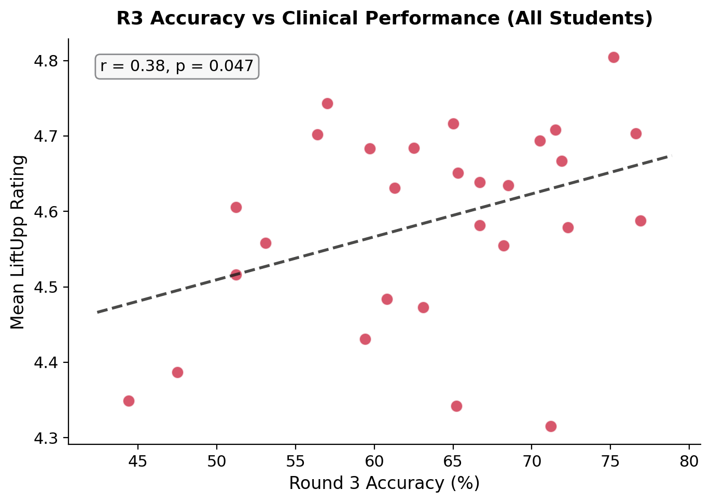
Results 1: Higher Accuracy = Better Clinical Scores
r = 0.38
p = 0.047
R3 Accuracy vs LiftUpp Mean
5
Notes:
Our first finding: higher accuracy on the dexterity test was associated with better clinical scores.
The relationship was more evident as the difficulty increased,
There was no relationship between time taken to place the pins and improved clinical activity.

Slide 6
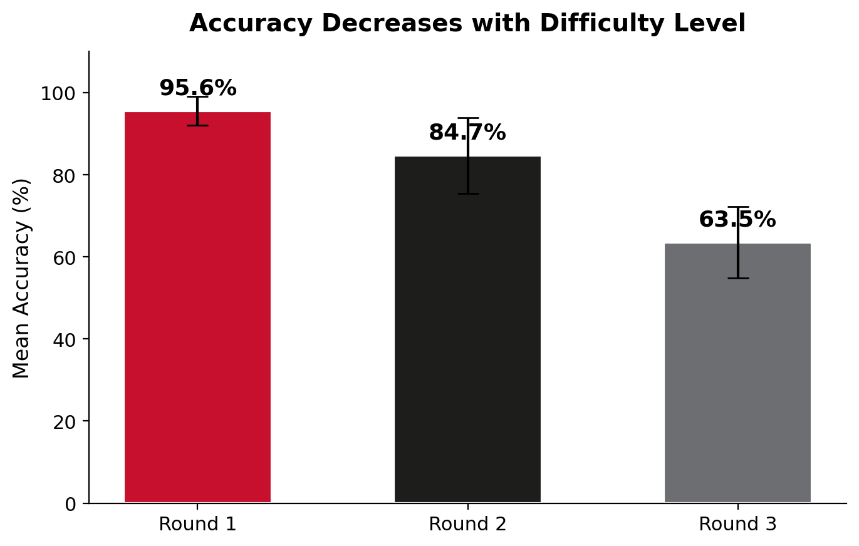
Results 2
4
Notes:
Looking at performance across the three rounds, we see that accuracy scores drop sharply as the difficulty increases.
The strongest relationship between accuracy and clinical scores was seen on the third round; the most difficult.
This round produced the widest spread of results and best discriminated between students.
This suggests that easy tasks do not discriminate — the relationship with clinical performance only emerges once the precision demand is high enough to separate participants. Any future iteration of this tool should be pitched at that higher difficulty from the outset.

Slide 7
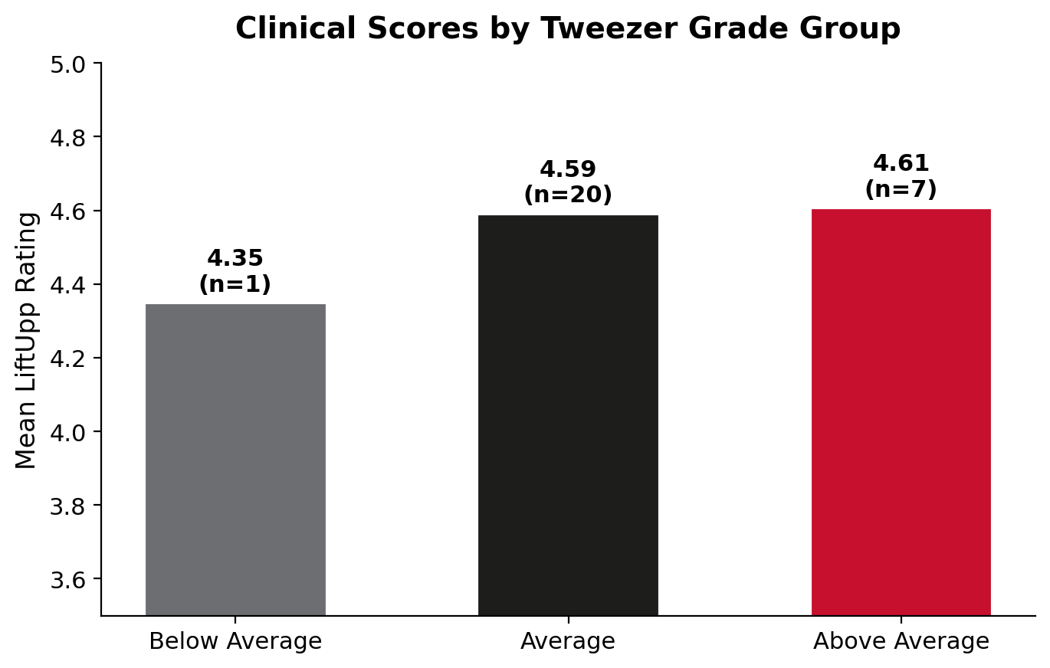
Results 3: Better Dexterity Grade = Higher Clinical Scores
6
Notes:
When we grouped students by overall dexterity grade, the same relationship held: better dexterity grade corresponded to higher clinical scores, lower to lower clinical scores and average to average clinical scores.
This matters practically, because a grade is far more usable than a raw correlation coefficient for example, during the admission process.

Slide 8
Results 4: Strongest in Dexterity-Demanding Specialties
Endodontics
r = 0.48, p = 0.033
(Year 4, overall score)
Strongest single finding
Conservation
r = 0.42, p = 0.025
(All students, R3 accuracy)
Strongest accuracy finding
Also trending: Periodontics (r = 0.37, p = 0.051) | Direct restorations (r = 0.34, p = 0.075)
7
Notes:
Our final result shows that the relationship was strongest in the specialties that make the greatest dexterity demands.
Endodontics was the specialty that showed the strongest correlation, followed by cons. Periodontics also trended in the same direction.
No relationship was seen in oral surgery, orthodontics or radiology.
This shows that the test is measuring what we hope, fine motor skills, instead of observing a ‘good student’ effect.

Slide 9
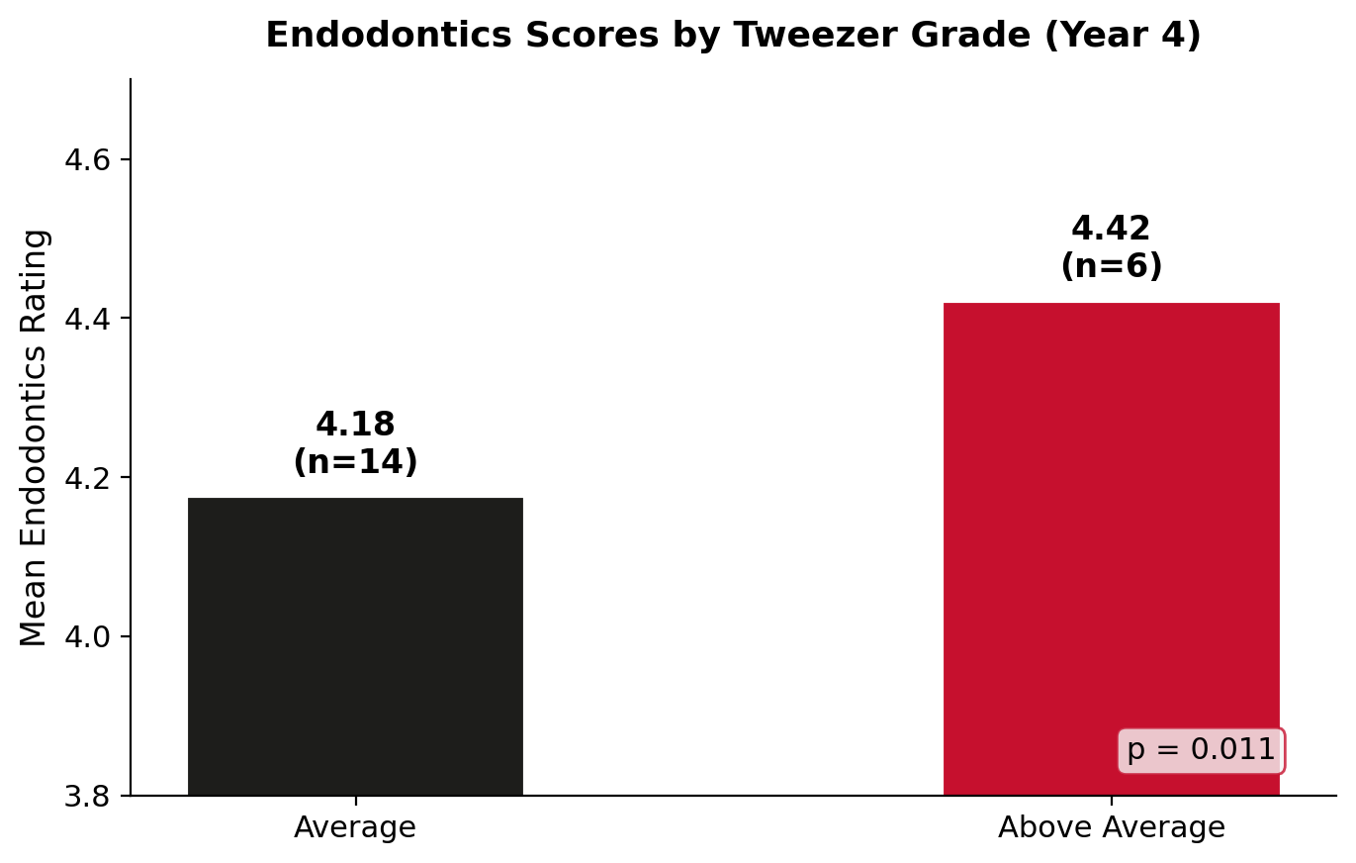
Results 5: Endodontics
4.42 vs 4.18
p = 0.011
Above Average vs Average
8
Notes:
Endodontics was also the only specialty where overall composite score predicted performance, not just the accuracy.

Slide 10
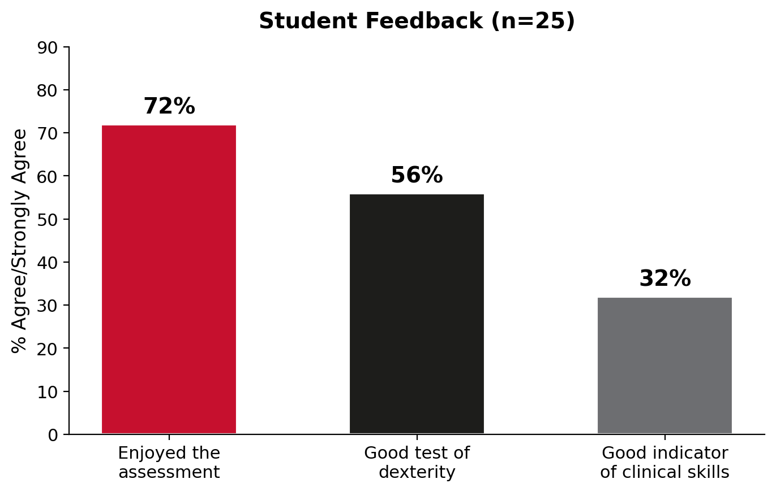
Results 6: Student Feedback
Enjoyed it — but sceptical
about clinical prediction
Students understand that dexterity
is one component of clinical
competence, not the whole picture.
This gap is itself statistically
significant (Wilcoxon p = 0.009)
9
Notes:
After completion of the test, voluntary feedback questionnaires were given.
100% of participants completed the feedback.
Overall, 72% of students enjoyed the assessment and 56% thought it was a good test of dexterity.
Only 32% thought it was a good indicator of clinical skills, which demonstrates an understanding that dexterity is only one component of being a strong clinician.

Slide 11
Next Steps
Larger sample
Expand across all year groups for greater statistical power
Technology refinements
Address stylus responsiveness and visual design based on student feedback
Longitudinal tracking
Test in Year 1 and follow clinical outcomes through to graduation
Multi-centre validation
Replicate at other dental schools
11
Notes:
Going forward, we would like to collect more data across all year groups for greater statistical power.
Feedback from the student’s critiques the responsiveness of the stylus used and colour contrast made visualising the screen difficult. We would aim to address this prior to expanding our research.
We would like to incorporate longitudinal tracking, following students from 1st year until graduation.
We would also like to roll out this research to other dental schools to see whether the results are similar.

Slide 12
Conclusion
1
The test works
Accuracy drops across rounds — Round 3 discriminates best
2
Accuracy predicts clinical skill
Significant correlation with LiftUpp scores (p = 0.047)
3
Strongest for endodontics
The most dexterity-demanding specialty
4
Measures innate ability
Tweezer scores don't change with year of study
5
One piece of the puzzle
Should complement, not replace, other assessment methods
10
Notes:
To conclude.
A simple, short, digital dexterity test showed a statistically significant positive correlation with clinical performance in dental students, with the strongest relationships appearing in the most dexterity-demanding specialties.
The immediate, low risk, application is early identification and support: using this in Years 1 and 2 to direct additional skills teaching towards the students most likely to need it.
The longer-term question of whether this has a legitimate role in selection requires further research with a large sample size. Using this tool in the recruitment of dental students must also come with the understanding that it is only one component of being a good clinician.

Slide 13

QUB
Belfast
Trust
NIMDTA
Thank You
Thank you for your attention!
maya.fahy@belfasttrust.hscni.net
Queen's University Belfast
Belfast Health & Social Care Trust | NIMDTA
ADEE Budapest 2026

