Slide 1


Integrating Material Consumption Data into Sustainable Dental Education Planning
Andrea Fanni Vass,
Anna Júlia Dézsi, Tamás Demeter,
Zsuzsanna Viktória Berki,
Krisztina Márton
August | 2026

Slide 2



# carbon footprint of dentistry
The carbon footprint of healthcare sector is 5%
Within dentistry accounts for 3%
Increasing awareness, positive attitudes
Limited data are available on material use in preclinical dental education
Duane B, Berners-Lee M, White S, Stancliffe R, Steinbach I. An estimated carbon footprint of NHS primary dental care within England. How can dentistry be more environmentally sustainable? British Dental Journal. 2017;223:589–593.
August | 2026
Notes:
Therefore, it is important that the application of sustainability principles—the 4Rs—is also reflected in the organization of education.
Education provides an ideal environment for fostering a sustainable approach to dentistry.

Slide 3
# carbon footprint of dental education
practical education →
highly material- and energy-intensive
growing student numbers → increasing material consumption, waste generation
preclinical education →
no risk of contamination
ideal environment for fostering a sustainable approach to dentistry
August | 2026
Notes:
Therefore, it is important that the application of sustainability principles—the 4Rs—is also reflected in the organization of education.
Education provides an ideal environment for fostering a sustainable approach to dentistry.

Slide 4
# 4R in dental education
Rethink
Reduce
Reuse
Recycle
August | 2026
Notes:
Therefore, it is important that the application of sustainability principles—the 4Rs—is also reflected in the organization of education.
Education provides an ideal environment for fostering a sustainable approach to dentistry. Sustainable procurement, eco labels.

Slide 5

# aims
Monitoring material consumption on Odontotechnology and Prosthodontics Preclinical Courses (OPP)
Waste volume measurements
Evaluating strategies for the sorting and repurposing
Development of educational organization strategies suitable for sustainability principles
Shaping of student attitudes
August | 2026
Notes:
Identification of reusable/recyclable material groups

Slide 6
# methods
Prospective observational study
Location: Semmelweis University Faculty of Dentistry, Educational Centre Skill Laboratory
Period: September – December 2025.
Categorization and measurement of used materials by electronic scale (d= 1g)
Registration of student attendance on practices
Descriptive statistical analysis
August | 2026

Slide 7


# syllabus
Upper and lower complete denture fabrication
Anatomical impression taking
Fabrication of light-curing acrylic special tray
Fabrication of shellac-based occlusal rim
Determination of centric relation
Fabrication of trial dentures
August | 2026
Notes:
Therefore, it is important that the application of sustainability principles—the 4Rs—is also reflected in the organization of education.
Education provides an ideal environment for fostering a sustainable approach to dentistry. Sustainable procurement, eco labels.

Slide 8
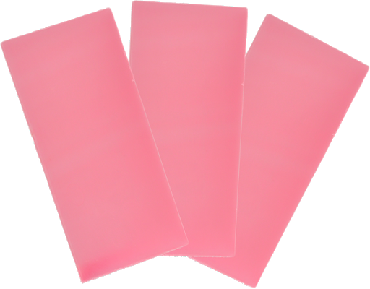
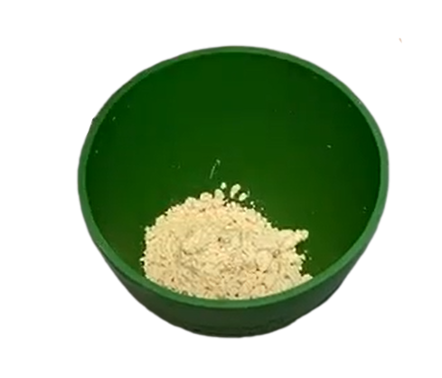
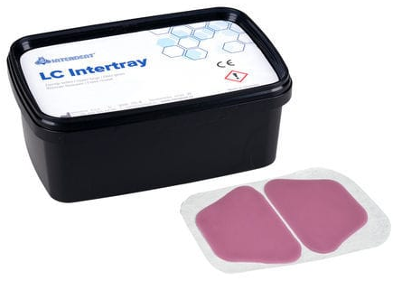
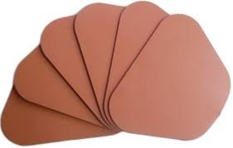
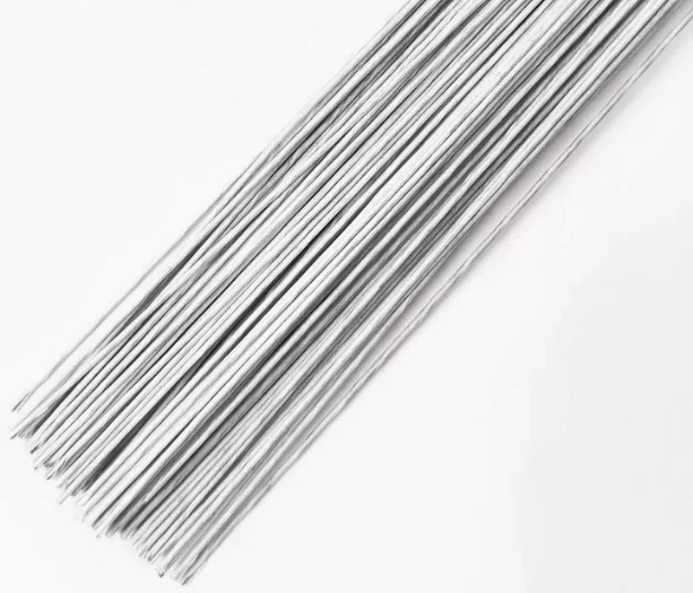
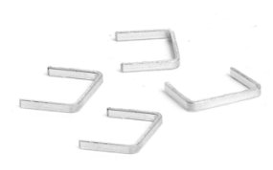
# results – OPP I. course
Material types and consumption:
rose modelling wax
5079 g
alginate
52849 g
light-curing acrylic tray material
9939 g
shellac plate
2699 g
metal wire
133 g
staples
28 g
August | 2026

Slide 9
# results
Total material consumption per semester: 70 727g (~70 kg)
Average material consumption per capita: 441 g
Total waste production (with set alginate impression): 159 845g (~160 kg)
Average waste production per capita: 998 g
August | 2026

Slide 10
# results – reprocessing potential
Material | Consumption (g) | Recollection (g) | Net consumption (g) | Waste reduction (%)
wax | 5079 | 842 | 4238 | 16,6
light-curing acrylic | 9939 | 3292 | 6647 | 33,1
August | 2026

Slide 11
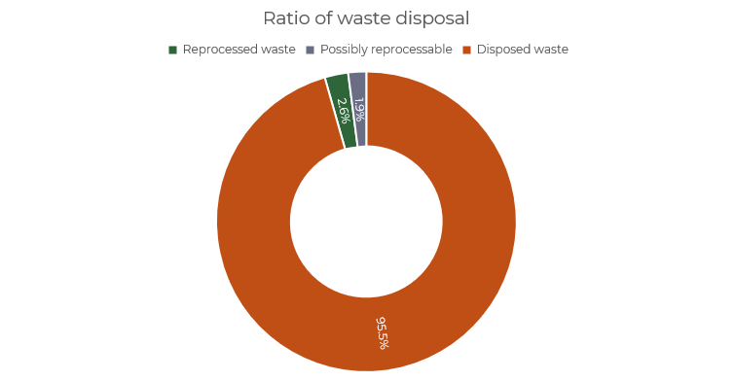
# results – ratio of waste disposal
Total waste 159 845g
Reprocessed waste 4134 g
Possibly reprocessable ~ 3000g
August | 2026

Slide 12
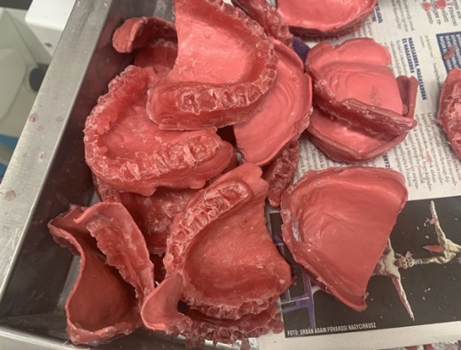
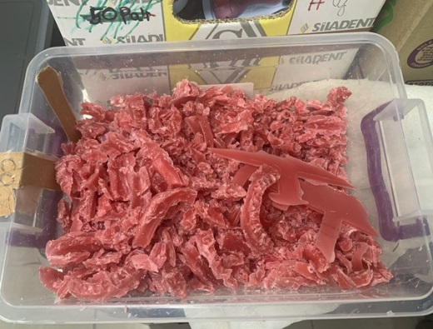
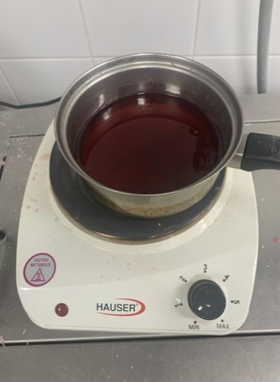
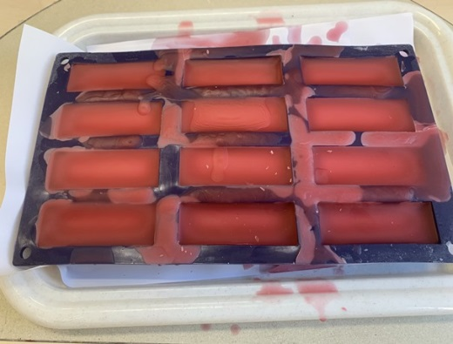
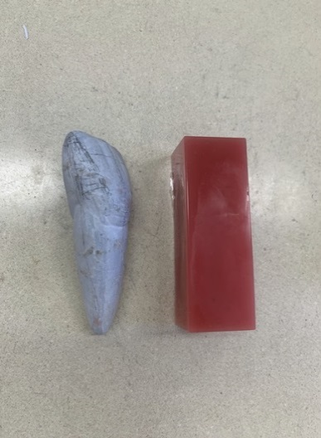
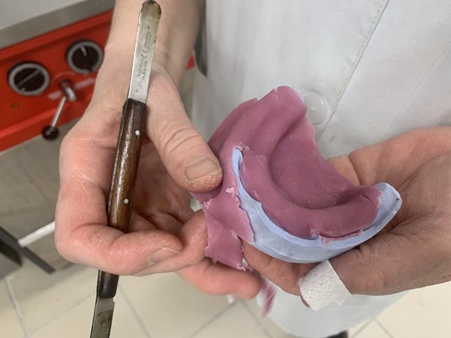
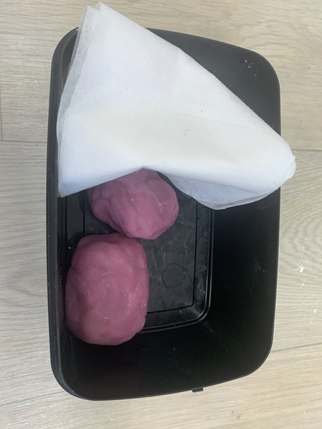
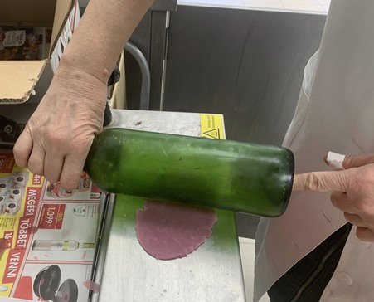
# behind the scene – reprocessing
Wax
Light-curing acrylic
August | 2026

Slide 13
# results – recycle potential
Alginate impression waste: 146 101 g/semester
93,3% of the total waste volume
August | 2026

Slide 14
# discussion
A significant amount of non-infectious educational waste
Residual material recollection as a first sustainable step
Recycling of uncontaminated alginate impression waste - big potential
  agricultural fertilizer
  denture polishing agents
  thermal insulation
Tanvi Kedar Date, Vasanthi Swami. Breathing New Life into Alginates: A Journey of Reuse and Recycle. Indian Journal of Contemporary Dentistry/ Vol 13 No 2 July-December 2025
Matteo Cibinel, Giorgia Pugliese, Davide Porrelli, Lucia Marsich, Vanni Lughi: Recycling alginate composites for thermal insulation, Carbohydrate Polymers, Volume 251, 2021, 116995, ISSN 0144-8617
August | 2026

Slide 15
# sustainable education management
Implementing the 3R approach is a realistic possibility in preclinical dental education
Material reprocessing in educational workflow
Organization of education and procurement of materials based on consumption
Forecasting resource requirements based on student numbers
August | 2026
Notes:
The ecological footprint of dental education can be reduced through conscious organization and recycling programs.

Slide 16
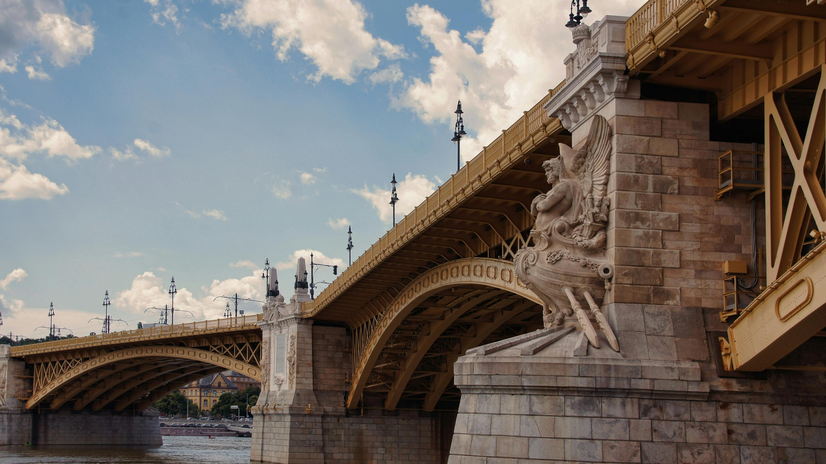

Teaching sustainable dentistry begins with sustainable dental education

Slide 17
Thank you for your attention!
vass.andrea.fanni@semmelweis.hu

