Slide 1

The Empathy Operatory:
Where Simulation Meets Compassion
Christine Riedy, PhD, MPH
Delta Dental of MA Associate Professor, Oral Health Policy and Epidemiology
Harvard School of Dental Medicine
Notes:
Thank you for your submission of an abstract to ADEE 2026 Budapest for consideration for inclusion in our Oral/Topic presentation stream. I am pleased to advise you that your abstract has been accepted. This means you will be able to make an oral presentation of approximately 10 minutes followed by 5 minutes Q&A with the delegates.

Slide 2
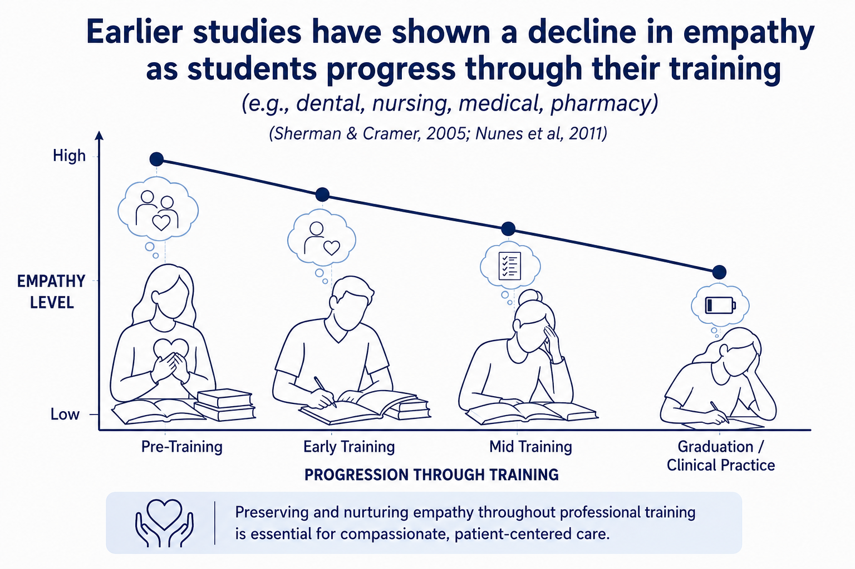
Image generated by ChatGPT
Notes:
Empathy in patient care... "a cognitive attribute that involves an ability to understand the patient's pain, suffering, and perspective combined with a capability to communicate this understanding and an intention to help."
One of first studies in dentistry:
Sherman – Jefferson Scale of Physician Empathy ( 20 items on a 7 point likert scale)
Scores range from 20 to 140, with higher scores indicating higher levels of empathy. Students rate their level of empathy on each item, from 1 (strongly disagree) to 7 (strongly agree).
A change in empathy from the beginning to the end of the first year has also been shown in other health professional trainees – pharmacy, veterinary, nursing and medicine
Moreover changes in curriculum design should ensure maintenance and development of empathy in students. These may include interprofessional learning, development of a team work ethic, changes in assessment process and a change in emphasis from fact based learning to applied learning
Source: Nunes et al. Int J Med Edu. 2011; 2:12-17

Slide 3
2-17 Graduates must be competent in managing a diverse patient population and have the interpersonal and communications skills to function successfully in a multicultural work environment.
Intent:
Such an environment should facilitate dental education in: … and;
  the development of core professional attributes, such as altruism, empathy, and social accountability, needed to provide effective care in a multidimensionally diverse society.
Source: CODA.org: Predoc Standards
Notes:
Empathy in patient care... "a cognitive attribute that involves an ability to understand the patient's pain, suffering, and perspective combined with a capability to communicate this understanding and an intention to help."

Slide 4
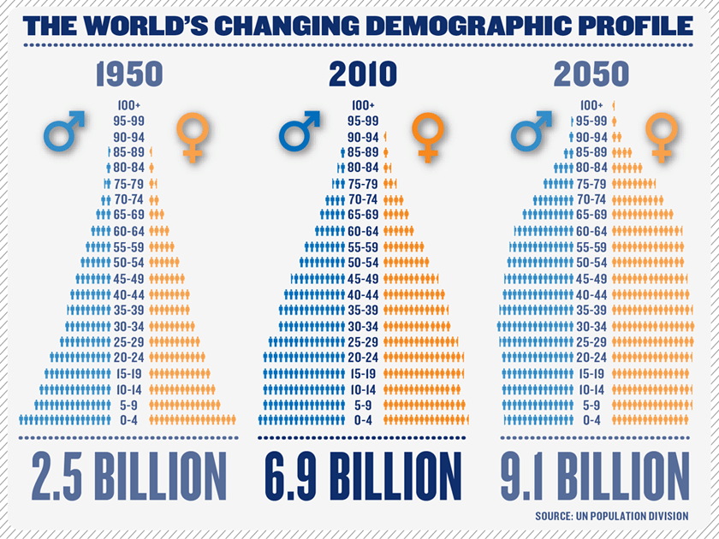
Source: Changing-age-distribution-from-the-United-Nations-Population-Division-No-2012-4-December.png (840×630)

Slide 5
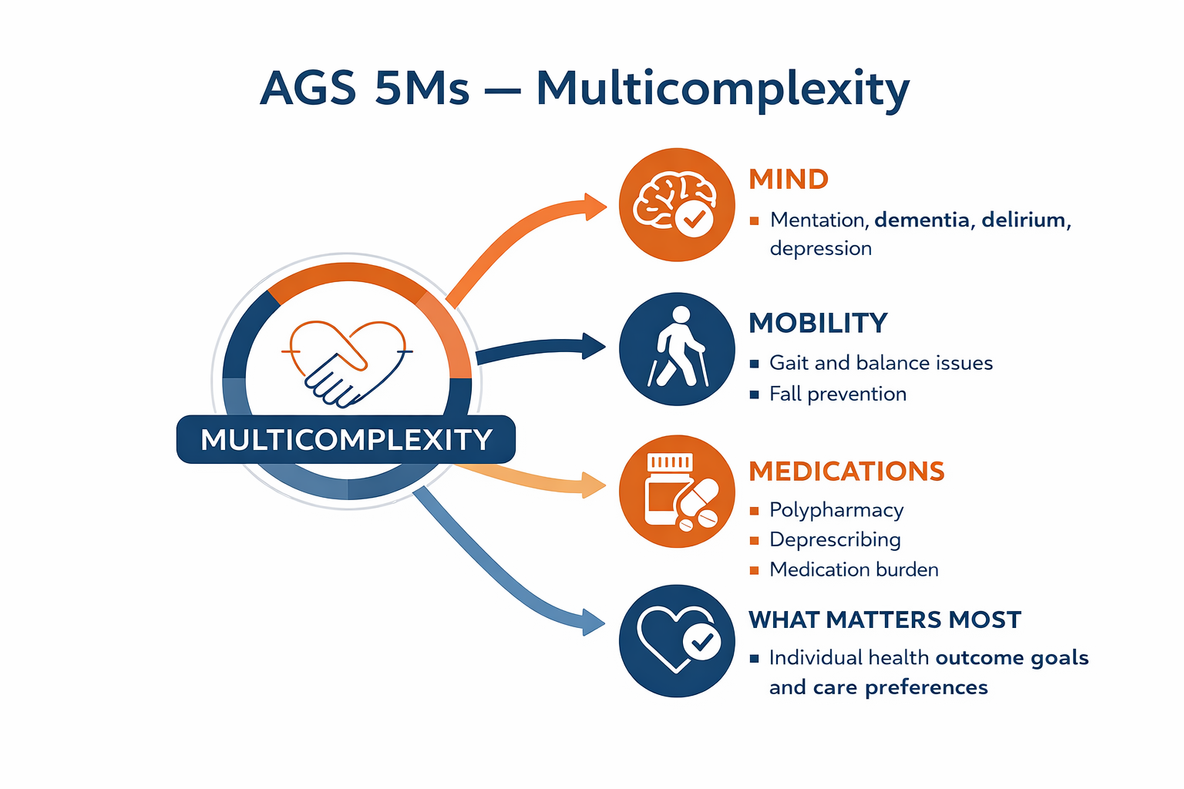

Predoctoral Oral Health Education for an Aging America (POHETAA)
Transform the education and clinical training of predoctoral dental students by incorporating:
an age-friendly framework
interprofessional focus
aging & geriatric-focused track
Image generated through ChatGPT
Notes:
Predoctoral Training in General, Pediatric and Public Health Dentistry and Dental Hygiene (HRSA/BHW)
The Predoctoral Oral Health Education and Training for an Aging America (POHETAA) program will incorporate age-friendly, interprofessional, and social determinants of health principles into predoctoral education and clinical skills training related to OAs.
Didactic:
Review Geriatric 5M’s
Misconceptions of Aging
Seattle Care Pathway

Slide 6
GeriSuit
Simulation Learning Objectives
Recognize age-related physical and sensory changes
Experience the impact of these changes on common dental tasks
Apply clear, patient-centered communication strategies
Identify modifications to the dental environment and treatment process
Reflect on personal assumptions and empathy related to aging and describe how this experience will shape your approach to delivering compassionate, evidence-based geriatric dental care.
Notes:
Recognize age-related physical and sensory changes—including reduced mobility, decreased dexterity, visual decline, and hearing impairment—that directly affect a patient’s ability to participate in dental care.
Experience the impact of these changes on common dental tasks, such as completing forms, transferring to the dental chair, maintaining an open mouth, following instructions, and performing oral hygiene.
Apply clear, patient-centered communication strategies (e.g., slowing pace, simplifying explanations, using teach-back, supporting hearing or vision limitations) to enhance understanding and reduce patient anxiety.
Identify modifications to the dental environment and treatment process—such as positioning supports, shorter appointment segments, adaptive devices, and accessible navigation—to improve comfort, safety, and clinical outcomes for older adults.
Reflect on personal assumptions and empathy related to aging, and describe how this experience will shape your approach to delivering compassionate, evidence-based geriatric dental care.

Slide 7
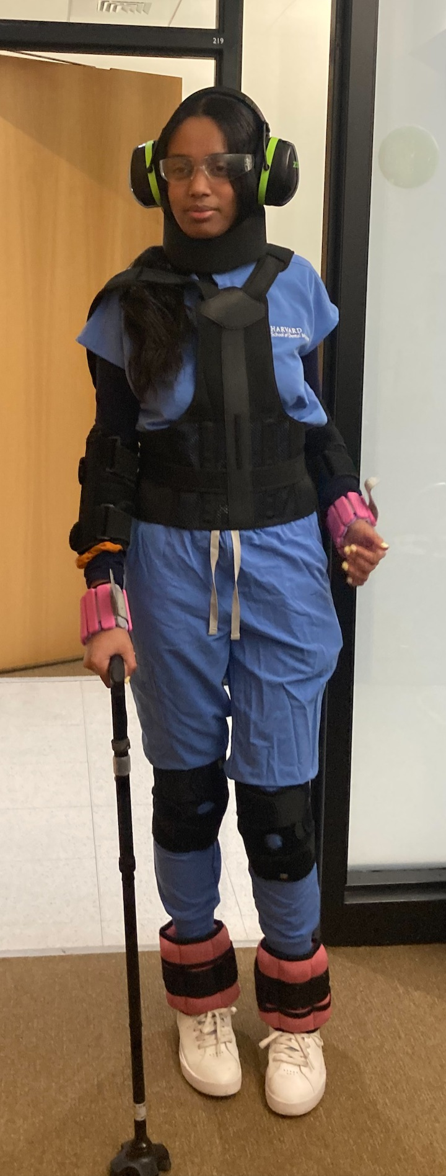
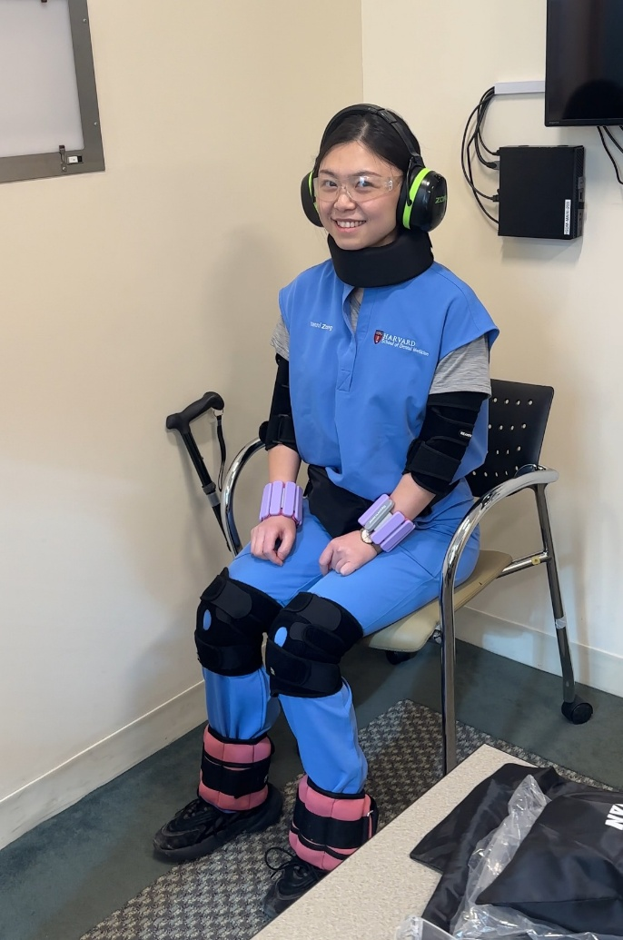
Aging & Geriatrics Rotation (Experiential)
D-2 Yr Emergent Clinical Experience:
Photos courtesy of Y Zong and Y Fasel
Notes:
D-2 ECE – aging and geriatric rotation
Experiential:
Mobility Test
Geriatric Suit (GeriSuit) Simulation
Also….
Campus/Clinic Tour
Patient interview/geriatric assessment tool
Seattle Care Pathway cases
Wheelchair transfer

Slide 8
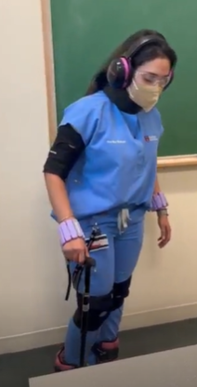
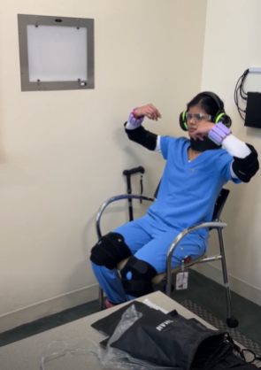
GeriSuit Activities
Timed Up and Go (TUG) test
  Mobility
Brushing and flossing demonstration
  Dexterity
Patient-provider communication
  Hearing
  Vision
*Coming this fall – Arthritis gloves
Photos courtesy of H Rakam and V Patil
Notes:
Timed Up and Go (TUG) test measures the time it takes for a person to stand from a chair, walk 3 meters, turn, return, and sit down, providing a reliable assessment of mobility, balance, and fall risk.

Slide 9
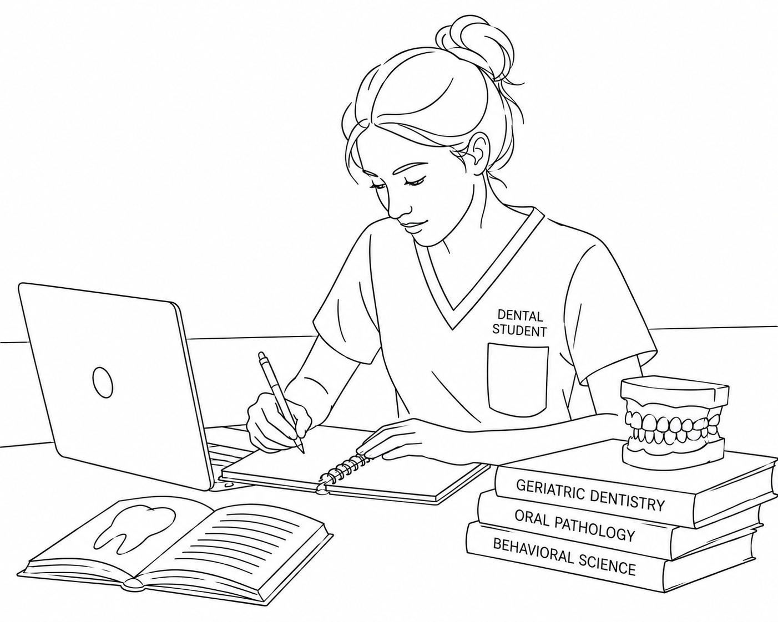
ECE Geriatrics – GeriSuit Student Feedback
"It was a lot more difficult than I had expected and I think it’s important to have a lot of patience for older adult patients. "
Image generated through ChatGPT

Slide 10
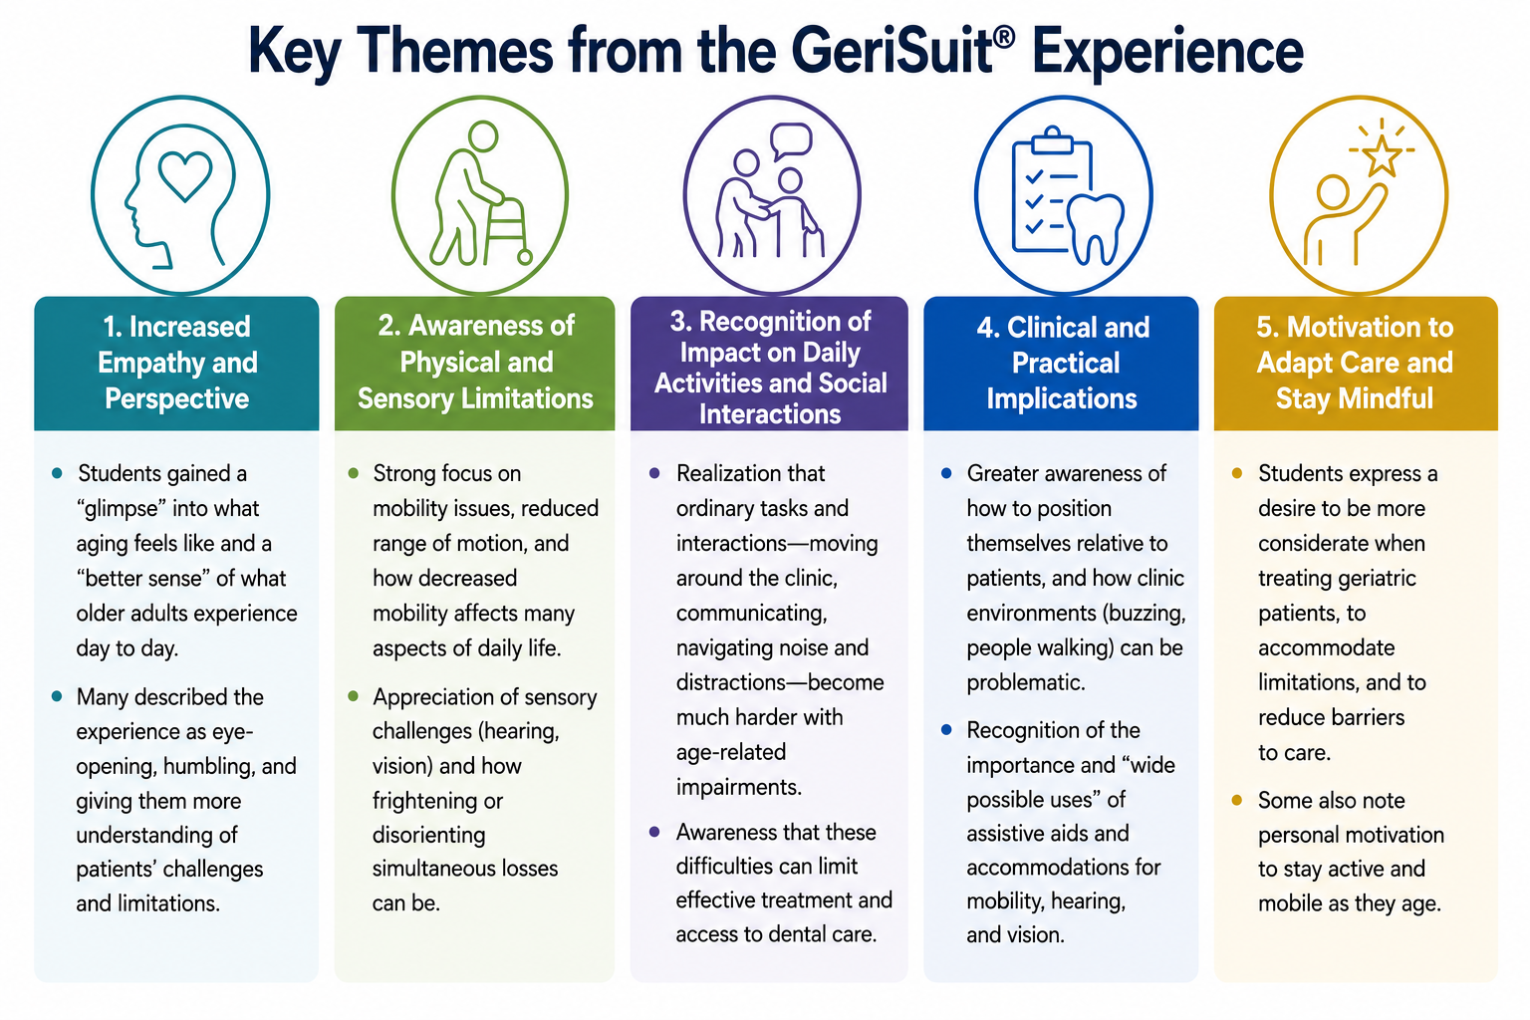
Source data – D2 student evaluations (N=29); Image generated through ChatGPT
Notes:
Increased empathy and perspective
Students gained a “glimpse” into what aging feels like and a “better sense” of what older adults experience day to day.
Many described the experience as eye-opening, humbling, and giving them more understanding of patients’ challenges and limitations.
Awareness of physical and sensory limitations
Strong focus on mobility issues, reduced range of motion, and how decreased mobility affects many aspects of daily life.
Appreciation of sensory challenges (hearing, vision) and how frightening or disorienting simultaneous losses can be.
Recognition of impact on daily activities and social interactions
Realization that ordinary tasks and interactions—moving around the clinic, communicating, navigating noise and distractions—become much harder with age-related impairments.
Awareness that these difficulties can limit effective treatment and access to dental care.
Clinical and practical implications
Greater awareness of how to position themselves relative to patients, and how clinic environments (buzzing, people walking) can be problematic.
Recognition of the importance and “wide possible uses” of assistive aids and accommodations for mobility, hearing, and vision.
Motivation to adapt care and stay mindful
Students express a desire to be more considerate when treating geriatric patients, to accommodate limitations, and to reduce barriers to care.
Some also note personal motivation to stay active and mobile as they age.

Slide 11
Experience Aging. Elevate Care.
Acknowledgements: POHETAA team (Drs. Lisa Thompson, Elizabeth Alpert, Tien Jiang, Hugh Silk, Shivangi Kaplish and HSDM Geriatric Student Interest Group). Photo credits: Y. Fasel; H Rakam and V Patil
The Health Resources and Services Administration (HRSA), Department of Health and Human Services (HHS) provided financial support for this project. The award provided 100% of total costs and totaled $295,254. The contents are those of the author. They may not reflect the policies of HRSA, HHS, or the U.S. Government.

