Slide 1
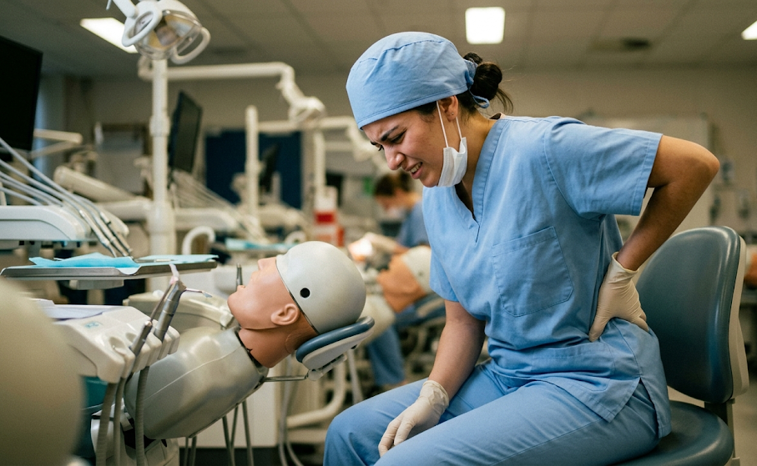
Smart Education:
An AI-Powered Tool for Pre-Clinical Ergonomic Training
64 to 93%
prevalence
Dias da Silva MA; Tonni I; Bonetti S; Savoldi F; Paganelli C; Dalessandri D
University of Brescia
teach / evaluate / empower

Slide 2
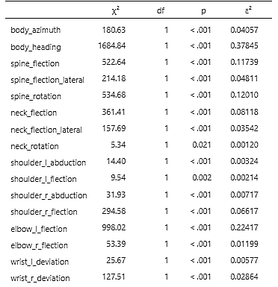
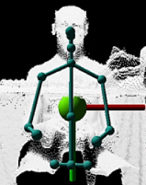
IA-powered computer vision assistant
100 working sessions
Correct vs Bad posture
5 senior teachers

Slide 3
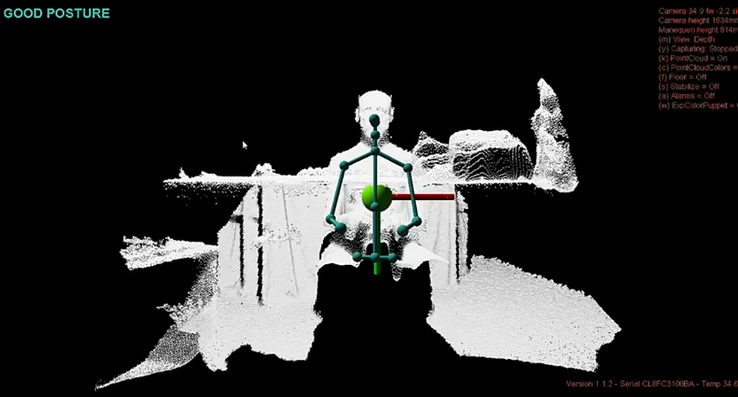
The AI vision system is a robust tool for identifying gross ergonomic deviations in real-time.
Empowering students through self-correction, supporting teachers with objective metrics

