Slide 1


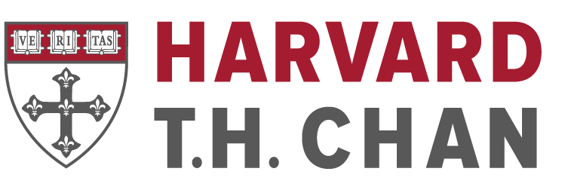





“Integrating the Dual-Layer C.L.E.A.R.H. Framework into Community-Embedded Dental Education”
Evidence and Empathy as the focus in oral health professionals’ education, August 27, 2026
A life-course blueprint for global workforce transformation
Steffany Chamut, DDS, MPH, FICD
Associate Professor, Director of Research and Scholarly Activity
PNWU School of Dental Medicine. Yakima, WA, USA
Affiliate Faculty, Harvard T.H. Chan School of Public Health,
Departments of Environmental Health and Epidemiology, Boston, MA, USA
Visiting Lecturer, The University of the West Indies, Mona School of Dentistry, Mona, Kingston, Jamaica
2022 Health and Aging Policy Fellow; Congressional Fellow, USA
NIH PI & Scholar in the Health and Aging Brain Study-Health Disparities (HABS-HD) Health Enhancement Scientific Program (HESP), USA
schamut@pnwu.edu
Notes:
Good morning. I want to propose a simple shift in how we prepare dentists for an aging world. C.L.E.A.R.H. is a dual-layer educational framework designed to make complex, whole-person risk visible and actionable across the curriculum. The central idea is straightforward: if we want a different workforce, we have to change the lens through which students learn to see the patient.

Slide 2
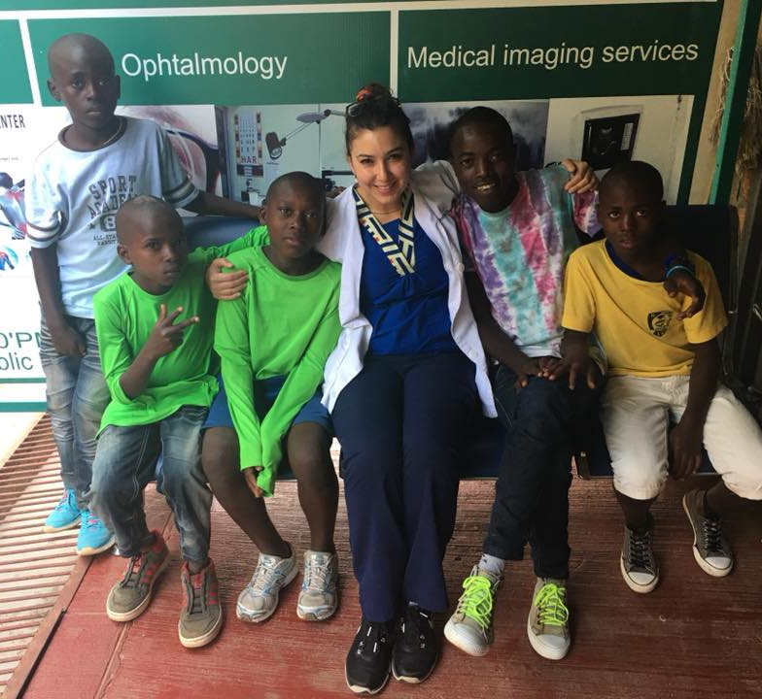
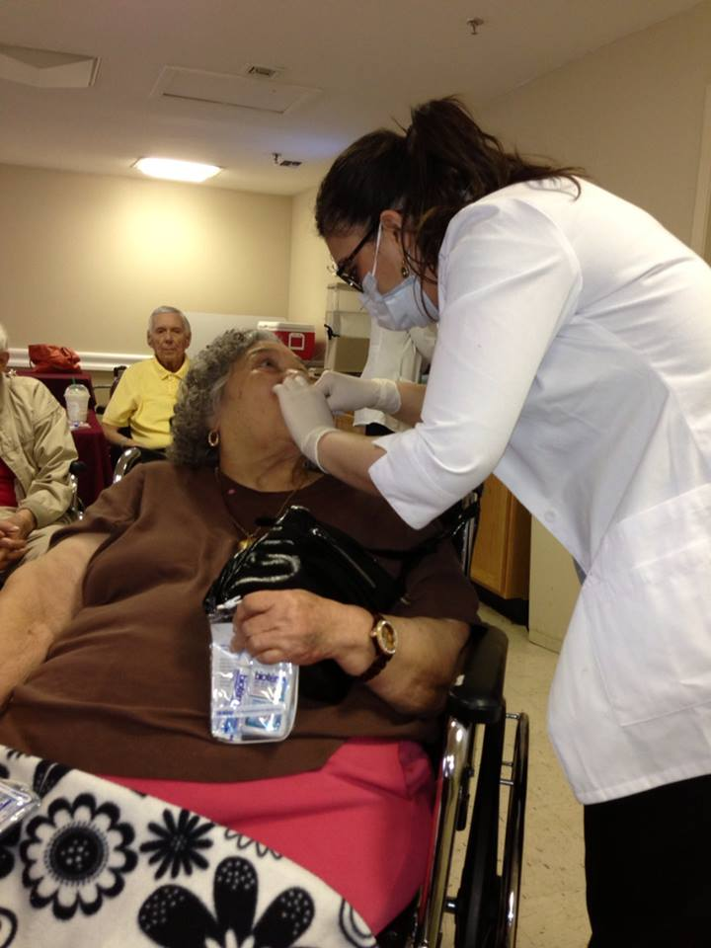
Educational and Work Timeline
More Than 2,000 Miles: Building a Global Perspective
My Journey as a Community/Public Health, Geriatric Dentist, and Educator
GLOBAL HEALTH
Rwanda
Uganda
Jamaica
Mexico
Chile
Brazil…
MX / UTHSCSA / NIH /
HRSA / CU ANSCHUTZ
HARVARD
CU ANSCHUTZ / PNWU /
HARVARD T.H. CHAN
Completed advance training in Prosthodontics, Dental Public Health, and Geriatrics, Health Policy and Entrepreneurship.
Established a strong foundation in clinical practice with a focus on vulnerable, underserved, and medically complex populations.
Lead teaching/mentoring, curriculum development, research, and national and international policy and educational initiatives focused on aging, health equity, and global oral health.
Lead community and population health innovative initiatives focused on innovative approaches including interprofessional education, DPH, Nutrition, geriatric curriculum development and clinical care,
and quality of Life, HIV, and neurological–oral health NIH founded research.
Engaged in global health initiatives and research, including capacity-building in Uganda, Mexico, Jamaica, and Rwanda, emphasizing prevention, HIV and oral healthcare, and community workforce development.
Notes:
This timeline highlights the key stages of my professional development from clinical foundations and public health training to becoming an educator at Harvard to HRSA-NIH-funded research and policy work at CMS. Each step strengthened my ability to teach, build programs, and form partnerships in communities facing inequities, —skills essential for advancing new initiatives as those aligned with this Dental school.

Slide 3
The educational problem
We have a demographic revolution, but a curriculum built for yesterday...
AGING
WORLD
Older adults are retaining more teeth, and living with more multimorbidity, polypharmacy, cognitive vulnerability and functional complexity.
We still tend to teach dentistry by age-segmented topics, such “pediatrics” or “geriatrics” as a population or a late curricular topics, rather than as a way of reasoning across the life course.
If we wait until a patient is “old” to teach aging, we are already late.
Notes:
We are living through a demographic revolution, but much of dental education is still organized for yesterday’s patient. Older adults are retaining more teeth while also living with multimorbidity, polypharmacy, cognitive vulnerability, and functional complexity. Yet we often teach geriatrics as a population encountered late in training. If we wait until someone is old to teach students how aging-related vulnerability develops, we are already late.

Slide 4


WHO has already defined the direction
Dental education must build the workforce
PROMOTION + PREVENTION
WHO GLOBAL ORAL HEALTH
STRATEGY 2023–2030
Universal Health Coverage
for oral health by 2030
• Prevention
• Primary health care
• Life-course care
• Population-responsive workforce
Identify risk and vulnerability earlier.
03
HEALTH WORKFORCE
Align competency-based education with population needs.
ORAL HEALTH CARE
Integrate essential oral health care into primary health care.
C.L.E.A.R.H.
Translates this global policy direction into a teachable clinical reasoning framework.
WHO. Global strategy and action plan on oral health 2023–2030. Geneva: World Health Organization; 2024.
Notes:
And this is not only an educational argument. WHO has already defined the direction for global oral health through 2030: prevention, integration with primary health care, life-course approaches, and a workforce prepared around population needs.
For dental education, the challenge is how we operationalize that vision—how we teach students to recognize vulnerability earlier, connect oral health with whole-person health, and act before complexity becomes crisis.
That is where C.L.E.A.R.H. fits. It translates this global policy direction into a clinical reasoning framework students can actually use.

Slide 5
What changes?
The student/graduate, not simply the syllabus
FROM
TO
Procedure-centered
→
Person-centered
Age-segmented
→
Life-course
Clinic-bounded
→
Community-embedded
Reactive
→
Prevention-oriented
Dentistry in isolation
→
Health-system connected
A SOCIALLY ACCOUNTABLE, AGING-READY WORKFORCE
Goal: prevention-oriented primary care responsive to demographic aging, inequity and community service needs.
Notes:
So what changes? Ideally, the graduate—not simply the syllabus. We move from procedure-centered to person-centered care; age-segmented to life-course reasoning; clinic-bounded to community-embedded education; reactive to prevention-oriented practice; and dentistry in isolation to health-system connection. The outcome is an aging-ready, socially accountable workforce prepared for prevention-oriented primary care.

Slide 6
The gap is not another geriatrics lecture. The gap is the lens.
Clinical
complexity
Function
Nutrition
Cognition
Social +
caregiving
Access
These risks do not begin at 65, and they do not arrive one at a time.
Curriculum shift: AGE-BASED CONTENT → LIFE-COURSE CLINICAL REASONING
Notes:
The gap, therefore, is not another geriatrics lecture. The gap is the lens. Clinical complexity, function, nutrition, cognition, caregiving, and access do not suddenly appear at age 65, and they rarely arrive one at a time. We need to move from age-based content to life-course clinical reasoning, so students recognize interacting vulnerabilities earlier and understand how they change treatment decisions.
Currently, we are graduating students have been reported as underprepared for adaptive treatment planning and older-adult needs.

Slide 7
C.L.E.A.R.H. makes complexity teachable, and repeatable.
C
Clinical complexity
L
Life-course risks
E
Environmental + social determinants
A
Access barriers
R
Risk identification
H
Health-system coordination
SECOND LAYER • culturally responsive • ethics-informed • accessibility-focused • person-centered
Dual-layer C.L.E.A.R.H.: Comprehensive educational lens spanning biological, functional, socio-environmental and caregiving determinants.
Notes:
C.L.E.A.R.H. makes that complexity teachable and repeatable. C is clinical complexity; L, life-course risks; E, environmental and social determinants; A, access barriers; R, risk identification; and H, health-system coordination. The second layer matters just as much: every domain is approached through culturally responsive, ethics-informed, accessibility-focused, person-centered care. It is not a checklist added to dentistry. It is a common reasoning lens.

Slide 8
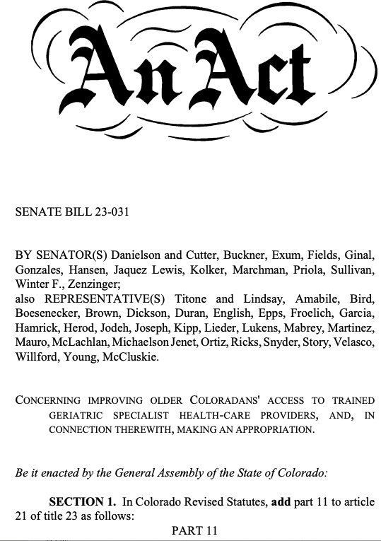



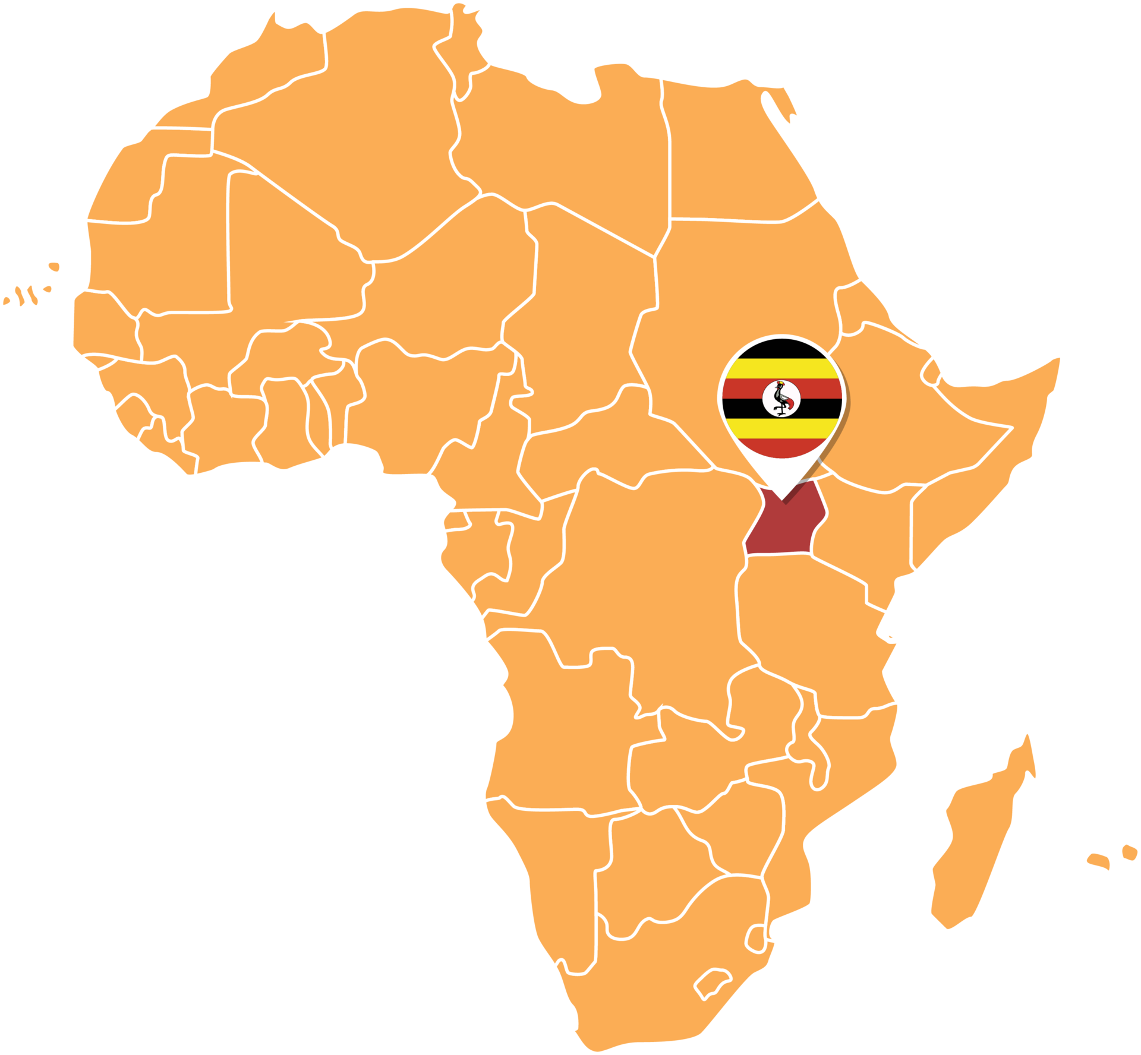

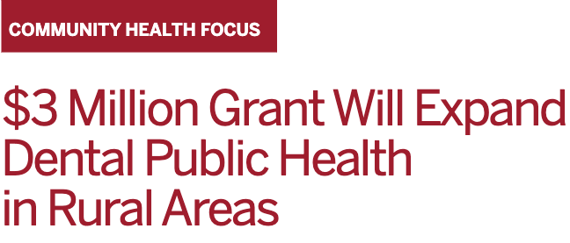
Research gives students hans-on experiences to connect the mouth to the whole person.
Functional
dentition
Mastication +
diet adaptation
Nutrition +
inflammation
Brain + functional
health
Caregiving +
access
“Oral diseases and quality of life in older adults on anti-retroviral therapy (ART) in Uganda (ODQoL-UG)”
Health, Health & Aging Brain Study – Health Disparities (HABS-HD): “Exploring Neurological and Indirect Biomarkers for Potential Correlations with Oral Health: An Interdisciplinary Approach”
“Catalyzing Oral Health Workforce for Rural and Vulnerable Populations (COHW)-Co-PI”
RESEARCH → RECOGNITION → PREVENTION
Notes:
Prevention is multifaceted—diet, behavior, and broader social determinants all shape oral health across the lifespan. But prevention also requires innovation in how we detect emerging risks, especially for vulnerable populations such as older adults.
Beyond research, addressing gaps in aging and oral health also requires strong policy foundations. In Colorado, we built programs that aligned directly with state legislation to expand geriatric training.
Research gives students a reason to connect the mouth to the whole person. Our aging and global-health work points to pathways linking functional dentition and mastication with diet adaptation, nutrition, inflammation, brain and functional health, caregiving, and access. The educational sequence is research to recognition to prevention. Students do not need to become aging researchers; they need to learn how evidence changes what they recognize in front of them.
US National Institutes of Health, Health & Aging Brain Study – Health Disparities (HABS-HD) and
"Oral diseases and quality of life in older adults on anti-retroviral therapy in Uganda (ODQoL-UG)” Funded research inform the framework, not as isolated
“research content,” but as evidence students can use to recognize vulnerability earlier.
Mouth-to-Mind work links jaw/occlusal dysfunction with malnutrition and AD/ADRD risk and emphasizes early, accessible detection.
R21: The project aims:
To determine the impacts of geriatric syndromes (frailty, depression, and cognitive decline) on oral health and quality of life in people with HIV, and
To explore the mechanisms of integration of oral health services into routine HIV care in the context of rural Sub-Saharan Africa.
Long-term care Goal: Design an intervention in southwestern Uganda to assess the inclusion of an oral health preventive and promotion program in routine HIV care.
HRSA:
One of my strongest passions is developing community-based programs and advancing dental education.
I am committed to preparing trainees to serve underserved and rural communities, shaped by my own experiences growing up in Mexico and working in rural regions since high school, where I saw firsthand the needs and challenges people face.
Core of how I aid to develop the HRSA Rural post-doctoral Oral Health Education program at Harvard, which intentionally proposed to expose students to the realities of health inequities, chronic disease, and culturally diverse communities. And here, I see this is a foundational opportunity, where the education is designed around community-integrated training; which is great.
Addresses a gap in dental education and in access to care with respect to underserved and vulnerable populations in rural areas of New Hampshire.
Curriculum Development; Faculty Development; Student Support and Mentorship
Increase the primary care oral health workforce to effectively provide comprehensive general and advanced dental care incorporating interdisciplinary and population health (e.g., social determinants of health) approaches to underserved and vulnerable populations with complex medical and behavioral health needs in rural NH.
Three areas of focus for the programs are:
Underserved and Vulnerable Populations,
Rural Training Sites, and
Dental Public Health
Increase the primary care oral health workforce to effectively provide comprehensive general and advanced dental care incorporating interdisciplinary and population health (e.g., social determinants of health) approaches to underserved and vulnerable populations with complex medical and behavioral health needs in rural NH.
Improve and expand oral health care capacity, access, and services for underserved and vulnerable individuals living in rural areas by fully planning, developing, implementing two postdoctoral training programs (general dentistry (AEGD) and enhanced existing DPH program) with rural tracks.
Increase the number of postdoctoral trained primary care dentists with expertise in rural health; specifically, general dentistry and public health who will increase workforce capacity in rural NH. These trainees will choose to practice in rural and/or underserved areas with vulnerable populations after postdoctoral training.
Increase the number of primary care dentists; in general dentistry and public health, competent to provide patient-centered, comprehensive, culturally appropriate care for underserved and vulnerable individuals living in rural areas.
Evaluation, operational and administrative support to achieve sustainability.
Collaborating on a response to create new models to improve access and delivery of dental care by supporting innovative postdoctoral dental residency training programs. This collaborative, multidiscipline application requests funding to create two rural residency program tracks (RT) within the disciplines of general dentistry and dental public health to increase access to oral health services for rural populations in NH.
Harvard School of Dental Medicine (HSDM) will be in partnership with Bi-State Primary Care Association as our clinical site liaison and recruitment center, Dartmouth-Hitchcock Medical Center (DHMC) for oral surgery and physical diagnosis training, and 6 other rural sites for care delivery training. The partnership between HSDM, DHMC, NH’s training sites and Bi-State Primary Care Association not only expands the pipeline of dental professionals training in the state, but it also creates opportunities for dentists to become more proficient in providing quality health care focused on population health and be recruited to NH permanently after completing their formal dental training.
By the end of the 5-year project period we anticipate a total of 17 dental graduates.
We anticipate with this collaborative project (AEGD-RT/DPH-RT) to provide trainees in-depth education and field experiences for rural populations addressing the care and management of medically-complex, special and vulnerable populations (i.e. older adults). Through formal relationships already established with clinical rotation sites, the training will focus on interprofessional practice, social determinants of health, cultural competence and oral health literacy.
We propose to establish a new Advanced Education in General Dentistry (AEGD) program that will directly address a gap in dental education and in access to care with respect to underserved and vulnerable populations in rural areas and enhance our current Dental Public Health certificate program to focus on rural and vulnerable populations.
With these new and enhanced residency programs we will provide trainees in-depth education and field experiences for rural populations addressing the care and management of medically-complex, special and vulnerable populations (i.e. older adults). Through formal relationships already established with clinical rotation sites, the training will focus on interprofessional practice, social determinants of health, cultural competence and oral health literacy. Supplemental funds enable us to include telehealth and simulation experiences in the curricula for both the AEGD and DPH programs.

Slide 9
Do not add another course. Thread C.L.E.A.R.H. from D1 to D4.
D1
D2
D3
D4
SEE
CONNECT
ACT
COORDINATE
History + risk
recognition
Oral function +
whole-person health
Adaptive treatment
planning
Community +
interprofessional care
Cases
Simulation
Clinic
Community
Scalable because it reorganizes existing learning around a common reasoning framework.
Designed for distributed, community-embedded education and compatible with Recruit–Educate–Return workforce strategies.
Notes:
Implementation does not require another course. Thread the same lens from D1 through D4. In D1, students see risk in histories and cases. In D2, they connect oral function with whole-person health through simulation. In D3, they act through adaptive treatment planning in clinic. By D4, they coordinate across community and interprofessional settings. The content can already exist; C.L.E.A.R.H. reorganizes it around a shared way of thinking.

Slide 10
A global curriculum should keep the lens constant,
and let the context change.
Rural U.S.
Rwanda
Uganda
Jamaica
Mexico
SAME C.L.E.A.R.H. LENS
LOCAL EXPRESSION
Social accountability means preparing dentists for the patients, communities and systems they will actually serve.
Framework development draws on community-based/geriatric education, HRSA workforce initiatives and collaborations across multiple countries.
Notes:
The lens can remain constant while the context changes. A rural community in the United States, Rwanda, Uganda, Jamaica, or Mexico will express risk, resources, culture, and access differently. Social accountability is not making every curriculum identical. It is preparing graduates to use a transferable reasoning framework while responding to the patients, communities, and health systems they will actually serve.

Slide 11
What changes? The graduate, not simply the syllabus.
FROM
TO
Procedure-centered
→
Person-centered
Age-segmented
→
Life-course
Clinic-bounded
→
Community-embedded
Reactive
→
Prevention-oriented
Dentistry in isolation
→
Health-system connected
A SOCIALLY ACCOUNTABLE, AGING-READY WORKFORCE
Goal: Prevention-oriented primary care responsive to demographic aging, inequity and community service needs.

Slide 12
The opportunity for dental education is bigger than “more geriatrics.”
STOP
teaching aging only at the end.
START
teaching every student to see vulnerability earlier.
C.L.E.A.R.H. is not six more things to teach.
It is one better way to see the patient.
If we change the lens, we can change the workforce, and how the world ages with oral health.
Notes:
The opportunity is bigger than adding more geriatrics. We should stop teaching aging only at the end and start teaching every student to recognize vulnerability earlier. C.L.E.A.R.H. is not six more things to teach. It is one better way to see the patient. And if we change that lens, we can change the workforce—and ultimately how the world ages with oral health.

Slide 13



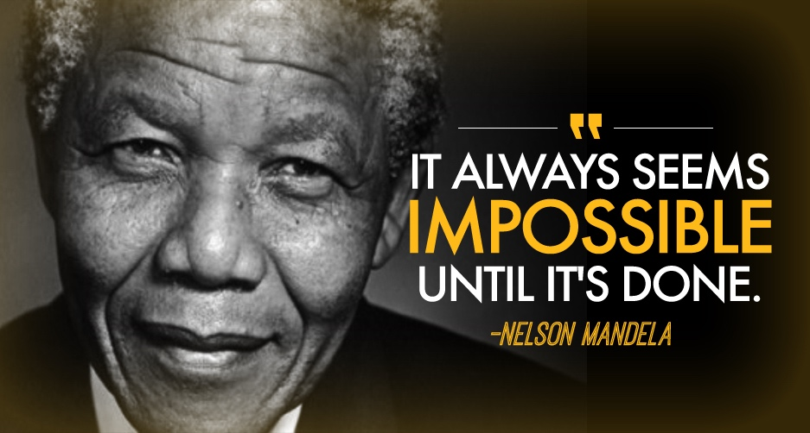

“There is No Health Without
Good Oral Health”
Steffany Chamut, DDS, MPH, FICD
Associate Professor, PNWU School of Dental Medicine
Director of Research and Scholarly Activity
Affiliate Faculty, Harvard T.H. Chan School of Public Health,
schamut@pnwu.edu
Follow me: Steffany Chamut
Notes:
Thank you so much for your time and attention. I’d be happy to take any questions.”
------
“I welcome your questions, and I’m happy to elaborate on any part of the presentation — whether related to curriculum, rural rotations, HRSA experience, research, faculty development, community partnerships, or my vision for how we can build something transformative here at PNWU.”
“There is no health without oral health”—especially for older adults navigating the challenges of dementia.
Through programs like this, we’re helping providers deliver care that’s truly integrated, compassionate, and impactful.
A. Vision & Fit Questions
1. “Why do you want to join PNWU?”
Your Answer (verbatim-ready):
“I’m drawn to PNWU because its mission exactly aligns with the trajectory of my career — improving health outcomes for rural and medically underserved communities through culturally respectful, interprofessional, and community-centered care.
What stands out to me about PNWU is that its model is intentionally designed around workforce development, preventative education, and service to the region. Those are the values that have shaped every stage of my work — from HRSA to Harvard, from Rwanda to Washington’s community health centers.”
Professor-track pivot:
End with:
“…and I see myself contributing not just as a faculty member but as someone who can build programs, expand partnerships, and elevate PNWU’s national presence.”
2. “What is your long-term vision for your role here?”
Answer:
“My long-term vision is to build a center of excellence in community and geriatric oral health that integrates research, interprofessional education, and community partnerships across Washington.
I want PNWU to become a national leader in rural oral health training — the same way Rwanda became a global model for health workforce reform.
With the right framework, this school can train students who not only practice dentistry, but also shape the systems they work within.”
Professor-track pivot:
“…and professor-track would allow me to lead sustained program development and scholarship that strengthens the school over time.”
B. Teaching Questions
3. “How do you approach teaching?”
Answer:
“My teaching philosophy is active, culturally responsive, and equity-driven.
I design learning experiences that build critical thinking, reflect real community needs, and prepare students for interprofessional practice in resource-limited settings.”
Professor-track pivot:
Emphasize your ability to design curriculum, not just teach it.
4. “What courses could you teach immediately?”
Answer:
Community dentistry
Geriatric dentistry
Prevention / population health
Oral-systemic health
Cultural competence / CLEARH
IPE coursework
Evidence-based dentistry
Practice management in underserved settings
Bonus:
Add:
“And I am prepared to develop new courses aligned with HRSA and NIH priorities.”
C. Research & Scholarship Questions
5. “What is your research agenda over the next 5 years?”
Answer:
“My research will continue advancing three complementary areas:
Oral health and aging, including cognitive decline
Rural workforce development
Culturally grounded oral health prevention
These priorities directly match Washington’s needs and PNWU’s mission.”
Professor-track pivot:
End with:
“I am committed to producing peer-reviewed publications and engaging students in scholarly work that strengthens PNWU’s academic reputation.”
6. “How will you involve students in research?”
Answer:
“By integrating research questions into community rotations, case-based learning, and interprofessional projects.
Students can easily contribute to data collection, quality-improvement cycles, and population health analysis.”
D. Community & Rural Focus Questions
7. “What is your experience in rural health?”
Answer:
“I’ve worked with multiple HRSA-funded community health partners in Washington — including SeaMar, Yakima Neighborhood Health Services, and Yakima Valley Farm Workers Clinic.
I understand rural demographics, oral health disparities, agricultural worker needs, and the systemic barriers to care.
I’ve also worked in low-resource environments globally, which further prepares me for rural U.S. contexts.”
8. “How will you build partnerships with community clinics?”
Answer:
“I already have foundational relationships in Washington from my HRSA work and previous collaboration with Dr. Mark Koday.
At PNWU, I would build structured agreements for rural rotations, interprofessional experiences, and shared faculty development.”
E. Leadership Questions
9. “How do you lead teams?”
Answer:
“My leadership style is collaborative, mission-driven, and systems-focused.
I bring people together, align goals, and build sustainable structures — whether in Rwanda’s HRH Program, at HRSA, or in my NIH interdisciplinary teams.”
10. “Why professor-track, not associate?”
Answer:
“Because my strengths lie in building programs, contributing scholarship, expanding partnerships, and leading interdisciplinary initiatives.
I’m not just interested in participating in PNWU’s development — I want to shape it.
Professor-track aligns with the scope and trajectory of my work.”
2. HOW TO TURN EVERY ANSWER INTO A PROFESSOR-TRACK ANSWER
Regardless of the question, always end with one of these pivots:
“This is why I’m prepared to contribute at a strategic, program-building level.”
“I want to help PNWU develop a national identity in rural oral health.”
“My goal is to strengthen the school’s long-term infrastructure — teaching, research, and community partnerships.”
“Professor-track provides the continuity needed to build sustainable programs.”
3. RED-FLAG QUESTIONS & HOW TO REFRAME
A. Weaknesses
Say:
“One area I am intentionally developing is…”
Make it about growth, not deficit.
B. Conflict or Difficult colleague
Reframe to:
“I focus on alignment, communication, and shared mission.”
C. Why did you leave your last institution?
Use a neutral, professional framing:
“I’m looking for an institution whose mission and values align with my commitment to rural and underserved communities — and PNWU represents that alignment.”
4. YOUR STRENGTHS NARRATIVE (REPEAT THESE THEMES)
These 7 themes define your brand:
Global → Federal → Academic Continuity
Washington-specific HRSA + Yakima connections
Geriatric & Rural oral health expertise
Interprofessional teaching excellence
Equity & cultural literacy leadership
Program-building and curriculum development
NIH-funded innovative research
Every answer should touch one or two of these.

