Slide 1
DASH-ing into programmatic assessment at the Melbourne Dental School
Clare McNally, Suhrid Gupta, Kunal Patel, Katherine Reid
CRICOS

Slide 2

Acknowledgement of Country

Slide 3
Background
The Melbourne Dental School (MDS) is implementing a program wide approach to assessment.
This long-term program of change was initiated largely due to disparate clinical assessment methods across dental disciplines, thereby increasing the cognitive load for students who had to interpret the different methods, and make their own connections regarding progress in each discipline.
I am presenting on behalf of my team – there is a lot of technical language – so if I can’t answer your question, please reach out and I will connect you directly with my colleagues.
Notes:
Started by trying to align and centralise our assessment data so we could implement the same/ or a similar assessment method across all assessment types. This would reduce cognitive load and start to allow for longitudinal and programmatic analysis
Applied to get risr – denied. Could not afford, or school would not invest in third-party program. Medical school were using risr but it was not available to the whole university.
Set up our assessment program in Qualtrics and broke it – it slowed down to the point where it took up to 5 minutes to download the results. At the same time we supervised a Master of Data Science student group who identified alarming issues with our assessments that were impacting student outcomes – in particular was the impact supervisors were having on student grades. We needed to get into the weeds, get more data and build our assessment program from the ground up.
What we didn’t have or perhaps make time for was the design of our assessment blueprint. This is for all sorts of reasons, but not having that blueprint is now putting our whole assessment program at risk. I will explain this further at the end of the presentation.

Slide 4
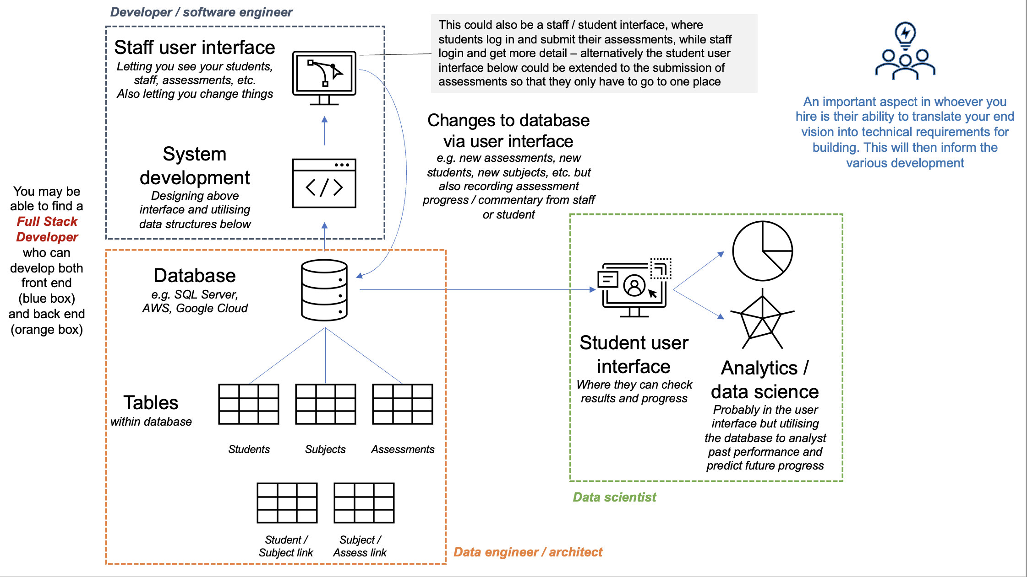
Identifying the solution?
Notes:
Identifying a FSD
Kunal our data analyst identified that we needed to use a Server – to host our own database to have our front and back end - platform

Slide 5
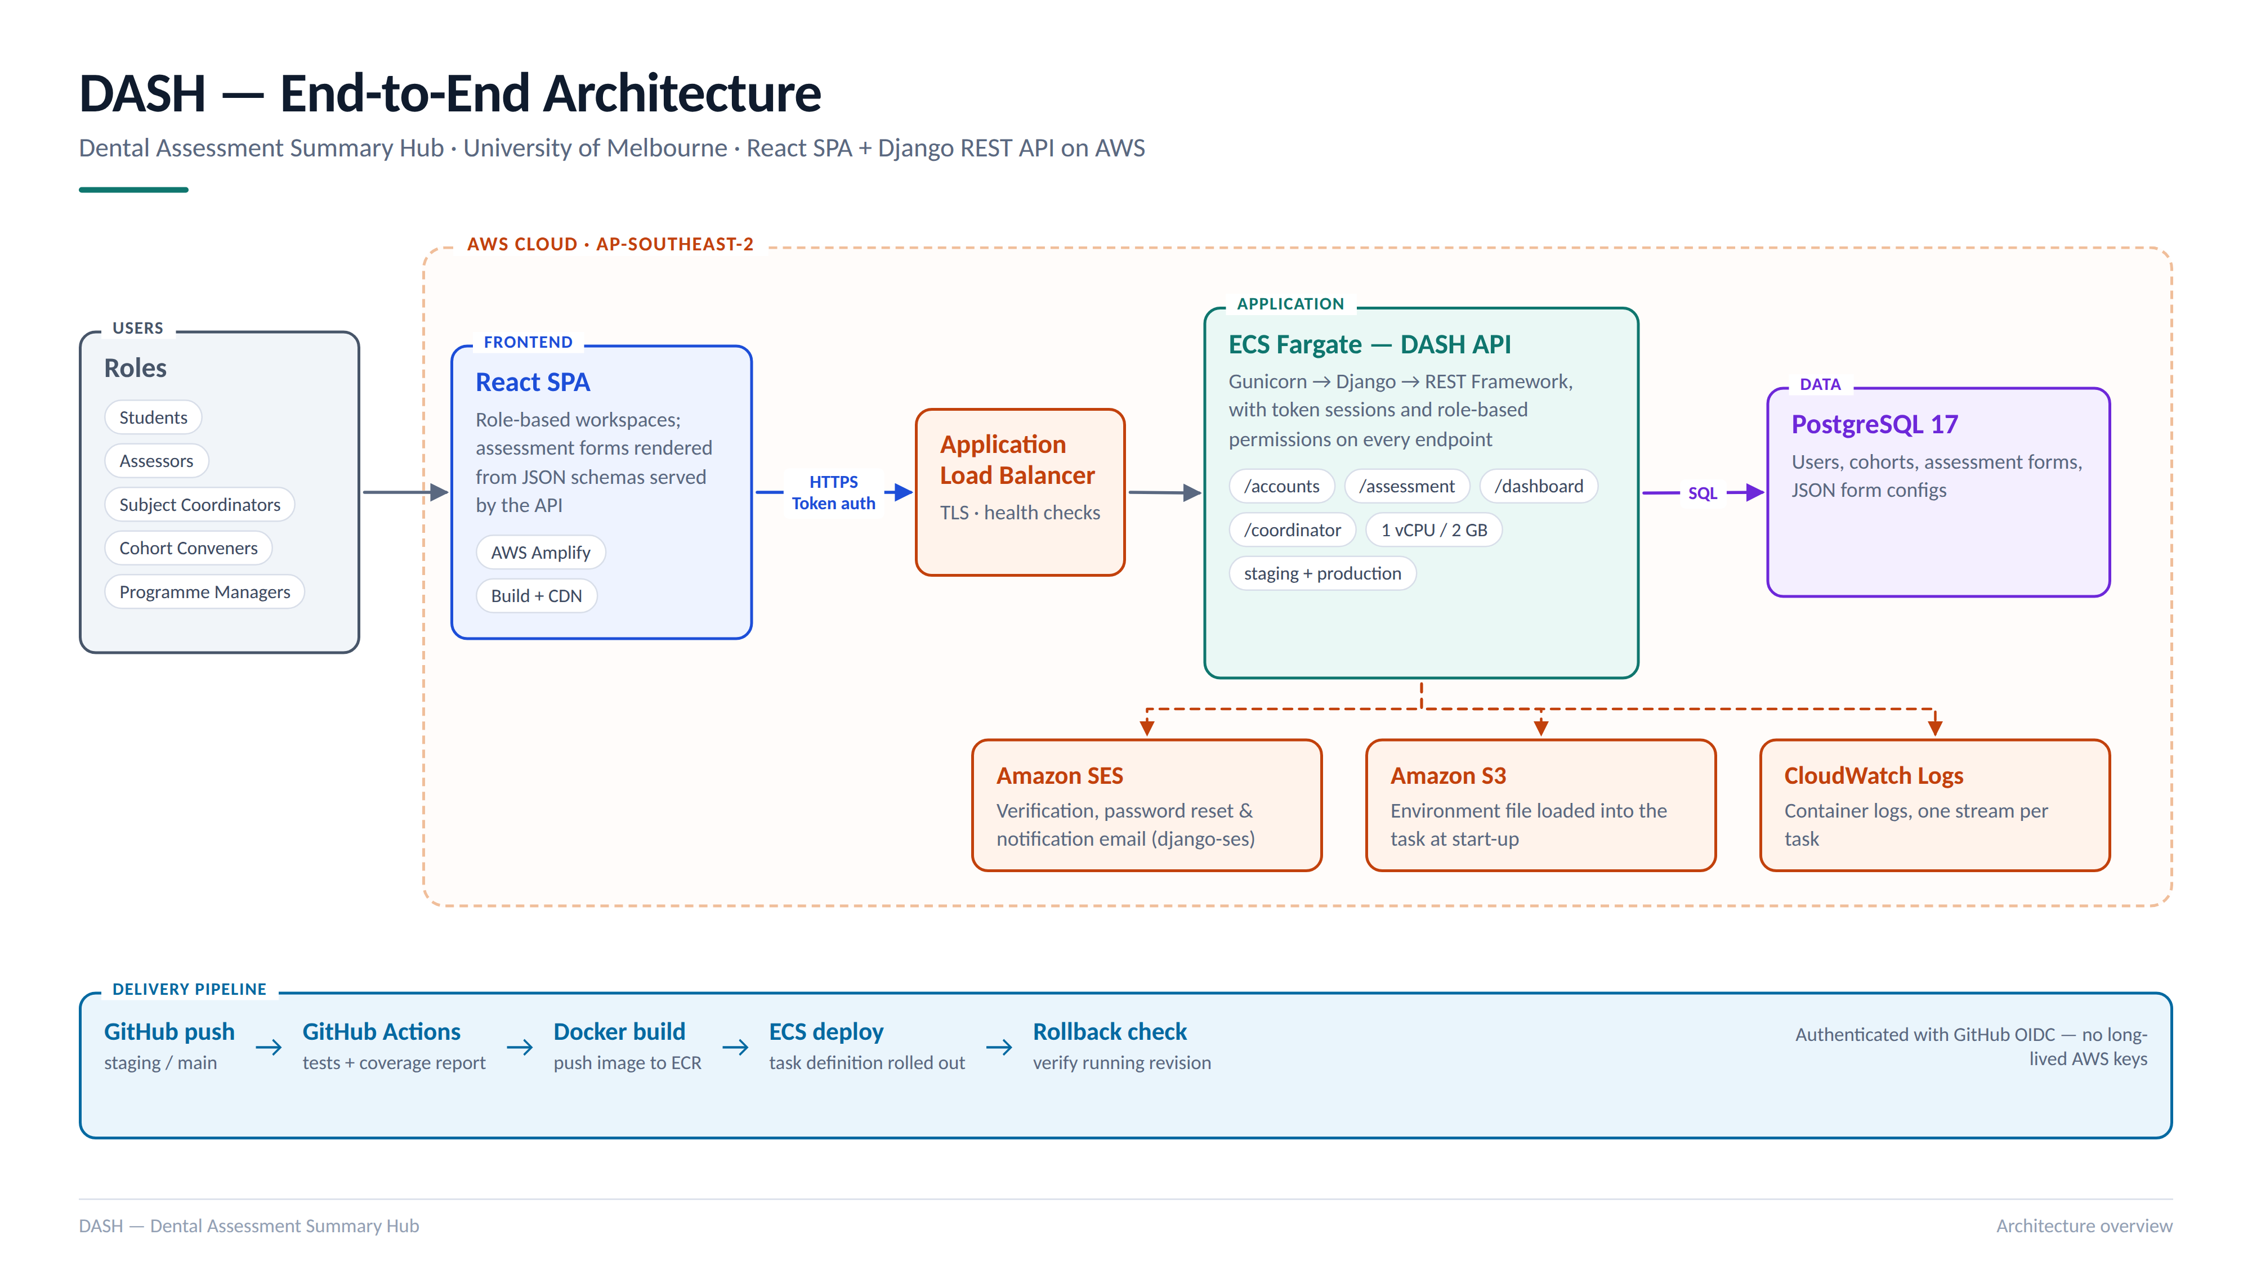
DASH Architecture - technical

Slide 6
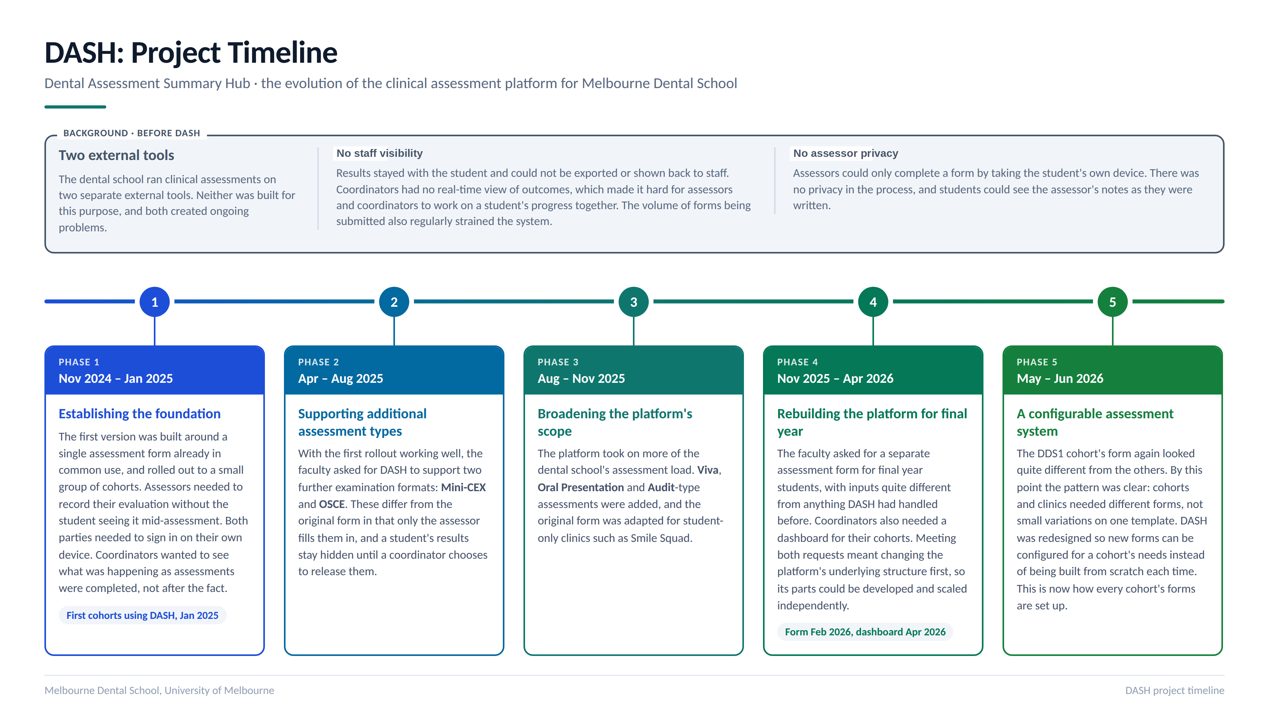
Development Timeline

Slide 7
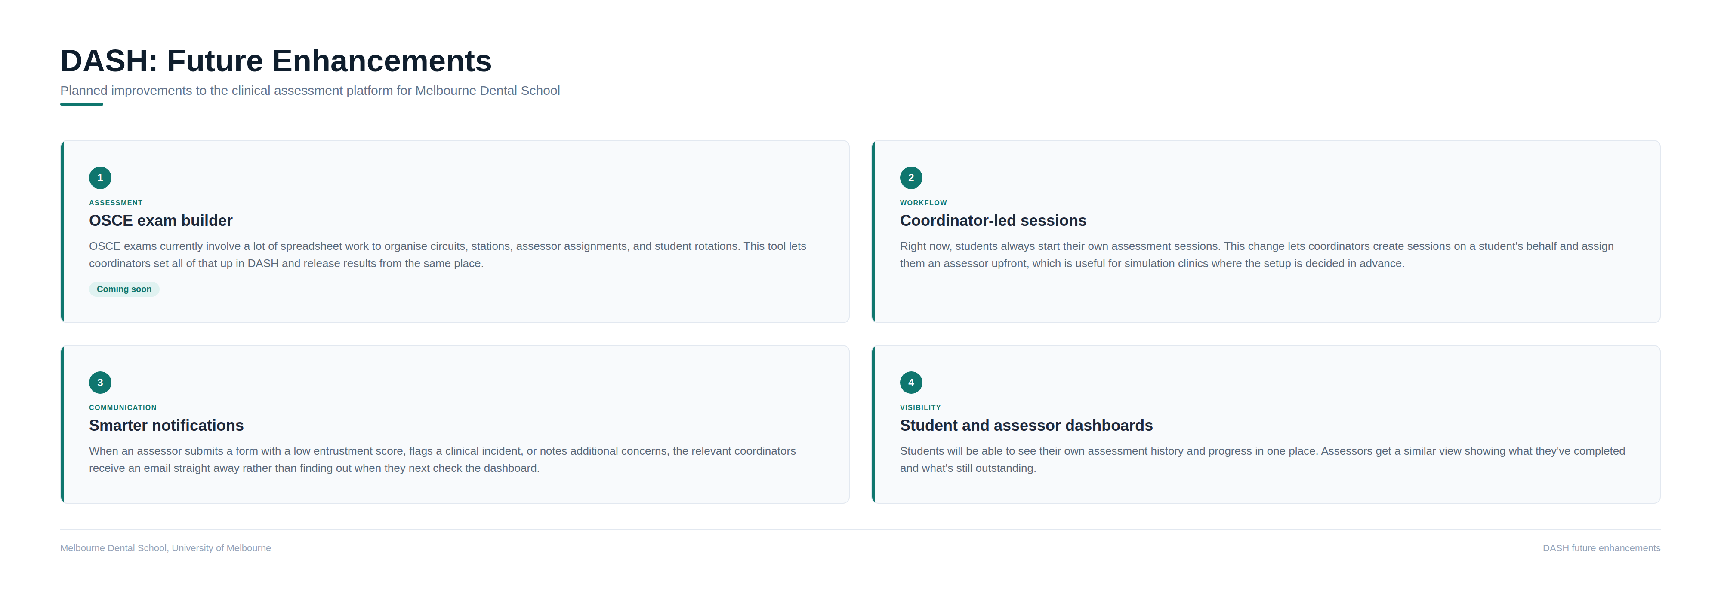
Future Enhance

Slide 8
Methods for data reporting
DASH API → Python ingestion → PostgreSQL (JSONB forms + relational student/subject tables)
Deduplication on assessmentId, upsert logic, COALESCE handling for legacy/renamed form keys
SQL views per subject/cohort, generated dynamically so a new subject doesn't need new code
Derived layer: item-number frequencies, operator/assistant counts, FTA/CA, entrustment scores, assessor-level aggregates
Outputs: automated Excel cohort reports (formula-driven, at-risk flagging) + ReportLab/Matplotlib PDF summaries

Slide 9
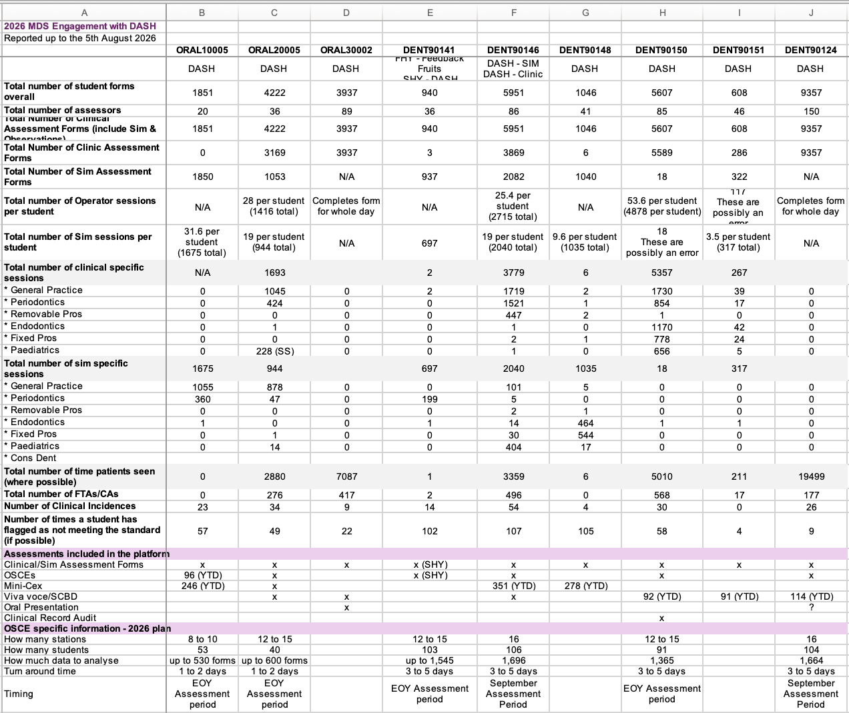
YTD – over 33,000 assessment interactions recorded.
Approx 20,000 more forms to collect this year
Program & roles no longer supported by the school
Commercialization process to try to get University support to adopt the program across other schools
Notes:
Discuss what is happening now

Slide 10
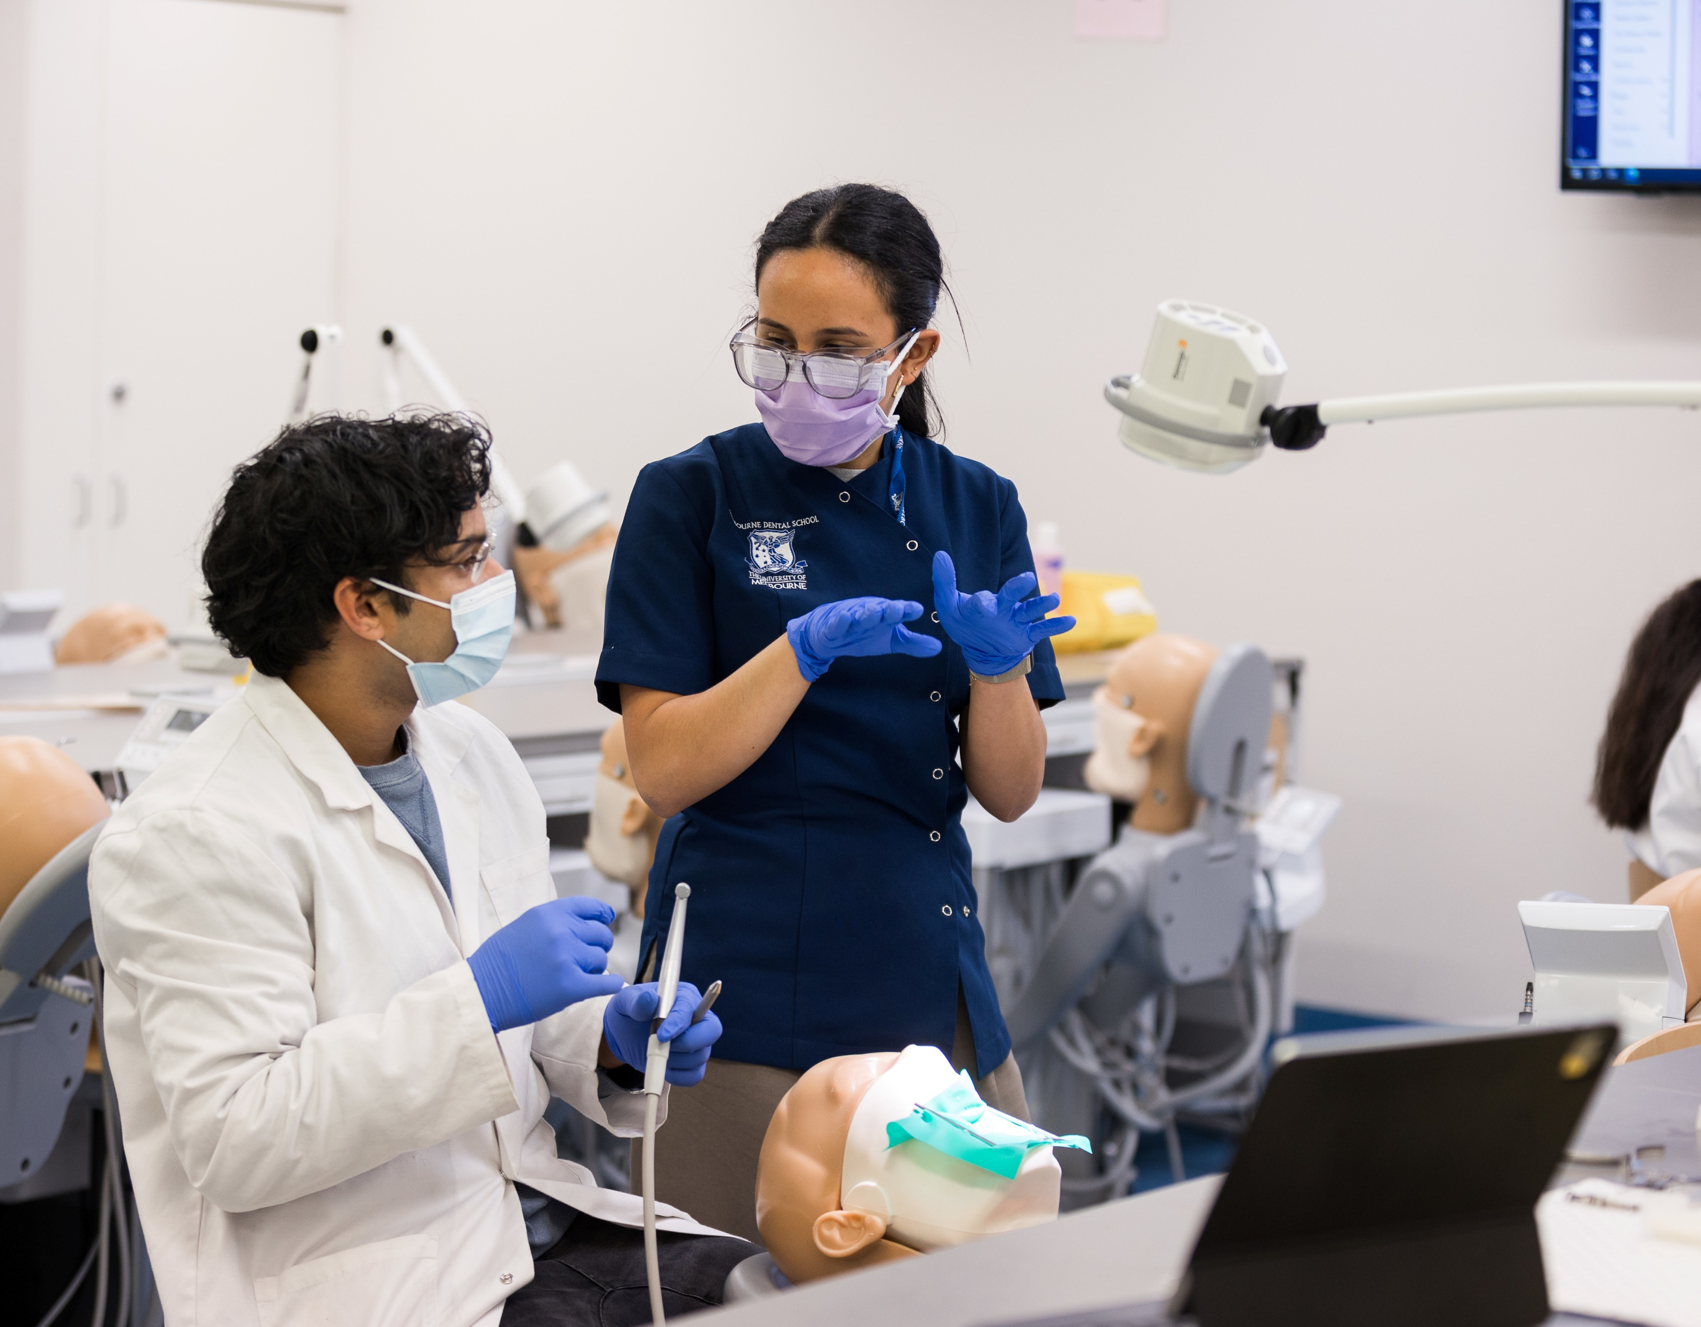

Thank you for being part of this session and a big thank you to my colleagues for being prepared to work to improve the student experience.
Please reach out, especially if you would like to discuss the process with Kunal & Suhrid

