Slide 1
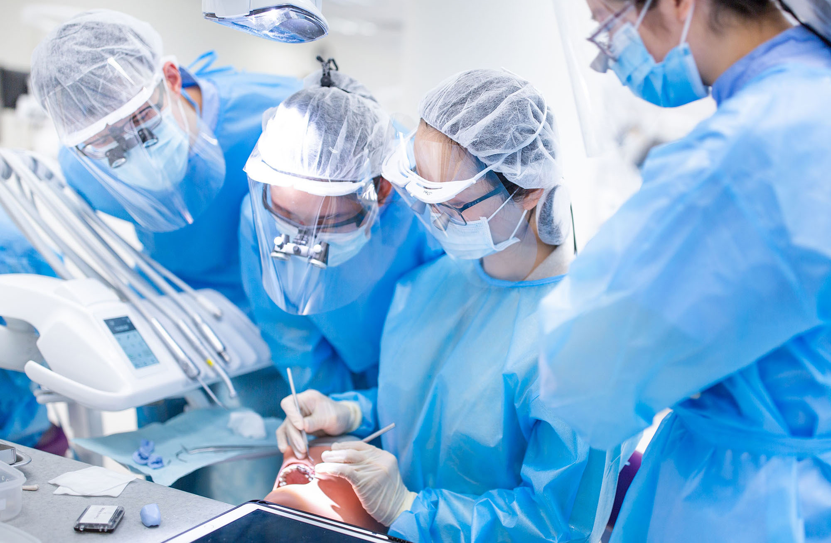




Flipped class and learning through assessment in simulation
skills in prosthodontics
1 / 9
Michael Botelho and Dr Samantha Li
University of Hong Kong

Slide 2
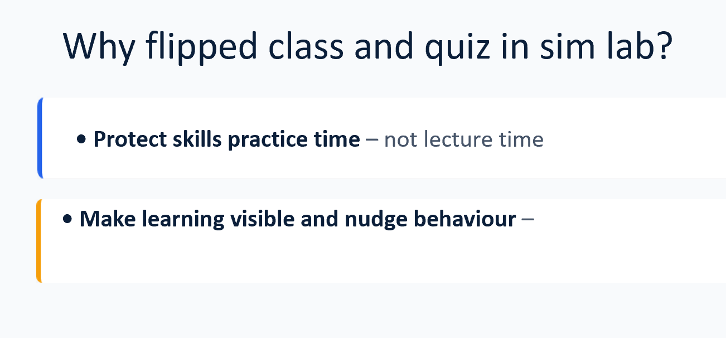
Flipped class and learning through assessment in simulation
skills in prosthodontics
1 / 9
Michael Botelho and Dr Samantha Li
University of Hong Kong

Slide 3
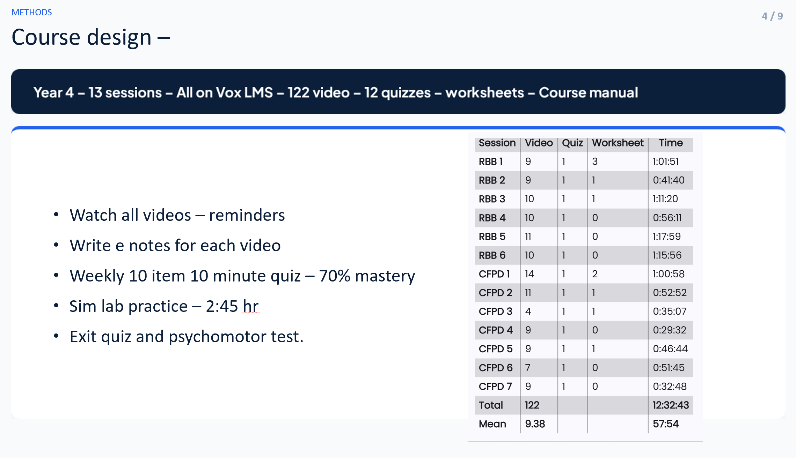
Flipped class and learning through assessment in simulation
skills in prosthodontics
1 / 9
Michael Botelho and Dr Samantha Li
University of Hong Kong

Slide 4
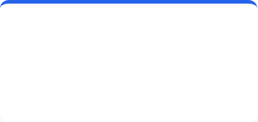
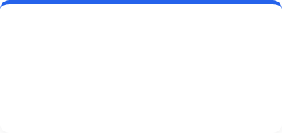

RESULTS: ENGAGEMENT
6 / 9
High uptake of preparatory activities (n=89 students) HREC ethics
>90%
80–90%
100%
Video engagement
E-note submission
Quiz mastery
across the course
of students
eventually met 70% threshold

Slide 5
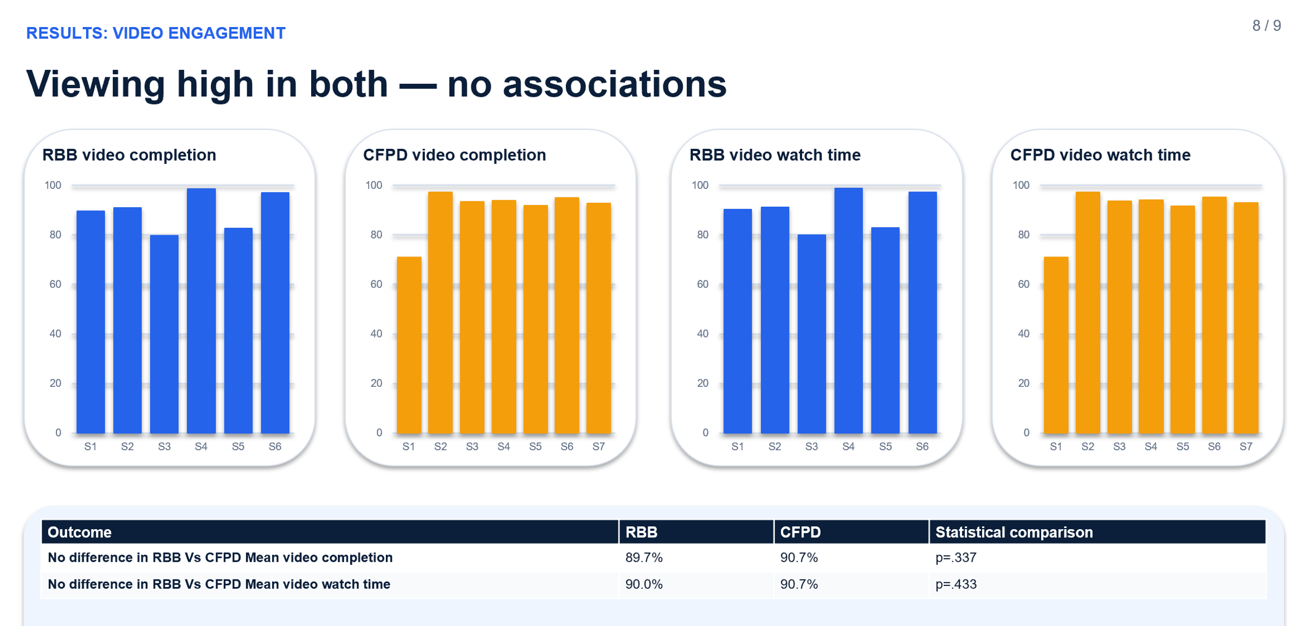
RESULTS: ENGAGEMENT
6 / 9
High uptake of preparatory activities (n=89 students)
>90%
80–90%
100%
Video engagement
E-note submission
Quiz mastery
across the course
of students
eventually met 70% threshold

Slide 6
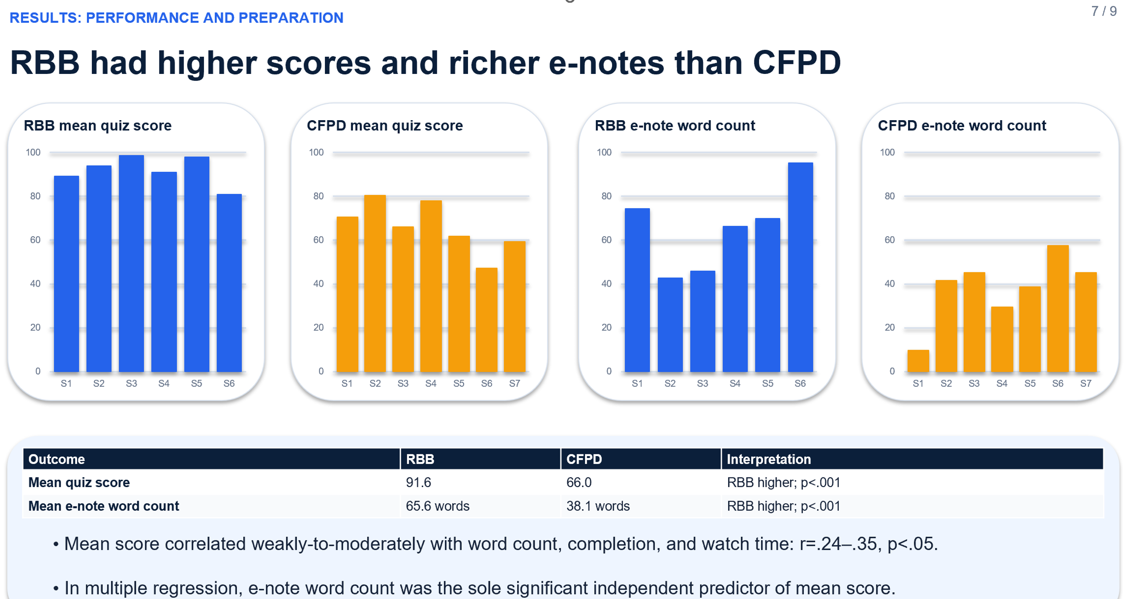
RESULTS: ENGAGEMENT
6 / 9
High uptake of preparatory activities (n=89 students)
>90%
80–90%
100%
Video engagement
E-note submission
Quiz mastery
across the course
of students
eventually met 70% threshold

Slide 7

RESULTS AND DISCUSSION
9 / 9
Conclusion and next steps
Flipped delivery protected simulation time
E-notes engagement was associated with quiz outcome.
Mastery quizzes stimulated engagement and feedback.
Analytics and feedback made learning visible.
Qualitative follow will be performed.

