Slide 1
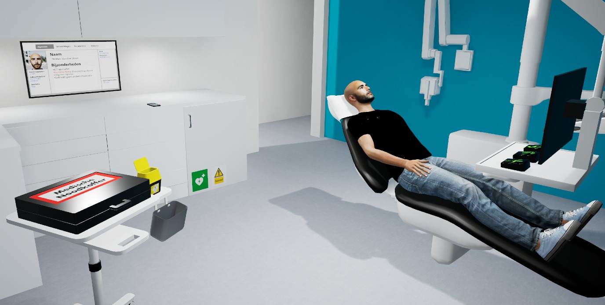
DentEmergencyVR
An immersive VR virtual reality training tool to train acute medical situations in the dental chair

Slide 2
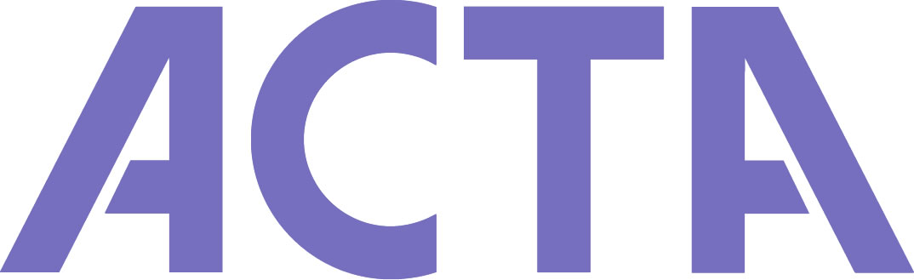
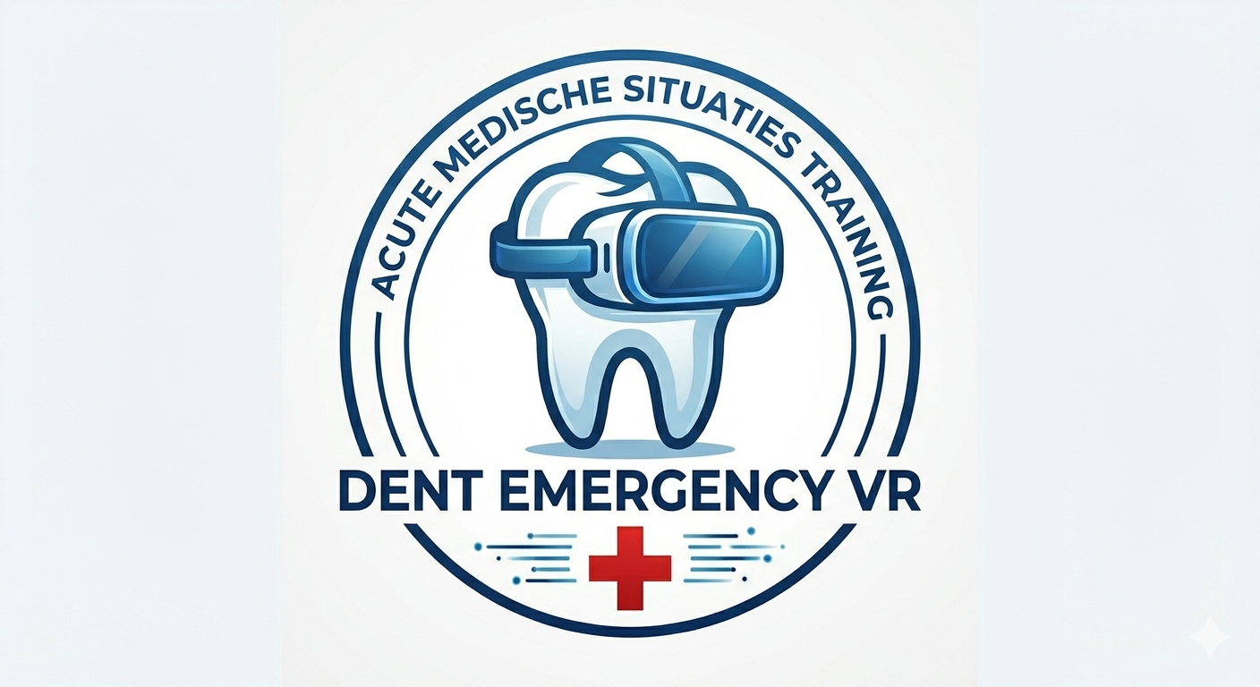

Academic Center for Dentistry Amsterdam (ACTA)
Denise van Diermen, M.D., PhD, associate professor
Tim van Amstel, M.D.
Marije Petersen, M.D., MSc in Dentistry, PhD
Kelsey Martina, M.D.
Center for Information Technology, RUG
Pjotr Svetachov, Bart Campman, Gert-Jan Verheij
Dental Faculty at UMCG
Henri Lohr, MSc in Dentistry, educational director

Slide 3
Reason and background
People get older and more medically complex
People keep their own teeth until in old age
Medically complex patients visit the dentist more often for invasive procedures
Acute medical emergencies occur more frequently in the dental office
Dentists should be able to manage this

Slide 4
Current training of dental students at ACTA
Theoretic courses in year 2 and 3 on medical diseases and implications for the dental treatment
Practical course in year 4
Training in blood pressure measurement, medication presciption, management of acute medical situations
Exam: LOTUS actor plays a scenario, students have to solve it
Feedback of students: very instructive course but stressfull to do the LOTUS exam. Need for more opportunities to practice.

Slide 5
Start of the project
2020: ABCDEsim
2021: Comenius Teaching Fellow subsidy awarded
2022/2023: mismatch
2023: tried to return the money to NRO
2024: money but no plan…. VU Education day: VR session… New Idea… roundtrip through the Netherlands …..CIT Groningen: match!
2025: development of scenario’s with CIT & dental faculty in Groningen en Nijmegen
July 2025: first version ready
October 2025: first try-outs with students in the 4th year course at ACTA
May 2026: pilot study on the effectiveness of the VR training versus traditional training

Slide 6
Now available
Virtual dental clinic in VR
Avatar patient, student in dentist role
Possibilities:
Avatar is steerable to faint, get hypoglycemic, get an allergic reaction or an asthma attack
Avatar can speak and react to the student
Student can apply medical tools, such as a bloodpressure device, an oximeter, a glucose meter
Student can apply medication and oxygen
Student can call 112 and ask for an ambulance
Ambulance employee can enter, so the student can perform a medical handover

Slide 7
Evaluation of the pilot phase
7 groups of 20 students (n=140) experienced the VR tool actively or passively
In each group 3-4 students actually put on the headset and played a scenario (n= 21)
Questionnaire after use of DentEmergencyVR in oktober 2025
Response rate: 85/140 (60%)
Players (n=21)
How realistic is the VR experience?
7.7 on scale of 10
Was it exciting to play the scenario?
YES: 13/21
Was it exciting that other students watched you play?
YES: 7/21
Side effects of VR?
YES: 7/21, a bit dizzy, light headache
Watchers (n=64)
How much did you learn from watching?
7.9 on scale of 10
How much did you learn from giving feedback to the player?
7.4 on scale of 10

Slide 8
Quotes
“The VR experience really prepares you for the LOTUS exam”
“The VR experience is a realistic example”
“I could feel the stress of the emergency situation”

Slide 9
May 2026: pilot randomized controlled study
15 volonteer students from year 3
1 hour theory lesson on hypoglycemia
Random assignment into two groups: VR or traditional training
Next day: 20 minutes training
Immediately thereafter: LOTUS exam
We assessed competency, self-reported competence and confidence levels
Results are being analysed now

Slide 10
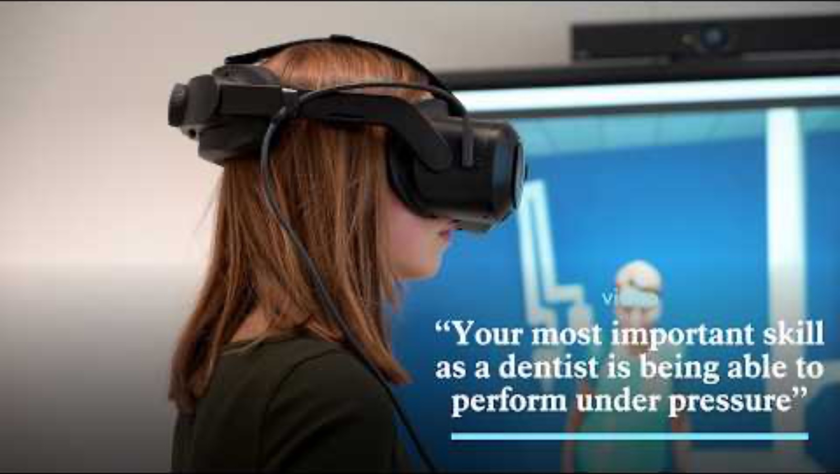

Slide 11
Plans for the future
Expand the possible scenario’s with heart attack, stroke and epilepsy
Disseminate the DentEmergencyVR to the two other dental schools and schools for Dental Hygiene in the Netherlands
Research the effects of the use of the VR tool on competency and confidence in all our 4th year dental students
Investigate the possibilities of implementing AI and a stand-alone version in this tool

