Slide 1
Teacher-controlled, AI marking of assessment for learning
Prof Michael G Botelho and Prof John Adeoye

Slide 2
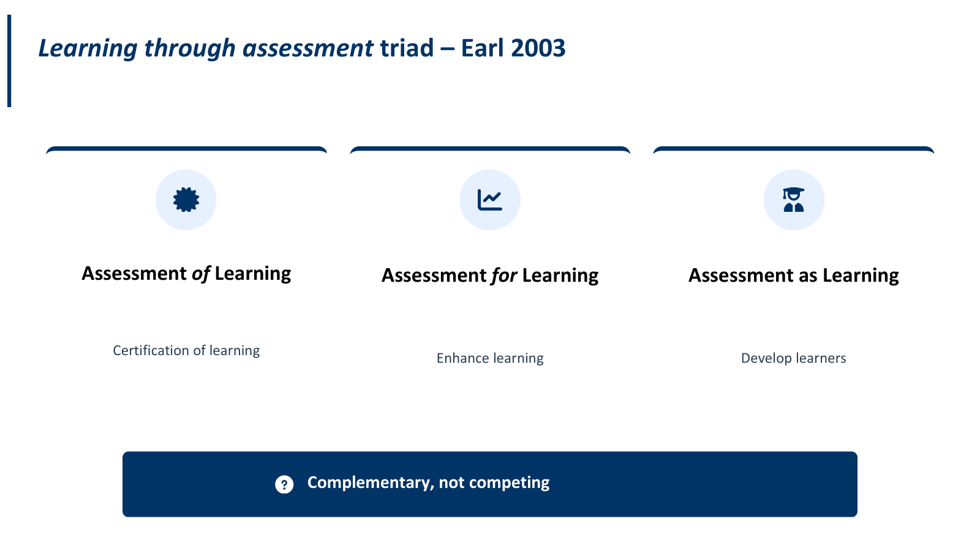
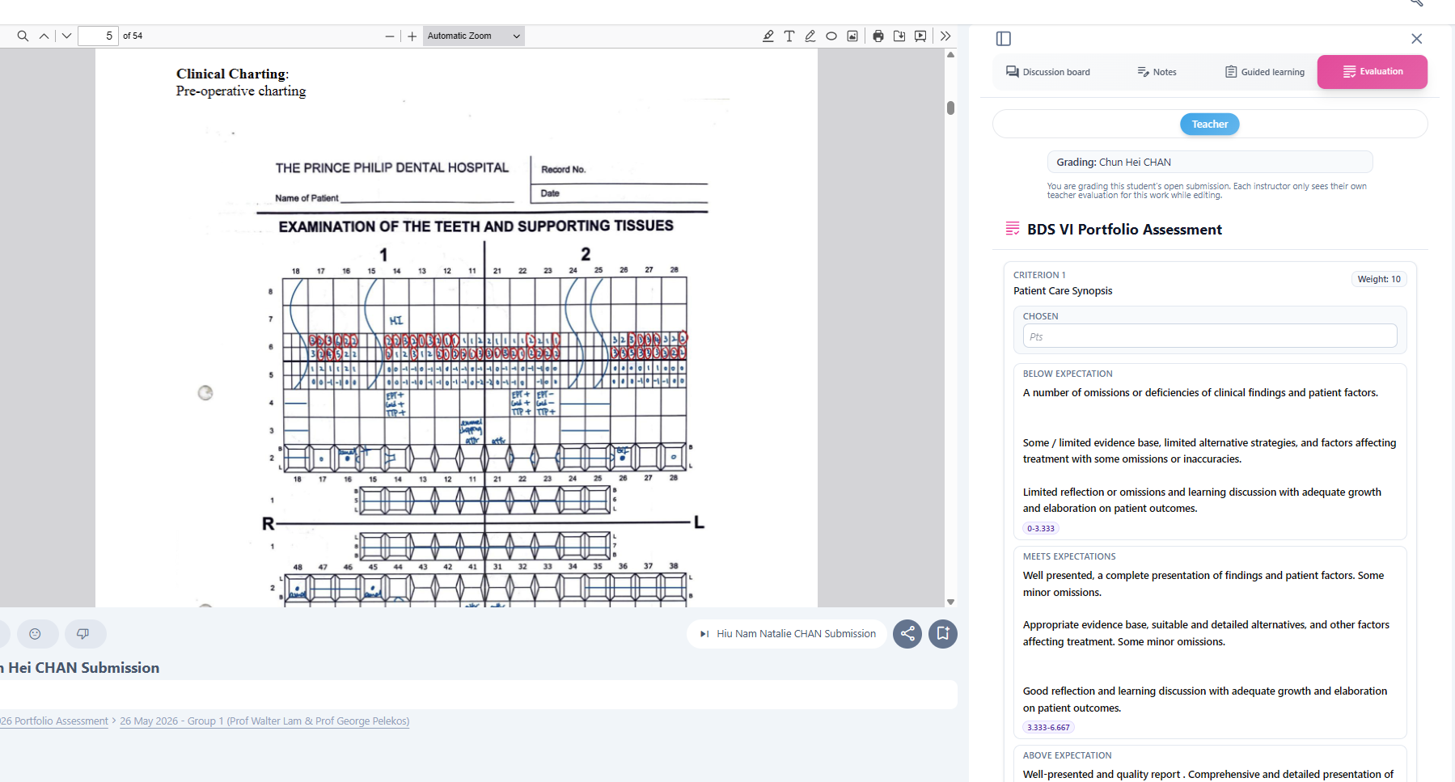
Vox 2.0 (vox.hku.hk) - Feedback
Self, peer, teacher evaluation

Slide 3
Vox 2.0 (vox.hku.hk) - Feedback
Informative assessment ​
Self, peer, teacher evaluation

Slide 4






Dory et al (2023), Kusurkar et al (2023), Schellekens et al (2023)
Impact of assessment for learning
Encourage targeted knowledge retrieval
Personalized feedback to support individual learning needs
Improve learner confidence and achievements
Higher intrinsic motivation
Assist in dynamic learning adjustments

Slide 5



Flipped class
PRE CLASS
Pre-class learning and MCQs
Identify misconceptions / gaps
Plan in-class remediation activities
IN CLASS
AFTER CLASS

Slide 6
Flipped class
PRE CLASS
Pre-class learning and MCQs
Identify misconceptions / gaps
Plan in-class remediation activities
IN CLASS
AFTER CLASS

Slide 7
AI in flipped class – delayed or immediate?
PRE CLASS
Pre-class learning and MCQs
Identify misconceptions / gaps
Plan in-class remediation activities
IN CLASS
In class assessment with delayed AI grading and feedback
In class assessment with Immediate AI grading and feedback
AFTER CLASS

Slide 8
AI in flipped class – delayed or immediate?
PRE CLASS
Pre-class learning and MCQs
Identify misconceptions / gaps
Plan in-class remediation activities
IN CLASS
In class assessment with delayed AI grading and feedback
In class assessment with Immediate AI grading and feedback
AFTER CLASS

Slide 9
AI in flipped class – delayed or immediate?
PRE CLASS
Pre-class learning and MCQs
Identify misconceptions / gaps
Plan in-class remediation activities
IN CLASS
In class assessment with delayed AI grading and feedback
In class assessment with Immediate AI grading and feedback
AFTER CLASS
Students revise, goal set remediation activities – A as L
Demonstrate evidence of remediation
Teachers plan class feedback

Slide 10






Why you should not use just any AI chatbot for SAQ grading!
General-purpose AI chatbots can hallucinate!
Risky if used alone
for marking
Can award grades
with
Calculate the wrong score
Paraphrasing may be difficult to control
Privacy concerns

Slide 11

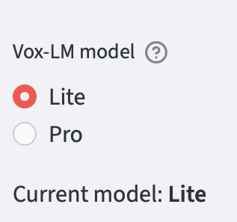
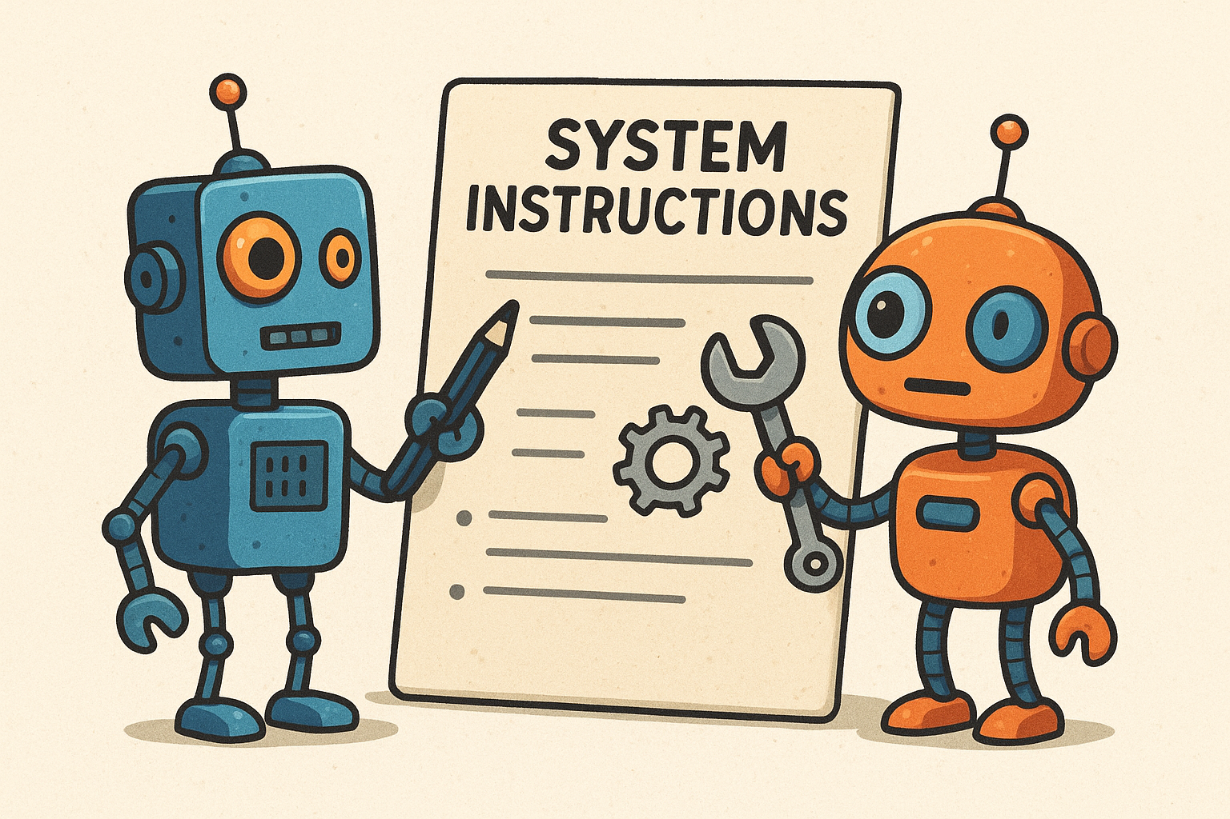
Our Solution: AI grading on Vox 3.0 for SAQs
AI-based tool for SAQ grading and summarization of performance
Grades based on rubrics, model answers, and exemplars provided by teachers
One of the best open-source AI model series
Vision-language model
Open-source models for better data security and privacy
Instruction-tuned models
8B parameter
(Lite)
32B parameter
(Pro)
Prompt-engineered system

Slide 12
Overview – Teacher in control with AI in the loop on Vox 3.0
STEP 1
(Model answer)
STEP 2
(AI restructuring of model answers)
STEP 3
(Sample grading)
STEP 4
(AI grading)
STEP 5
(Human feedback)
Teacher grades samples for few-shot
AI marking
Student-in-control
No
issues
Student can challenge
Teacher creates model answer
AI-restructured
model answers
AI assessment marking
AI re-marking
No sample grading -
Zero-shot
AI marking
Discussion
Teaching team moderate model answers
Teacher-in-the loop
Final grades

Slide 13
Overview – Teacher in control with AI in the loop on Vox 3.0
STEP 1
(Model answer)
STEP 2
(AI restructuring of model answers)
STEP 3
(Sample grading)
STEP 4
(AI grading)
STEP 5
(Teacher feedback)
Teacher grades samples for few-shot
AI marking
Teacher-in-control
Student-in-the-loop
Needs review
Teacher creates model answer
AI-restructured
model answers
AI assessment marking
Student can challenge
No sample grading -
Zero-shot
AI marking
Discussion
Teaching team moderate model answers
Final grades

Slide 14
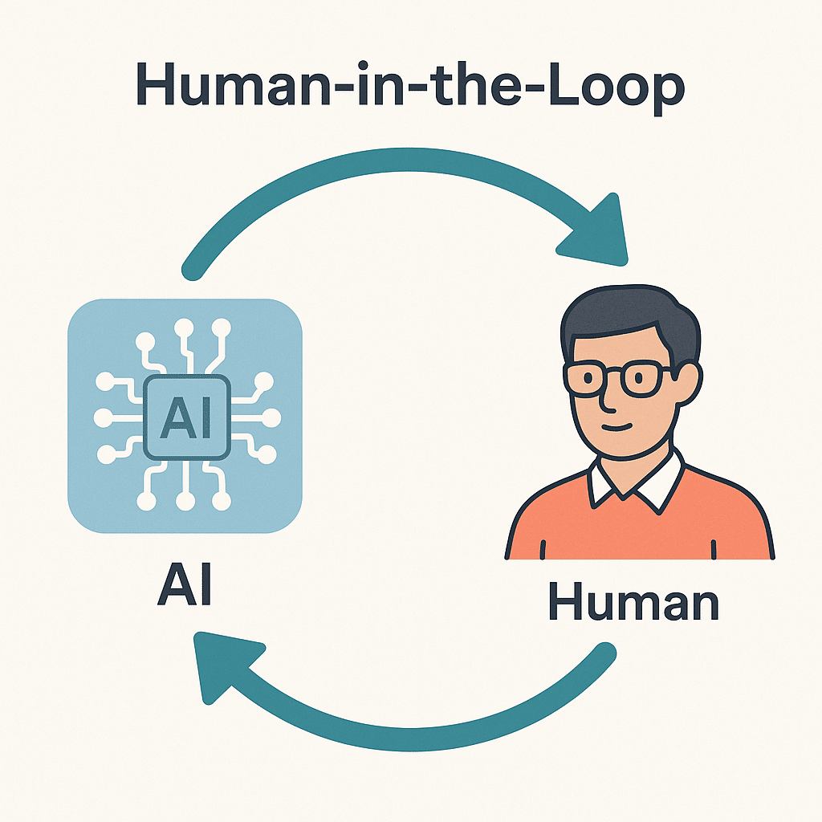
Roles within AI grading workflow
Teacher + AI (Qwen): Co-validate the marking scheme (MS)
AI (Qwen) – Uses calibrated MS to grade (Examiner)
Computational logic – Checks whether marking point is in student answers (Verifier)
Feedback – Calculates scores and personalized feedback
Frontend: Shows scores, feedback, and confidence
Student: Can challenge/argue re-grading for AI to re-mark
Teacher: Confirm, moderate and approve grades
Encourages human in the loop

Slide 15
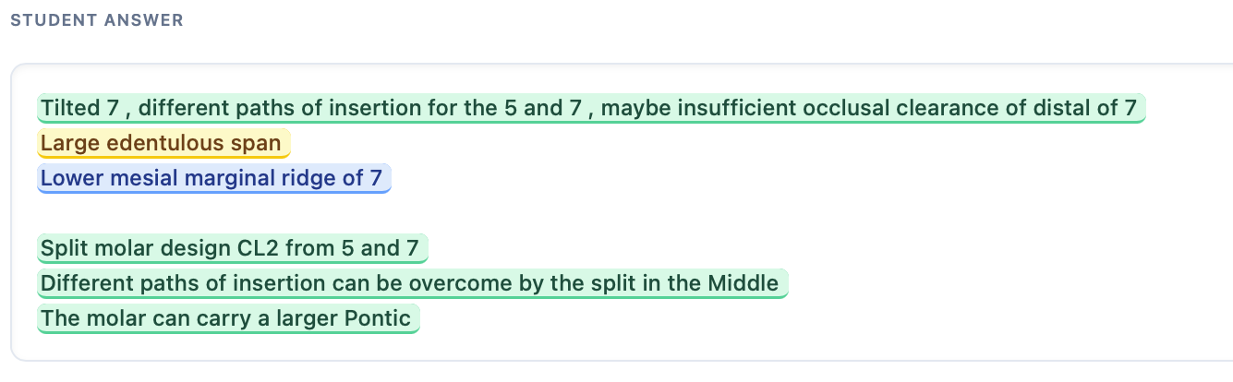
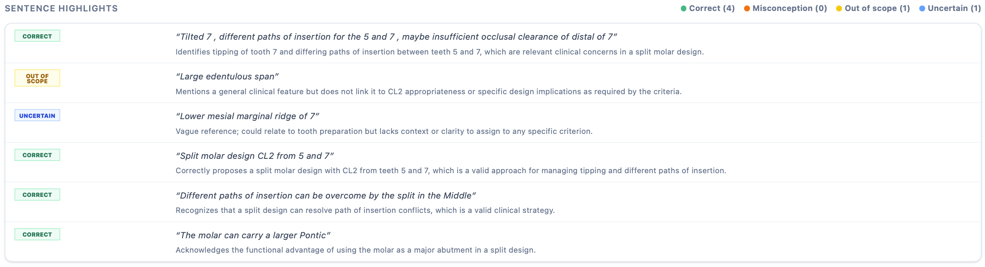
Highlights by AI to code feedback to aid assessment for learning

Slide 16
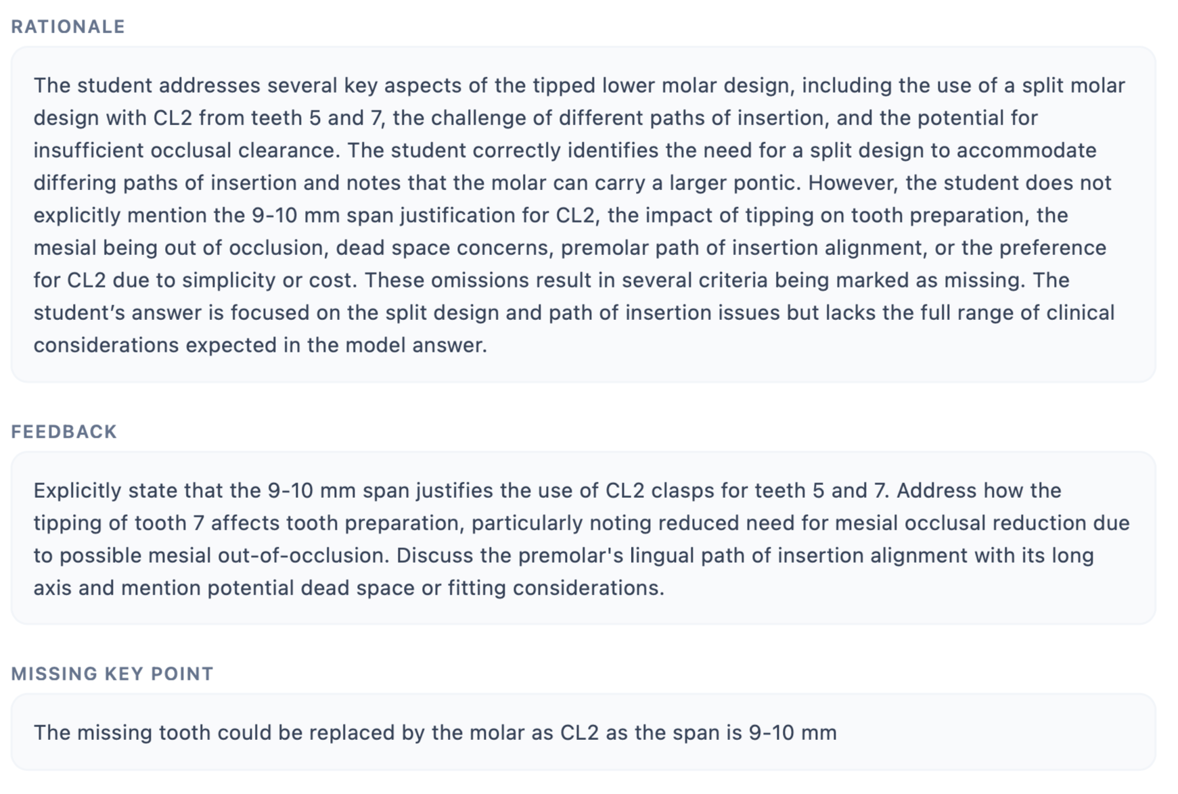
AI grading rationale and personalized feedback

Slide 17
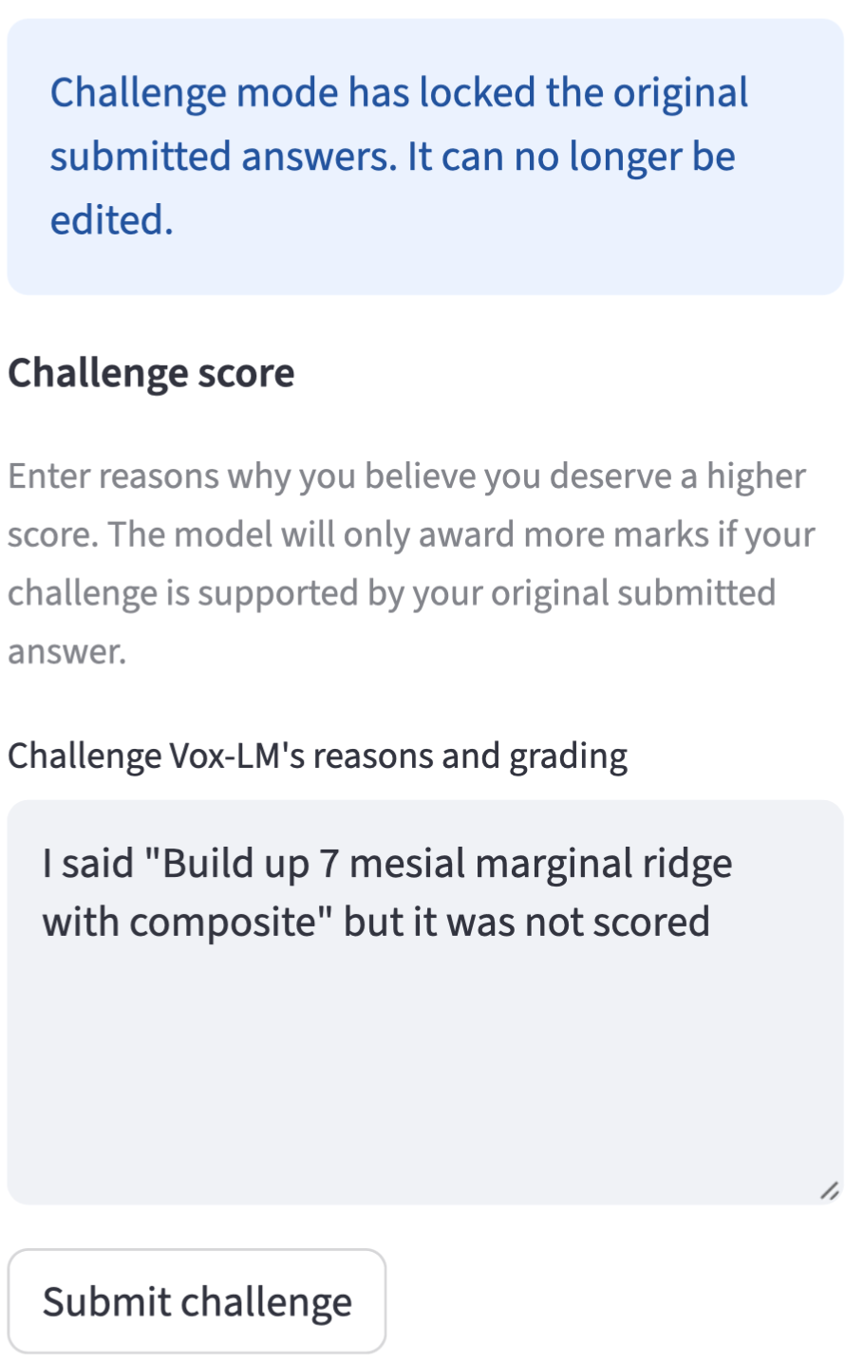
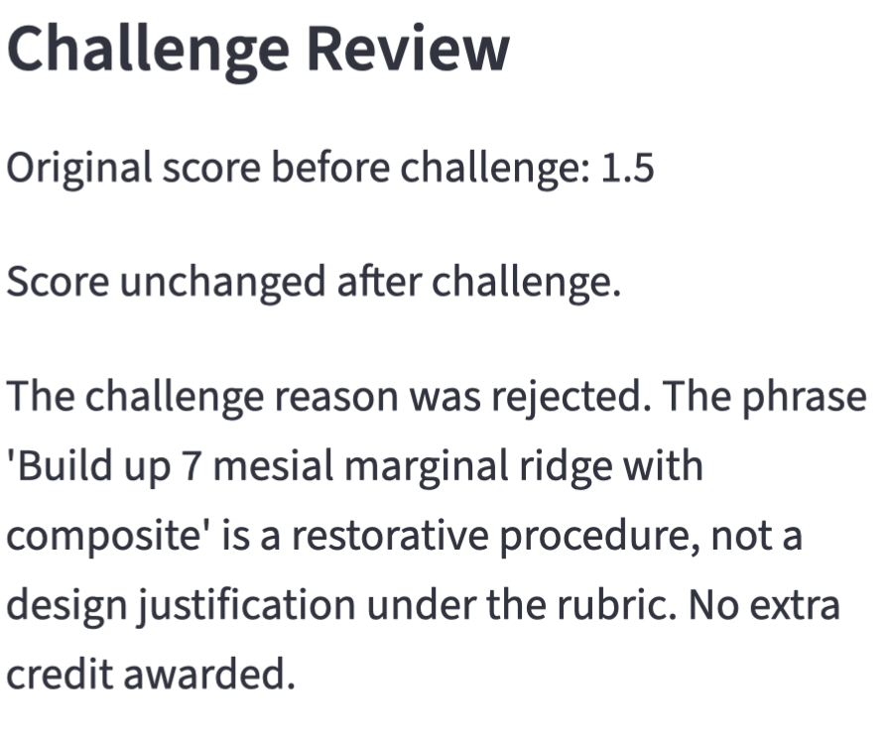
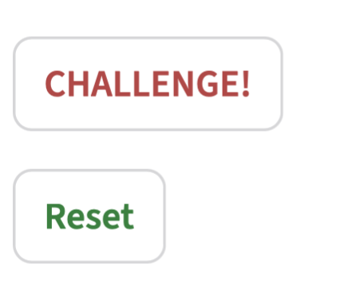
Student-in-the-control challenges
`
`

Slide 18
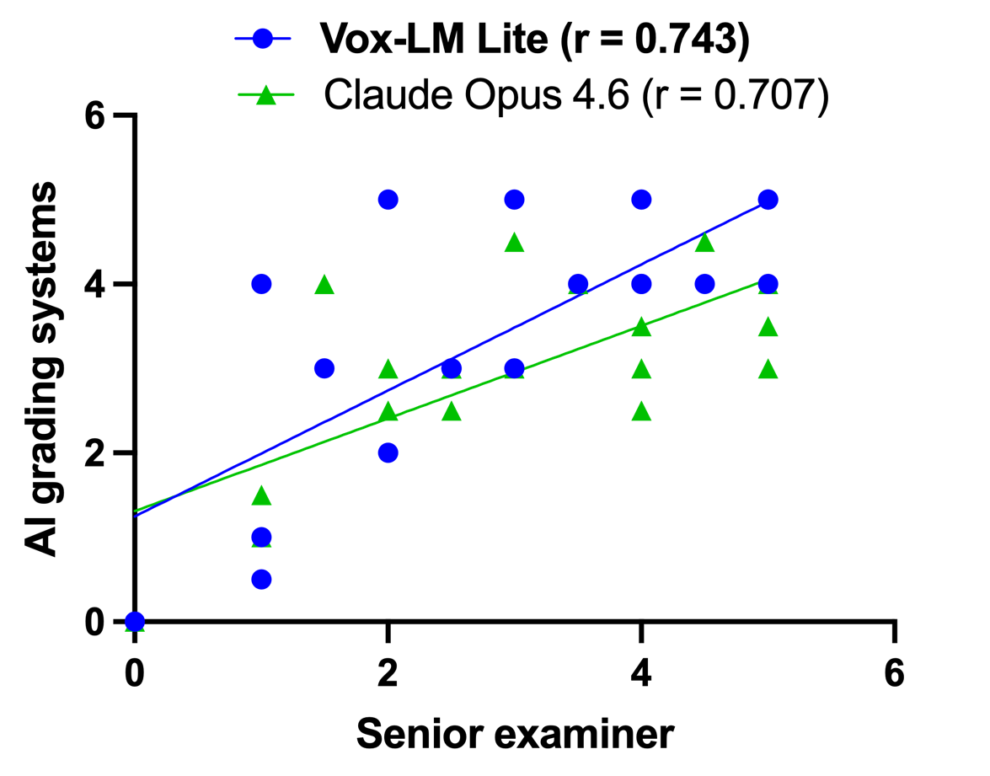
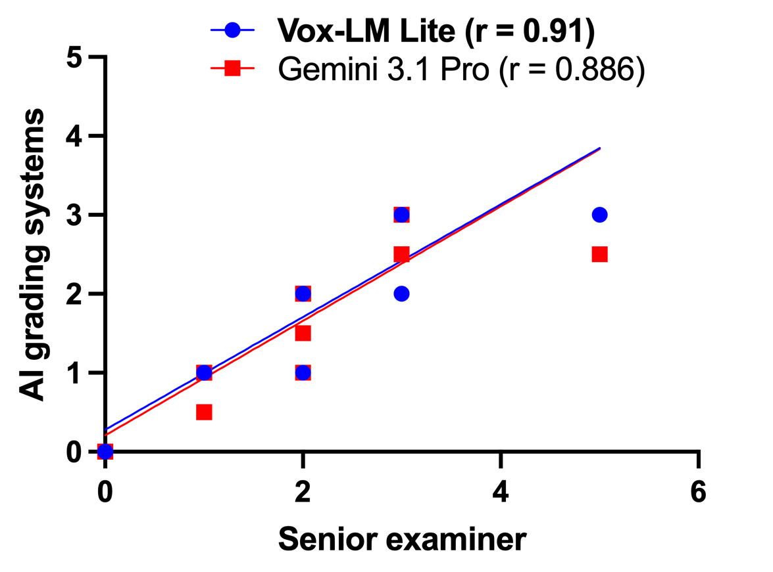
Correlation between zero-shot AI marking and teacher marking
Q 1 – Lower Blooms
Q2 – Lower Blooms

Slide 19
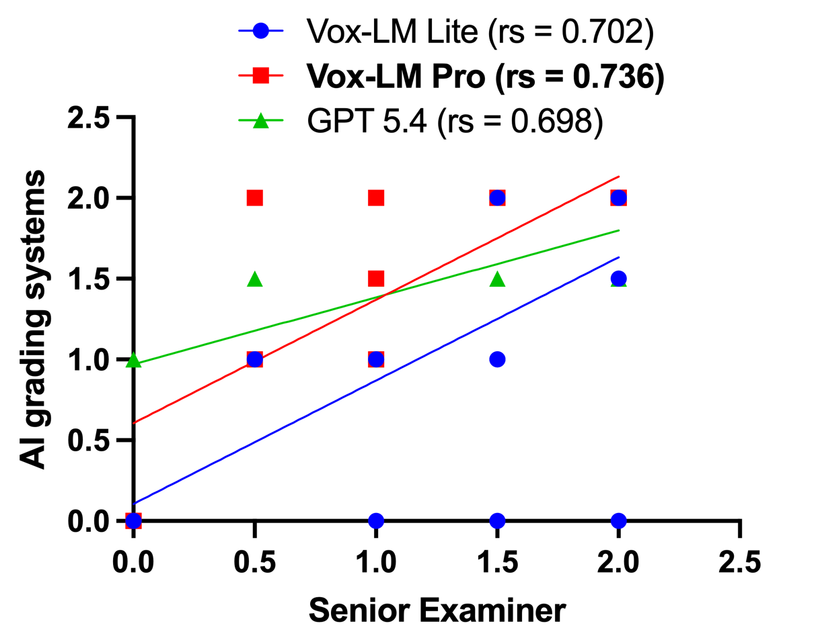
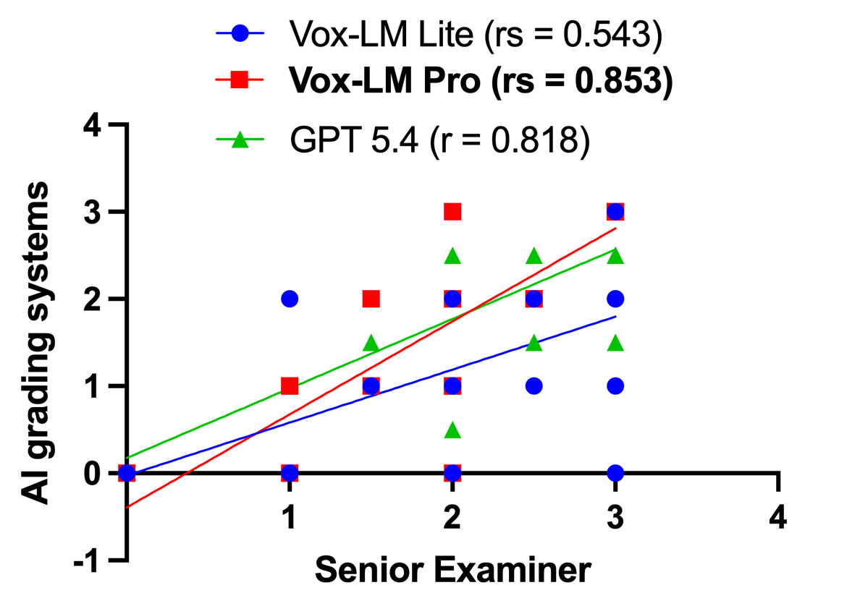
Correlation between zero-shot AI marking and teacher marking
Q3 – Higher Blooms
Q4 – Conceptual difficulty

Slide 20

What we’re planning now?
Comparative study between teachers and AI for marking short-answer questions in health sciences on Vox 3.0

Slide 21



Future uses
Summative (high-stakes) assessment
Application across medical education
Investigating longitudinal pedagogical outcomes
e.g. feedback update, learner engagement, academic performance etc.

Slide 22


Best practices for AI-based grading
AI understands AI!
Have AI format
or structure model answers before grading
Perform Individual sample grading

Slide 23


Best practices for AI-based grading
AI understands AI!
Have AI format
or structure model answers before grading
Teacher-in-the-control to mark examples for AI to use for few-shot grading
Perform Individual sample grading
Student-in-the-control challenge grading, justify rationale and agree on score / feedback

Slide 24



Best practices for AI-based grading
Never automate final grades without human in the loop
AI can identify class / student level gaps and misconceptions
AI literacy for students to critique AI feedback

Slide 25

Acknowledgement
Embedding AI automated feedback and learning analytics within an HKU learning management system

Slide 26
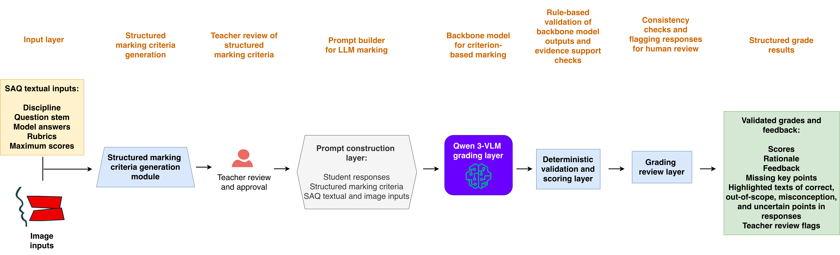
AI grading framework on Vox 3.0
*Critical for hallucination detection

Slide 27
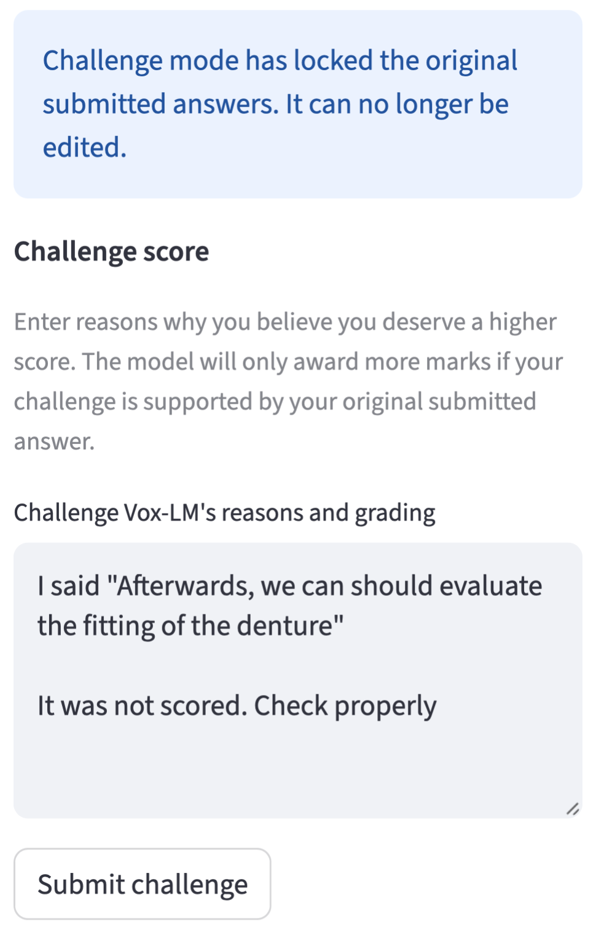
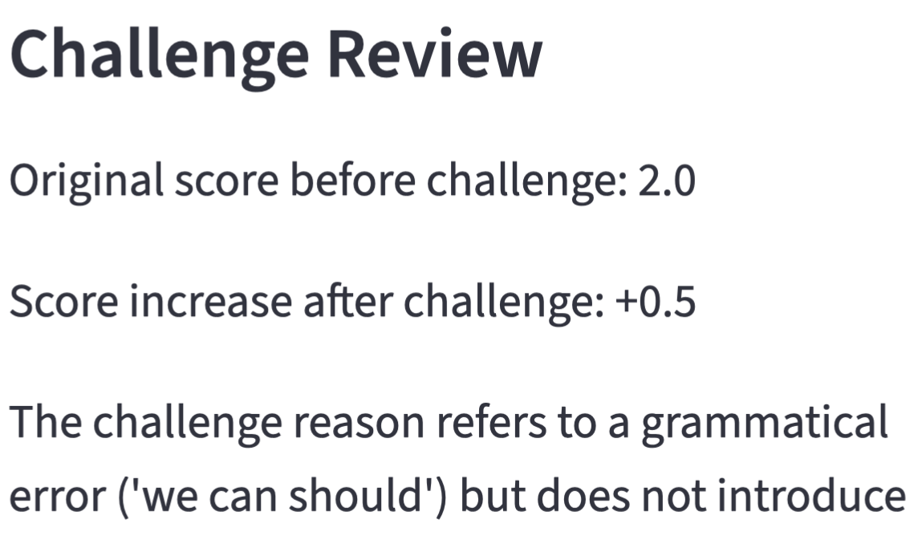
Student-in-the-loop challenges
`
`

