Slide 1


THE USE OF IMMERSIVE VIRTUAL REALITY VIDEO IN TEACHING CLINICAL DENTISTRY
DR SHABANA YOUNAS

Slide 2






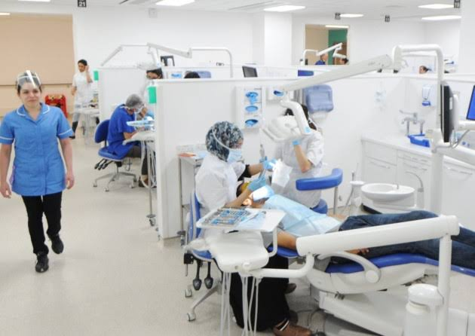
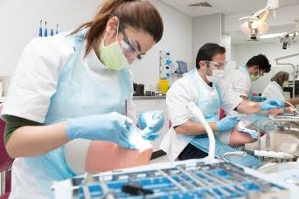
About Me….
As a Dental Educator, I have a keen interest in the teaching and learning process around students gaining procedural skills in labs and clinics and my research work is focused around improving this process for my students.
Paediatrics
Masters in Education, FHEA, SFHEA
Senior Clinical Lecturer Paediatric Dentistry

Slide 3


DIFFICULT TO TEACH THE HOW
WE CAN TEACH THE WHAT
COMMUNICATION
SOFT SKILLS
NON-DENTAL

Slide 4
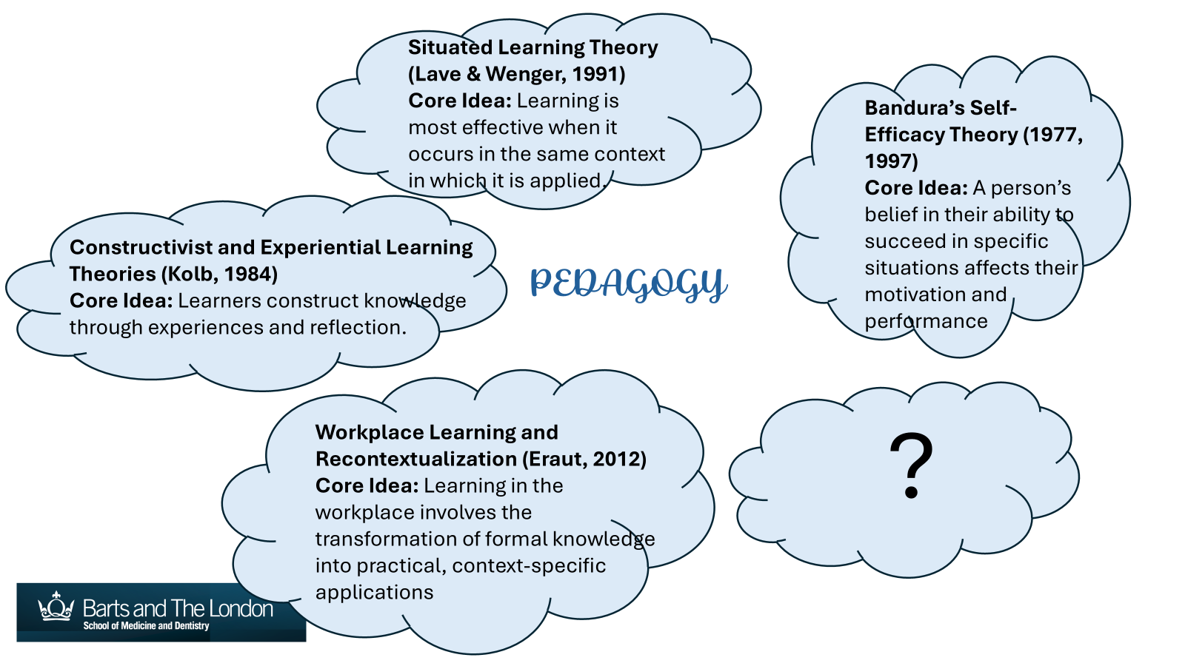

Slide 5
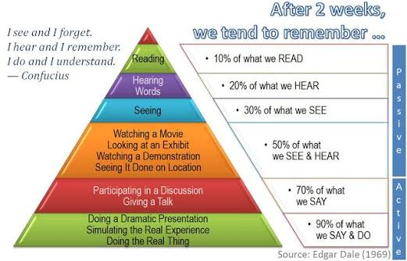
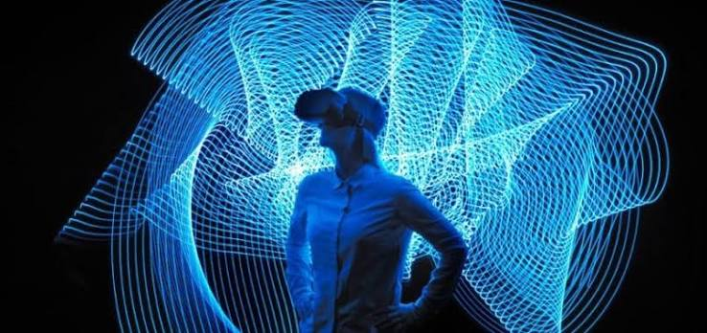
THE CONE OF LEARNING: EDGAR DALE 1969

Slide 6
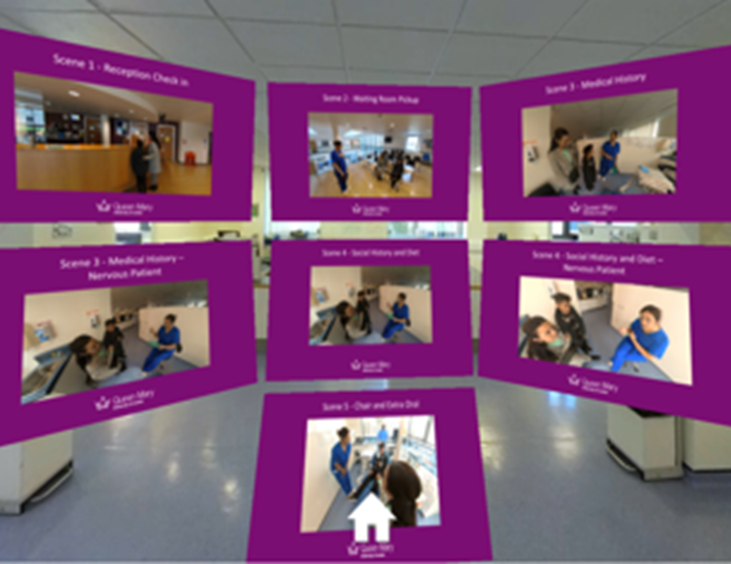

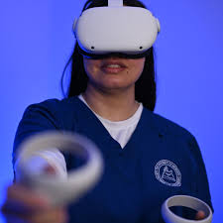

Methods:
A 360° VR video was created featuring an experienced Paediatric dentist in two scenarios:
Routine dental examination on child patient
An anxious child’s first dental visit

Slide 7
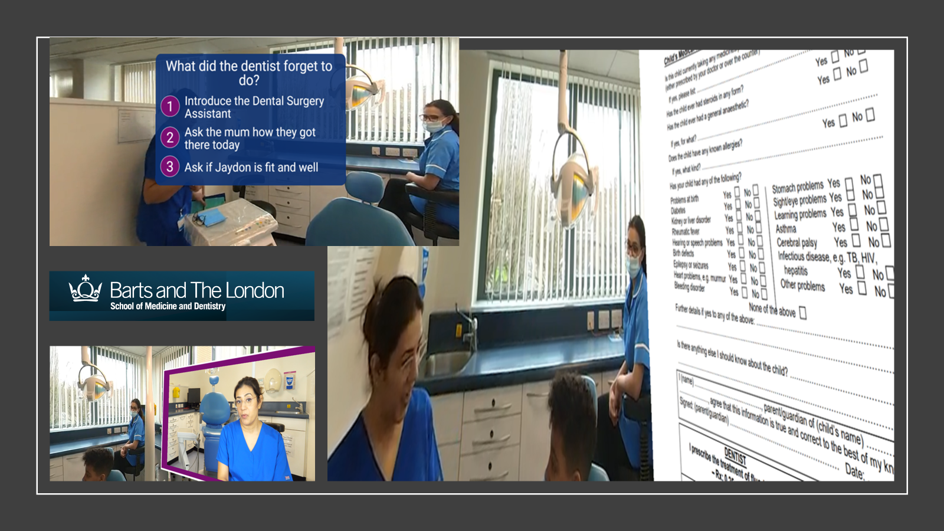

Slide 8
SURVEY AND DATA COLLECTION:
The video was made available for student use before their first scheduled clinic, both in a timetabled seminar and for independent home use.
Data was collected from 61 UG second year dental students, from the Institute of Dentistry at Queen Marys University London, before the students attended their first child patient dental clinic.
The data was collected in the form of anonymous surveys focusing on students’ perceived readiness and self-efficacy after having the lecture History and Examination of a Child Patient and after engaging with the VR video simulations.
The survey was accessed via QR code, taking only a few minutes for students to complete. The survey included both open and closed text questions. The survey explored how the students feel about the upcoming child check up, what the students believed may help prepare them better for clinic and if the current resources of lectures were sufficient for their preparation.
Thematic analysis was used to explore emerging trends from the data.
Using theories of Workplace learning and recontextualization the Data was further analysed.

Slide 9
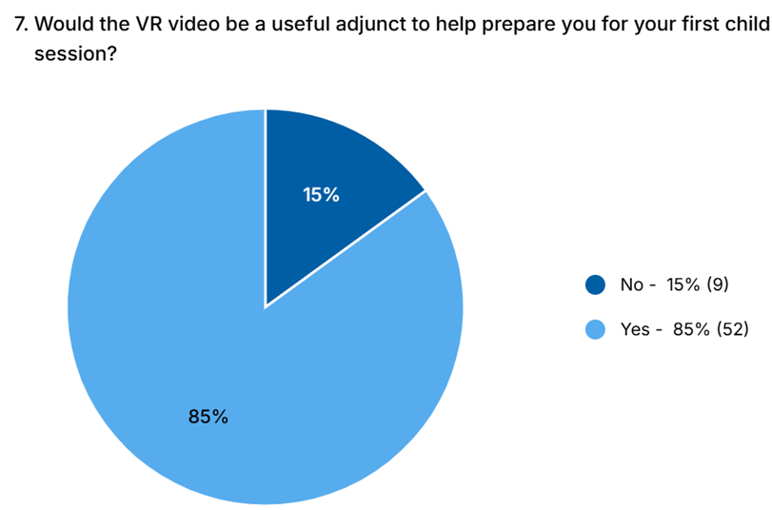
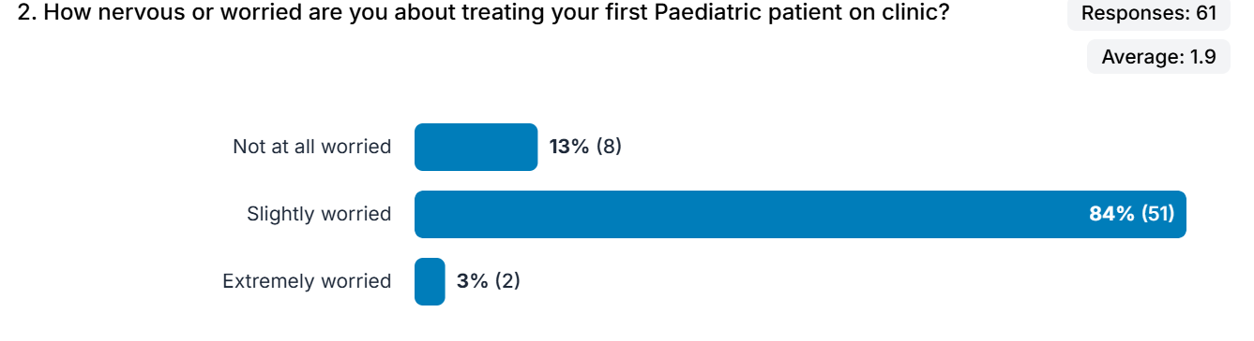
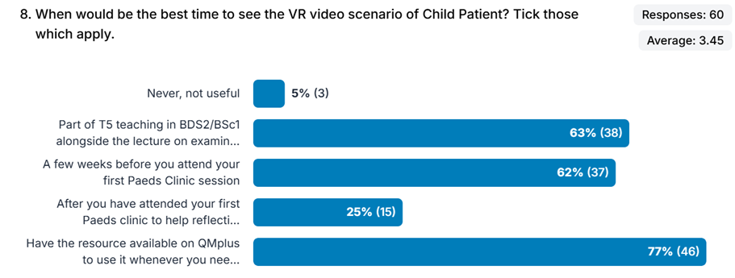
RESULTS:

Slide 10

CONCLUSIONS:
Findings suggest that VR videos can positively influence dental students' feelings of preparedness, contributing to a greater sense of confidence and skill when transitioning to real-world clinical experiences.
The study also discusses the potential of VR technology in addressing educational gaps, offering a safe and effective platform for experiential learning and increasing the overall efficacy of dental education.
Hence highlighting the potential of VR as a valuable educational tool in dentistry, offering a novel approach to bridge the gap between theoretical learning and real-world clinical application.

Slide 11
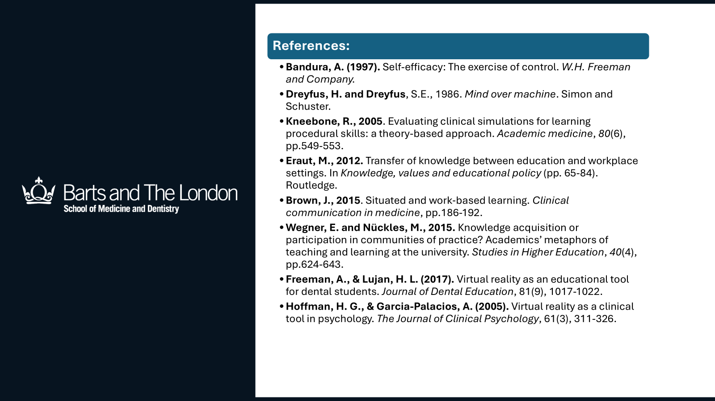

Slide 12




