Slide 1
Student Perceptions of Early Haptic Simulation in Undergraduate Dental Education:
A Mixed-Methods Study
Alsaqer A, Brown J, Cairns A, Al-Ani Z

Slide 2
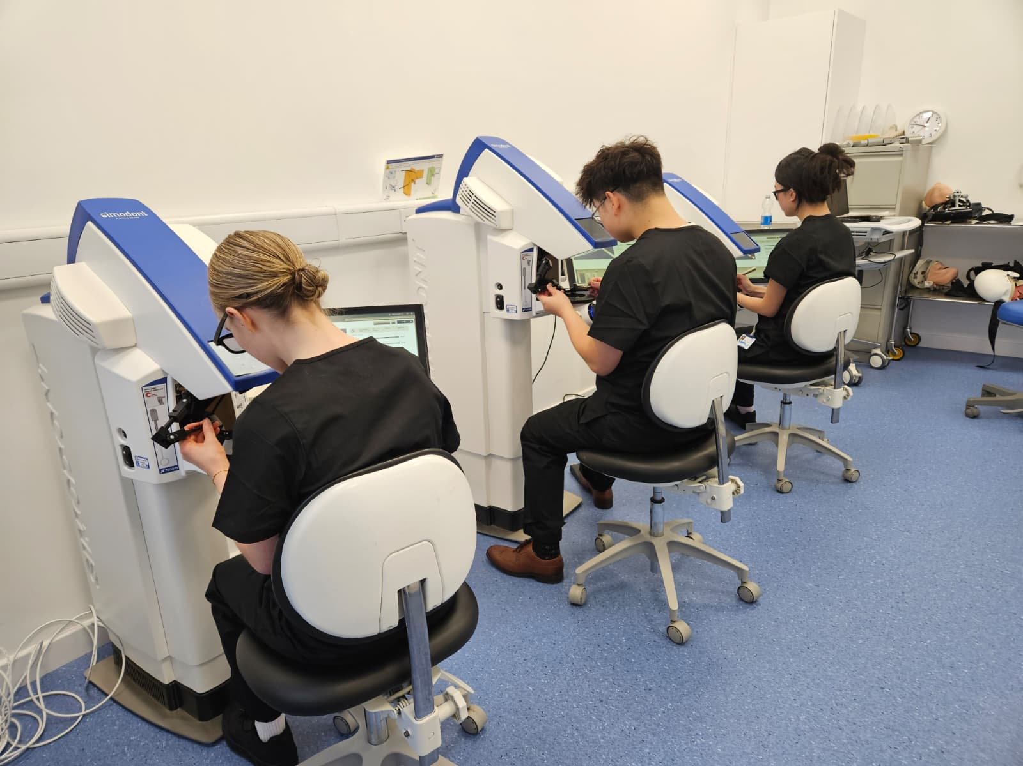
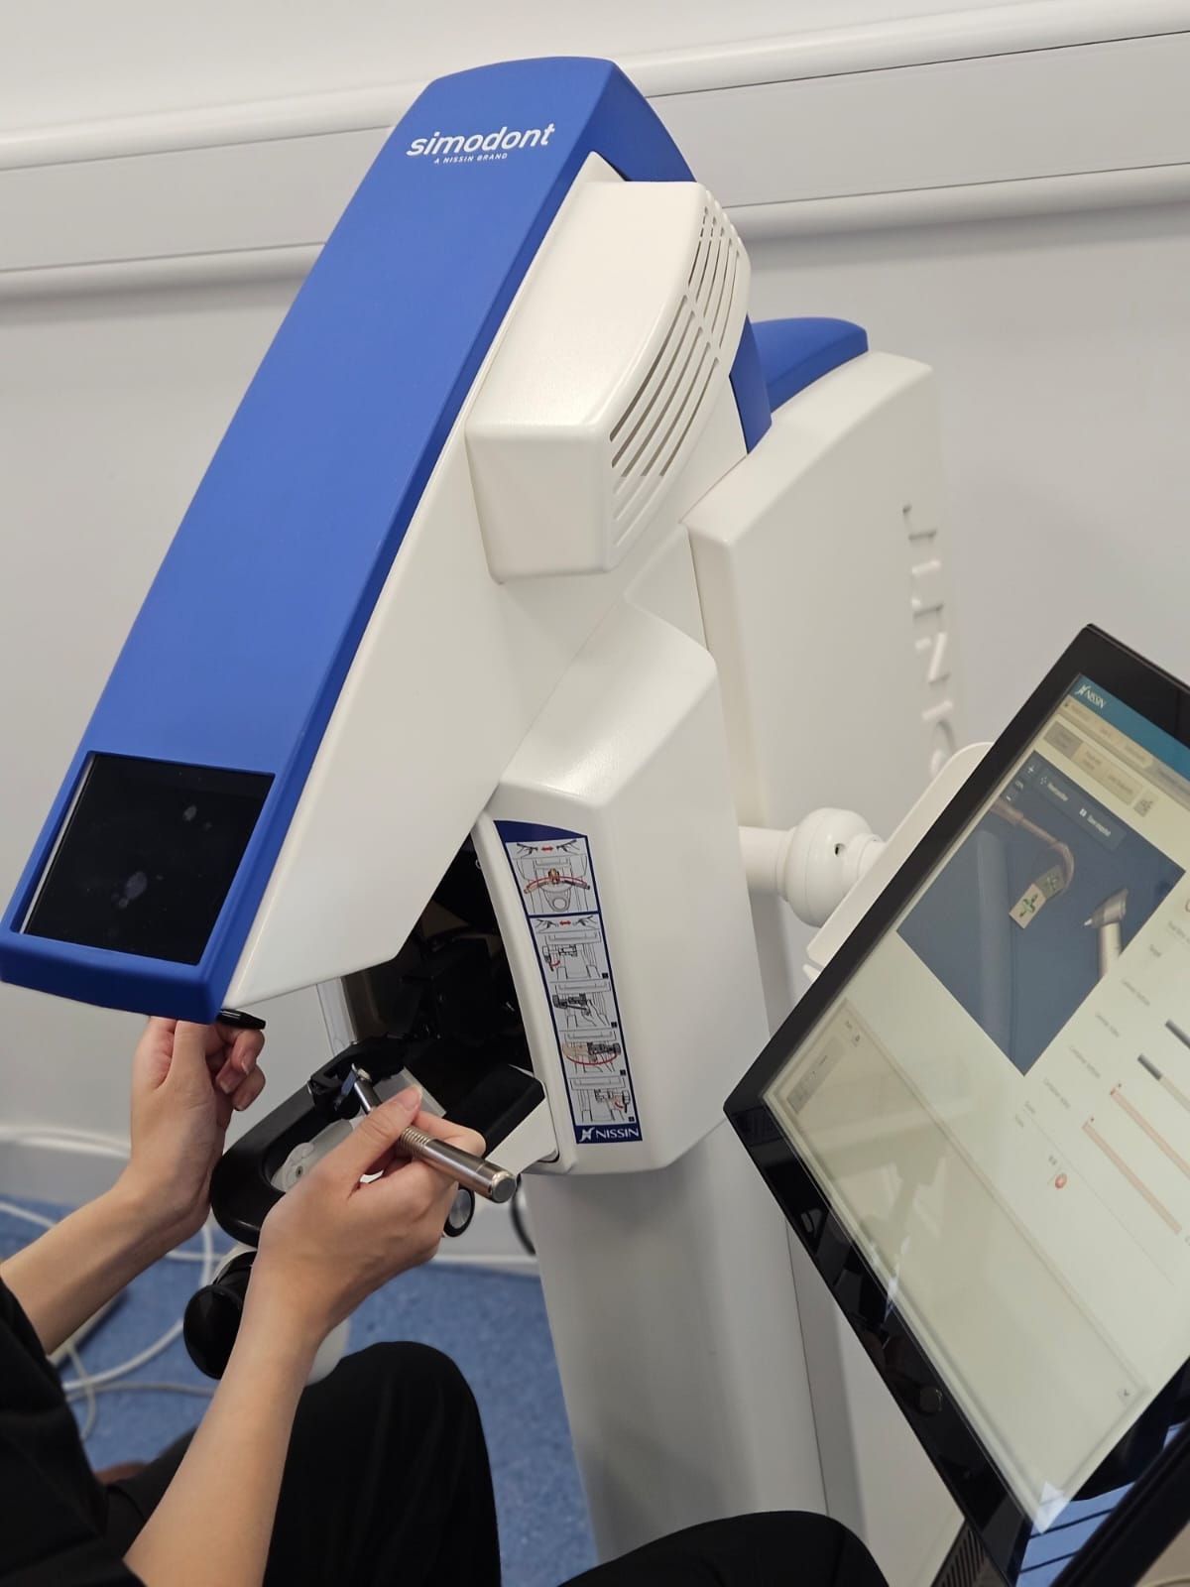
Background
Haptic simulation is increasingly incorporated into undergraduate dental curricula to support psychomotor development, confidence, and formative feedback. However, evidence regarding its educational value when introduced as a limited intervention remains inconclusive.
At the University of Glasgow, the Simodont® haptic simulator was recently introduced as a one-off session during the first preclinical year.
Understanding how students perceive this early exposure is essential to inform evidence-based curricular integration of haptic simulation in dental education.

Slide 3
Aims and Objectives
The objectives were to evaluate perceived educational value, confidence, and preparedness for preclinical training, development of manual dexterity, simulation realism, and the role of feedback and timing. A further objective was to compare immediate perceptions of first-year students with retrospective views of second-year students.
This study aimed to explore undergraduate dental students’ perceptions of early exposure to haptic simulation.

Slide 4

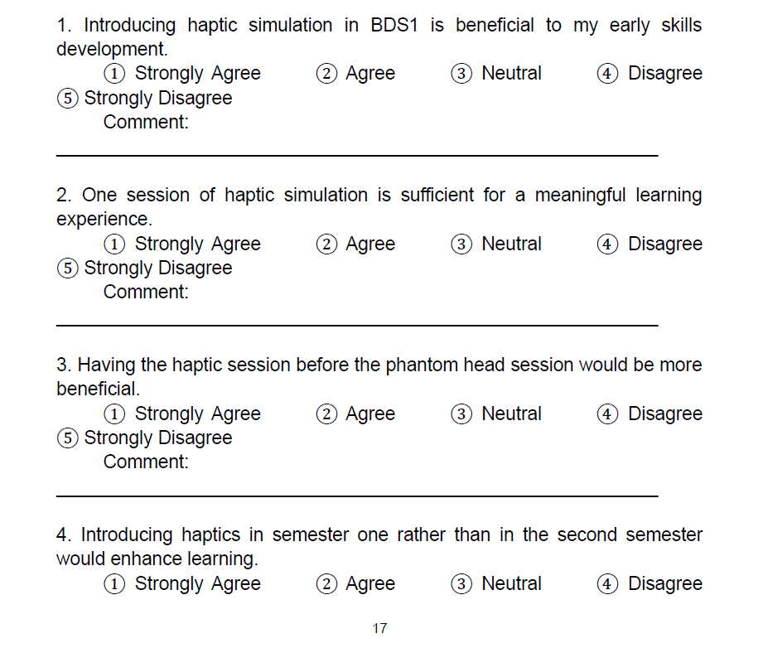
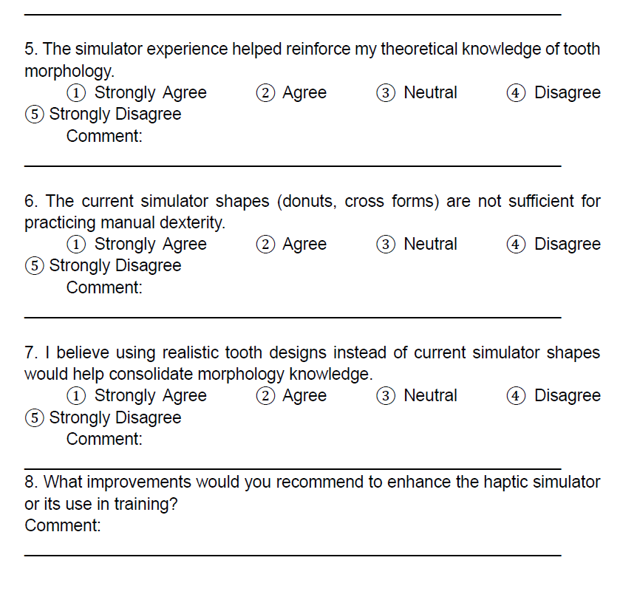
A cross-sectional, mixed-methods survey was conducted involving first-year (BDS1, n = 15) and second-year (BDS2, n = 12) dental students who had completed a single simulation session at the end of their first year.
Questionnaires included Likert-scale items and open-ended questions structured around five educational domains. Quantitative data were analysed descriptively, and qualitative responses underwent thematic analysis.
Materials and methods

Slide 5
Results
BDS1 students generally perceived early haptic exposure as beneficial for confidence, skill awareness, and preparedness for subsequent phantom-head training. In contrast, BDS2 students expressed more critical views regarding the simulator’s impact on manual dexterity and technical skill development.
Across both cohorts, students consistently reported that a single session was insufficient for meaningful psychomotor learning.
Key limitations included simplified task design and reduced realism. Strong consensus emerged regarding the need for increased session frequency, enhanced anatomical fidelity, structured feedback, and clearer curricular integration.

Slide 6
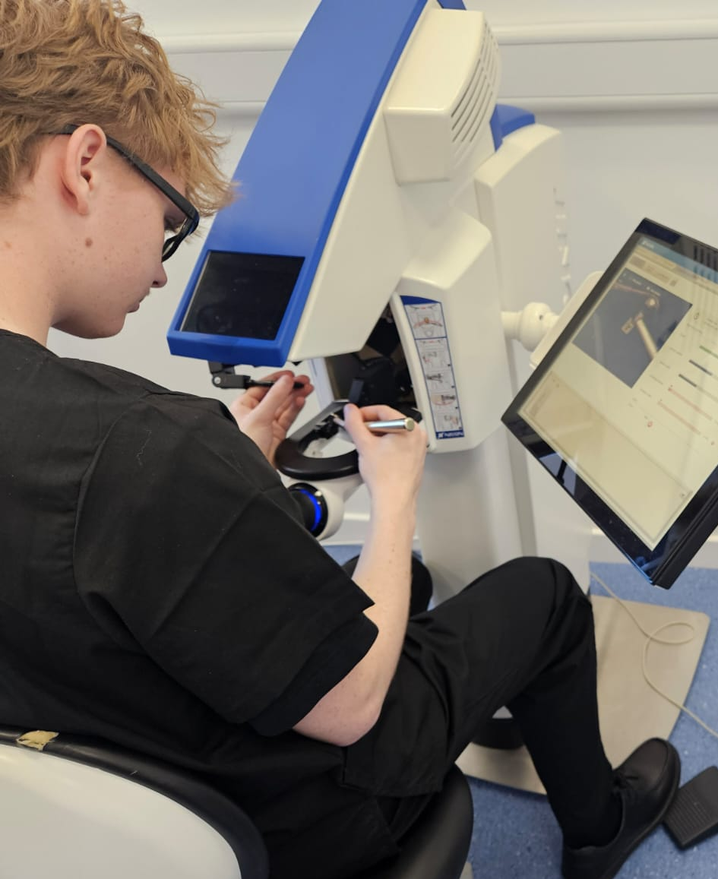
Conclusion
Early exposure to haptic simulation was perceived as a valuable adjunct for orientation, confidence building, and reflective learning, but not as a replacement for conventional phantom-head training.
Students emphasised that repetition, realism, and alignment with the preclinical curriculum are essential to maximise educational impact.
These findings provide evidence-informed guidance for dental schools considering the early-stage implementation and curricular integration of haptic simulation technologies.

