Slide 1

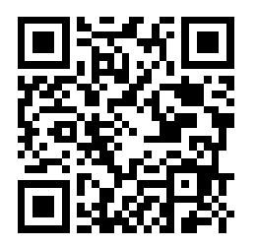

Transdisciplinary learning experience
Type 2 Diabetes Mellitus
Universitat de Barcelona
Sofia Valmaseda de la Rosa

Slide 2

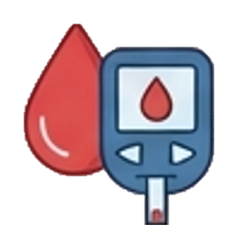

Background
International Diabetes Federation (2025): 11.1% of adults will be diabetic¹
90% Type 2 Diabetes Mellitus (T2DM), increasing
Future health professionals must be well-prepared to understand this disease and its systemic consequences
To support this goal, a transdisciplinary learning experience was organized for students from 4 different health-related degree programs.
1) International Diabetes Federation. (2025). IDF Diabetes Atlas (11th ed.).

Slide 3
Aims and Objectives
To promote the exchange and discussion of clinical cases involving patients with T2DM among students from different health science disciplines.

Slide 4
Materials and methods
DEBRIEFING
3D IMMERSION
PREBRIEFING

Slide 5


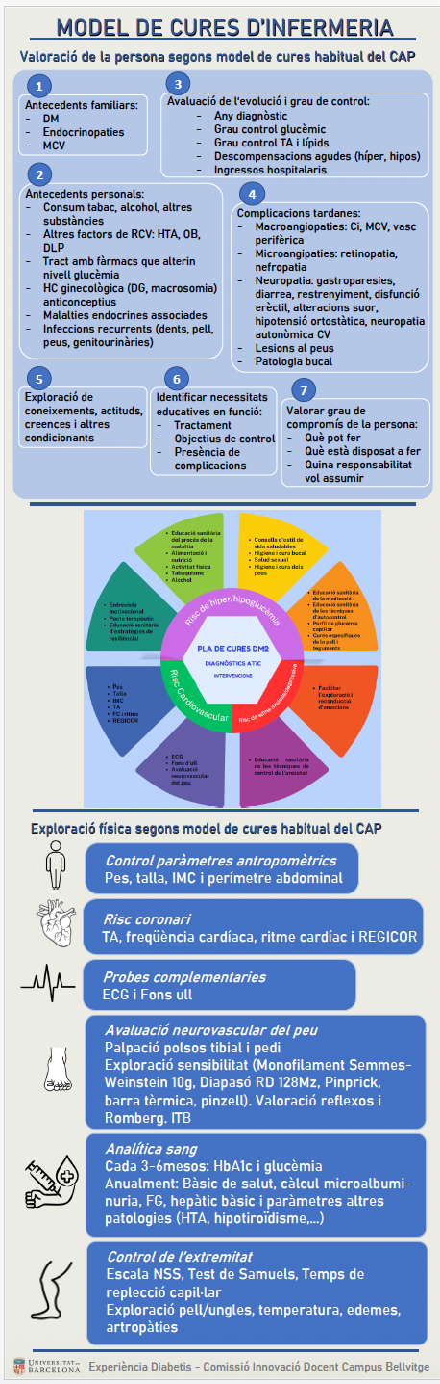
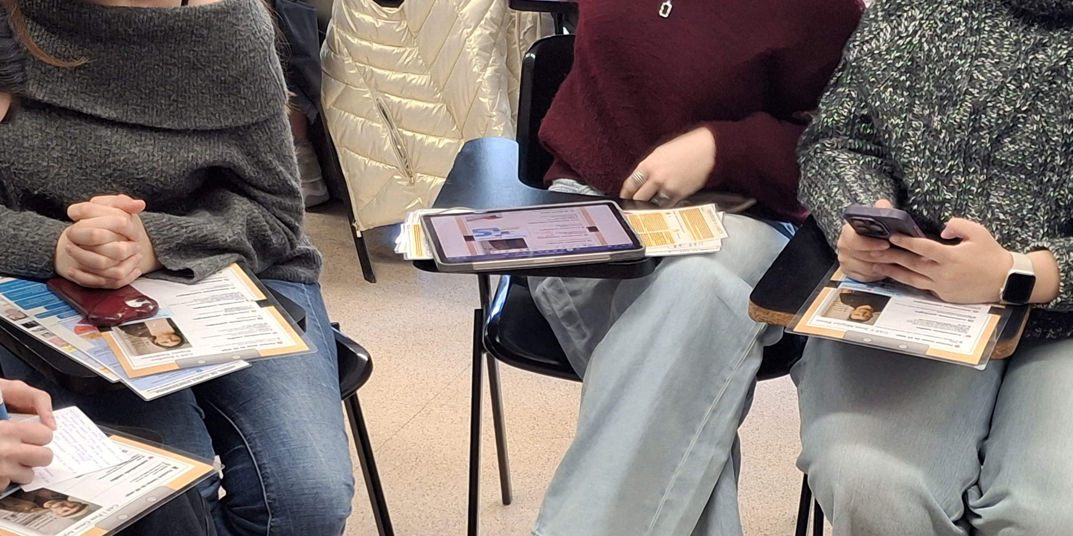
Materials and methods
Participants 34 students at the University of Barcelona
1
Prebriefing
Infographics and guidelines available online and distributed in print.

Slide 6
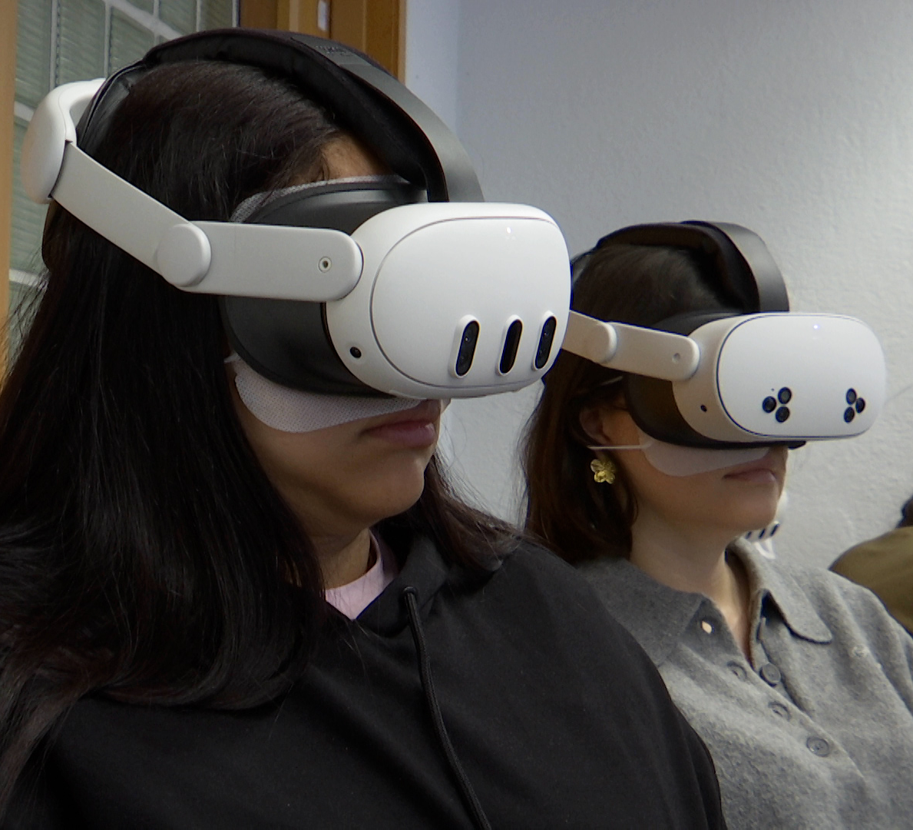
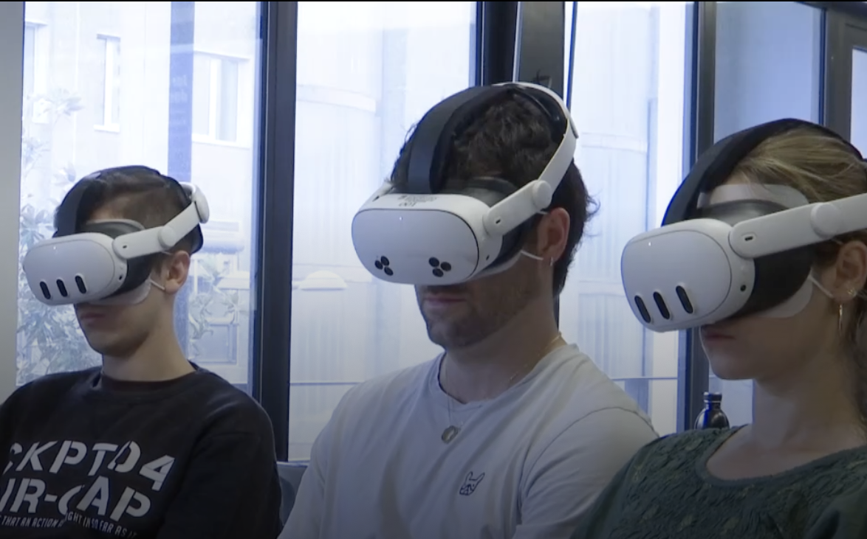
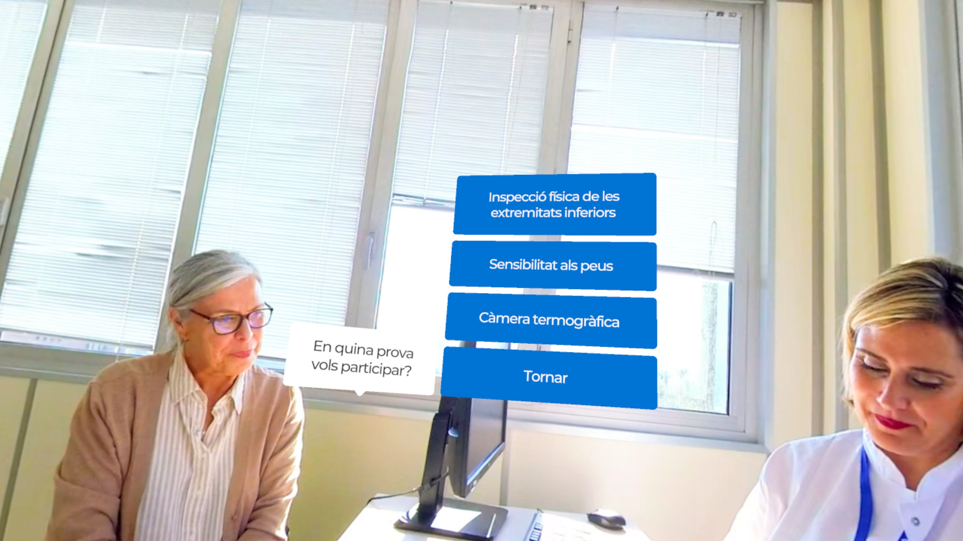
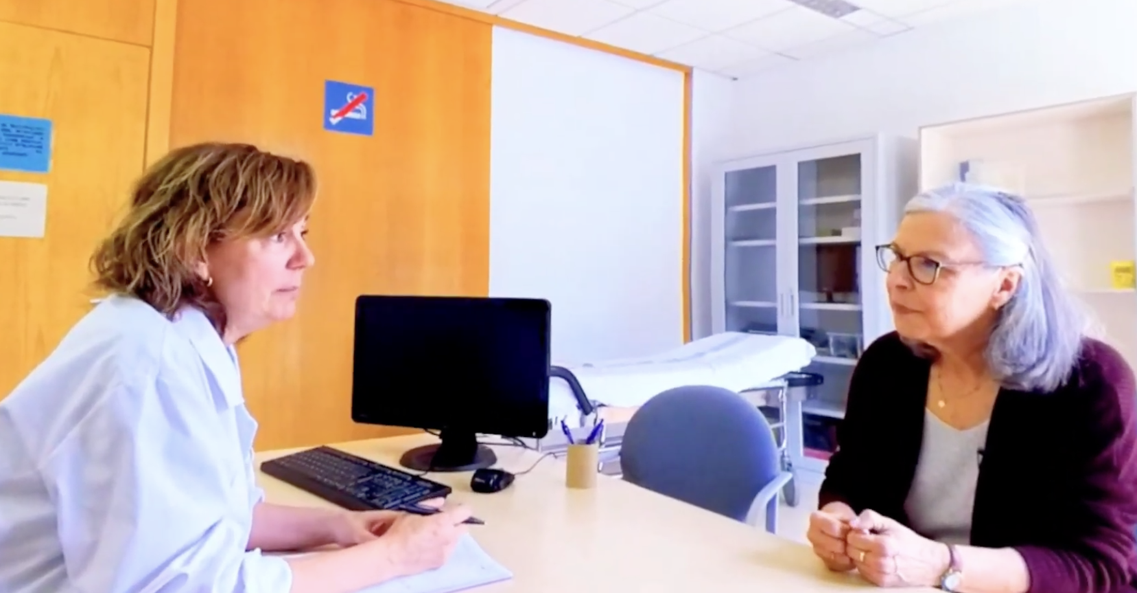
Materials and methods
2
Immersion
Virtual reality headset for an immersive 31-minute visit through 4 clinical consultations.

Slide 7
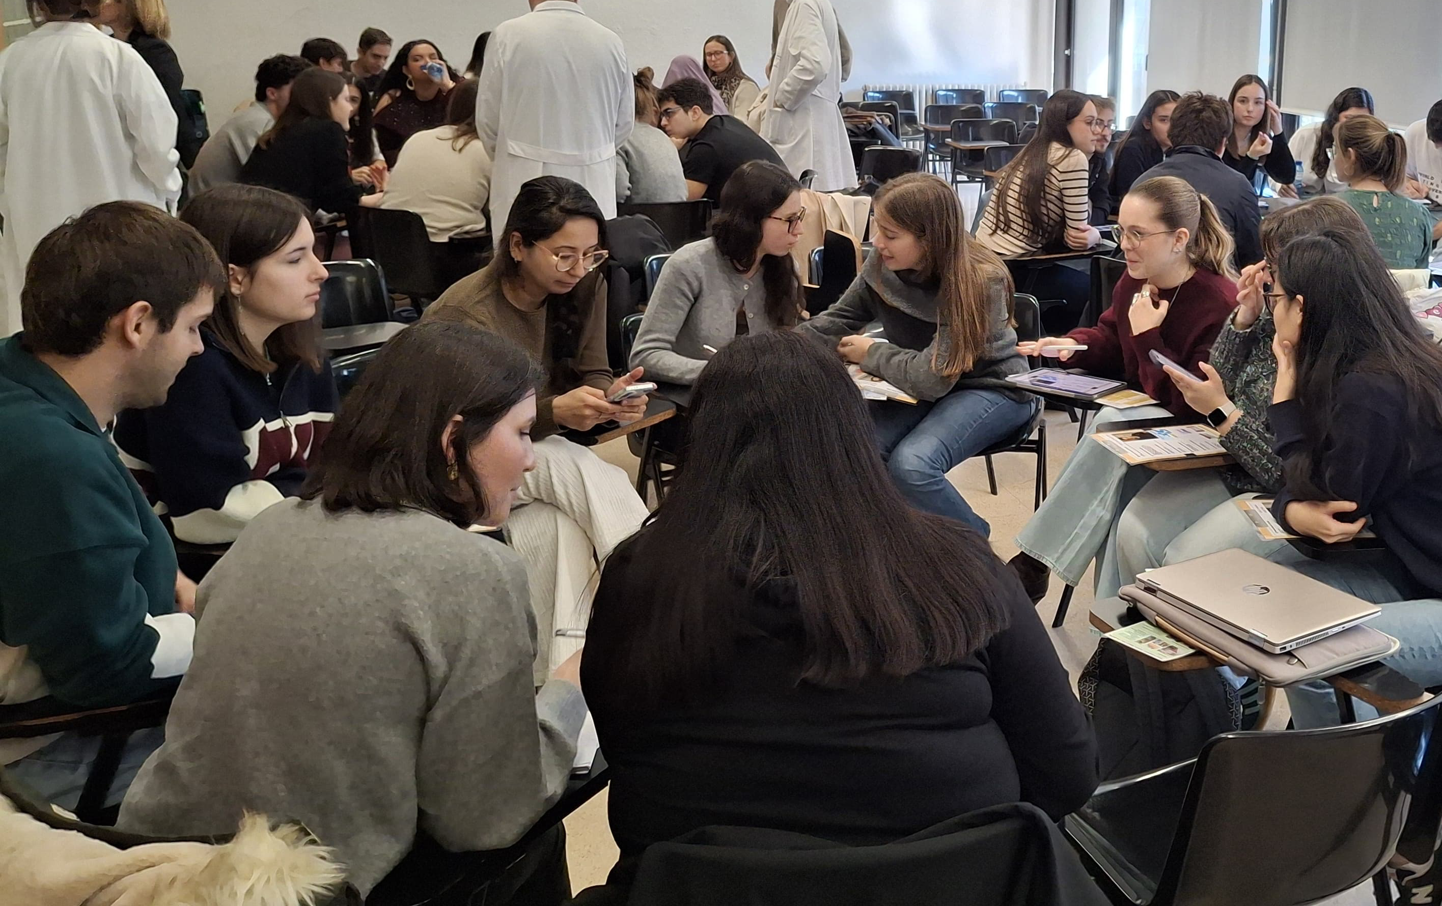
Materials and methods
3
Debriefing
Degree-specific groups analysed 4 clinical cases.
Reorganization into 4 mixed groups, each assigned one clinical case to prepare and present.

Slide 8
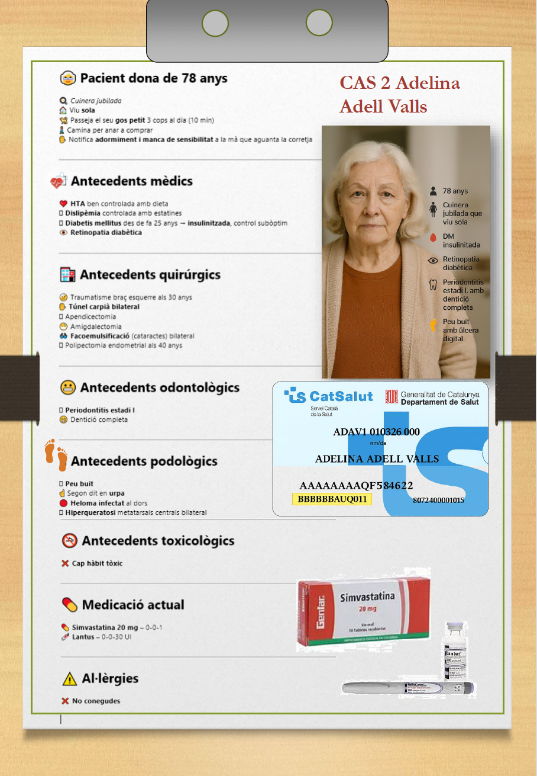
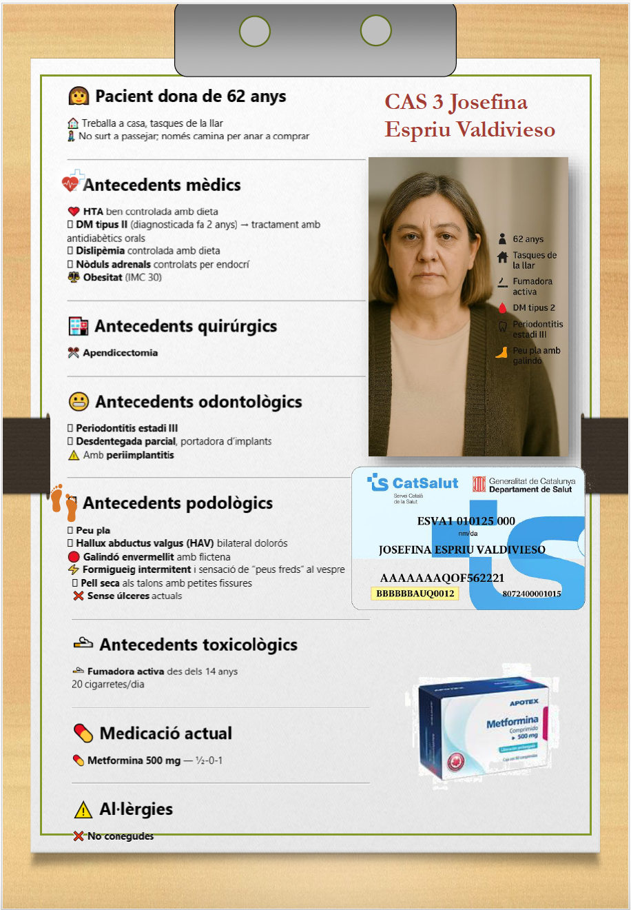
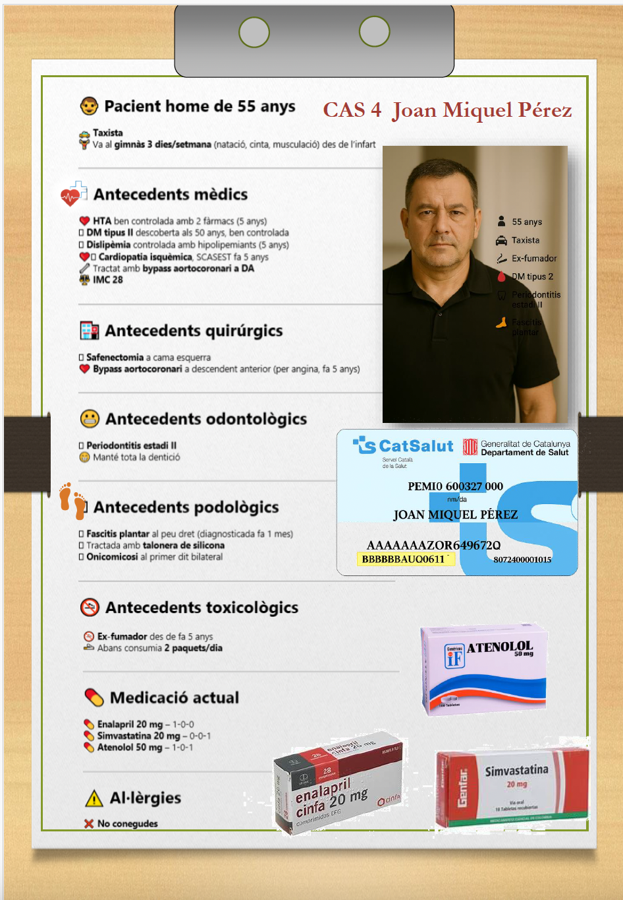
Materials and methods

Slide 9
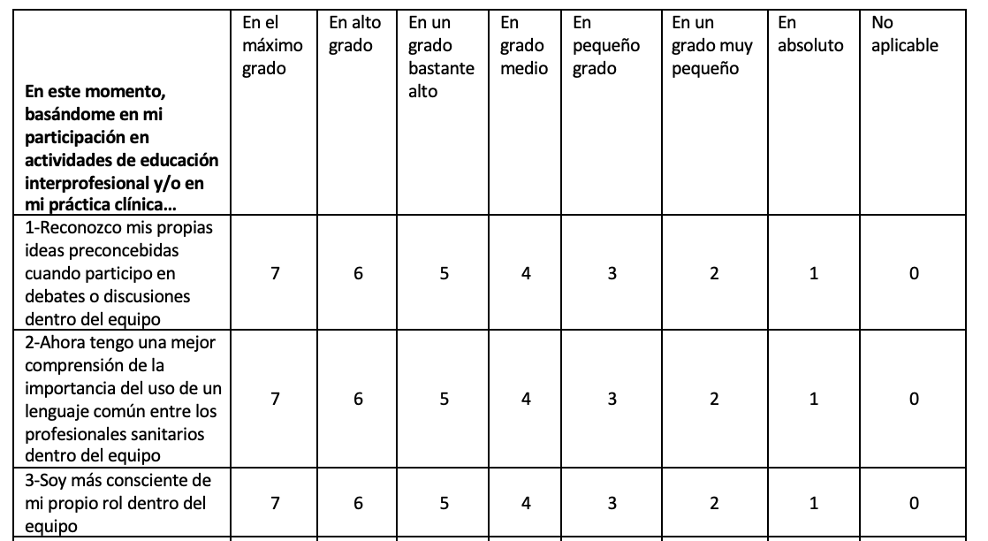
Materials and methods
Interprofessional Socialization and Values Scale (ISVS-21S)¹ evaluated the perceptions of the knowledge acquired through educational interprofessional activities pre-experience and post-experience.
7-point scale, where 1 means “Not at all” and 7 means “To the highest degree”.
1) González-Pascual, J. L., Márquez, M. G., Rodríguez-Rey, R., Zabaleta-Del-Olmo, E., Raurell-Torredà, M., Romero-Collado, Á., & Hidalgo-Sanz, B. (2022). Adaptation and validation of the Interprofessional Socialization and Valuing Scale (ISVS) in Spanish university health sciences students. Journal of interprofessional care, 36(6), 916–922.

Slide 10

Relationship between periodontitis and systemic inflammation of T2DM.
Strategies for the prevention of diabetic foot in T2DM patients.
Comprehensive care and ongoing support required by T2DM patients.
Diagnosis and management of T2DM patients
Results
Improvement in ISVS-21S
(p < 0.05) in all questions
Cohen’s D > 0.79:
Strong effect of change

Slide 11
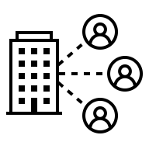

Discussion and conclusion
Students develop a more integrated and holistic understanding of T2DM
Facilitates more effective interprofessional referrals^{1,2}
Ensures a comprehensive assessment of patients living with T2DM
Fosters better coordination among future health professionals^{1,2}
1) Sezgin, M. G., & Bektas, H. (2023). Effectiveness of interprofessional simulation-based education programs to improve teamwork and communication for students in the healthcare profession: A systematic review and meta-analysis of randomized controlled trials. Nurse education today, 120, 105619.
2) Khalili, H., Orchard, C., Laschinger, H. K., & Farah, R. (2013). An interprofessional socialization framework for developing an interprofessional identity among health professions students. Journal of interprofessional care, 27(6), 448–453.

Slide 12
Thank you for your attention

