Slide 1
Fine-tuning Stable Diffusion XL
for Radiographic Images

Slide 2
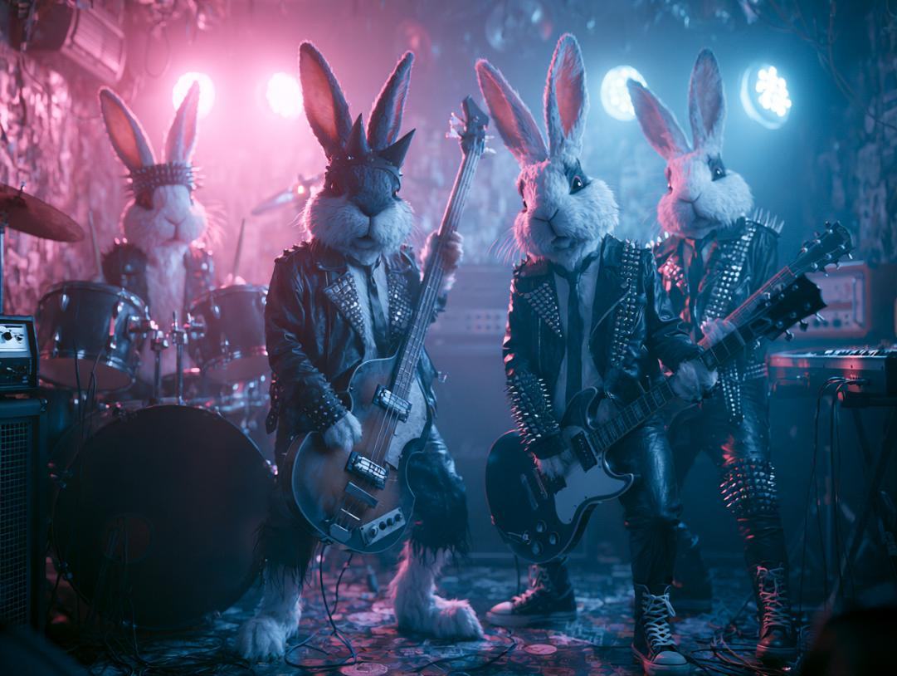
Four rabbits playing in a heavy metal band, leather clothes, drums, bass, guitar, keyboard, on stage in a small club.
→
Notes:
T2I models recap
Attempts to leverage for dentistry, copyright siloes and consent

Slide 3
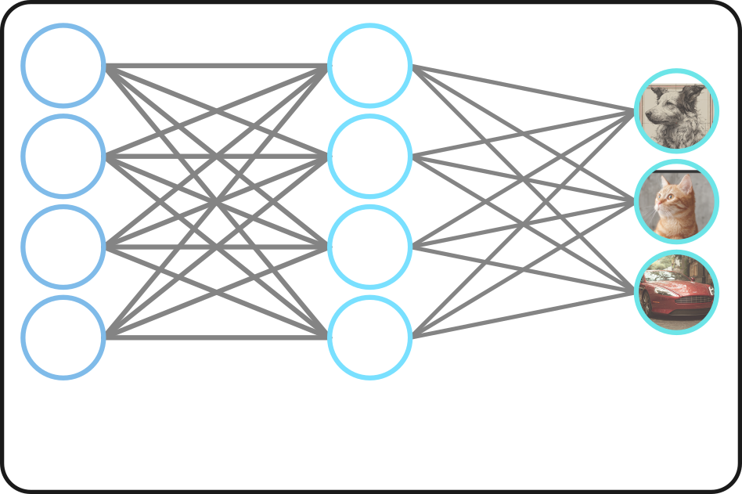
Notes:
Billions
Most models = very bad at attempting radiographs
Training your own models = very expensive
It’s possible to teach an existing AI a new concept

Slide 4
LoRA
Notes:
Low rank adaptation

Slide 5
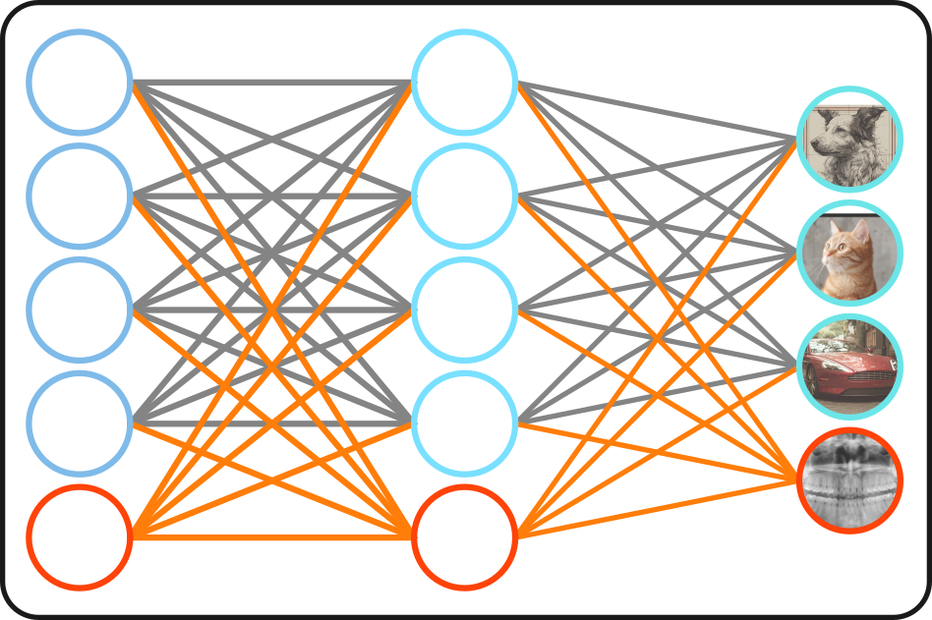
Notes:
Bolts on new concept

Slide 8
Notes:
Don’t work by themselves
Portable / shareable / modular
Not 40 – 120 GB

Slide 9
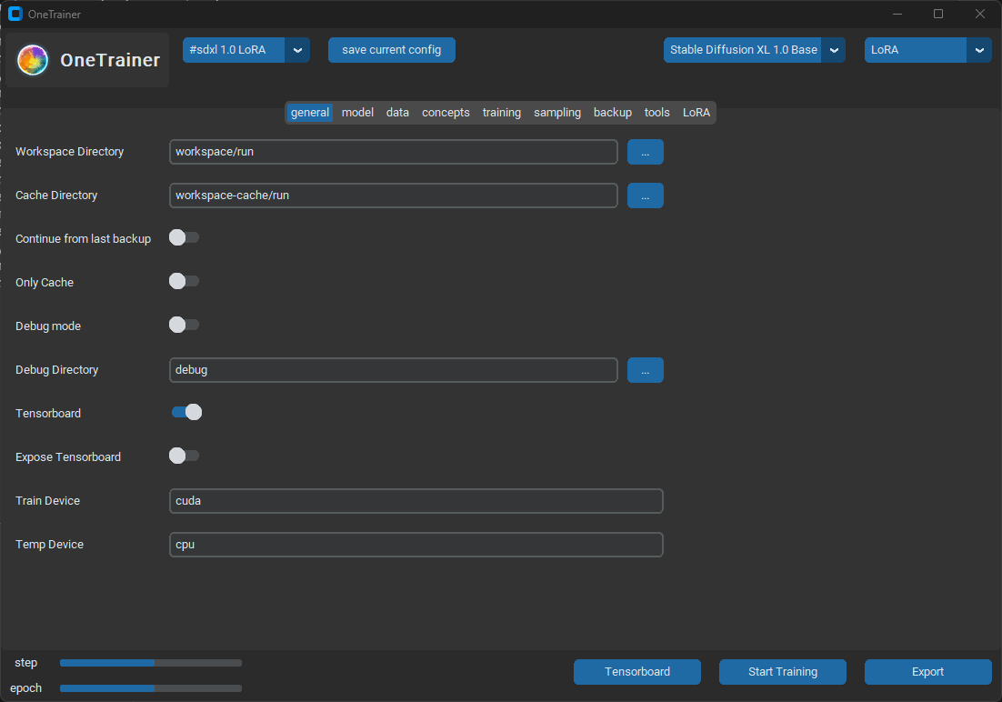
Notes:
Free
Good docs
Lots of config options but you only really need to change a few.
Comes with a default config

Slide 10
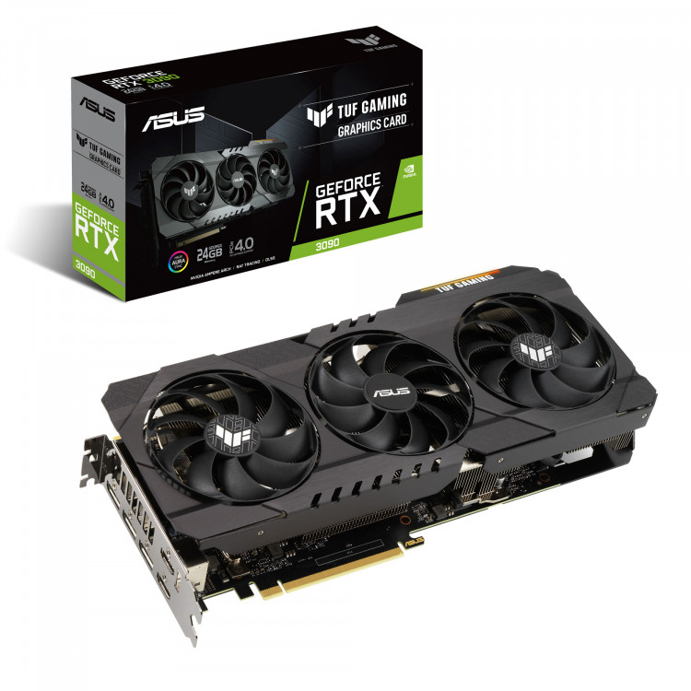
For Training
Released in 2020
Notes:
RTX 3090
Second hand under 1000

Slide 11
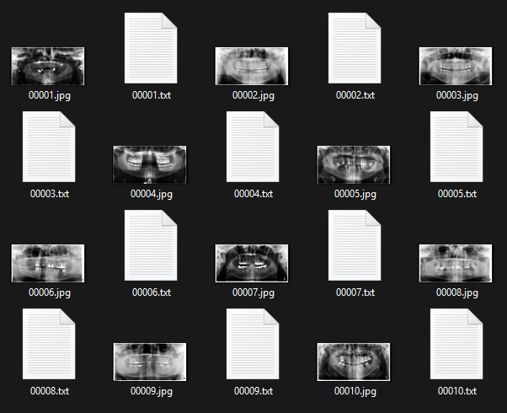
Notes:
Imgs + txt descriptions
As few as 10
Unknown maximum

Slide 12
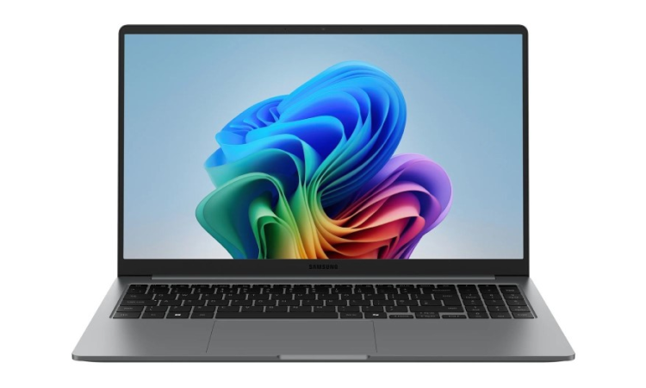
For Normal Use

Slide 13


Slide 14
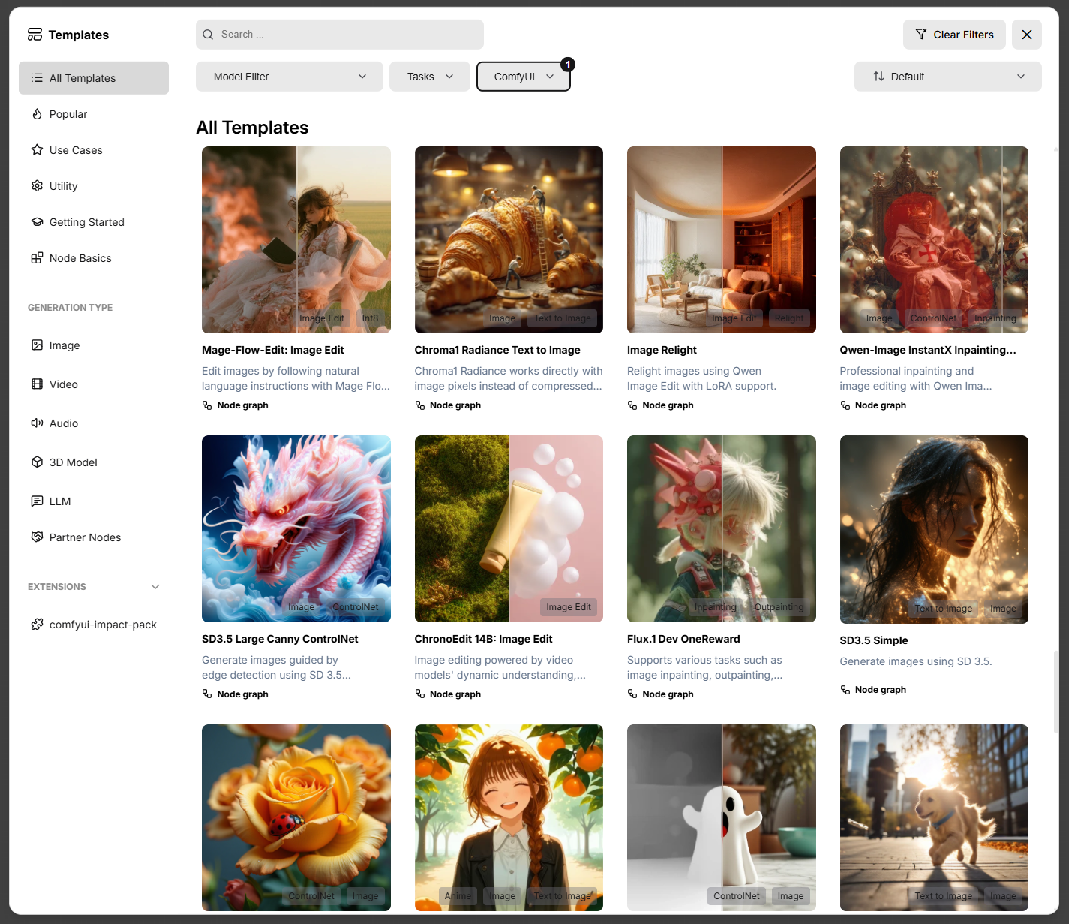

Slide 15
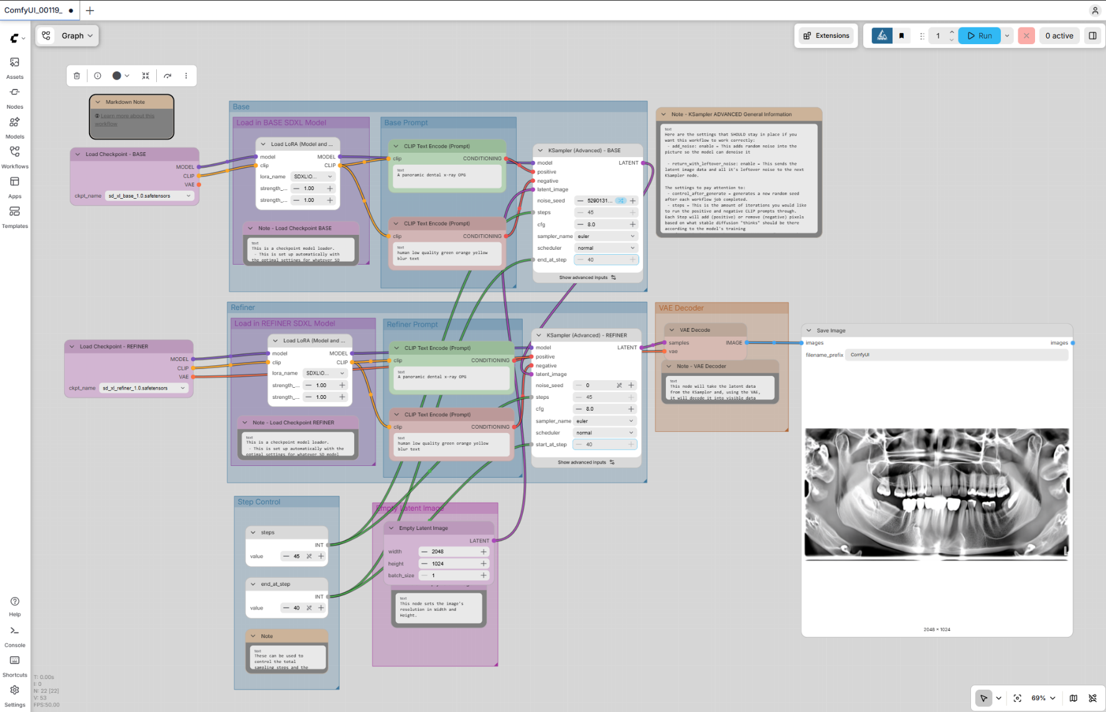
Notes:
Intimidating
But simple really

Slide 16
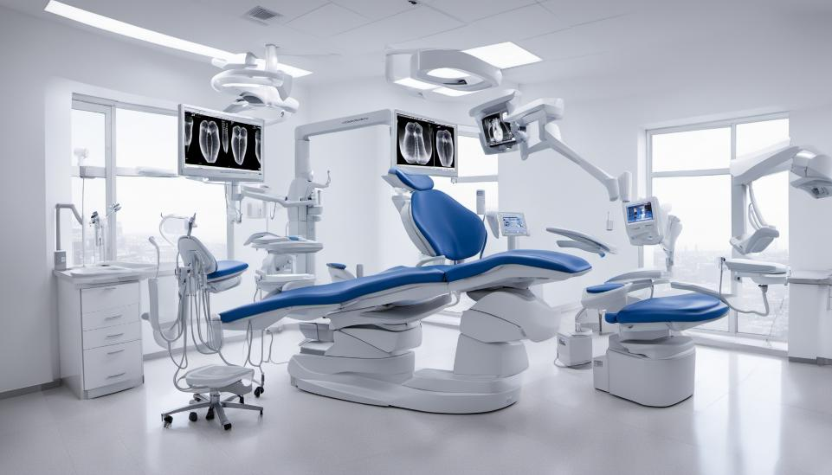
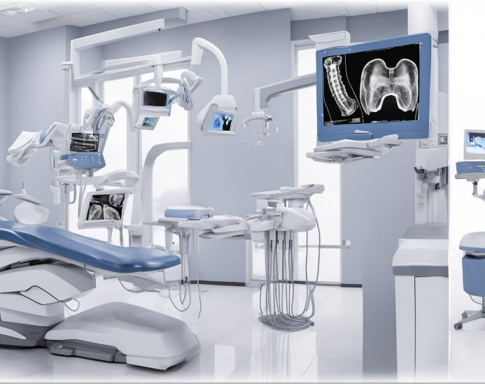
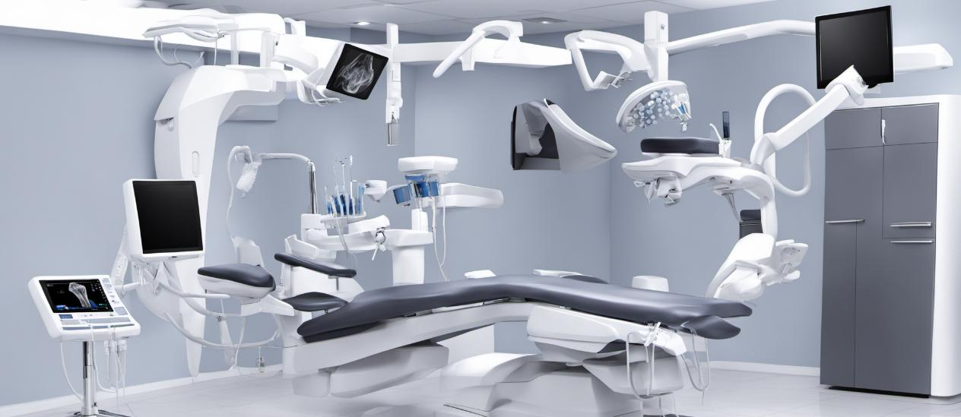
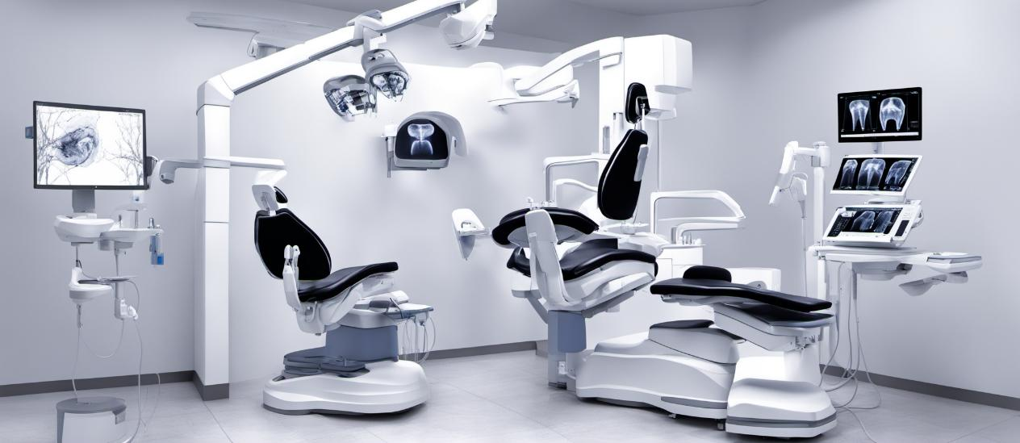
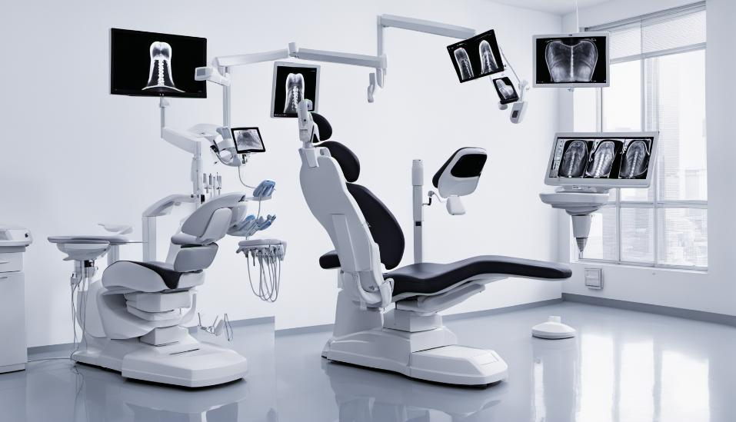
Notes:
“panoramic dental x-ray” before lora

Slide 17
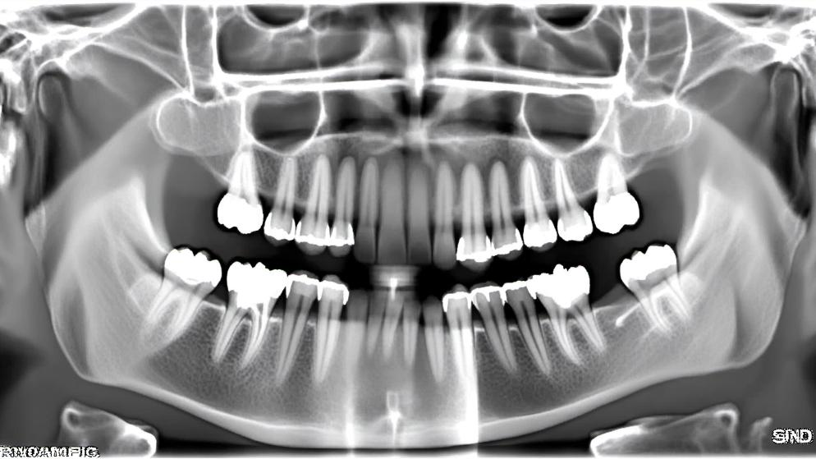
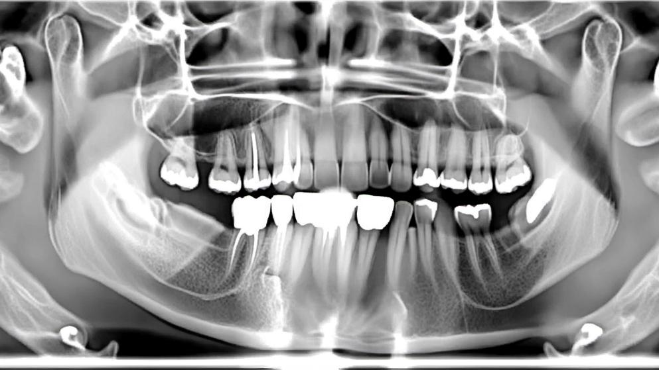
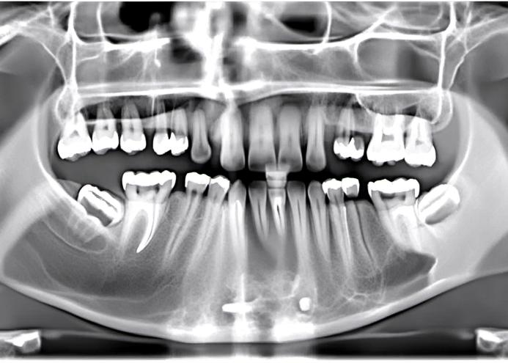
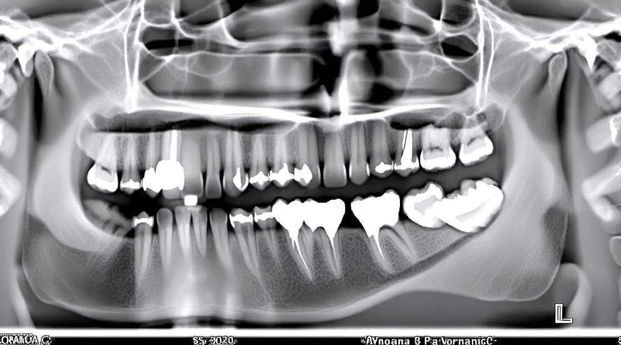
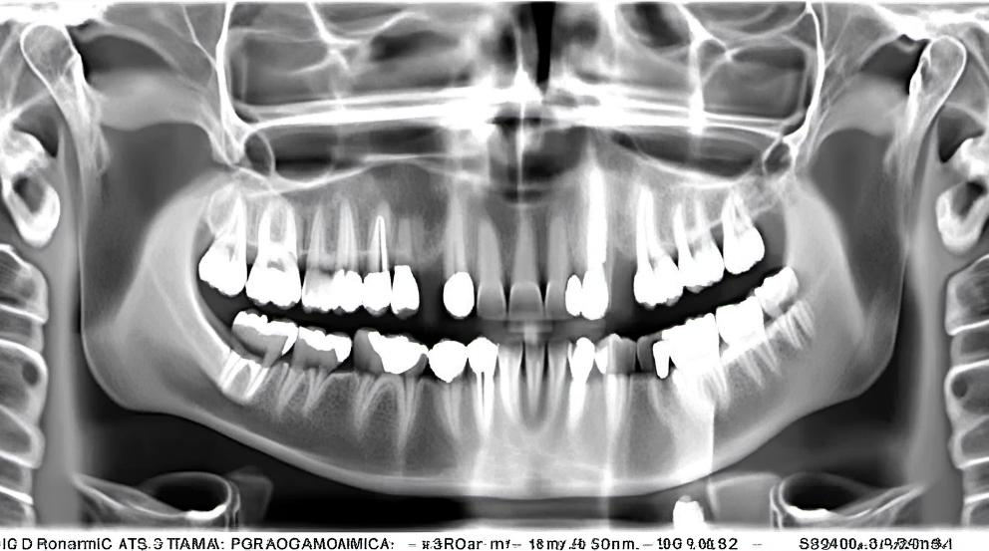
Notes:
“panoramic dental x-ray” after lora applied
Only 100 additional images
+ a single fine-tuning pass (ran overnight)
Not there yet, but more images, better base models and longer training cycles may get us there.

Slide 18

Douglas Bean douglas.bean@abdn.ac.uk

