Slide 1
What Influences Student Preparation for Flipped Learning?
A/Prof Samantha Byrne
Melbourne Dental School
The University of Melbourne
ADEE Conference
27th August 2026

Slide 2
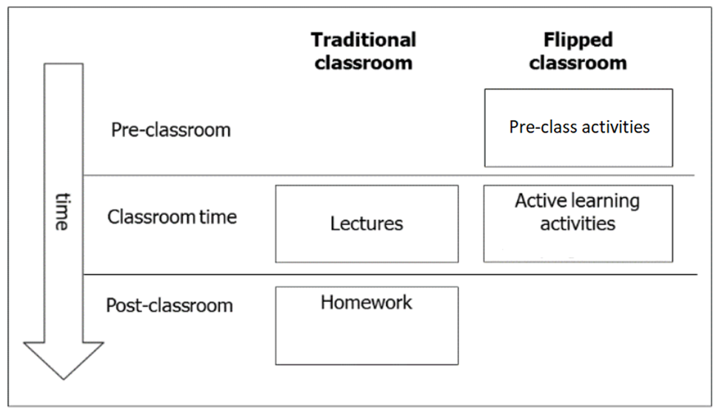


The flipped classroom
Improved learning outcomes, academic skills and satisfaction over non-flipped classrooms
Bosch-Farre et al., 2024, Naing et al., 2023, Strelan et al., 2020b
Students must prepare for class, which requires motivation and self-regulated learning strategies
Lee & Choi 2019, Akcayir & Akcayir 2018, Baig & Yadegaridehkordi 2023
Figure adapted from Mok (2014)
Notes:
The flipped classroom or flipped learning is an instructional strategy or model that moves some of the content that would normally be presented during class to pre-class (click).
This frees up in-class time (click) for students to engage in active learning as they apply their knowledge during collaborative problem-solving activities.
Compared with more traditional lecture based on non-flipped classrooms, flipped learning improves student learning outcomes, academic skills, and student satisfaction.
However, a major challenge of flipped classrooms is students not preparing for class. Preparation depends on many factors including student motivation and use of self-regulated learning strategies.

Slide 3



Self-regulated learning (SRL), pre-class learning modality and preparation for class
SRL: the cognitive, metacognitive, behavioural, motivational and emotional aspects of learning
Completing pre-class learning requires self-regulated learning SRL strategies
Students with different levels of SRL may prefer different modalities of content delivery
Oudbier et al., 2022, Han 2025
Sun et al., 2020, Davies et al., 2021, Han 2025
Notes:
Self-regulated learning refers to the cognitive, metacognitive, behavioural, motivational and emotional aspects of learning. Self-regulated learners set themselves goals, monitor their progress towards these goals, and change the learning strategies they are using in order to help them achieve these goals.
(click) When preparing for a flipped classroom, students are usually asked to either watch a short video or to read some information.
(click) Self-regulation is need to prepare for a flipped classroom. Students need to be motivated to set aside time, think about what they need to do, persist if they find it difficult and check their understanding.
Students with different levels of SRL may prefer different modalities of content delivery such as preferring videos, or preferring readings, and this might influence their preparation.

Slide 4

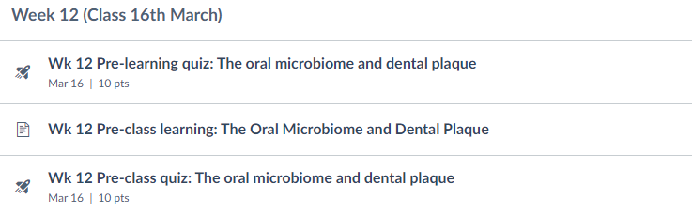
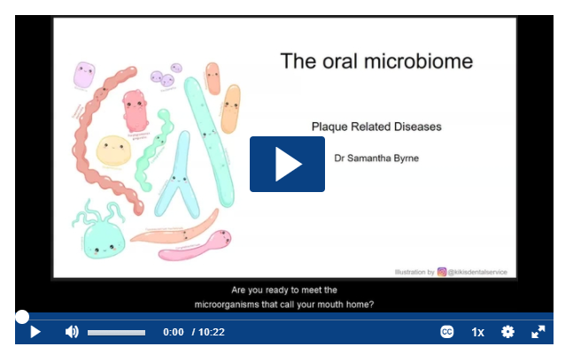
Research question
How do students prepare for a flipped classroom using different activity formats (videos and readings) and how does this relate to self-regulated learning?
Notes:
Therefore, the aim of this project was to examine how students prepare for a flipped classroom using videos and readings and how this relates to their learning.
(click) To prepare each week, students were expected to completed a pre-learning quiz.
(click) Then, either watch a short video, or read information on the Learning Management System. Videos and readings were alternated during the semester.
(click) Finally they completed a pre-class quiz. Students could complete this quiz as many times as they needed, to get a score out 8/10.

Slide 5
Methods
1st year Bachelor of Oral Heath students
106 students (2021 – 2023)
12-week semester, flipped classroom for 10 weeks (weeks 2 – 11)
  5 weeks with pre-class learning videos
  5 weeks with pre-class learning readings
Mid-semester: 42 item questionnaire assessing dimensions of self-regulated learning online (Jansen et al. 2018)
  7-point scale (1 = not at all true of me, 7 = very true of me)
  Metacognition, time management, environmental structuring, persistence, help-seeking
End of semester: 16 item questionnaire Perceptions of, and Preferences for Pre-class Learning
  8 x 5-point scale (1 = Strongly disagree, 5 = Strongly agree)
8 open ended questions on perceptions
Learning Management System activity data
UoM Ethics ID: 2056529.2
Notes:
This was a mixed methods study with three cohorts of first year BOH students.
A flipped classroom was run over one semester, with pre-class learning for 10 of those 12 weeks.
Self-reported self-regulated learning was recorded via a questionnaire.
As were student preferences for and perceptions of the pre-class learning.
Data from the learning management system where the pre-class learning activities were available to students was also collected.

Slide 6

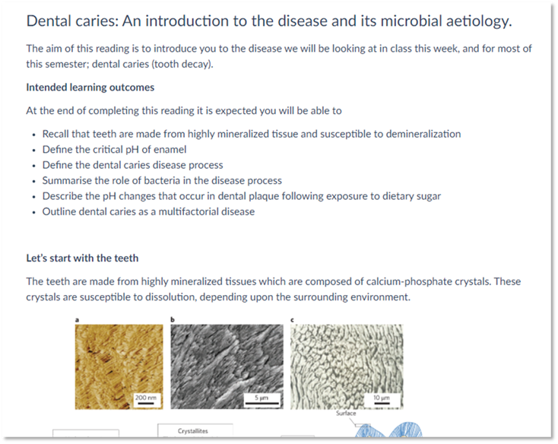
Results: There was no difference in observed preparation behaviour in the LMS between videos and readings.
No significant difference in students accessing pre-class learning before class if it was a video or reading
(McNemar’s test p = 1.00)
No significant difference in number of pre-class quiz attempts to reach 8/10 when pre-class learning was a video or reading
(Mann-Whitney U test, U = 37048.550, z = -0.285, p = 0.775, r = -0.0088)
Notes:
Looking at the influence of videos and readings, there was no significant difference in accessing the pre-class learning if it was a video or a reading.
This was to be expected, as students did not know if the pre-class learning was a video or a reading before accessing it.
There was also no difference in the number of pre-class quiz attempts to obtain a minimum score of 8/10 for readings and videos. This indicates students could prepare just as well with both videos and readings.

Slide 7
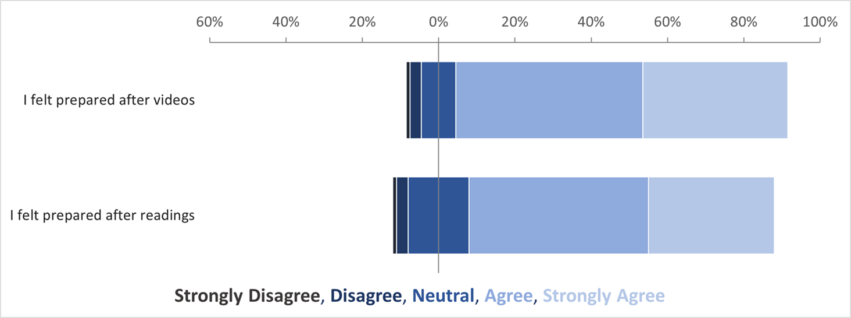
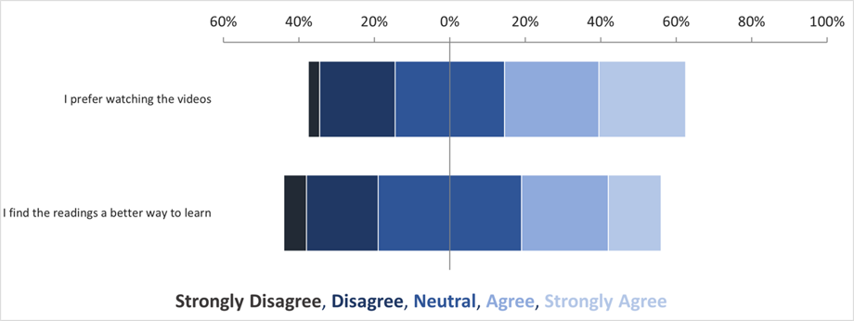
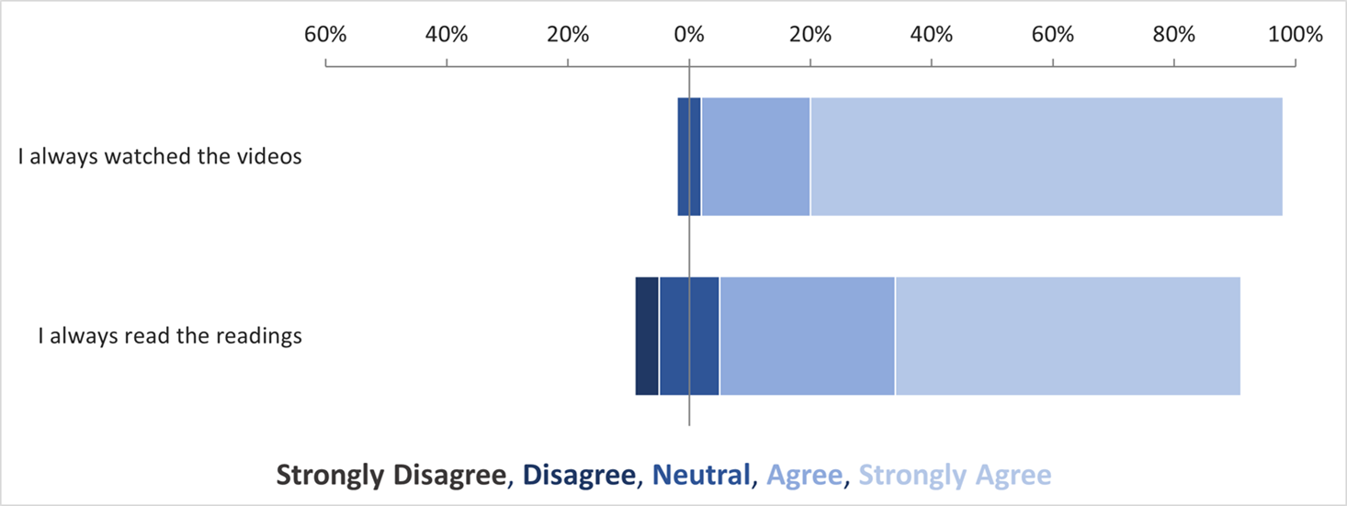
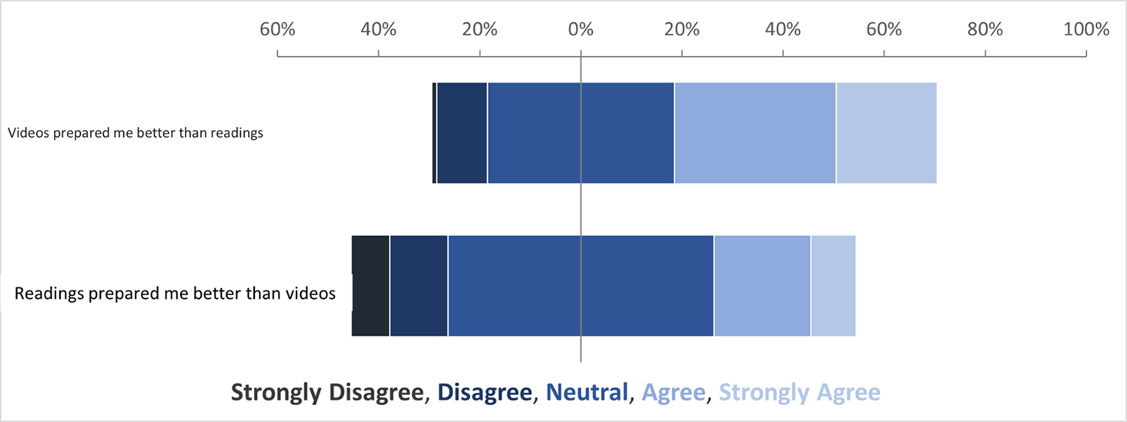
Results: Preparation behaviour and perceived relative efficacy
No difference between feeling prepared with videos and readings No difference between preference for videos and readings
Paired-samples t-tests
Significant difference between self-reported preparation with videos and readings
Videos (M = 4.75), Readings (M = 4.39), t(78) = 4.509, p<0.001
Significant difference between perceived relative efficacy of videos and readings
Videos better (M = 3.58), Readings better (M = 3.10), t(77) = 2.470, p<0.001
Notes:
Looking at student perceptions of and preferences for the different preparation materials,
there was no significant difference in students feeling prepared after videos and readings. And (click) there was no significant difference between students preferring videos and readings.
(click) However, significantly more students reported always watching the videos before coming to class than completing the readings. And significantly more students felt that the videos prepared them for class better than the readings.
What this shows is that when a student visits a page on the LMS, the activity type such as video or reading may influence their behaviour.

Slide 8

Results: Qualitative analysis of perceptions of pre-class learning
What did you like about the videos?
What did you dislike about the videos?
What did you like about the readings?
What did you dislike about the readings?
What factors did you feel facilitated your ability to prepare for class?
What factors did you feel hindered your ability to prepare for class?
What could your instructor have done to improve your experience?
Any other comments?
Reflexive thematic analysis (Braun and Clarke 2006, 2021)
Iterative, inductive process of coding (Excel)
Semantic coding, with selective latent coding
Candidate themes generated to describe patterns of meaning across the dataset, avoiding a priori frameworks
Notes:
We will now look at the qualitative data.
Students were asked about what they liked and disliked about the videos and readings, and what they felt facilitated or hindered their preparation for class.
(click) Qualitative data was analysed using reflexive thematic analysis.

Slide 9





Theme 1: I can see the value in preparing for class
“The pre-class learning gave me an overview of the topic that we were going to learn about in the next class which created an incentive to complete them so as to reduce confusion during the class itself” (2022_10)
Theme 2: The pre-class learning needs to be just right
“Lengthy pre class learning materials discouraged me from completing the required activities and the quiz would then be completed not to the best of my ability and not after a productive study session.” (2023_10)
Theme 3: The structure of the content and learning at my own pace are important to me
“I loved how organised this class was, I knew what needed to be done and it was easy to pair the learning outcomes with the readings and lecture slides provided.” (2023_17)
Theme 4: I want to feel like the teacher is explaining the concept to me
“It for me was a bit harder to stay engaged and on track w [sic] the readings as you know there wasn’t a voice or a person directing through.” (2021_05)
Theme 5: Quizzes motivate me and help me prepare
“In order to get more than 8/10, I had to read the pre-learning material which helped me to stay up to date with all the content. This helped me to prepare me for class every week.” (2023_38)
Notes:
Five themes were developed.
(click) The first theme was “I can see the value in preparing for class”. Students felt the pre-class learning was a valuable use of their time. Key to this theme was students seeing clear connections between the pre-class activities and what they were doing in class.
(click) The second theme describes that students didn’t want the pre-class learning activities to take too long or be too difficult.
(click) The third theme captured descriptions of the clear consistent structure of the activities in the LMS as facilitating their preparation.
(click) The fourth theme was ‘I want to feel like the teacher is explaining the concept to me’ In this theme, students expressed that the teachers’ voice helped keep them engaged and improved their learning.
(click) In the final theme, the quizzes were described by students as increasing motivation, enabling them to monitor their preparation and facilitating a feeling of enjoyment associated with preparation

Slide 10
Discussion: Preparation and Self-regulated Learning
Students want to prepare for class and will do so if they perceive it as valuable
SRL strategy: Task value activation
Format of pre-class learning influences preparation behaviour and perceptions of preparedness, with videos and readings associated with different SRL strategies
SRL strategy: Videos – interest activation, increasing motivation
SRL strategy: Readings - monitoring of cognition, but may enable short-cut taking behaviour
Manageable, well-structured pre-class learning enables students to manage their cognitive load and self-regulated their learning
Self-regulated learning strategy: Time management
Quizzes enable self-regulation during pre-class learning in a flipped classroom
Self-regulated learning strategy: Task value activation, Judgements of learning
Wang et al., 2025
Walsh et al., 2024
Persky et al., 2015
Kwong et al., 2026
Mojtahedi et al., 2020
Notes:
Multiple self-regulated learning strategies were observed following qualitative data analysis.
(click) Students want to prepare for class, and this is associated with task value activation.
(click) Videos and readings are associated with different SRL strategies. Videos increase students’ interest and motivation, and readings enable students to monitor their cognition.
(click) Manageable, well structured pre-class learning enables students to self-regulate their learning, particularly enabling time management
(click) And quizzes support student preparation through task value activation, and enabling judgements of learning.

Slide 11




Implications for practice: supporting preparation
To support self-regulation of cognition, and behaviour, students need to know how and why to complete the pre-class learning
To support self-regulation via task-value activation, pre-class learning must be designed such that each activity is clearly linked to each subsequent activity
To support self-regulation via interest activation, it is best to use instructor developed videos when employing videos for pre-class learning
To support students to self-regulate their cognition and motivation, consider incorporating quizzes into pre-class learning
Notes:
To support self-regulation of cognition, and behaviour, students need to know how and why to complete the pre-class learning
(click) To support self-regulation via task-value activation, pre-class learning must be designed such that each activity is clearly linked to each subsequent activity
(click) To support self-regulation via interest activation, it is best to use instructor developed videos when employing videos for pre-class learning
(click) To support students to self-regulate their cognition and motivation, consider incorporating quizzes into pre-class learning

Slide 12
Thank you
Research Supervisors
A/Prof Kristine Elliott
A/Prof Heather Verkade
A/Prof Sean Kang
Advisory Chair
Prof Jan van Driel
The Statistical Consulting Centre at the University of Melbourne
Dr James Fernando
BOH1 cohorts 2020 – 2023
Photographs from Unsplash (unsplash.com)
Icons created with The Noun Project (thenounproject.com)
This project was supported by an MDS Learning & Teaching Futures Grant

Slide 13
References
Akçayır, G., & Akçayır, M. (2018). The flipped classroom: A review of its advantages and challenges. Computers & Education, 126, 334-345.
Baig, M. I., & Yadegaridehkordi, E. (2023). Flipped classroom in higher education: a systematic literature review and research challenges. International Journal of Educational Technology in Higher Education, 20(1), 61.
Bosch-Farré, C., Cicres, J., Patiño-Masó, J., Basuldo, P. M., Toran-Monserrat, P., Martínez, A. L., & del Carmen Malagón-Aguilera, M. (2024). Effectiveness of the flipped classroom methodology in higher education. A systematic review. Educación XX1, 27(1), 19-56.
Braun, V., & Clarke, V. (2006). Using thematic analysis in psychology. Qualitative Research in Psychology, 3(2), 77-101.
Braun, V., & Clarke, V. (2021). One size fits all? What counts as quality practice in (reflexive) thematic analysis? Great Britain.
Davies, R., Allen, G., Albrecht, C., Bakir, N., & Ball, N. (2021). Using educational data mining to identify and analyze student learning strategies in an online flipped classroom. Education Sciences, 11(11), 668.
Han, F. (2025). Sustainable Lifelong Learning Competence: Understanding University Students’ Self-Regulated Learning in Flipped Classrooms by Combining Questionnaire and Learning Analytics Data. Sustainability, 17(21), 9495.
Jansen, R. S., Van Leeuwen, A., Janssen, J., & Kester, L. (2018). Validation of the revised self-regulated online learning questionnaire Lifelong Technology-Enhanced Learning: 13th European Conference on Technology Enhanced Learning, https://doi.org/10.13140/RG.2.2.12530.56004
Kwong, R., Kwok, M. L. J., & Wong, H. (2026). Autonomous and controlled motivation in a flipped-classroom approach. Asia Pacific Education Review, 27(2), 509-521. https://doi.org/10.1007/s12564-024-09983-0
Lee, J., & Choi, H. (2019). Rethinking the flipped learning pre-class: Its influence on the success of flipped learning and related factors. British Journal of Educational Technology, 50(2), 934-945. https://doi.org/10.1111/bjet.12618

Slide 14
References
Mojtahedi, M., Kamardeen, I., Rahmat, H., & Ryan, C. (2020). Flipped Classroom Model for Enhancing Student Learning in Construction Education. Journal of Civil Engineering Education, 146(2), Article 05019001. https://doi.org/10.1061/(ASCE)EI.2643-9115.0000004
Mok, H.N. (2014). Teaching Tip: The Flipped Classroom [Article]. Journal of Information Systems Education, 25(1), 7-11.
Naing, C., Whittaker, M. A., Aung, H. H., Chellappan, D. K., & Riegelman, A. (2023). The effects of flipped classrooms to improve learning outcomes in undergraduate health professional education: A systematic review. Campbell Systematic Reviews, 19(3), Article e1339. https://doi.org/10.1002/cl2.1339
Oudbier, J., Spaai, G., Timmermans, K., & Boerboom, T. (2022). Enhancing the effectiveness of flipped classroom in health science education: a state-of-the-art review. Bmc Medical Education, 22(1), 34.
Persky, A. M. (2015). Qualitative Analysis of Animation Versus Reading for Pre-Class Preparation in a "Flipped" Classroom. Journal on Excellence in College Teaching, 26(1), 5 - 28.
Strelan, P., Osborn, A., & Palmer, E. (2020). Student satisfaction with courses and instructors in a flipped classroom: A meta-analysis. Journal of Computer Assisted Learning, 36(3), 295-314. https://doi.org/https://doi.org/10.1111/jcal.12421
Sun, Z., & Xie, K. (2020). How do students prepare in the pre-class setting of a flipped undergraduate math course? A latent profile analysis of learning behavior and the impact of achievement goals. The Internet and Higher Education, 46, 100731.
Walsh, J. N. (2024). Using cluster analysis to identify procrastination and student learning strategies in a flipped classroom. The International Journal of Management Education, 22(1), Article 100936. https://doi.org/10.1016/j.ijme.2024.100936
Wang, L., de Vetten, A., Admiraal, W., & van der Rijst, R. (2025). The Relationship Between Students’ Pre-Class Learning Behaviors and Student Engagement in Tutorials. Active Learning in Higher Education, 1-14. https://doi.org/10.1177/14697874251367661

