Slide 1
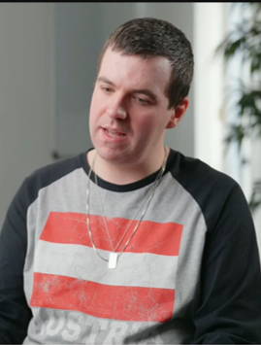

Embedding Cultural Humility in Dental Education:
An Experiential Teaching Approach to Developing Empathy and Inclusive Practice
Harriet Boyd
Lecturer in Societal and Cultural Transformation in Dental Education

Slide 2
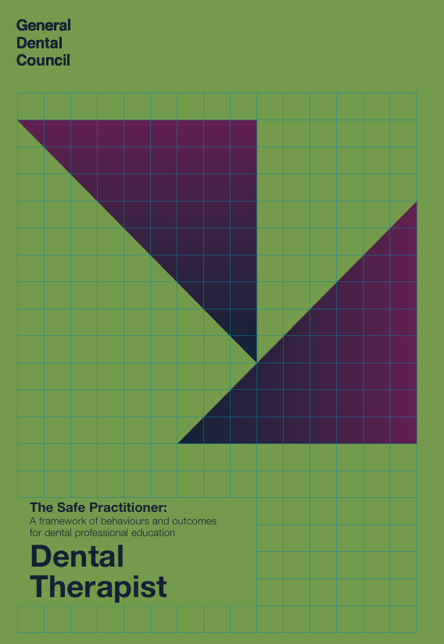
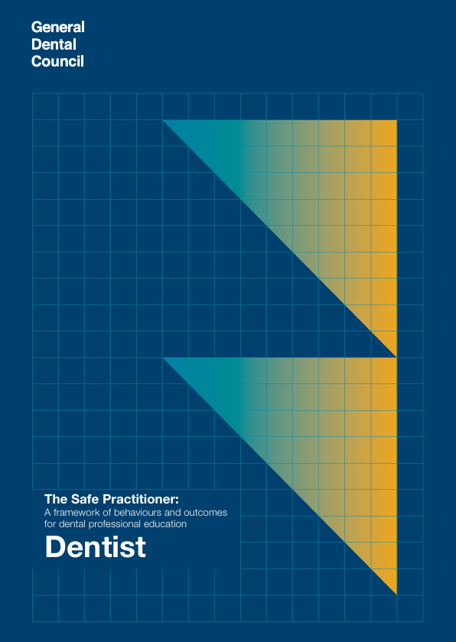
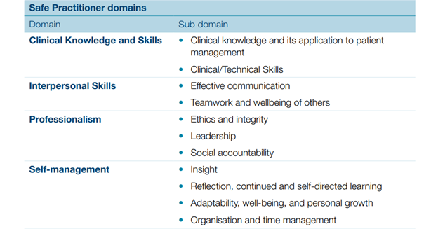
GDC Safe Practitioner Framework
I2.4 - Explain the contribution that team members and effective team working makes to the delivery of safe and effective high-quality care, including the benefits of working in culturally diverse teams
P(B)3 - Demonstrate cultural competence, accepting and respecting the diversity of patients and colleagues
P1.3 - Describe diversity, equality, inclusion and discrimination and the underpinning legislation, and explain how to apply these principles to manage patients with protected characteristics and work within the dental team (noting that this legislation may differ in England, Scotland, Wales and Northern Ireland)
P 1.4 - Explain cultural competence and its relevance in assessing the needs and planning care for patients from diverse backgrounds

Slide 3


Learning resource identity

Slide 4
Resource package
Stage 1: Groundwork online resource, accessible via Minerva.
1
Stage 2: Two face-to-face teaching sessions:
2
A full cohort lecture.
A small group discussion using bite-sized videos of patients and staff members with protected characteristics sharing their prior dental experiences.
Stage 3: Guided reflection following the face-to-face teaching sessions, which will form part of the PPD portfolio, accessible via CAFS.
3

Slide 5
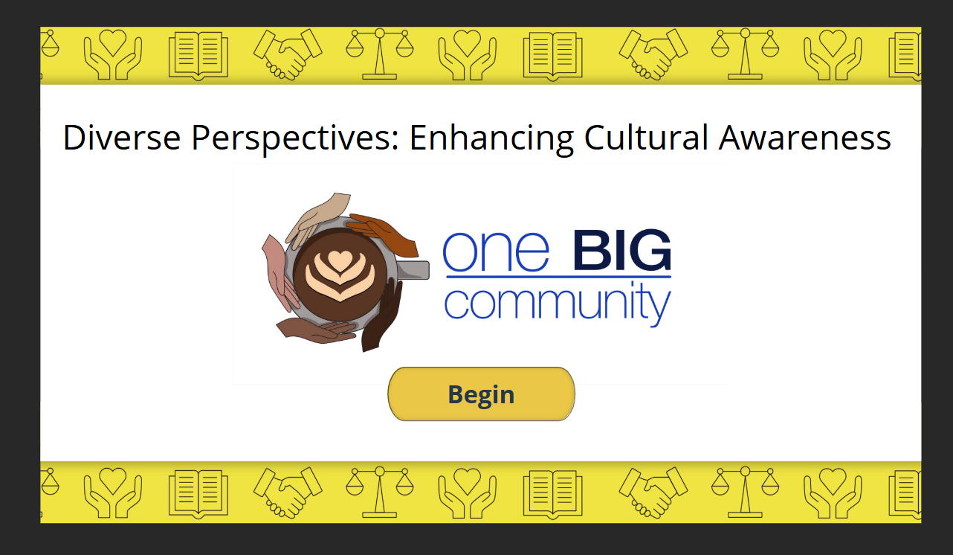
Stage 1: Pre-learning resource package
Psychological safety development
Focus on language barriers and cultural differences
Put students in the space of language and cultural differences

Slide 6
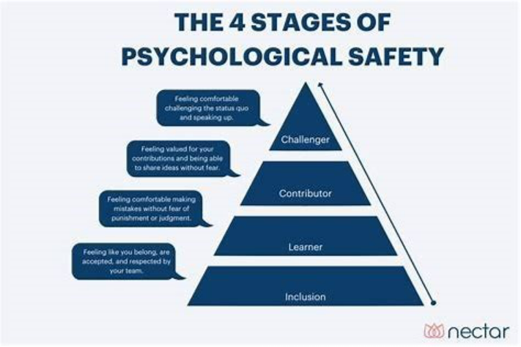
The 4 Stages of Psychological Safety
Year 1

Slide 7
Stage 2: Full group lecture
Understand cultural humility and the principles of equality, diversity and inclusion in dentistry, including relevant legislative frameworks
Recognise protected characteristics, intersectionality, unconscious bias, stereotyping and prejudice

Slide 8
Stage 2: Seminars
Small group learning: Students work in organised small groups, further divided into smaller discussion groups
Bite-sized videos: Short clips sharing lived experiences of patients and staff with protected characteristics
Facilitated discussions: A psychologically safe space to explore the challenges presented in the videos

Slide 9

A taste of one of the videos...

Slide 10
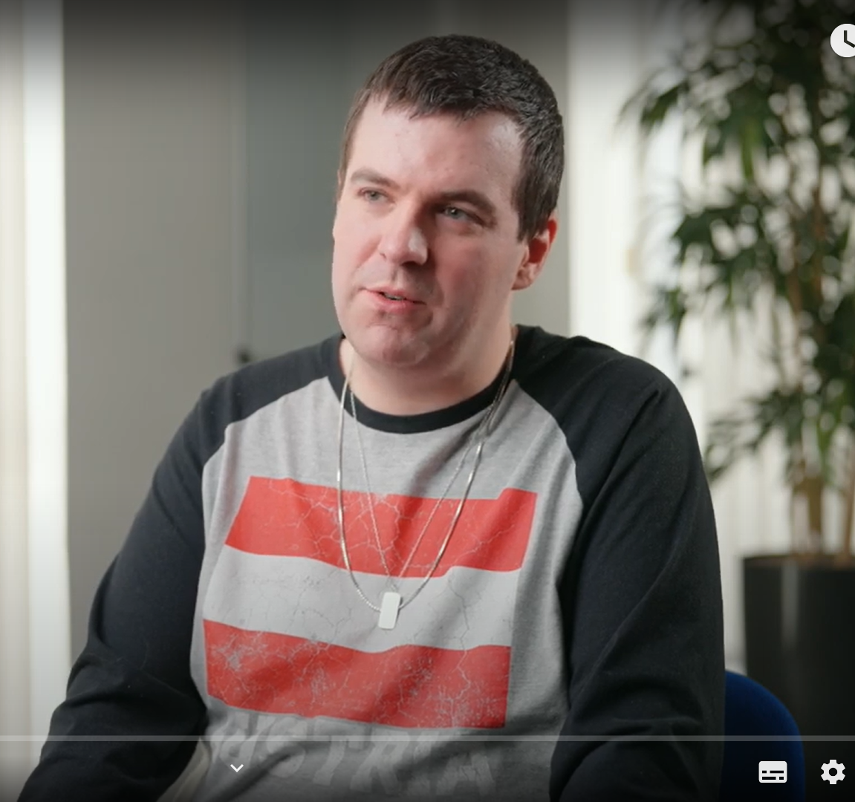
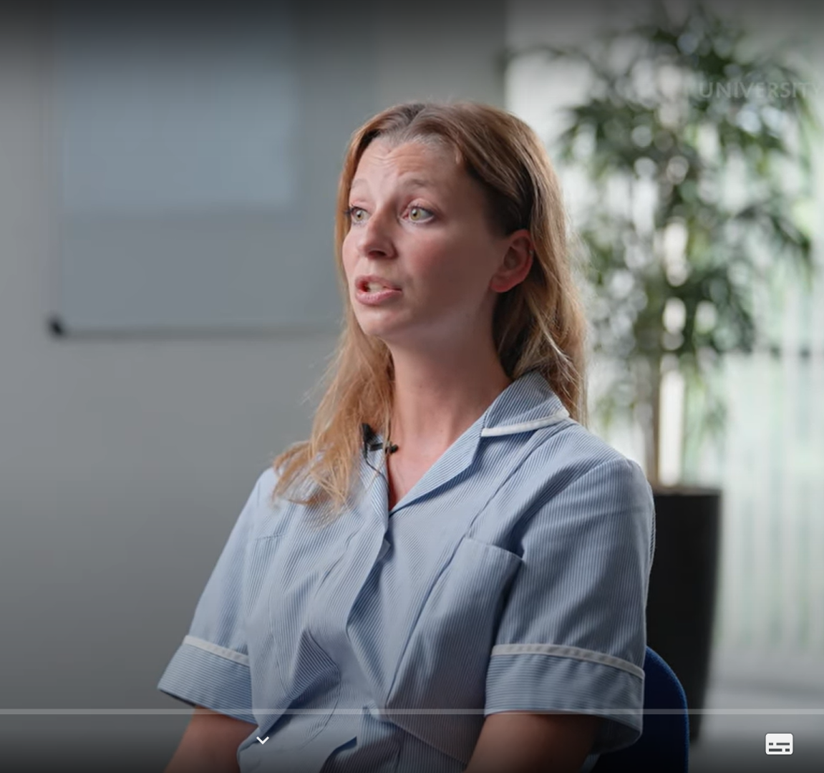
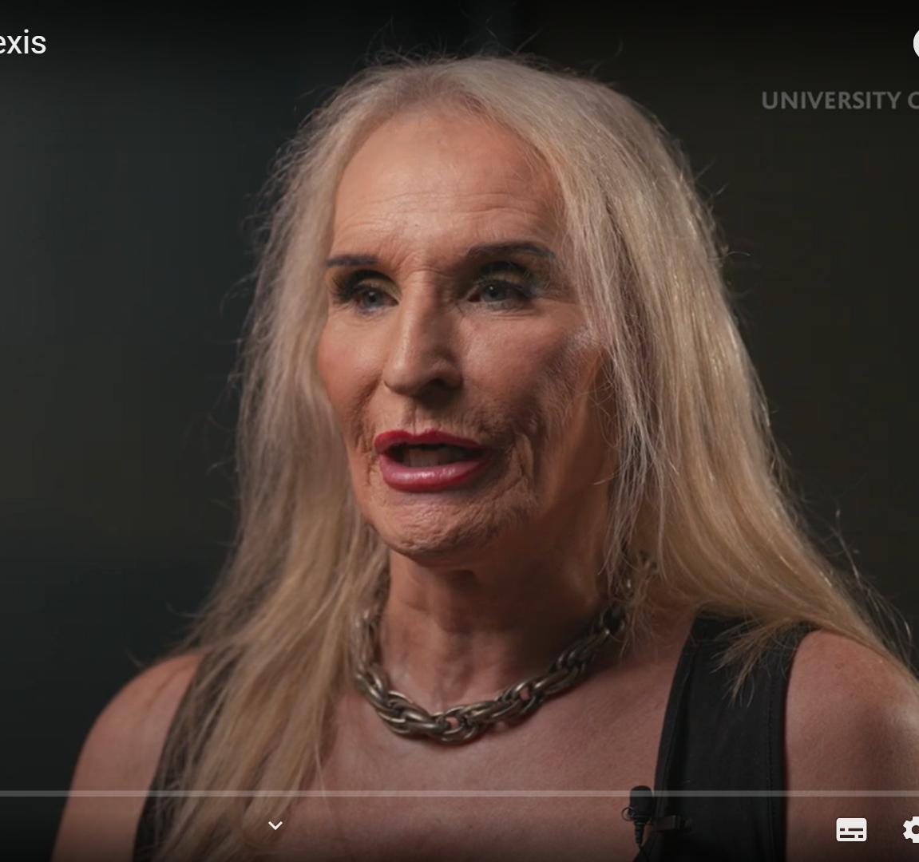
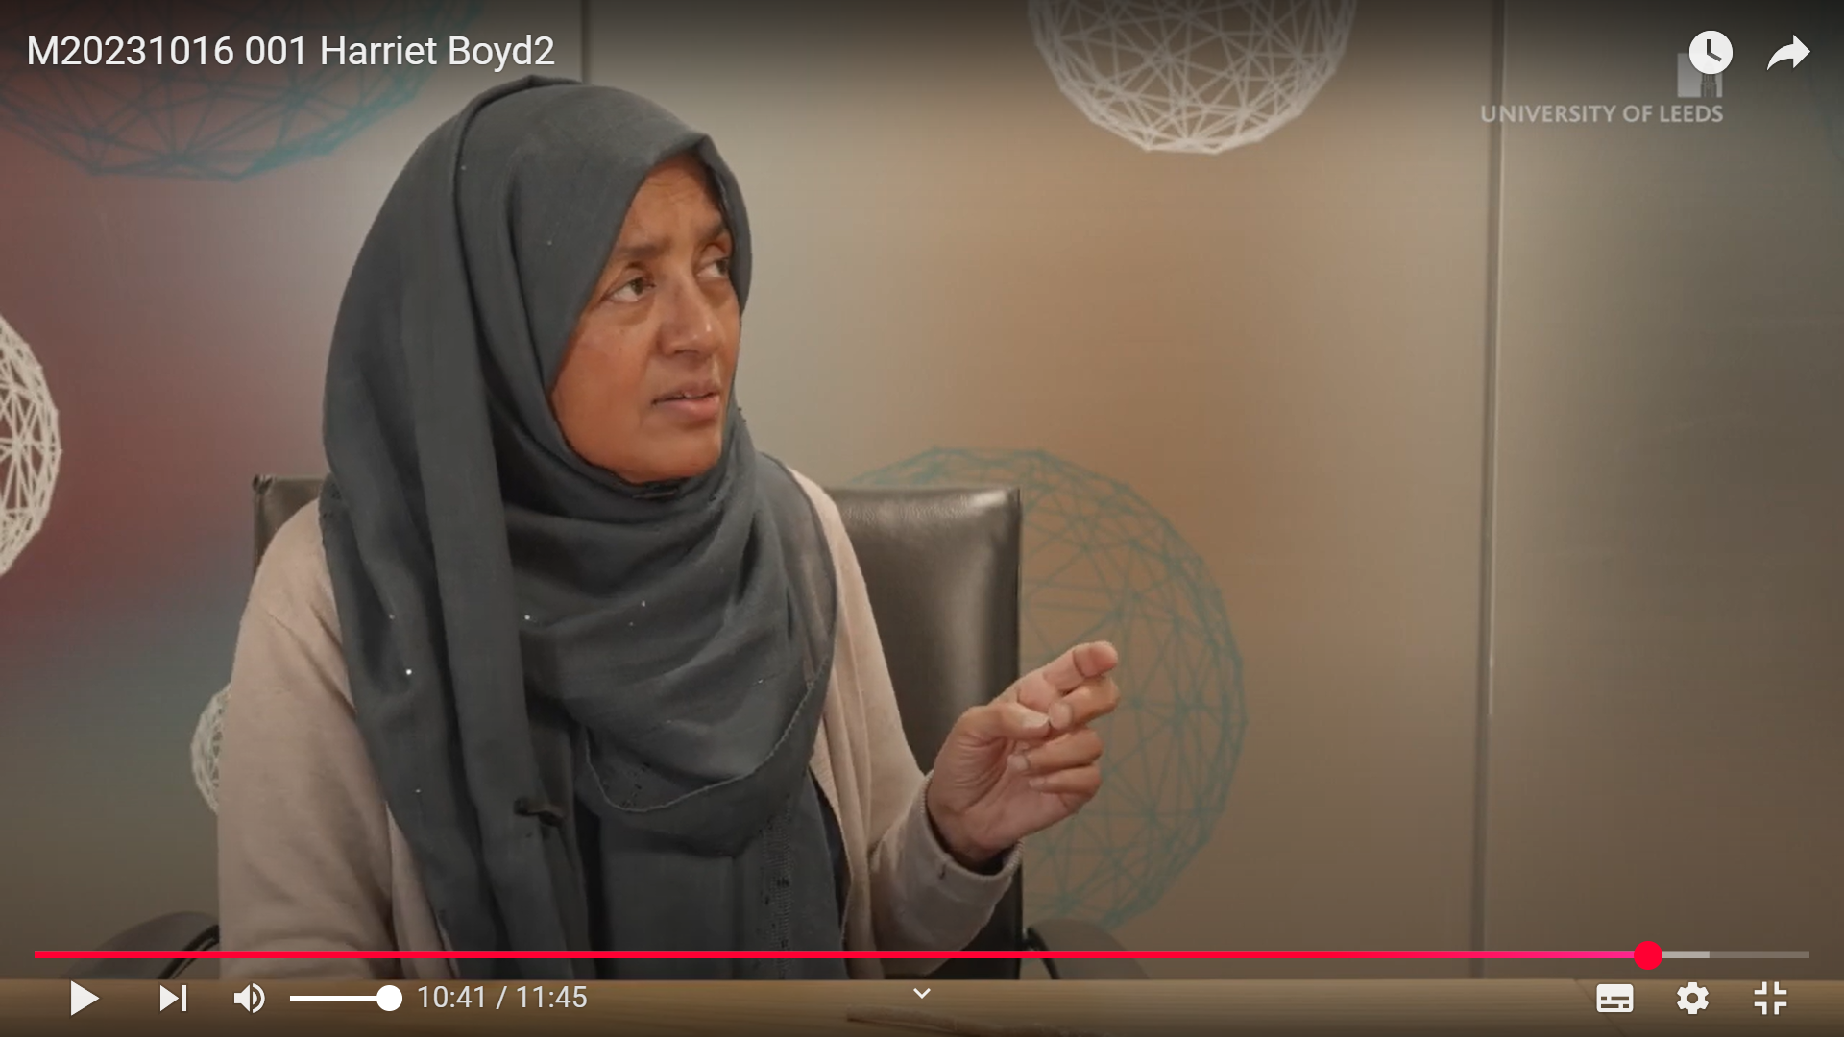
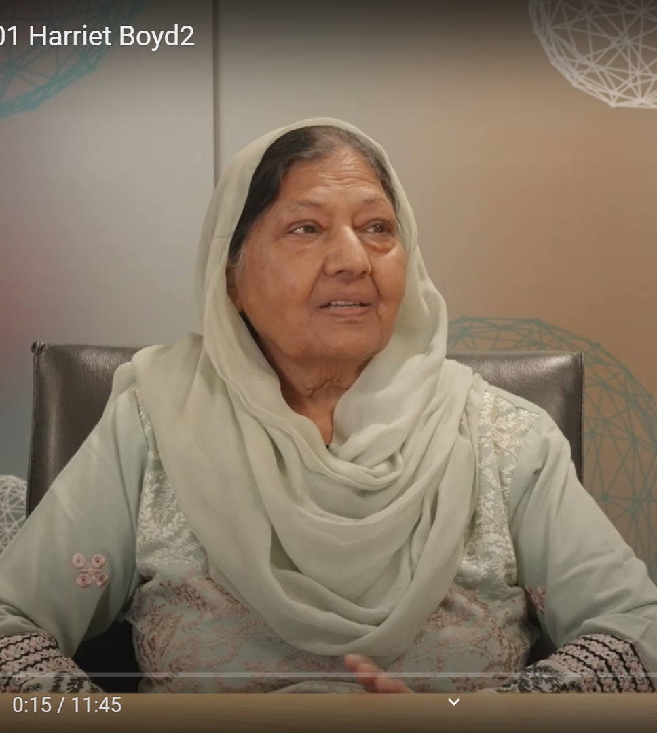
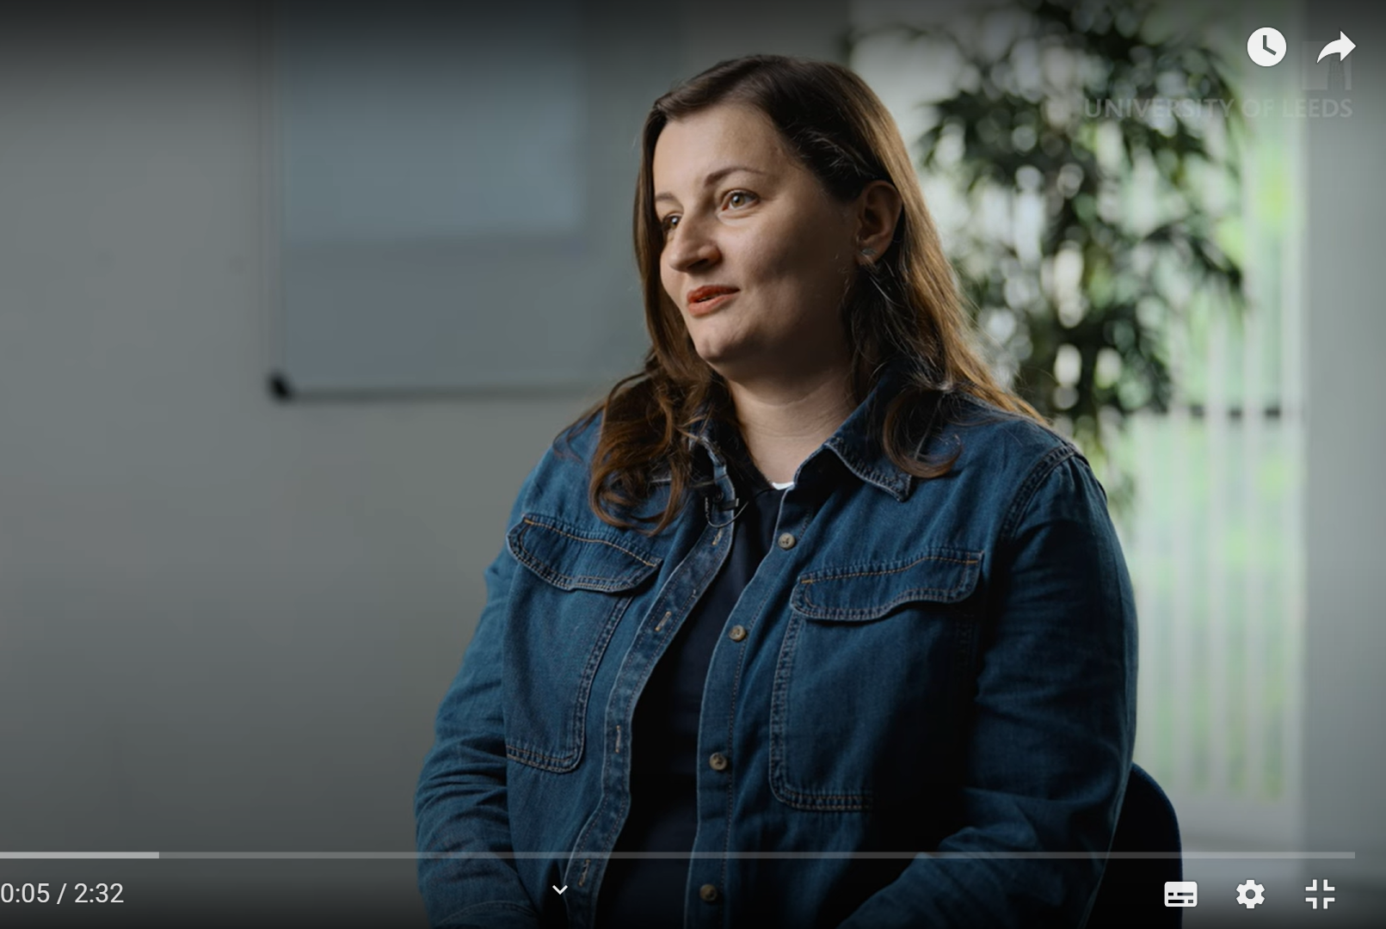
Razia and Yasmin - explores ethnicity, culture and religion
Michael – explores disability
Ewelina – explores ethnicity and culture
Marta - explores ethnicity, culture and sexual orientation
Alexis – explores gender

Slide 11
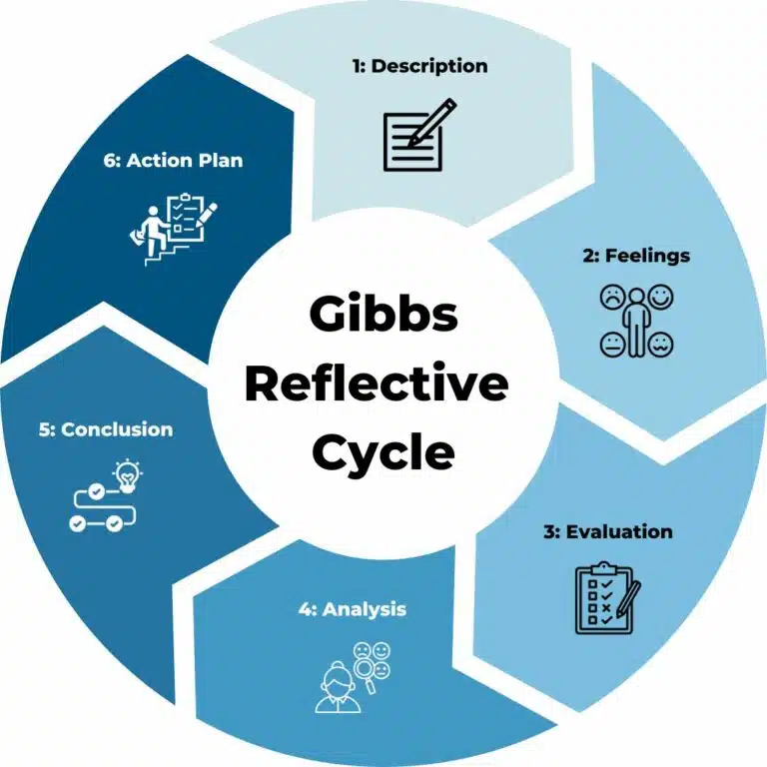
Stage 3: Guided Reflection
Guided questions using the Gibbs reflective cycle
Engagement matters
Wellbeing support / signposting
Part of their professional development portfolio
Gibbs Reflective Cycle 1988

Slide 12
Safe space
Engagement
Professional growth
Empathy and compassion
Challenging bias
Inclusive practice
Professional identify / guardianship
Courage to open up
Curiosity to learn
Applying baseline knowledge
Story bonding / deep discussion
Constructive discomfort

Slide 13
Next steps
Designing Year 2: Develop progression into Year 2 with a continued focus on reflective practice and inclusive learning.
Leeds-Vanderbilt Collaboration: Explore how psychological safety develops longitudinally across the programme.
Dissemination: Publication currently under preparation.

Slide 14
References
General Dental Council (2023) Safe practitioner learning outcomes and behaviour framework. London.
Gibbs, G. (1988) Learning by doing: A guide to teaching and learning methods. Oxford: Further Education Unit.
Kotru, D. (2024) From fear to fearless: 6 strategies to creating a psychologically safe workplace. Anzen Consulting.
Vanderbilt University Medical Center (n.d.) Center for Patient and Professional Advocacy (CPPA). Available at: https://www.vumc.org/cppa.

