Slide 1



Emotional Vulnerability and Suicidal Risk among Dental Students: Findings from the PROSIA-U Study
Cristina de la Rosa Gay
Universitat de Barcelona

Slide 2
Suicide: Leading Cause of Death Among Youth (aged 15-29) in Spain
Core Objectives of the Projects:
- Analyzing Risk and Protective Factors
- Involving the Educational Community
Prosia-Y
(Young people)
Prosia-U
(University students)
Prosia-B
(Barcelona’s Youth)
Universitat de Barcelona

Slide 3
Academic pressure
Social changes
Exposure to social media
Depression
Impulsivity, Trauma
Early identification
Understanding to improve prevention strategies
Promoting students’ emotional well-being
Emotional Distress
Mental Health Problems
Suicidal Behavior
Universitat de Barcelona

Slide 4
Risk Factors / Predictors: stress, academic burnout, loneliness, impulsivity, childhood trauma, social media use, substance use, family functioning, personal/family history of suicide.
Outcomes: Emotional distress indicators, non-suicidal self-injury, suicidal thoughts/ behaviors
Protective Factors: Resilience, coping strategies, life satisfaction, social support.
Materials & Methods
Mesures & Variables:
Anonymous Online Questionnaire
Confidental and Voluntary
Gender Perspective
196 Dental Students
Cross-sectional Study
169
27
Universitat de Barcelona

Slide 5
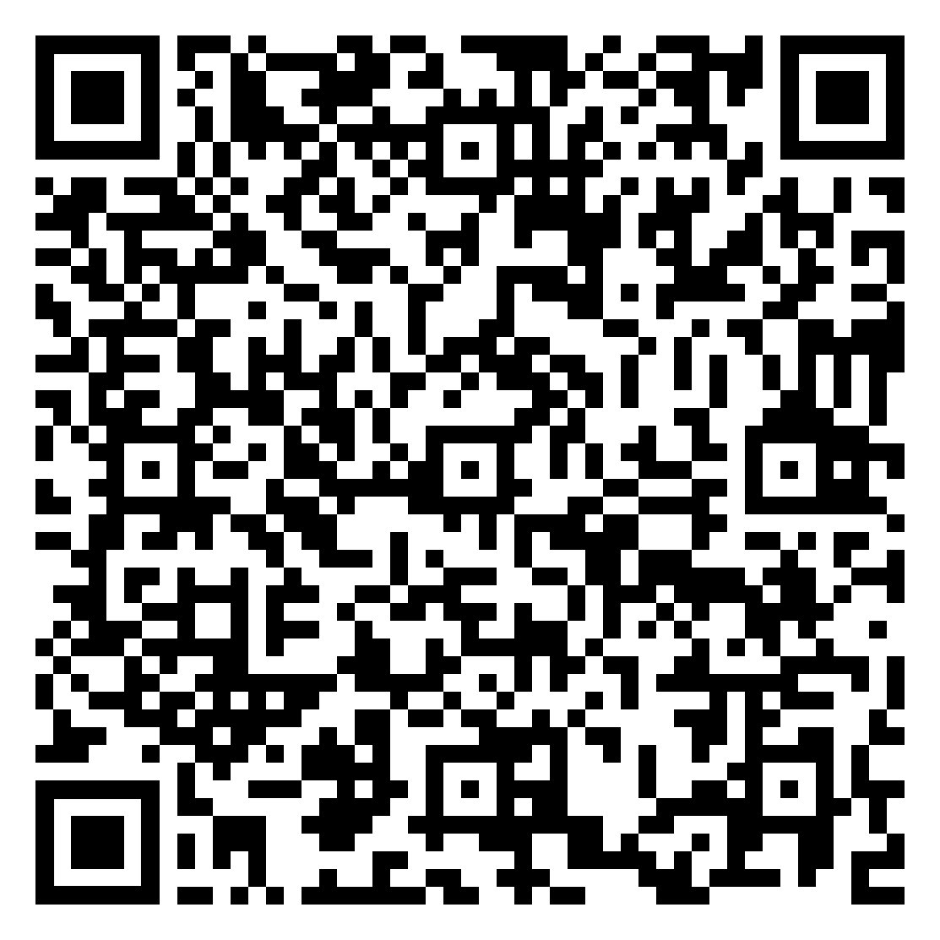
Key Results
Sample Characteristics
Median age: 21 years
86.2 % Women
Social Media Use
TikTok: 9h / week
Instagram: 7 h /week
Mental Health Indicators
Suicidal Thoughts: 42.9% Women vs 29.6% Men
Suicide attempts: 3.0% Women (5)
34.7% migrated to Barcelona
22.4% combined work & study
Non-Suicidal Self-Injury: 12.5% Women / 14.8% Men
YouTube: 3h/week
Facebook: 1h/week
X: 1h/week
Universitat de Barcelona

Slide 6
Notable Levels of Emotional Distress
Women: particularly vulnerable
High Social Media Use
Infrequent Suicide Attempts
Unmet Emotional Needs – Vulnerability
Prevalence of non suicidal self-injury
Academic Pressure
High Academic Demands
Intense Clinical Training
High Stress Levels
Reported thoughts of wanting to disappear
Universitat de Barcelona

Slide 7
Better address students’ well being
Reduce future risk
Prevention
Early Detection
Mental Health Support
Universitat de Barcelona

Slide 8
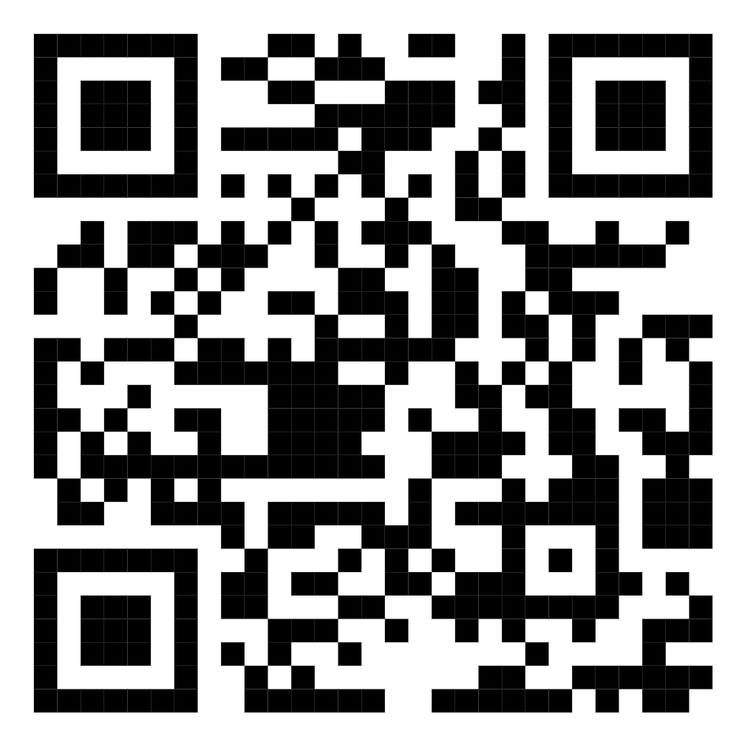
References
Carballo, J. J., Llorente, C., Kehrmann, L., Flamarique, I., Zuddas, A., Purper-Ouakil, D., Hoekstra, P. J., Coghill, D., Schulze, U. M. E., Dittmann, R. W., Buitelaar, J. K., Castro-Fornieles, J., Lievesley, K., Santosh, P., & Arango, C. (2020). Psychosocial risk factors for suicidality in children and adolescents. European Child & Adolescent Psychiatry, 29(6), 759-776.
Compas, B. E., Jaser, S. S., Bettis, A. H., Watson, K. H., Gruhn, M. A., Dunbar, J. P., Williams, E., & Thigpen, J. C. (2017). Coping, emotion regulation, and psychopathology in childhood and adolescence: A meta-analysis and narrative review. Psychological Bulletin, 143(9), 939-991.
Memon, A. M., Sharma, S. G., Mohite, S. S., & Jain, S. (2018). The role of online social networking on deliberate self-harm and suicidality in adolescents: A systematized review of literature. Indian Journal of Psychiatry, 60(4), 384.
Miranda-Mendizabal, A., Castellví, P., Parés-Badell, O., Alayo, I., Almenara, J., Alonso, I., Blasco, M. J., Cebrià, A., Gabilondo, A., Gili, M., Lagares, C., Piqueras, J. A., Rodríguez-Jiménez, T., Rodríguez-Marín, J., Roca, M., Soto-Sanz, V., Vilagut, G., & Alonso, J. (2019). Gender differences in suicidal behavior in adolescents and young adults: Systematic review and meta-analysis of longitudinal studies. International journal of public health, 64(2), 265-283.
Muyor-Rodríguez, J., Caravaca-Sánchez, F., & Fernández-Prados, J. S. (2021). COVID-19 Fear, Resilience, Social Support, Anxiety, and Suicide among College Students in Spain. International Journal of Environmental Research and Public Health, 18(15), 8156.
Universitat de Barcelona

Slide 9
Thanks!
Does anyone have any question?
Cristina de la Rosa Gay
crosagay@ub.edu
Universitat de Barcelona

