Slide 1
ADEE ANNUAL MEETING | 2026
LIVE
Are Live Demonstrations Still the Gold Standard in Dental Education?
VIDEO
BMC Medical Education 2025;25:108 · doi.org/10.1186/s12909-025-06672-3
Notes:
[0:00-0:45] Good morning. I’m Rawan AlKahtani a clinical consultant and assistant professor of restorative dentistry from Princess Nourah bint Abdulrahman University in Saudi Arabia.

Slide 2
Why ask this question?
1
THE EVIDENCE SO FAR
Psychomotor skill is the core of dental training
Mixed
Most single trials report no significant difference in performance
Satisfaction findings contradict each other
No pooled estimate existed for dentistry
2
Live demonstration is fragile at scale
3
Video is available — but is it equivalent?
AlKahtani et al., BMC Medical Education 2025;25:108
Notes:
Wy are we asking this question ? Three points. First, demonstration is how psychomotor skills by observational learning of a motor task. Second, the live model is fragile: it varies by instructor, visibility collapses at high ratios, and time usually allows one pass only. Third, video promises consistency, a close-up view and unlimited replay — but most faculty still treat it as supplementary rather than a replacement. Individual trials have been inconsistent and nobody had pooled them for dentistry. That was our gap.

Slide 3
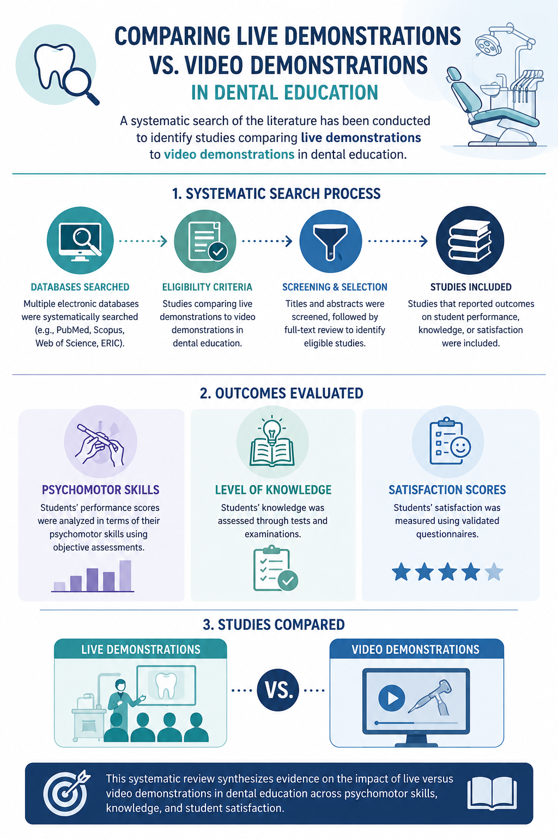
Studies Compared
To find our answers— we must know where to look
Notes:
We carried out a systematic search of the literature to identify studies comparing live demonstrations to video demonstrations in dental education.

Slide 4
Outcomes Evaluated
Three outcomes were assessed
Notes:
These studies have investigated and analyzed undergraduate students’ performance scores in terms of their psychomotor skills, level of knowledge, and satisfaction scores reported
through questionnaires.

Slide 5
Review question
PICO framework — PRISMA-guided systematic review
In dental education, how do recorded video demonstrations compare to live demonstrations in terms of undergraduate student performance and satisfaction scores?
P
I
C
O
Population
Intervention
Comparator
Outcomes
Undergraduate dental students
Excluded: postgraduates, non-dental students
Recorded video demonstration of a psychomotor clinical skill
Excluded: online lectures, live-video, 3D models, e-modules
Live (in-person) demonstration
Excluded: live lectures
Quantitative performance (practical/knowledge grades)
Quantitative satisfaction scores
Study designs: randomised controlled trials and quasi-experimental trials · full text · English language
Notes:
Our aim: systematically review and compare live versus recorded video demonstrations for undergraduate practical performance, knowledge, and satisfaction. The PICO question is on screen. Two boundaries matter for interpreting our results. Intervention had to be a pre-recorded video of a psychomotor skill . And the comparator had to be a live demonstration, not a live lecture. Only RCTs and quasi-experimental trials were eligible.

Slide 6
From 3,686 records to 8 poolable studies
PRISMA flow
3,686
2,222
34
10
8
›
›
›
›
records identified
after duplicates removed
full texts assessed
included in the review
in the meta-analysis
PubMed 2,426 · Ovid 926
Scopus 173 · WoS 149 · other 6+6
1,464 duplicates removed
2,188 excluded on title/abstract
24 excluded on intervention (12),
comparator (6) or design (6)
1 excluded: fair quality
1 excluded: insufficient data
Nine randomised controlled trials and one quasi-experimental trial. Nine rated “good” quality, one “fair” (Downs & Black).
Notes:
The search yielded 3,686 records; and Ten studies met the criteria. Two further studies could not enter the meta-analysis: due to quality or insufficient data. So ten studies narratively, eight pooled.

Slide 7
What the ten studies looked like
Published 2001-2023 · all undergraduate cohorts, 2nd to 5th year
9 : 1
28-120
6
10
RCTs : quasi-experimental
participants per study
countries (1 not reported)
different clinical procedures
Orthodontics
3 studies
Cast trimming · Adam's clasp · wire bending
Operative dentistry
3 studies
Class I & II cavity preparation · light-curing technique
Prosthodontics
3 studies
FRC post restorations · altered cast · arrangement of denture artificial teeth
Endodontics
1 study
Working length with an electronic apex locator
Notes:
The evidence base is small and heterogeneous by design. Nine RCTs, one quasi-experiment, sample sizes from 28 to 120, spread across six countries. Critically, the ten studies taught ten different procedures across four specialties

Slide 8
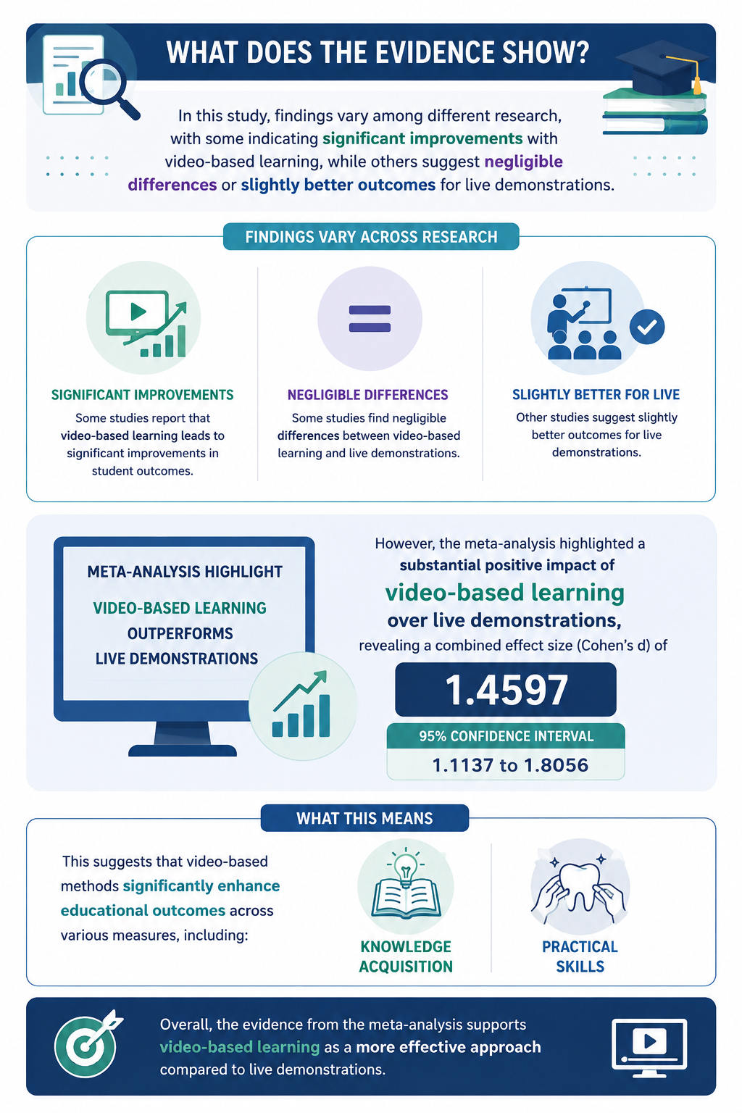
Findings Vary Across Research
Data overview of included studies
Notes:
In this study, findings vary among different research,with some indicating significant improvements with video-based learning, while others suggest negligible differences or slightly better outcomes for live demonstrations

Slide 9
Meta-Analysis
Favoring video-based learning
Meta-analysis highlighted a positive impact of video-based learning over live demonstrations
Notes:
Data pertaining to psychomotor skills and knowledge acquisition scores were extracted and statistically analysed. the meta-analysis highlighted a substantial
positive impact of video-based learning over live demonstrations.

Slide 10
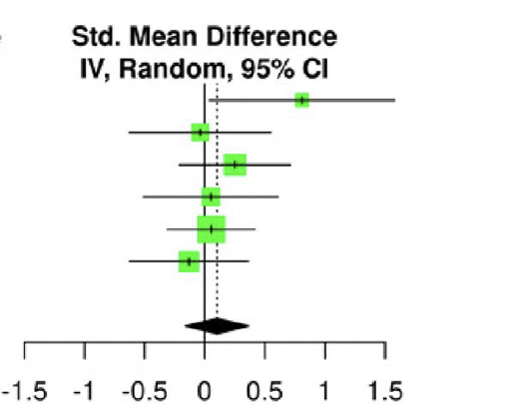
Outcome 1. Psychomotor Skills
Six studies included in the analysis
Significant differences in favour of video demonstrations.
The standard mean difference (Cohen’s d) is 0.68, with a 95% confidence interval of -0.62; 1.98 (P < 0.01)
Notes:
Student’s scores indicate that psychomotor skills were significantly improved following video demonstrations in comparison to live demonstrations revealing a SMD of 0.68 with a 95% CI.

Slide 11
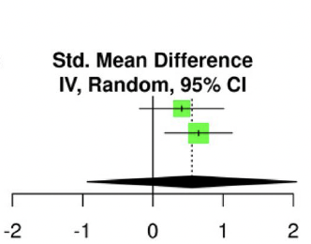
Outcome 2. Knowledge Skills
Two studies included in the analysis
Significant differences in favour of video demonstrations.
The standard mean difference (Cohen’s d) is 0.28, with a 95% confidence interval of -0.83;1.39 (P = 0.05)
Notes:
Similarly, Knowledge scores were significantly improved following video demonstrations in comparison to live demonstrations. With a SMD of 0.28 and a 95% CI.

Slide 12
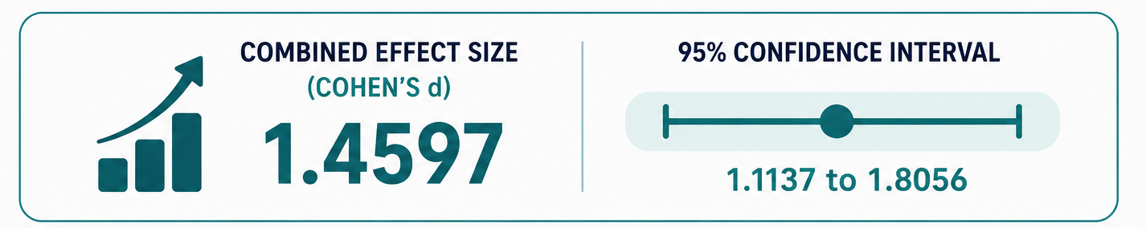
Total Effect Size
In favor of Video demonstrations
Notes:
the meta-analysis highlighted a positive impact of video-based learning over live demonstrations, revealing a combined effect size of 1.4597 and a 95% confidence interval. This
suggests that video-based methods significantly enhance educational outcomes across various measures, including knowledge acquisition and practical skills.

Slide 13
Where Advantage Concentrate
Disciplines that mostly benefit of Video-based demonstrations
The preference for video demonstrations is particularly pronounced in conservative dentistry and endodontics, compared with the other dental disciplines.
Operative dentistry
Endodontics
Conservative procedures
Working length determination
Notes:
Procedures in these disciplines are performed in a small, deep and poorly visible field. A camera can put every student in the operator's position; a live demonstration cannot.

Slide 14
Outcome 3. What Students Say
Reported strengths of each modality — satisfaction and perception data
VIDEO
LIVE
Clarity
Close-up visibility
Pause, rewind and review
Interactive
Real-time Q&A
Real-time tips and guidance
The known failure mode: students fast-forward through video and miss the minor details.
9
Notes:
Regarding student experience the two modalities are not competing — they are complementary. Video is commended for clarity, for visibility of the treatment steps, and for the ability to pause, rewind and review; students also rated it as educationally adequate. Live demonstration is valued for something video structurally cannot provide: interaction. Asking a question in the moment, getting a real-time tip, watching the whole sequence with the instructor present. One drawback students report themselves — they fast-forward, and they miss the small details.

Slide 15
What this means ?
Three practical implications for curriculum design
01
02
03
Video is a defensible primary modality
Do not delete the human
Design for the failure mode
Students skip ahead. Chapter the video, add checkpoints, reviewing it before the lab, and keep it available during and after the session.
It solves visibility, standardises the message across instructors, and removes the one-pass constraint.
The interaction students value cannot be recorded. Utilize the faculty time video frees from performing the demonstration to circulating, correcting and coaching during practice.
Notes:
[12:15-13:15] So what do you do with this? Three things. One: if you are short of faculty or teaching a large cohort, a good video is a defensible primary modality for demonstrating a procedure — the evidence supports its use. Two: do not read this as replacing the teacher. What video cannot do is answer the question the student asks while their hand is in the wrong position. Move that faculty time circulating and coaching students while practicing. Three: design against the known failure mode — chaptering, checkpoints, pre-lab viewing.

Slide 16
Conclusion
Video demonstrations are viable alternatives to live demonstrations for teaching clinical procedures in dental education.
Performance
Knowledge
Experience
Practice
Favours video; too few studies for a firm conclusion.
Favours video; too few studies for a firm conclusion.
Video wins on clarity and replay; live wins on interaction and real-time response.
Integrate both — video to deliver the procedure, faculty time to coach the practice.
Further research with standardised methodology and larger samples remains essential.
Notes:
[14:00-14:40] To conclude. Video demonstration is a viable alternative, not a compromise. On psychomotor and knowledge the direction favours video but the evidence base is thin. On student experience the two modalities are complementary. The practical message for our schools is integration: let the video carry the procedure reliably to every student, and spend the faculty hour you get back on coaching at the bench.

Slide 17
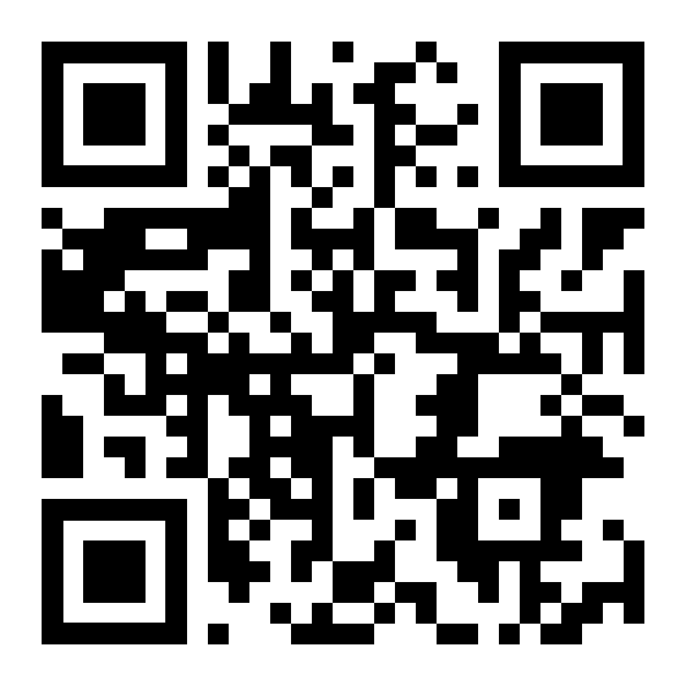
شـــــــكـــــراً
Thank You
___________________________________________________
Dr. Rawan AlKahtani, PhD
Clinical Consultant and Assistant Professor of Restorative Dentistry
Princess Nourah bint Abdulrahman University
Saudi Arabia
rnalkahtani@pnu.edu.sa
BMC Medical Education 2025;25:108 · doi.org/10.1186/s12909-025-06672-3
Profile
Notes:
Thank you very much for listening. Happy to take questions.

