Slide 1

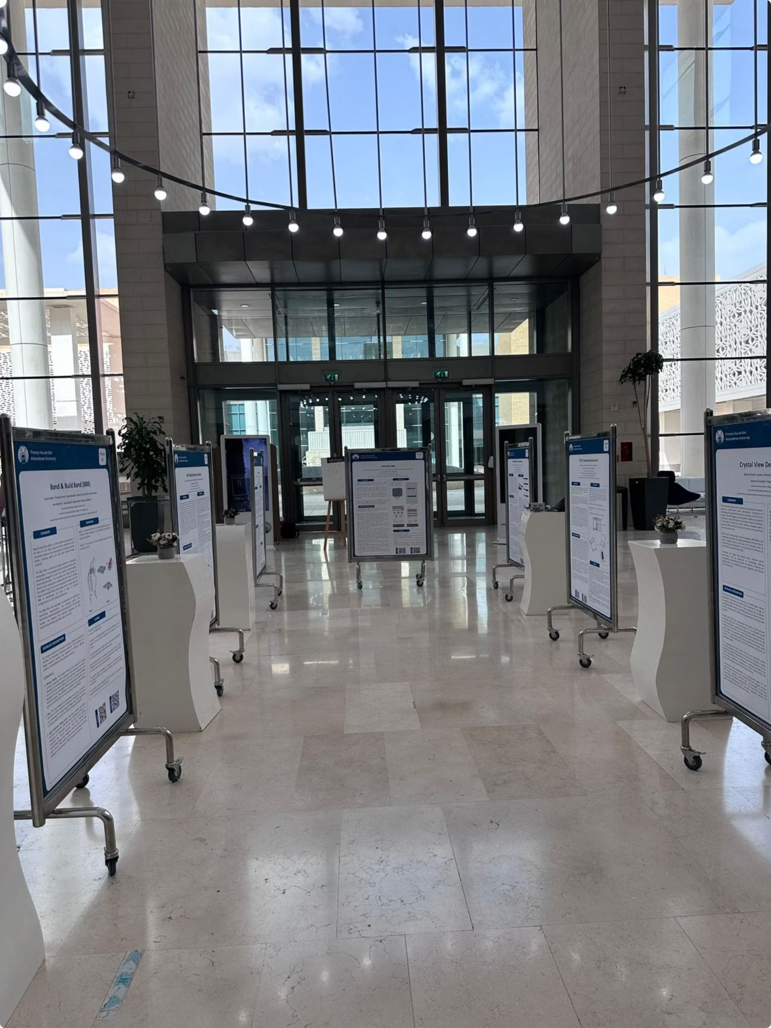
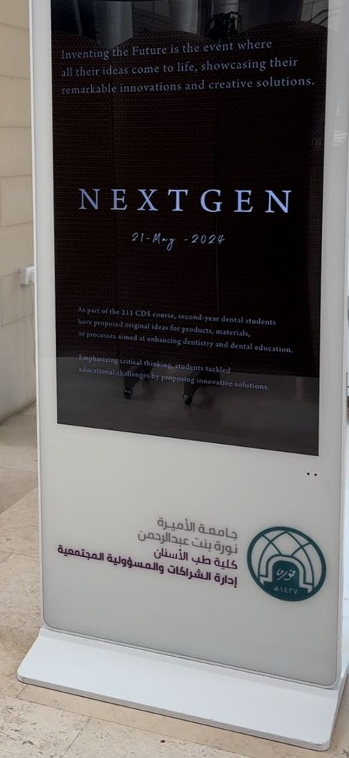
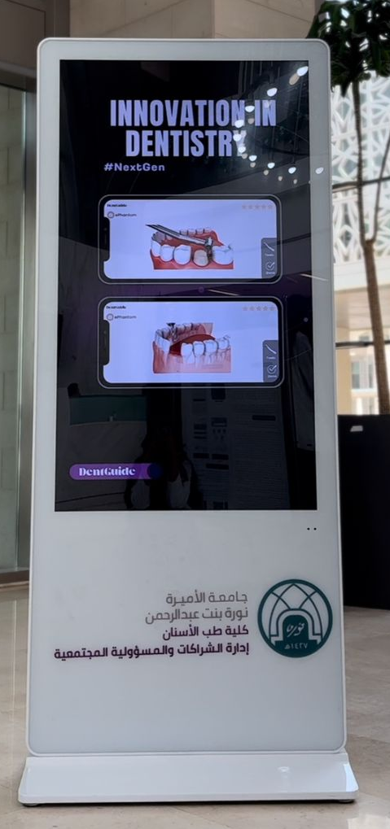
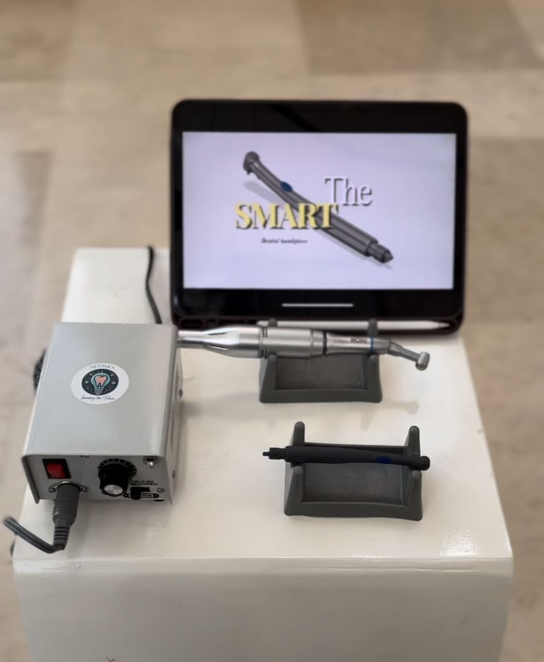
Introducing Design Thinking in Early Undergraduate Dental Education
NextGen Innovation Project
Notes:
Where in a dental curriculum do we teach students to invent? For most of us — including us, until recently — the honest answer is nowhere. NextGen: inventing the future, is our four-month answer to that question.

Slide 2



The Initiative
Innovative Solutions
Conceptual Prototyping
Interdisciplinary Collaboration
Notes:
NextGen rests on three pillars. Innovative solutions — ideation aimed at real clinical problems, not abstract creativity. Conceptual prototyping — low-fidelity work good enough to elicit feedback. And interdisciplinary collaboration — mixed teams working outside dentistry.

Slide 3
Methodology
A 4-month structured programme – 32 Second Year Dental Students
Phase 2 — Empathise, Define, Ideate
Phase 1 — Foundation
Weeks 3–6 · Team reflection on clinical problems, ideation & debate
Weeks 1–2 · Design thinking, IP, prototyping & support resources
Phase 4 — Showcase
Phase 3 — Prototype & Apply
Week 16 · Public poster session, pitch & prototype demo
Weeks 7–14 · Art & Design partnership, 3D prototypes, mini-patent application
Notes:
A four-month programme. We opened with a comprehensive lecture on design thinking, IP, prototyping, and the support resources available.
Students formed teams, reflected on real clinical difficulties, and worked through empathise–define–ideate. We met as a class to debate ideas openly. Each team committed to one innovation.
Teams were then paired with students from the College of Art and Design, who helped them sketch, visualise, and 3D-print prototypes. In parallel, each team completed a simplified mini-patent application — submitted in staged sections on announced deadlines.
The programme closed with a public poster session: pitches, prototypes, and a Q&A in front of faculty, staff, and students.

Slide 4
Why Design Thinking?
In Dentistry
Early Exposure
Human-centred problem solving
Builds lifelong innovation mindset
Notes:
Why design thinking, and why early? Two reasons. First — human-centred problem-solving is the same cognitive move a good clinician makes with a patient. Design thinking just gives it structure. Second — innovation is a habit. Introduce it in year one and it becomes part of professional identity. Our data backs this: students with no prior innovation training showed the largest gains.

Slide 5
Design-Thinking Competence
r = 0.86 (large)
Pre vs Post Intervention
Median Change
3.40 → 4.90
Self-rated design-thinking competence (1–5 scale)
4.90
3.40
Agreement Level
39% → 71%
Students agreeing or strongly agreeing with competence items
Pre
Post
Notes:
the first Outcome measured was— Design-Thinking Competence. Five items were assessed: problem identification, user observation, ideation, prototyping, iterating from feedback. Self-rated design-thinking competence median rose from 3.4 to 4.9 on a five-point scale. Effect size .86,.

Slide 6
Intellectual Property Literacy
r = 0.96 (very large)
Pre vs Post Intervention
Median Change
3.00 → 4.50
Self-rated IP literacy competence (1–5 scale)
4.50
3.00
Agreement Level
29% → 75%
Students agreeing or strongly agreeing with IP literacy items
Pre
Post
Notes:
Outcome two — IP Literacy. The one we were most nervous about. Patent content feels dry, and we expected pushback. Instead it produced our largest effect: .96. Median rose from 3.0 to 4.5. The strongest single item — knowing which offices to approach to start a patent application. Our reading: IP is an information gap, not a skill gap. Once students saw how the system works, the shift was nearly uniform.

Slide 7
Interdisciplinary Collaboration
r = 0.61 (large)
Pre vs Post Intervention
Median Change
3.33 → 4.83
Self-rated interdisciplinary collaboration (1–5 scale)
4.83
3.33
Agreement Level
46% → 68%
Students agreeing or strongly agreeing with collaboration items
Pre
Post
Notes:
Outcome three — Interdisciplinary Collaboration. Comfort with non-dental peers, explaining problems in plain language, importing ideas from other fields. Effect size .61 — the smallest of the four, but still large by convention. Here’s the tension worth noting: when we asked students which component was MOST valuable, interdisciplinary work was the single most frequent answer. Smallest effect by the numbers, most transformative by their own account.

Slide 8
Innovation Behaviours
r = 0.92 (very large)
Pre vs Post Intervention
Median Change
1.75 → 2.75
Self-rated innovation behaviours (0–3 scale)
2.75
1.75
Engagement
6/8 → 8/8
6 of 8 behaviours reached 100% engagement
Pre
Post
Notes:
Outcome four — Innovation BEHAVIOURS. Not perceptions — actual frequency of activities: design-thinking steps used, posters submitted, patent applications worked on, clinic improvements proposed. Effect size .92. Post-intervention, engagement reached 100% on six of eight behaviours (engaged more than once) and 96% on the other two. Cohort-wide, not driven by a few.

Slide 9





Implications for Dental Educators
Integrate DT Early
Make IP Core
Broaden Partnerships
Support Prototyping
Future Research
Notes:
Five implications, briefly. Integrate design thinking early — that’s where gains concentrate. Make IP core, not an add-on — it was our highest-effect subscale. Broaden interdisciplinary partnerships — students asked for biomedical engineering alongside art and design. Fund prototyping — fees were a barrier students flagged. And future work needs controlled, multi-site replication with objective measures.

Slide 10



Institutional Impact
Annual Innovation Poster Session
10 Students
Filed patents
Embedded in institutional calendar
Notes:
Two examples of impact beyond the study. First — our Annual Innovation Poster Session is now embedded in the institutional calendar. No longer a one-off; it’s the recurring forum where all students have the opportunity to present. Second — ten students from this cohort have submitted patent applications based on projects that started in the programme.

Slide 11




Conclusions
r=0.61–0.96
Feasibility
Effect Sizes
Replicable model
Changed Views
≥96%
Cohort Engagement
Notes:
To summarise — large effects across all four subscales, r between .61 and .96. The model is replicable and institutionally embedded. Cohort reported significant awareness and engagement post-intervention.

Slide 12

شـــــــكـــــراً
Thank You
___________________________________________________
Dr. Rawan AlKahtani, PhD
Clinical Consultant and Assistant Professor of Restorative Dentistry
Princess Nourah bint Abdulrahman University
Saudi Arabia
rnalkahtani@pnu.edu.sa
Profile
Notes:
Thanks to college of dentistry at PNU for the support, our students, and our partners at the College of Art and Design at PNU. Happy to take questions.

