Slide 1
Evaluation of a remote, training intervention for dental and dental therapy students using a mixed methods approach.
Clement Seeballuck, Simon Shepherd, Andrew Hall

Slide 2
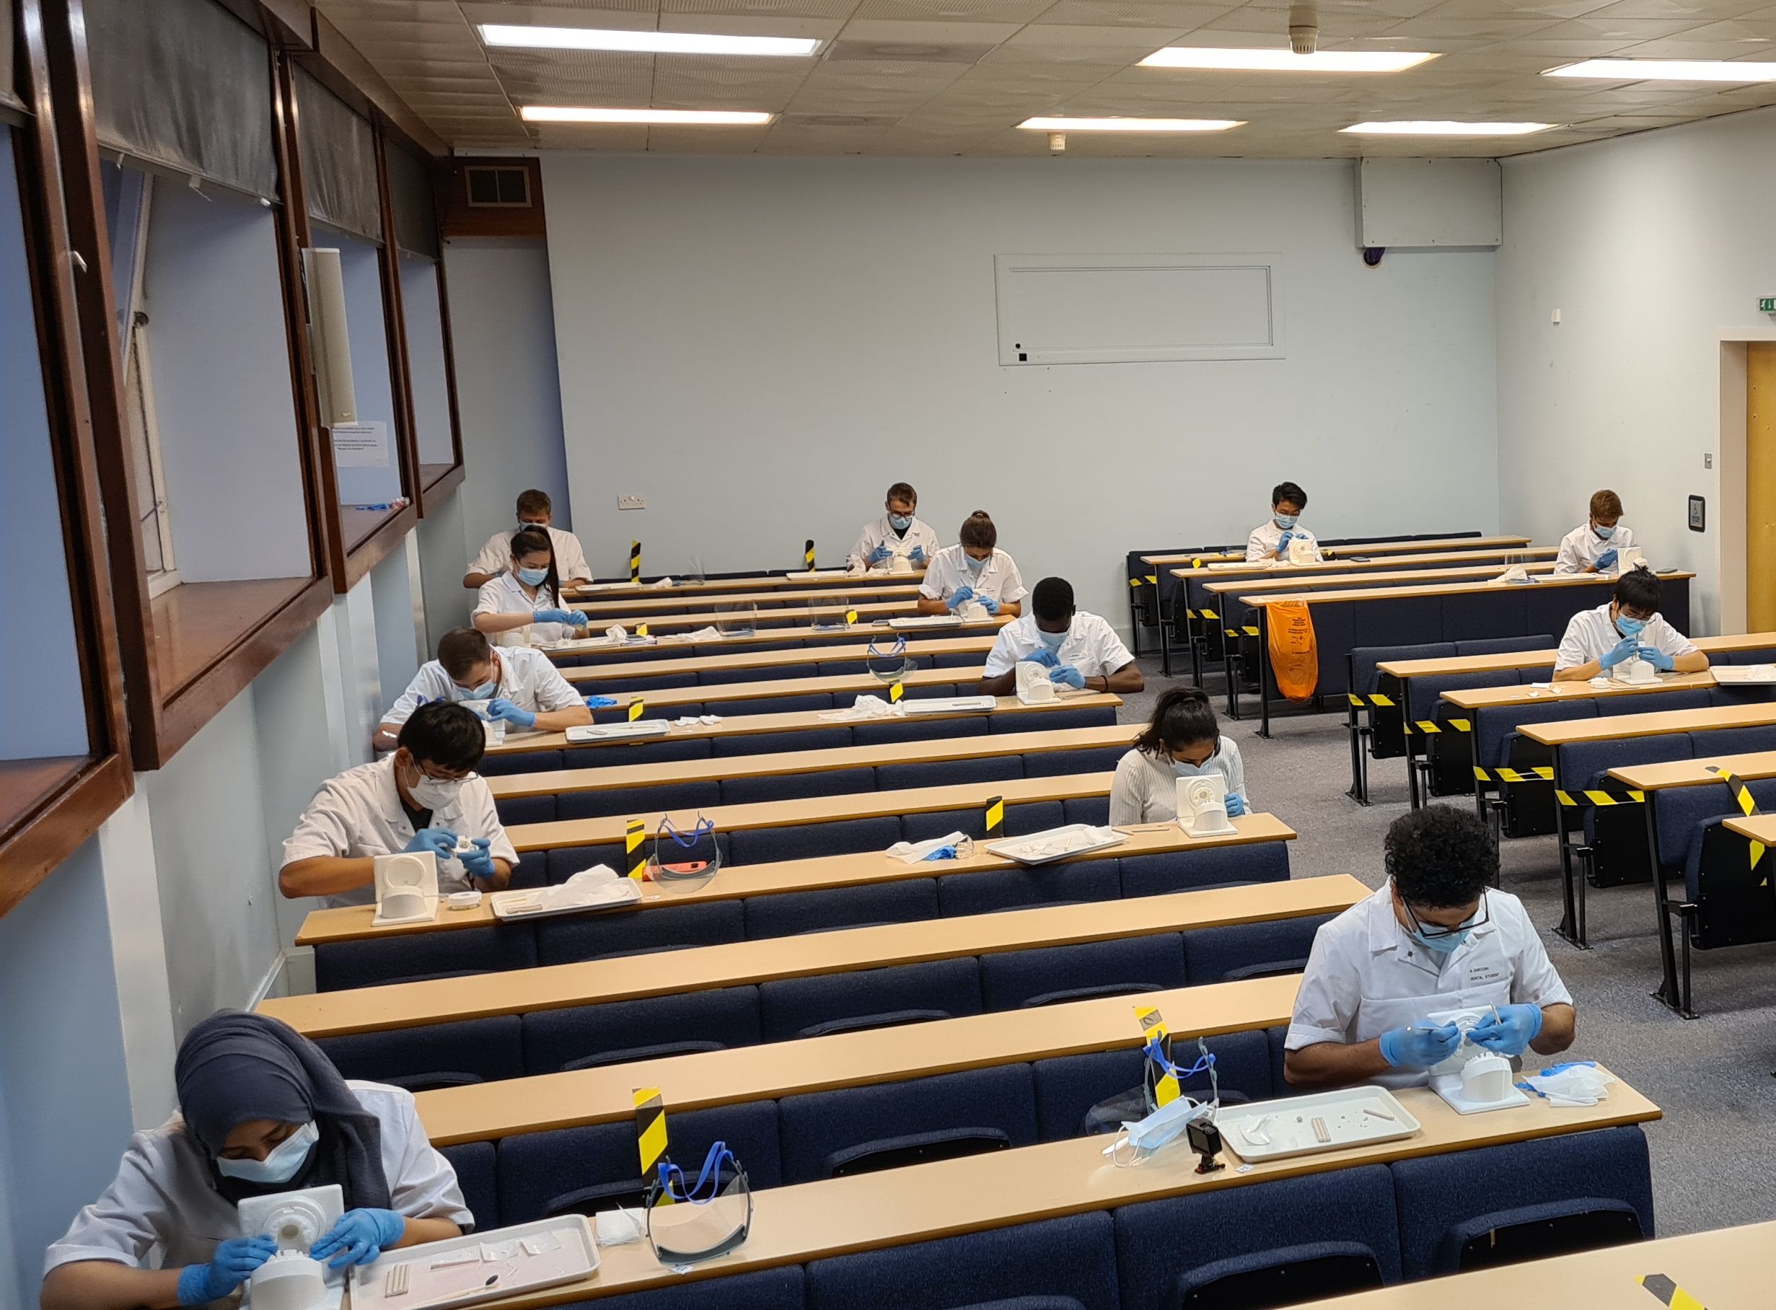
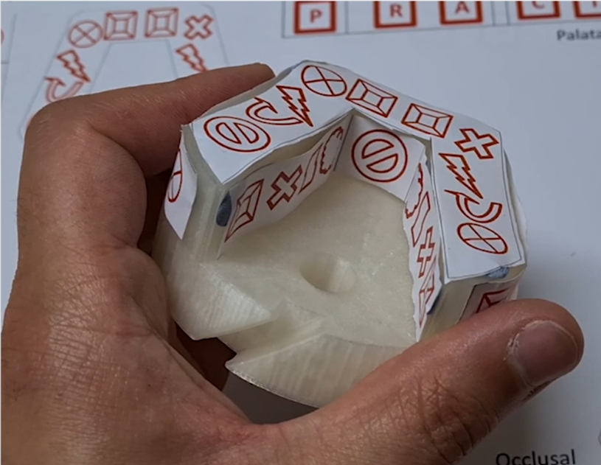
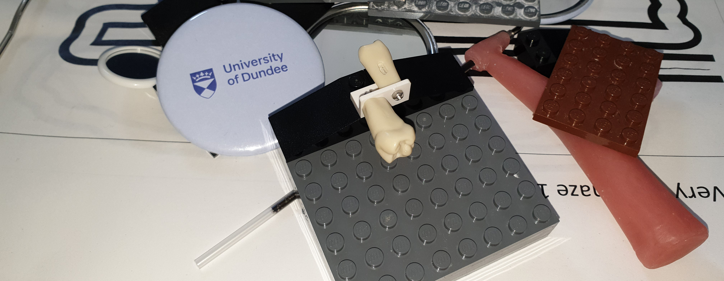
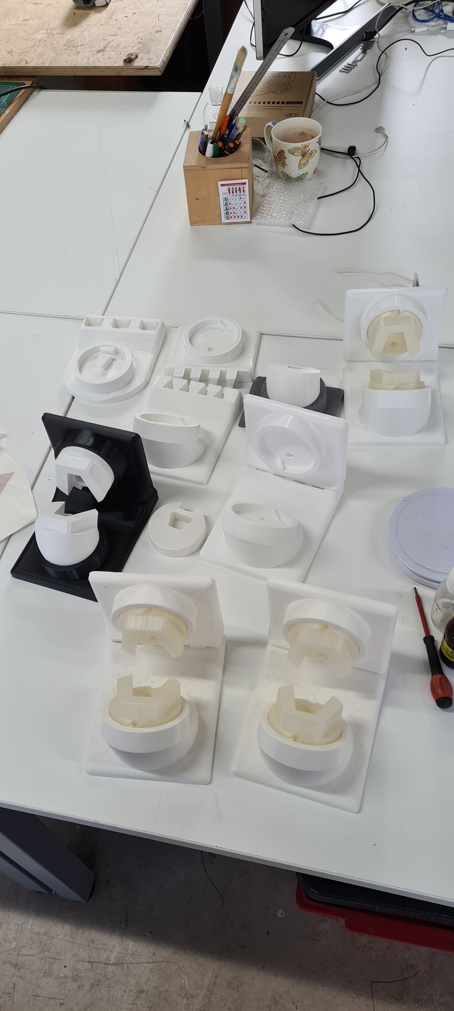
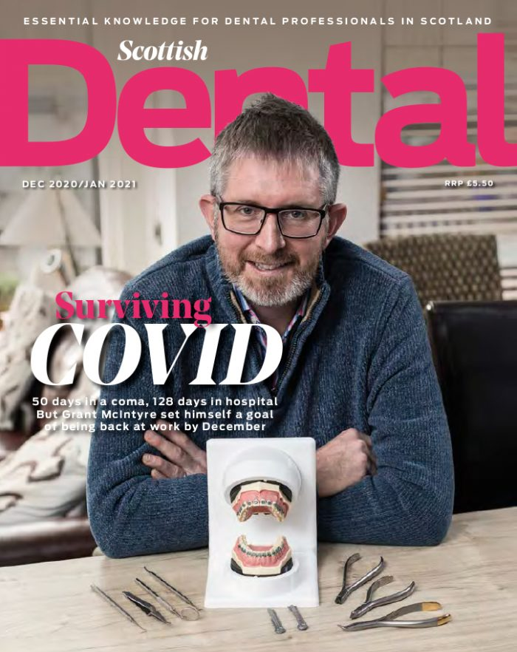
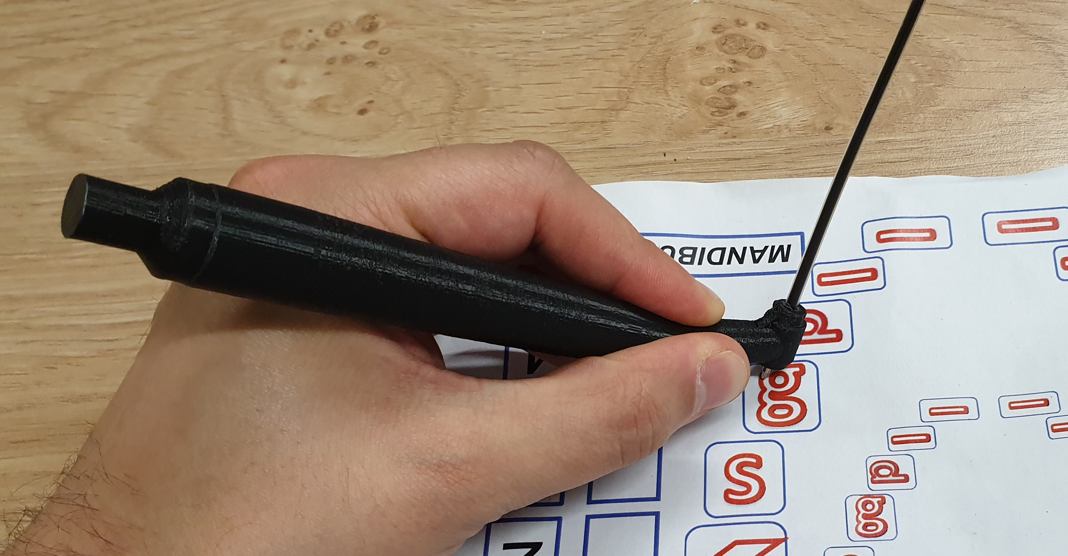
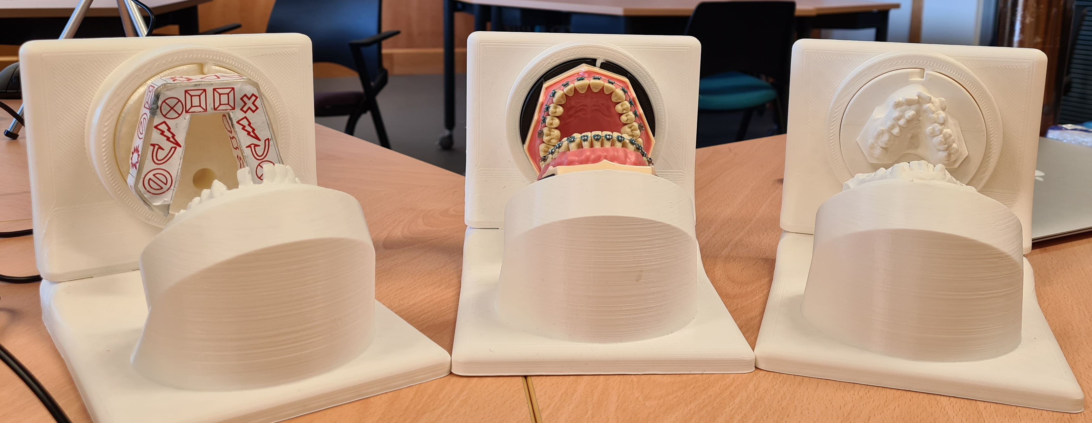
Background
Can remote training methods enhance clinically relevant manual skills development?
Pandemic!
2023: remote exercise
2018: Curriculum development
2019: Implementation and 3d printing
2022-present: in house implementation

Slide 3
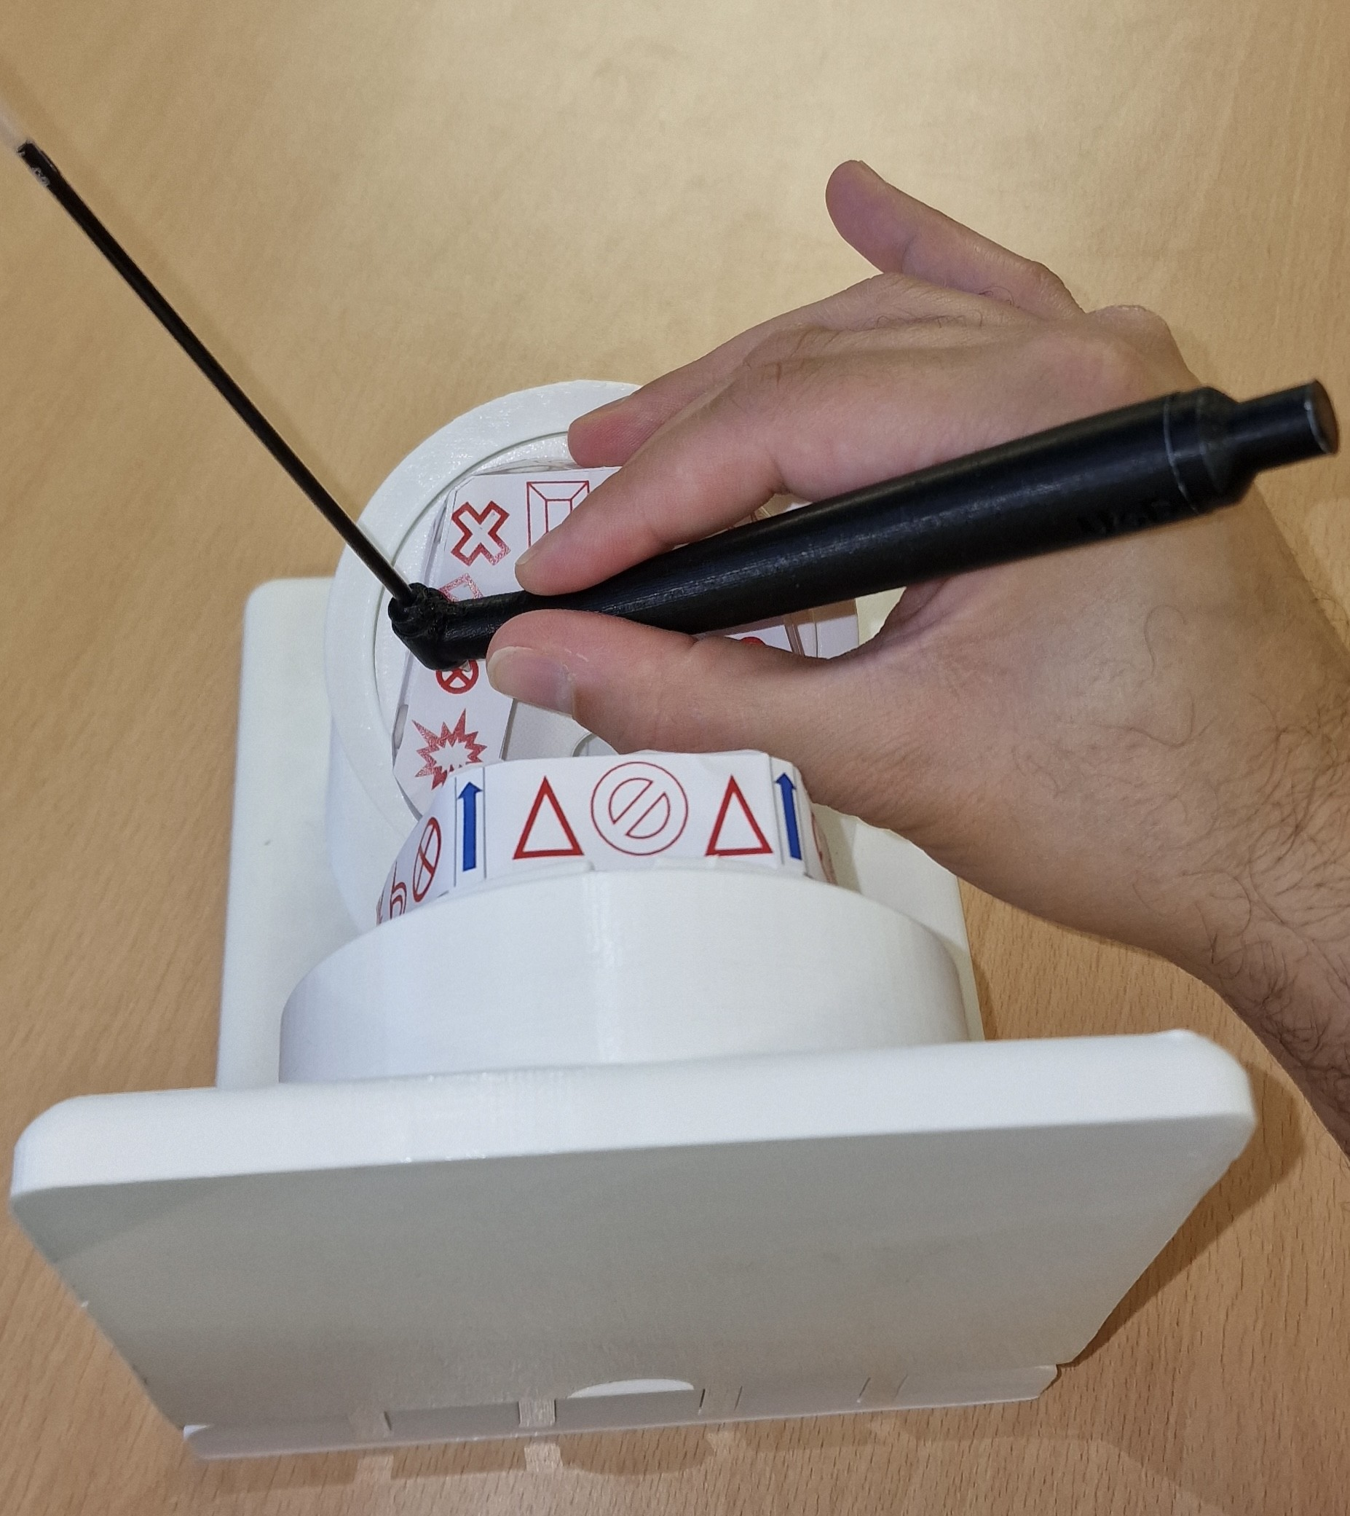
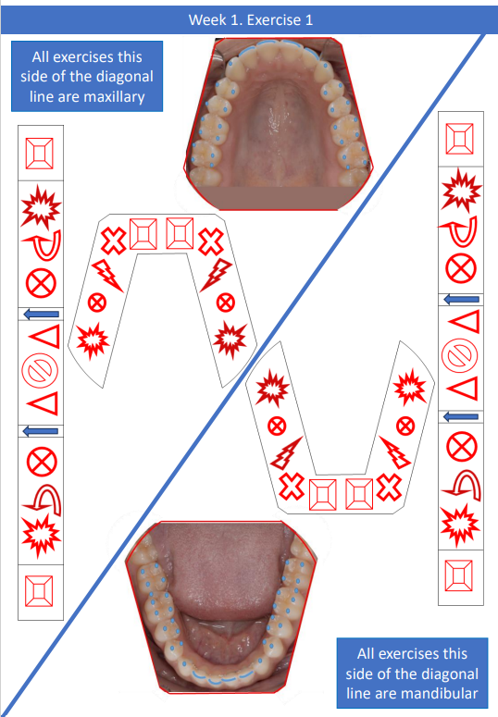
What is the intervention?
Distance learning clinical skills?
Unique pen analogous to high-speed.
Tabletop “phantom head”.
Exercises to practice:
  FDI notation,
  Indirect vision,
  Handpiece ergonomics.

Slide 4
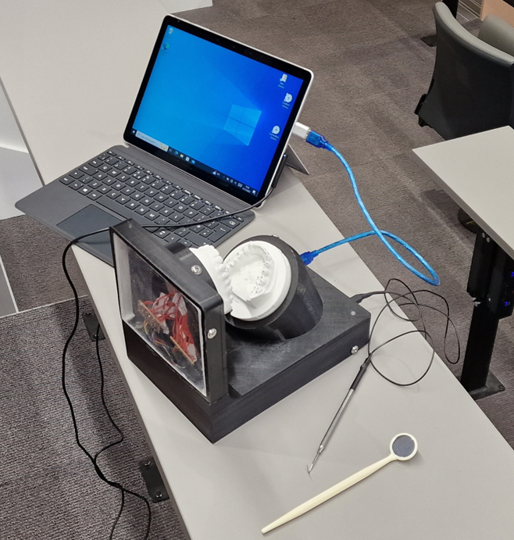
Methodology…
How do we evaluate!
Evaluation tool kit:
  1) Anatomy (Knowledge): Online assessment.
  2) Self-efficacy (Insight): Online questionnaire.
  3) Manual test (Skills): Machine test.
A randomised control design
Quantitative:
  Interpretation using a 2 (pre/post) X 2 (control/intervention) mixed factorial ANOVA. Bonferroni correction utilised
Qualitative:
  Focus groups with thematic analysis.
Ethical approval granted.

Slide 5
Quantitative results…
Self-efficacy
Knowledge
Manual skills
 | Baseline Mean S.E Score. | Post intervention Mean S.E. score. | % Difference.
Control group | 478.76 | 579.48 | 21.04%
Intervention group | 405.85 | 590.50 | 45.50%
STATISTICALLY SIGNIFICANT!
 | Baseline knowledge Mean “correct”. | Post knowledge Mean “correct”. | % Difference.
Control group | 38.52 | 38.43 | -0.12%
Intervention group | 37.15 | 41.75 | 12.38%
NOT STATISTICALLY SIGNIFICANT!
 | Mean baseline score per point. | Mean post intervention score per point. | % Difference.
Control group | 0.87 | 0.89 | 2.47%
Intervention group | 0.85 | 0.91 | 7.50%
NOT STATISTICALLY SIGNIFICANT!

Slide 6
Quantitative Results
Is insight learning?
Continuous formative feedback
Findings:
  Significant S.E increase-Intervention.
  Knowledge and Skills increase – Intervention.
  Significant correlation between Skills and S.E. - Intervention.
  Correlation with Knowledge and S.E.– Intervention.
Kendall’s Tau Correlation
=Negative significant | = Negative not significant | = Positive not significant | = Positive Significant
Correlation factors | Control group (co-eff) (Sig) | Intervention group (co-eff) (Sig) | Sample size (C), (I)
Base S.E. to Base Total Knowledge correct | (0.052) (0.758) | (0.027) (0.822) | 41 (21)(20)
post S.E. to post Total Knowledge correct | (-0.094) (0.563) | (0.133) (0.429) | 41 (21)(20)
Base S.E. to Base Skills test | (-0.030) (0.855) | (-0.097) (0.572) | 40 (21)(19)
Post S.E. to Post Skills test | (-0.129) (0.428) | (0.385) (0.027) | 40 (21)(19)
Base Knowledge to Base Skills test | (0.318) (0.062) | (0.331) (0.056) | 40 (21)(19)
Post knowledge to post skills test. | (0.232) (0.159) | (0.338) (0.058) | 40 (21) (19)

Slide 7
Qualitative feedback
“When I picked up my handpiece I was able to hold it much more comfortably than I think I would have been if I hadn’t had practice.”
“A good simulation of how it would be realistically. Like how you would do it with a patient”
Focus groups.
Identify strengths and weaknesses of and areas to improve:
  Equipment,
  Exercises,
  Evaluation toolkit.
Easy to assemble
Realistic simulation
Pen replicating ergonomics
Equipment
 | BDS | BSc | Control | Intervention | Total
Group 1 | 5 | 2 | 4 | 3 | 7
Group 2 | 8 | 0 | 2 | 6 | 8
Group 3 | 9 | 0 | 5 | 4 | 9
Total | 22 | 2 | 11 | 13 | 24
Ink issues
Lack of cheeks and adjustability
3D print tolerance
Pen insert complicating and limiting

Slide 8
Qualitative feedback
“I was guilty in clinics of kind of sacrificing posture because…whereas no one was assessing me apart from myself. So I was more strict with my posture.”
“To manoeuvre myself and get the finger rest more and practice doing that. I thought was really good.”
“I thought I had manual dexterity but then realising that I wasn't as good as I thought, it helped me realise that practice does make perfect.”
Fun alternative to study
Finger rest/ ergonomics
Posture
Anatomy/ quadrant orientation
FDI/
Terminology
Accuracy and control
Indirect vision
Reflective learning
Realism
Exercises
Colouring
Cusps
Too long, tedious
Too close to exams
Less exercises over longer
Instructions hard to follow

Slide 9
Qualitative feedback
“The confidence one, I think the scale of having it out of 100 was good as well, because you could be a bit more specific, because it's a bit more of a kind of subjective.”
“I think it cemented that knowledge of me because of how many questions they were.”
“The one where, like, it lit up with the iPad and stuff. I thought that was very engaging. And I also thought, it helped probably quite a lot.”
Relevant to training
Repeated evaluation allows reflection
Reflection on capability
Reflects on knowledge
Tactile feedback
Realistic
Evaluation
Self-efficacy
Manual Skill
Knowledge
Too long
Subjective
Unconscious bias
Orientation facing maxillary arch
Too long
Issues with accidental touch
Numbers vs descriptor rubrics

Slide 10
Recommendations
Frugal innovations should be embraced.
  Emerging technologies broaden teaching and evaluation possibilities
Need for evaluation strategies.
  Evaluation toolkits allow comparative research.
Consider integrating continuous formative feedback in teaching interventions.
Student feedback must be sought when integrating novel teaching.
Share your innovations!
cseeballuck@dundee.ac.uk

