Slide 1

“Waiting Well Together”: A Students As Partners Approach to Embedding Safe Practitioner Learning In Paediatric Dental Education and Evaluation of Student Led NHS Patient Care
Angela McKinney
Clinical Lecturer, Lead for Paediatric Dentistry Outreach
Alison Cairns, Professor of Paediatric Dentistry and Dental Education
Ross Deehan Dental Student
Scott Magee Dental Student
Jennifer Milne Dental Student

Slide 2
Children Awaiting GA
Why “Waiting Well Together”?
Recognising Vulnerability
Anxiety
Pain
Communication
Safe Practitioner Learning
Waiting Period
Uncertainty
Family Stress
Advocacy
Prevention
Two Challenges, One Opportunity

Slide 3

The Opportunity
Patients
Students
The Waiting Period Became Both a Patient Support Intervention and a Learning Environment

Slide 4
Aim
Co-design and Evaluate a Student as Partners Intervention Supporting Children Awaiting GA.
Student Safe Practitioner Development (GDC)
Service Improvement
Patient Support

Slide 5
Intervention
Co-Design
Waiting Well Clinic
Reflection
Student partners
Tutorial and triage form
Waiting well clinic/ telephone consultation
Evaluation

Slide 6
Evaluation Methods
Quantative : Pre/Post Questionnaires
Communication
Prevention
Advocacy
Safeguarding
Professionalism/Reflection
Qualitative: Focus Groups and Questionnaires
Open Text Responses
Thematic Analysis

Slide 7
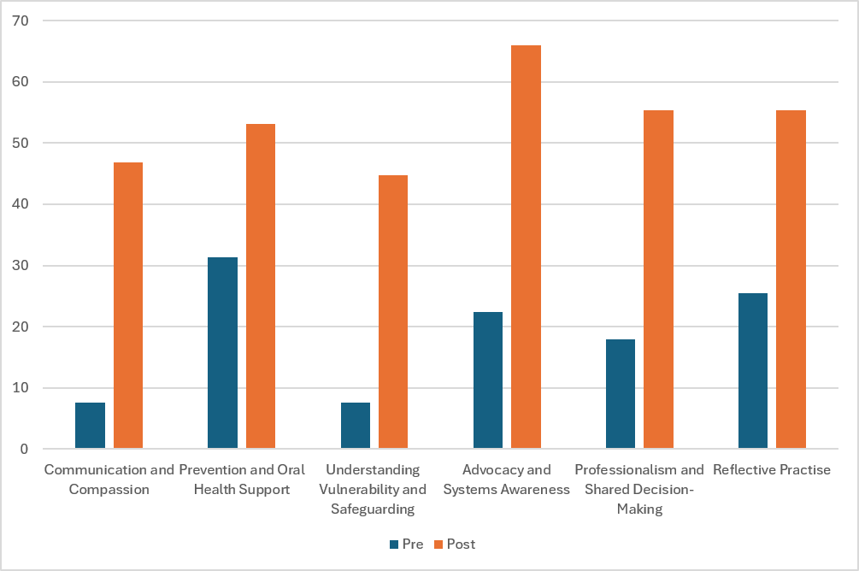
Results
Largest Gains
Advocacy (+43.6%)
Communication (+39.3%)
Understanding Vulnerability (+37.2%)
Professionalism and Shared Decision Making (+37.4%)
Confidence increased across all Safe Practitioner domains

Slide 8
Qualitative Findings
Confident Communication
Empathy and Vulnerability
What did students learn?
Advocacy and Barriers to Care
Safeguarding

Slide 9
Student Voices
“My confidence grew after completing the session, especially with the script to follow”
“The clinics opened our eyes to how many challenges families are dealing with”
What did students learn?
“Important to make the families feel heard and understood”
“We knew safeguarding in theory but didn’t feel confident putting it into practise”

Slide 10
Educational Impact
Students
Patients
Curriculum
Learning moved beyond treatment towards understanding the wider needs of children and families
Students contributed meaningfully to care during the vulnerable wait period
Patient centred care became a lived experience rather than a classroom concept
The greatest change was not what students knew, it was how they understood their role as future practitioners.as

Slide 11
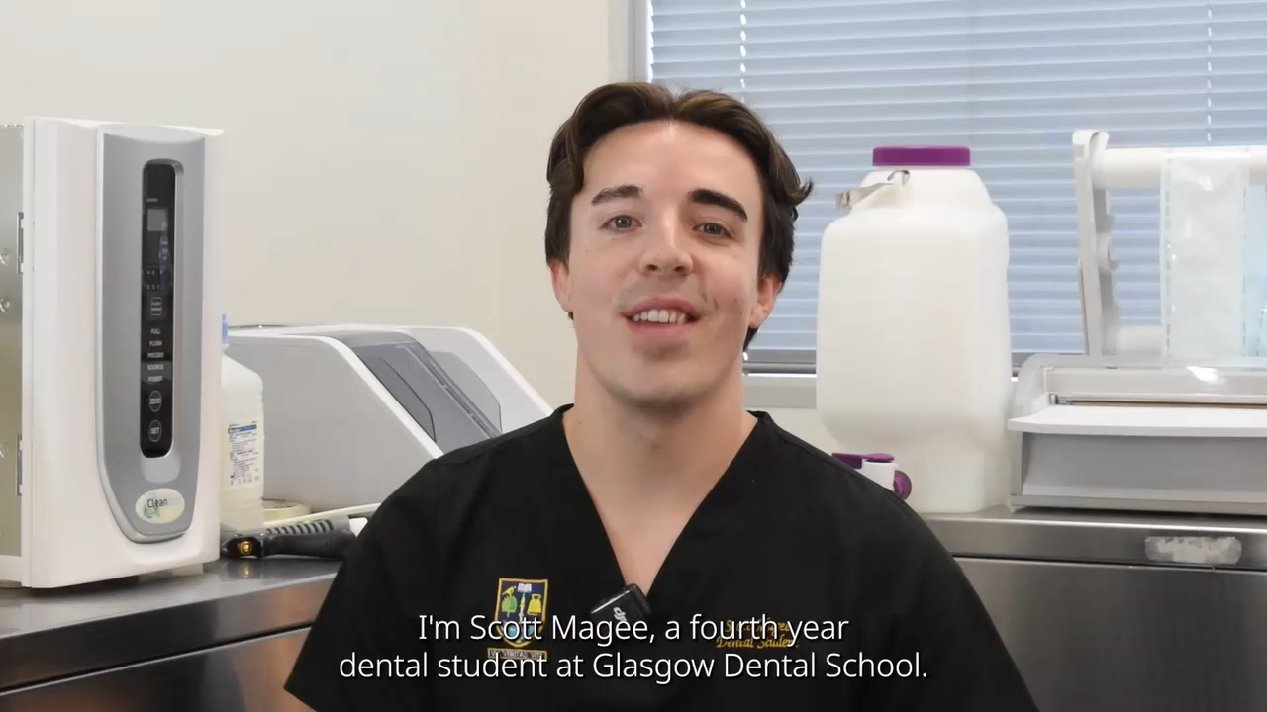
Our Student Partners

Slide 12
Conclusions
Active Waiting Time
Socially Accountable Education
Students as Partners
Understanding Vulnerability
“Waiting Well Together” aligns patient need, student learning and service improvement within one model of care.

Slide 13
Thank you for listening
Patient centred care
Social accountability
ADEE Graduating Dentist Framework
GDC Safe Practitioner Framework

