Slide 1
Using Rubrics to Enhance Faculty Calibration in Clinical Dental Education
Lucretia DePaola Cefola DDS, MS
Lucy Hovanisyan DDS, MBA
Chrystalla Orthodoxou DDS
New York University College of Dentistry
Notes:
Today we are presenting our work on how rubric‑based grading can enhance faculty calibration in a large clinical dental program. Our goal was to determine whether structured evaluation criteria can reduce variability among instructors and support more equitable assessment of student performance.

Slide 2
Background
Faculty calibration is essential for consistent, equitable assessment in mentorship‑based clinical programs.
Rubrics define performance criteria and reduce subjectivity across large teaching teams.
At NYU College of Dentistry, predoctoral students receive 0, 1, or 2 for each clinical procedure based on preparedness and competency.
Standardized grading supports fairness and enhances student learning outcomes.
Notes:
In large clinical programs like ours, multiple instructors supervise and grade students daily throughout patient care in the third and fourth year. Without calibration, grading can become inconsistent and subjective. Rubrics help by defining clear performance criteria. At NYU College of Dentistry, students receive a 0, 1, or 2 for each procedure based on their preparedness and adherence to clinical competencies. This structured approach is intended to support fairness and improve learning outcomes.

Slide 3
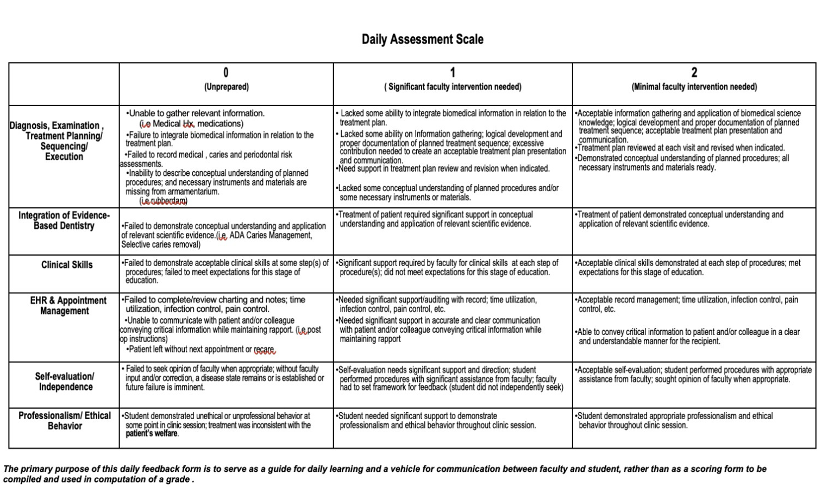
Aims & Methods
Aim: Determine whether a structured grading rubric improves calibration among clinical faculty
Data was collected from 13 instructors over 3 months at NYU College of Dentistry
Rubric used after each clinical procedure to assess:
  Diagnosis & treatment planning
  Evidence‑based dentistry integration
  Clinical skills
  Electronic health record management
  Self‑evaluation
  Professional & ethical behavior
Notes:
Our aim was to evaluate whether a structured rubric could help calibrate faculty. Over three months, 13 instructors used the same rubric to grade students after each clinical procedure. The rubric assessed six domains, including diagnosis, clinical skills, EHR use, and professionalism. Grades of 0, 1, or 2 reflected the level of faculty intervention required.

Slide 4
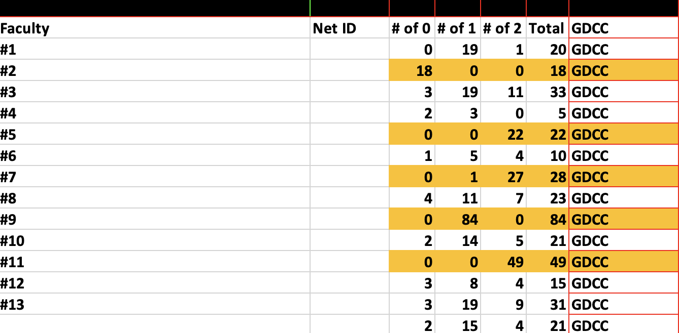
Results
Weekly reports tracked the number of 0, 1, and 2 grades per instructor.
Grading patterns varied widely across the 13 faculty members.
Outliers identified:
  Faculty #2: exclusively 0s
  Faculty #5, #7, #11: predominantly 2s
  Faculty #9: 84 grades of 1, no 0s or 2s (extremely narrow range)
Variation indicates differing thresholds for intervention and performance expectations.
Notes:
When we analyzed the grading data, we found substantial variation among instructors. For example, Faculty #2 assigned only 0s, while Faculty #5, #7, and #11 assigned mostly 2s. Faculty #9 gave 84 grades of 1 and no 0s or 2s, indicating a very narrow grading range. These patterns suggest that instructors interpret performance thresholds differently, even when using the same rubric.

Slide 5
Discussion & Conclusion
Grading patterns reveal each instructor’s calibration status relative to the group.
Outliers are flagged for review, not as “incorrect,” but to ensure alignment with program standards.
Rubrics with clearly defined criteria reduce variability and support equitable assessment.
Statistical review of grading informs faculty development, strengthens teaching consistency, and enhances student performance.
Rubric‑based calibration is a scalable model for large clinical programs.
Notes:
These grading patterns help identify which instructors may need calibration. Outliers are not necessarily incorrect in their assumptions. However, outliers show that calibration of faculty may not be aligned with program standards. Rubrics with clearly defined criteria reduce subjectivity and support more equitable assessment. Reviewing grading data also guides faculty development and strengthens consistency across the program. Overall, rubric‑based calibration is a scalable model for large dental schools.

