Slide 1
Dental Students' Attitudes Towards Patients with Mental Health Problems and the Role of Stigma-Reduction Interventions: A Systematic Review

Slide 2







Dr Chukwuemeka Ibeachu
DVM, MSc, PhD, FHEA
Dr Daniel Gabriel
BSc (Hons), BDS
Dr Alexander Montasem
BSc, MSc, MSc, PhD

Slide 3
Why is this Important?
Mental Health Statistics
  In England, 1 in 5 adults suffer with a common mental health condition.¹
  In Europe, 1 in 6 (or about 140 million) live with a mental health condition. There are approx. 300 suicides every day, which is the leading cause of death among people aged 15–29 years.²
Personal Experience
  Experienced depression, anxiety and multiple somatic symptoms.
  Suspended my degree for one year.
  Was signposted to counselling and CBT and used guided neuroplastic practice to achieve a complete recovery.
Dental professionals’ attitudes, knowledge and confidence can have a direct, positive impact on the oral and systemic health of patients experiencing mental health conditions.

Slide 4
Why is this Important?
Mental Health Statistics
  In England, 1 in 5 adults suffer with a common mental health condition.¹
  In Europe, 1 in 6 (or about 140 million) live with a mental health condition. There are approx. 300 suicides every day, which is the leading cause of death among people aged 15–29 years.²
Personal Experience
  Experienced depression, anxiety and multiple somatic symptoms.
  Suspended my degree for one year.
  Was signposted to counselling and CBT and used guided neuroplastic practice to achieve a complete recovery.
Dental professionals’ attitudes, knowledge and confidence can have a direct, positive impact on the oral and systemic health of patients experiencing mental health conditions.

Slide 5
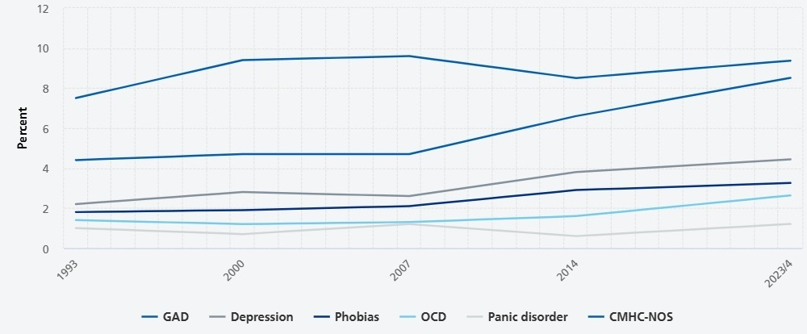
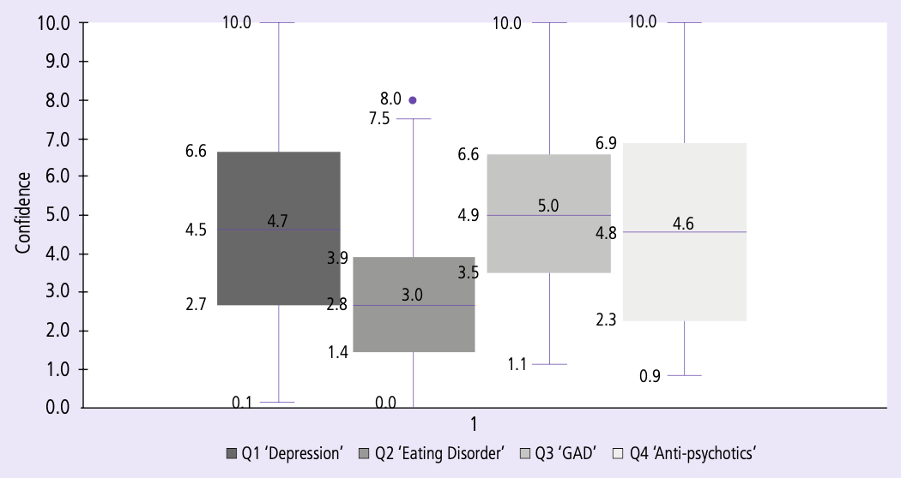
Background
Prevalence of common mental health conditions (CMHCs) in past week. 1993 to 2024 (Adults aged 16-64)¹
Student confidence ratings by survey question¹⁴

Slide 6
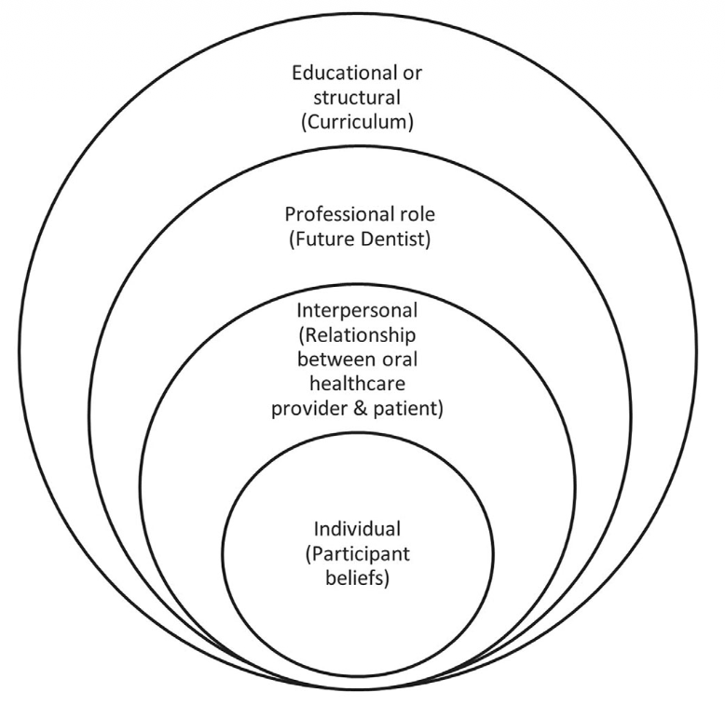
Background
Prevalence of common mental health conditions (CMHCs) in past week. 1993 to 2024 (Adults aged 16-64)¹
Student confidence ratings by survey question¹⁴
Multi-Level Influences on Dental Students’ Confidence in Caring for Patients with Mental Health Conditions¹⁸

Slide 7
Introduction
Patients with mental health conditions experience more oral health inequalities.
Stigma contributes to those inequalities.
The attitudes of dental students are important because they are the future oral healthcare providers who will care for these patients.
Educational interventions may reduce stigma and provide a more empathetic, equitable oral healthcare.
This is the first systematic synthesis of dental students’ attitudes and stigma-reduction interventions.

Slide 8
Methodology
01 Searching
02 Screening
03 Synthesising
Six databases & bibliographies
English-language publications; 2005–2026
Two independent reviewers
Predefined criteria; excluded literature reviews and qualified dentists
Narrative synthesis
15 studies from nine countries; RCTs, cross-sectional, qualitative and mixed methods designs

Slide 9
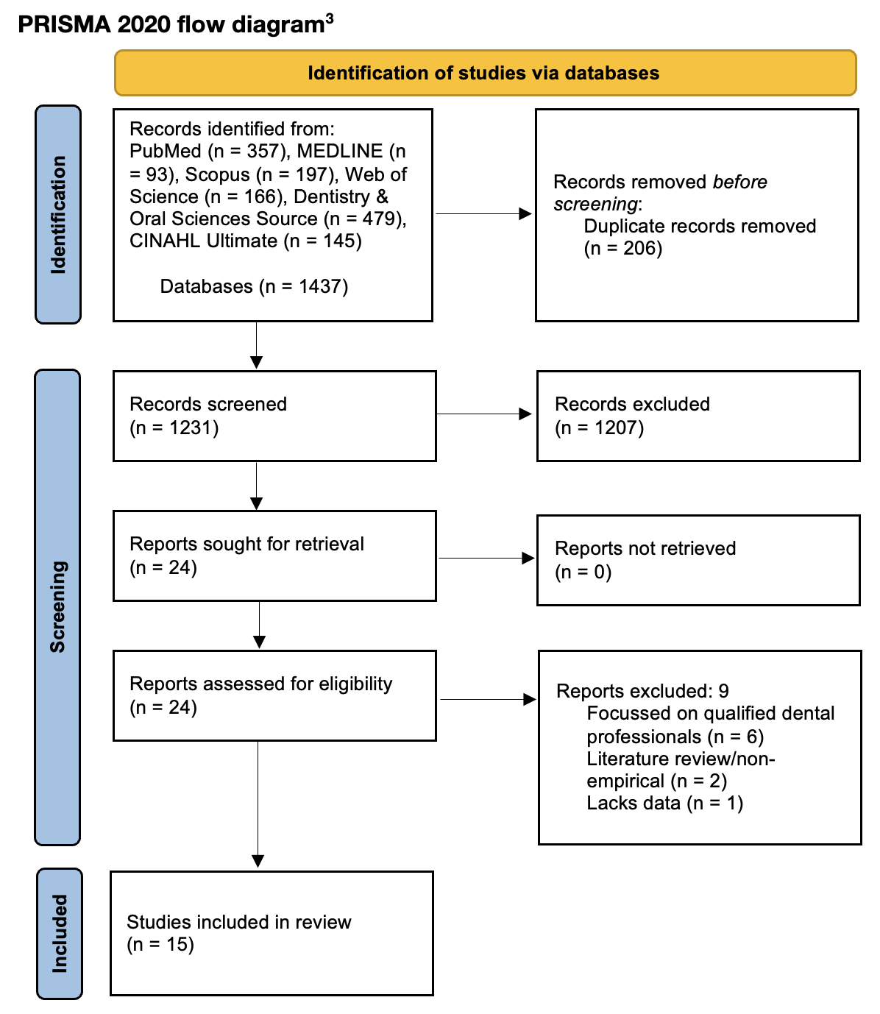
PRISMA Flow Chart

Slide 10
Results
Study Name & Design | Primary Method Used | Primary Results | Primary Conclusion
Perceptions only (n=9)
Kumar et al., 2021 Cross-sectional survey | 19-item knowledge and attitude questionnaire. | Positive treatment attitudes; knowledge was limited. | Recommended teaching of psychosomatic disorders.
Zechner et al., 2023 Qualitative survey | 6 open-ended items; qualitative content analysis. | Fear of personal harm and professional role uncertainty was prominent. | Clarification of professional roles particularly needed in serious mental illness care.
Malek et al., 2022 Multicentre survey | Questionnaire using Likert scale on perception, attitude and willingness. | Positive attitudes; willingness to interact varied by context and prior contact. | Curriculum should focus on barriers around willingness to interact.
Lennox et al., 2022 Cross-sectional survey | Questionnaire on mental health using quantitative measures. | Students lacked knowledge on how to manage patients with mental health conditions. | Recommendation to use focus groups to reduce stereotypes and improve confidence in signposting.
Zechner et al., 2022 Qualitative survey | 5 open-ended items; qualitative content analysis. | Gaps in mental health literacy, communication skills, referral skills and general anxiety due to lack of training. | Need for educational interventions to challenge the stigma and beliefs that these patients are dangerous.
Mubayrik et al., 2021 Cross-sectional survey | 21-item Likert scale survey on knowledge, attitudes and stigma. | Positive views coexisted with stigmatising beliefs. | Mixed attitudes indicate a need to reinforce knowledge and actively counter stigma.
Madhan et al., 2012 Cross-sectional survey | Medical Condition Regard Scale, a validated Likert scale tool. | Positive attitudes but condition-dependant; statistically significant decrease in positive regard during degree. | Interdisciplinary approach recommended to maintain positive attitudes as students progress to clinical years.
Kuthy et al., 2005 Cross-sectional survey | Questionnaire on comfort and future-willingness to provide care. | Comfort to treat levels varied significantly; fewer than 60% would treat vulnerable groups in future practice. | Clinical exposure may improve attitudes and willingness to treat.
Jung-Eun Ha et al., 2016 Cross-sectional survey | 38-item questionnaire on knowledge, perception and attitude. | Education or prior contact linked to more positive attitudes. | Strengthen clinical exposure to these patients to improve student attitudes.

Slide 11
Results
Study Name & Design | Primary Method Used | Primary Results | Primary Conclusion
Perceptions & Interventional (n=6)
Zechner et al., 2020 Quasi-experimental mixed methods | Didactic teaching and service learning. | Education interventions suggest stigma reduction; thematic analysis shows an increase in empathy, willingness to treat and reduced fear following contact with patients. | Teaching using direct patient contact can improve attitudes of students.
Elliott et al., 2020 Mixed-methods service evaluation | Scenario-based survey and focus groups. | Levels of confidence to treat were low, especially for undiagnosed conditions; lack of mental health education was the primary theme. | Suggestion to integrate communication skills workshops, case-based teaching, mental health first-aid training and clear referral pathways into the curriculum.
Patterson et al., 2014 Mixed-methods intervention | Targeted educational seminar with pre/post survey. | Positive attitudes; seminar further improved knowledge and beliefs; early views reflected media stereotypes, which were challenged by lived experiences. | Educational seminars with lived experience can improve attitudes and challenge unconscious stigma.
Brondani et al., 2021 Qualitative educational intervention | Lived-experience inverted-classroom and student reflection analysis. | Vignette prompted discussions about stigma, empathy and patient-centred care. | Vignettes can support reflective learning and increase awareness of stigma.
Grandon et al., 2023 RCT | Educational and contact-based intervention; attitude and social distance scales used. | Stigma reduced compared to controls in all healthcare students. | Dentistry-specific evidence remains uncertain due to small sample size.
Vielma-Aguilera et al., 2025 RCT, one-year follow-up | Pre-test, post-test and one-year follow-up educational-contact intervention trial. | No statistically significant stigma benefit remained after one year. | Brief educational interventions need reinforcement to maintain results.

Slide 12
Results
Across 15 studies involving 2,949 students
Students were usually willing to interact with and treat people with mental health conditions, but clinical uncertainty and emotional discomfort persisted. Structured teaching and contact-based learning improved attitudes and confidence, however gains were not sustained without reinforcement.
Positive
Attitudes
Knowledge
& Preparedness
Curricular Interventions
Overall positive student attitudes, however some stereotypes and fears persist.
Training on referral pathways and treating patients with severe mental illnesses are the key areas to strengthen.
Educational and contact-based interventions improve attitudes, knowledge and confidence in the short-term.

Slide 13
Embed mental-health literacy
Education about common and severe mental health conditions, referral pathways and oral health implications of psychosomatic disorders.
Build confidence through interventions
Use of educational seminars, communication workshops, simulated cases and learning with people who have mental health conditions.
Reinforce and evaluate
Revisit knowledge and attitudes longitudinally to assess changes throughout undergraduate training.
Embed
Practise
Sustain
Actions

Slide 14
Conclusions
  Students are generally positive, but subtle stigma remains.
  Knowledge and preparedness are insufficient in certain areas e.g. severe mental illness, referral pathways.
  Educational interventions improve attitudes, especially when they involve contact-based learning, although effects may require reinforcement.
  Dental education is a contributing factor in improving access to dental care and oral health inequalities.
Summary
Limitations
  Small sample sizes.
  Limited generalisability across populations.
  Lack of longitudinal data.
Research Suggestions
  Design RCTs to assess curricular interventions.
  Use standardised interventions & questionnaires.
  Conduct long-term follow-up studies.

Slide 15
References
Presentation References
1. Morris S, Hill S, Brugha T, McManus S, editors. Adult Psychiatric Morbidity Survey: Survey of Mental Health and Wellbeing, England, 2023/4. NHS England; 2025. Available from: https://digital.nhs.uk/data-and-information/publications/statistical/adult-psychiatric-morbidity-survey/survey-of-mental-health-and-wellbeing-england-2023-24.
2. World Health Organization Regional Office for Europe. Mental health [Internet]. Copenhagen: WHO Regional Office for Europe; 2026 Jan 8. Available from: https://www.who.int/europe/news-room/fact-sheets/item/mental-health
3. Page MJ, McKenzie JE, Bossuyt PM, Boutron I, Hoffmann TC, Mulrow CD, et al. The PRISMA 2020 statement: an updated guideline for reporting systematic reviews. BMJ 2021;372:n71. doi: 10.1136/bmj.n71
Included Studies References
4. Zechner MK, Sean Murphy, Ann Vasilenko, Gail Drucks, Cindy McMahon, Kim Singhal, Rishi. Evaluating the Impact of an Educational Program on Stigmatizing Attitudes in Dental Hygiene Students. American Journal of Psychiatric Rehabilitation. 2020;23(3):121–41.
5. Santhosh Kumar MP, Thenarasu V. Knowledge, awareness, and attitude of dental students towards management of dental patients with psychological problems. International Journal of Clinical Dentistry. 2021;14(2):241–51.
6. Brondani M, Alan R, Donnelly L. The role of an educational vignette to teach dental students on issues of substance use and mental health disorders in patients at the University of British Columbia: an exploratory qualitative study. BMC Medical Education. 2021;21(1).
7. Vielma-Aguilera A, Grandón P, Vidal D, Bustos C, Contreras Y, Castillo G, et al. One year later: Effectiveness of an intervention to reduce the stigma of mental disorders among university students. Psychiatry Research. 2025;351.
8. Grandón P, Vidal D, Vielma-Aguilera A, Bustos C, Contreras Y, Castillo G, et al. Effectiveness of an intervention to reduce stigma towards people with a mental disorder diagnosis in university students of healthcare careers. Psychiatry Research. 2023;328.
9. Kuthy RA, McQuistan MR, Riniker KJ, Heller KE, Qian F. Students' comfort level in treating vulnerable populations and future willingness to treat: results prior to extramural participation. Journal of dental education. 2005;69(12):1307–14.
10. Ha J-E, Hong S-M. Survey on Knowledge Level, Perception, and Attitudes of Dental Hygiene Students Toward Mental Disorders in Korea. Indian journal of science and technology. 2016;9.
11. Malek M, Yudin Z, Hamid N, Harun N, Bono S. Dental Students' Perception, Attitude and Willingness to Interact with Mental Illness Patients: A Multicentre Cross-Sectional Study. Journal of Dentistry Indonesia. 2022;29(1):43–51.
12. Madhan B, Gayathri H, Garhnayak L, Naik ES. Dental students' regard for patients from often-stigmatized populations: Findings from an indian dental school. Journal of Dental Education. 2012;76(2):210–7.
13. Patterson S, Ford P. Dentistry students’ views about mental illness and impact of a targeted seminar on knowledge and attitudes: A mixed-method study. Journal of Mental Health Training, Education and Practice. 2014;9(3):190–202.
14. Elliott E, Sharma S, Omar A, Hurst D. How confidently do students address patients with psychiatric conditions in the dental clinic? A service evaluation in a UK dental school. British Dental Journal. 2020;228(5):376–80.
15. Mubayrik AB, Alhefdhi RJ, Alrwais FS, Alzahrani SS, Almeaither RM, Altamimi AM, et al. DENTAL STUDENTS’ KNOWLEDGE AND ATTITUDES ABOUT MENTAL ILLNESS. Annals of Dental Specialty. 2021;9(3):65–71.
16. Zechner M, Singhal V, Murphy A, Karyczak S. Exploring Dental Students’ Perceptions of Mental Illness to Address Unmet Needs: A Preliminary Study. Open Dentistry Journal. 2022;16(Special issue 3).
17. Lennox C, Pandya JK, Lyttle R, Pandya S, Penlington C, Bowes C. Mental health and inclusivity support and education in a UK dental school: a cross-sectional survey. British Dental Journal. 2022;233(12):1029–34.
18. Zechner MR, Singhal V, Murphy AA, York J, Karyczak S, Muhammad A. Dental pre-doctoral student perceptions about serious mental illness: Concerns and role clarification. Journal of Dental Education. 2023;87(5):639–45.

Slide 16
Thank You

