Slide 1



Evidence and Empathy as the focus in
Oral Health Professionals' Education
Review Of Current Practice Of Students’ Reflections Under Clinical Domain
Anna Kameen

Slide 2

Faculty of Dentistry, Oral & Craniofacial Sciences
Contributors
Dr Jonathan San Diego
Professor Tim Newton
PhD Supervisors
Notes:
As part of my MSc in Clinical Education I explored the Effectiveness of Clinical Feedback in dentistry. I became very interested in clinical feedback and competence assessments.
At King’s as a clinical supervisor, I provide regular feedback. I notice that the forms we use for assessing and monitoring student’s clinical activities require them to analyse and self-reflect on their performance but many of them struggle to reflect and accurately self-grade their own clinical work and competence.
I decided to look into the literature on changes in metacognition and self-awareness in relation to clinical performance in dentistry BUT realised the lack of evidence and that in field of clinical dentistry.

Slide 3
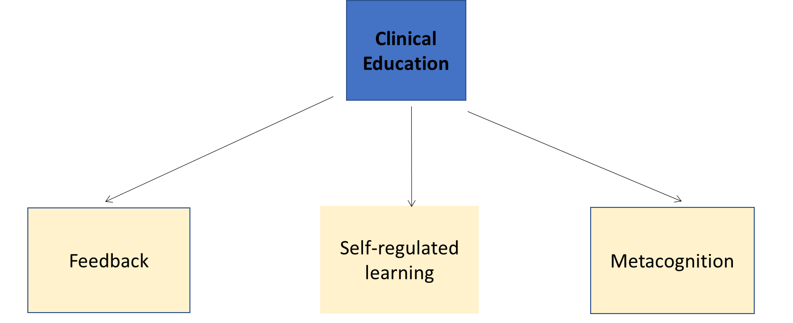
Background and Rationale
Ability to monitor one’s own study process in an accurate way is believed to be one of the most important skills needed in 21st century education (Carpenter et al.2020, Nietfeld et al., 2006).
Self-regulated learning -self-efficacy, self-judgment and self-evaluation essential to learning process (Zimmerman 2010)
Metacognitive monitoring- when accurate, has been shown to lead to improved self-regulation and improved performance’(Nietfeld et al.,2006). Calibration of metacognitive confidence to assess and promote learning of patient care showed student's overconfidence bias (Garbayo et.,al 2023)
Clinical skills learning- monitoring and analysis of metacognition well established and recognised in nursing & medicine but limitted evidence in dentistry
Nietfeld et al., 2006
84 UG psychology UG students for 4 months
Self-judgment monitoring after weekly classroom tests
Feedback on calibration and bias to improve monitoring accuracy
Results: Distributed exercises promoted improvement of monitoring skills and class test performance
Notes:
So far the literature review conducted to date has supported the following findings:
Feedback- an essential element of the educational process
Self-regulated learning- self control of the learning and thinking process--> part of reflective practice--> Zimmerman framework
Metacognition- thinking about clinical thinking and learning awareness is a part of self-regulated learning process and not a given skill. Students often misjudge and misevaluate effectiveness of teaching they receive
Given the significance of the metacognitive involvement and its monitoring in the process of learning, one can agree it is important to understand the factors contributing towards the sources and confidence levels of one’s metacognitive judgments which have yet not been studied in detail, because if these are well understood, it can help improve students’ metacognition and performance outcomes

Slide 4
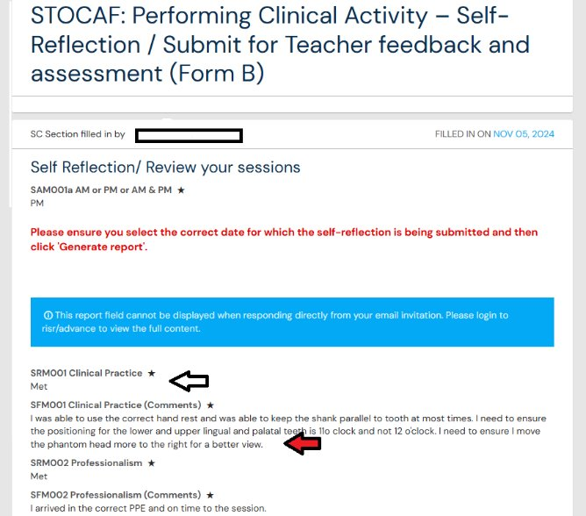
Curricular Context
At King's Dental Therapy and Hygiene and Bachelor of Dental Surgery students as part of their reflection on clinical performance submit forms called STOCAF and CAF. These comprise of a student-led self-grading and reflection and teacher's grading and feedback.
Notes:
STOCAFs and CAFs involve metacognitive self-judgment and rating but to date these have yet not been analysed.
There is inconsistency in practice of using STOCAFs and CAFs therefore I wanted to understand the students' and teachers' perceptions to barriers of delivering and receiving clinical feedback

Slide 5
Aims and Research Questions
AIM:
To investigate the effects off regular confidence judgment monitoring exercises performed as part of clinical feedback on metacognitive process changes and clinical competence assessment outcomes of dental undergraduates.
RESEARCH QUESTIONS:
1. What are dental clinical teachers’ perceptions of and barriers to delivering clinical feedback to undergraduate students?
2. Do distributed monitoring exercises and feedback improve calibration?
3. Do distributed monitoring exercises and feedback improve student clinical performance outcomes?
4. Does calibration or changes in calibration account for the observed changes in clinical performance measures and self-efficacy ?
Research Hypothesis
Metacognitive intervention in the form of periodic confidence-judgment monitoring and feedback may improve students’ clinical performance and metacognitive accuracy​

Slide 6
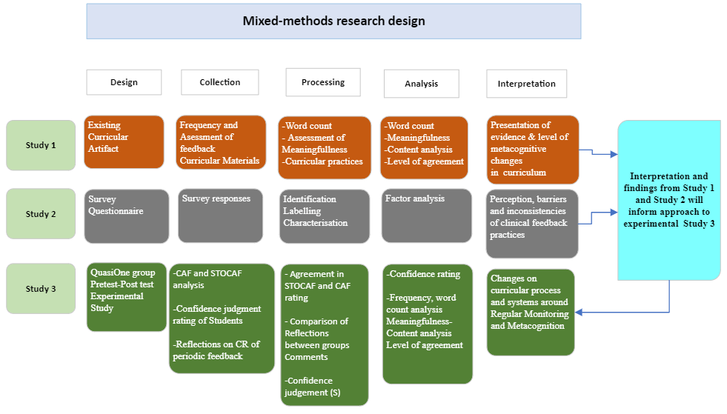

Slide 7
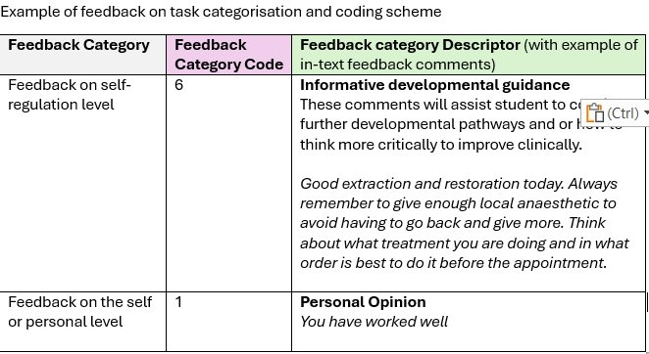
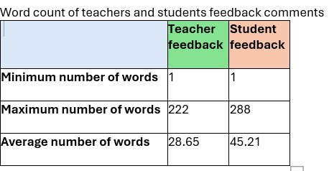
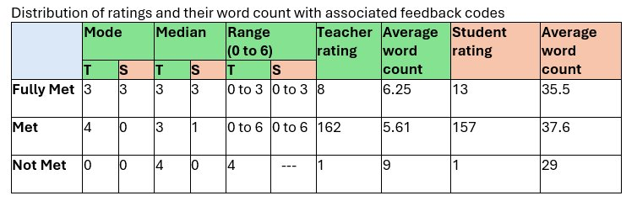
Word count Analysis and Feedback Categorisation
Notes:
S & T clinical reflections/feedback comments were analysed for level of meaningfulness and common themes/ concepts as well as the word count. Finally, levels of meaningfulness measured using feedback on task categorisation and coding scheme modified from the Hattie and Timperley model used by Derham et al.2022.
There was a great degree of differences in amount, length and quality of students’ and teachers’ feedback/reflections provided, ranging from no feedback attached to the grade, to a short sentence or a long paragraph. Distribution of codes varies across the grades in both students and their teachers’ comments with teachers mostly using higher code 4 (Corrective or directive advice related to task) and students using code 0 (Statement of facts & simple statement of what they did during the clinical session. The trend is that the more successful students do the higher order of reflection is shown. The implications of this are that we should encourage students to do higher order reflection at all levels and should encourage involving more words hence the intervention planned for the next study will be aiming to achieve this.

Slide 8
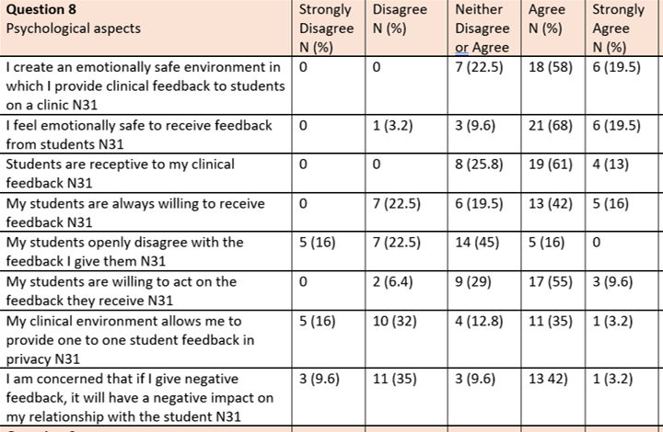
Study 2- Clinical teachers 'perceptions of and barriers to delivering clinical feedback
Identified dimensions in Literature & Survey
Time and availability
Technology and tools
Training, confidence and skills
Feedback Assessment Criteria
Psychological/ Social aspects of feedback provision

Slide 9
Research Questions
Question: Do distributed monitoring exercises and feedback improve student clinical performance outcomes?
Study 1 Artefact Analysis-->
Identified existing curricular processes and systems around distributed monitoring and metacognition, as well as accuracy of students’ self-judgment from STOCAFs
Question: What are dental clinical teachers’ perceptions of and barriers to delivering clinical feedback to undergraduate students?
Study 2 Staff Survey-->
Identified dental clinical teachers’ perceptions of and identify barriers to delivering clinical feedback to undergraduate students (DTH and BDS students) during their clinical supervision.
Question: Do distributed monitoring exercises and feedback improve calibration and clinical performance outcomes?
Study 3 Experimental Study--> aims to answer the above question

Slide 10
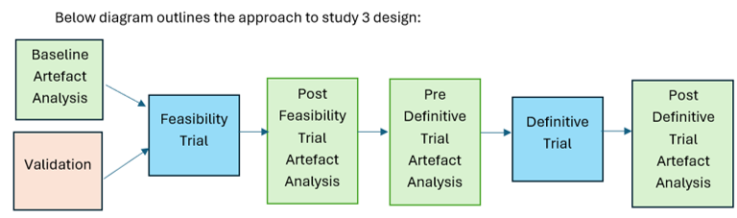
Future Research Work- Study 3
Teacher-Student Feedback Dialogue
Standardised approach using Zimmerman's Framework (Forethought/Performance/Self-Reflection)
Evaluation-Correction-Feedforward
Student's Confidence Rating
Not at all 0% -----------------------------100% Confident
confident
Confidence Feedback Conversation
Can you explain why you gave a confidence rating of 70%?

Slide 11

Thank you !

