Slide 1
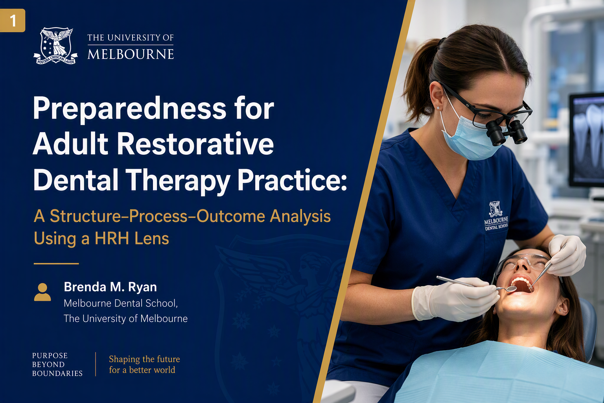
Notes:
Good morning, and thank you for the opportunity to present today.
I am Brenda Ryan from the Melbourne Dental School at the University of Melbourne.
This research examined how education influences preparedness for adult restorative dental therapy practice in Australia, and whether that preparedness is ultimately translated into actual scope utilisation and positive workforce outcomes.
The study is built around a simple but important observation: regulatory authorisation does not automatically result in scope enactment.
Practitioners may be legally permitted to perform services, yet still face barriers that prevent them from fully using their skills.
Preparedness, confidence, mentoring, workplace culture, and organisational support all play a role in determining whether education becomes practice.
Today I will briefly outline the rationale, methods, key findings, and implications.

Slide 2
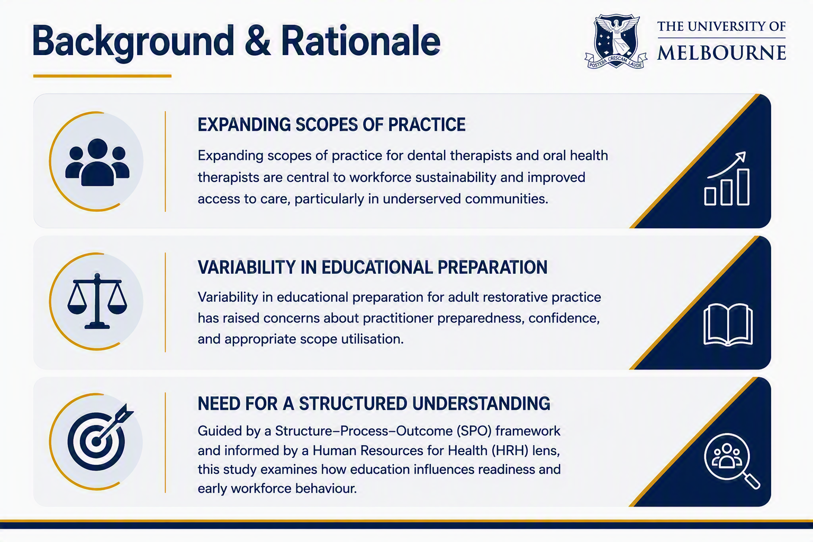
Notes:
Over the past two decades, Australia has progressively expanded the adult restorative scope of practice for dental therapists and oral health therapists.
These reforms were intended to improve access to care, strengthen workforce sustainability, and make better use of oral health practitioners' capabilities.
However, international and Australian evidence consistently suggests that legislative change alone is insufficient.
Even when practitioners are authorised to practise, utilisation remains highly variable.
Educational preparation, confidence, workplace acceptance, and mentoring all influence whether practitioners actually use their expanded scope.
At the time this research commenced, there was limited national evidence comparing educational pathways or examining how preparedness translated into workforce outcomes. This study was designed to address that gap.

Slide 3
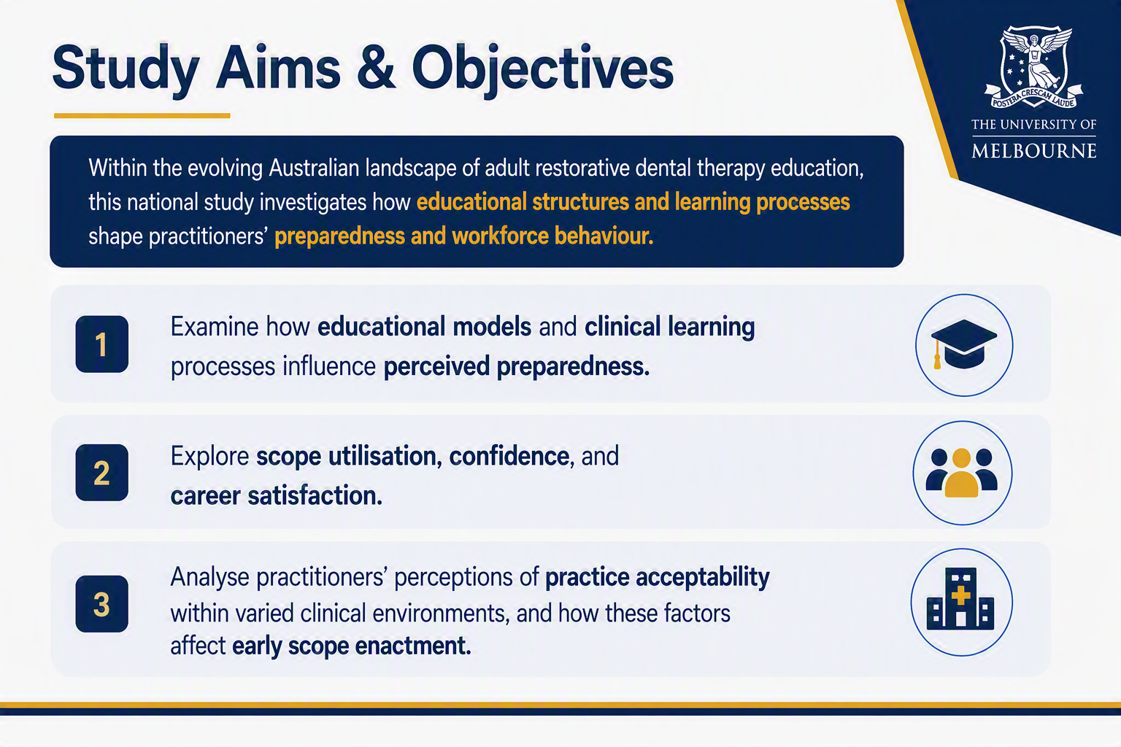
Notes:
Three objectives guided the research.
First, to examine how educational models and clinical learning experiences influence perceived preparedness for adult restorative practice.
Second, to explore relationships between preparedness, confidence, scope utilisation, and career satisfaction.
Third, to investigate how workplace environments and organisational factors shape the transition from educational preparation into actual clinical practice.
Collectively, these objectives shift the discussion from asking whether practitioners are authorised to practise to asking whether they are sufficiently prepared, supported, and enabled to practise.

Slide 4
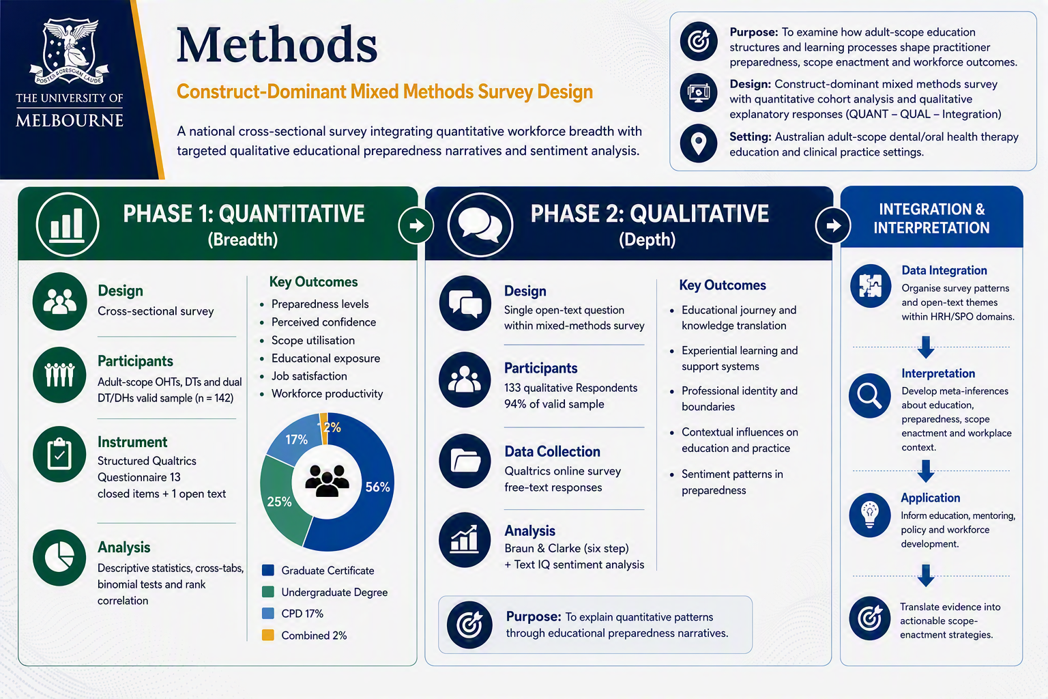
Notes:
The study used a construct-dominant mixed-methods design organised through a Structure-Process-Outcome framework interpreted using a Human Resources for Health lens.
Phase one comprised a national cross-sectional online survey.
The valid sample included 142 adult-scope educated practitioners across oral health therapy, dental therapy and dual dental therapy and dental hygiene registration groups.
The sample represented approximately 16 per cent of the estimated Australian adult-scope practitioner population.
The measures included perceived preparedness, comfort or confidence using the scope, educational exposure, scope utilisation, practice experiences and job satisfaction.
This phase therefore examined not only whether participants had completed adult-scope education, but whether education was associated with readiness and the capacity to use the scope in contemporary practice
Qualitative data came from a focused open-text survey question and analysed practitioners' reflections on their educational experiences that best prepared them for adult restorative practice and what they felt was missing. Reflexive thematic analysis and sentiment analysis were used to explore these narratives.
These narratives were analysed through Braun and Clarke’s six-phase reflexive thematic analysis.
The qualitative analysis focused on the educational journey, experiential learning, professional identity, contextual influences and the affective dimensions of preparedness.
Importantly, these narratives did not replace the quantitative results. They helped explain how particular educational experiences contributed to confidence, uncertainty and readiness.
When the two phases were brought together, a clear systems-level interpretation emerged

Slide 5
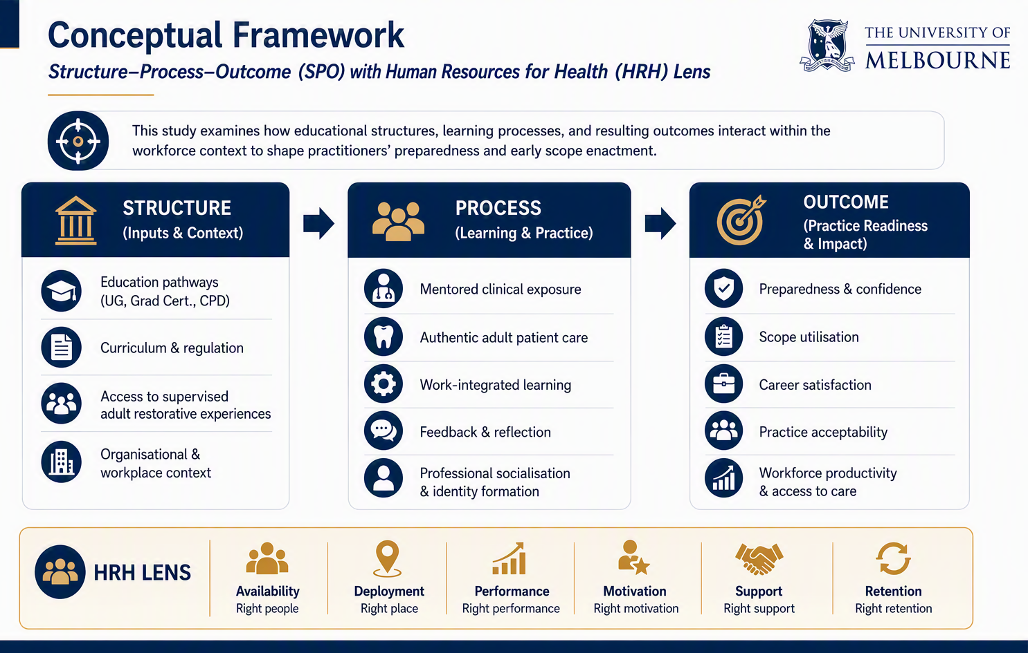
Notes:
As mentioned, an SPO-HRH framework underpins the interpretation of the findings.
At the structural level, preparedness is influenced by educational pathways, curriculum design, clinical exposure, mentorship, and the broader workforce environment.
The process domain represents the translation of those educational experiences into clinical practice through patient care, professional relationships, supervision, feedback, and scope utilisation.
Finally, outcomes include preparedness, confidence, career satisfaction, practice acceptability, retention, and workforce contribution
Importantly, the framework highlights that workforce outcomes are not created by education alone. They emerge through interaction between educational preparation and workplace systems

Slide 6
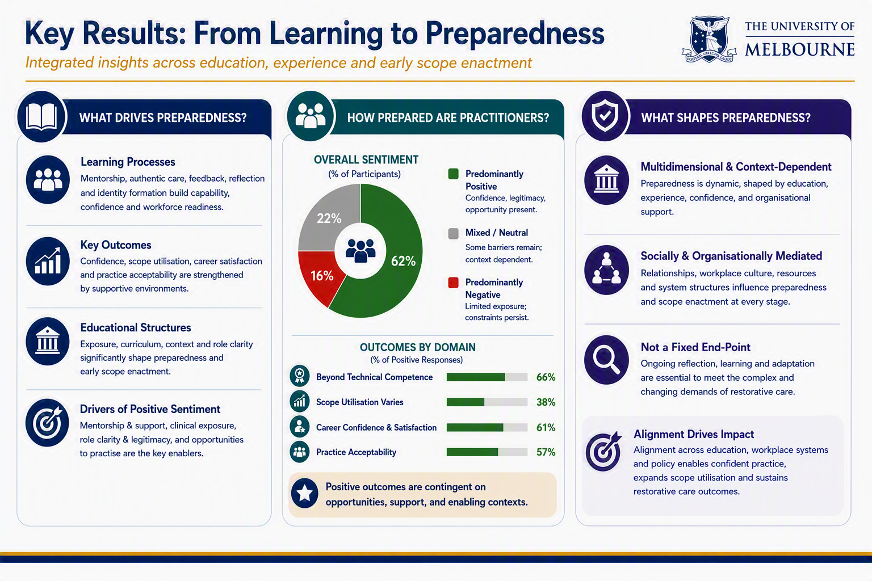
Notes:
Several findings were particularly noteworthy.
Most practitioners reported moderate to high levels of preparedness and confidence following their adult-scope education. Positive educational experiences were strongly associated with confidence and comfort in practice.
The strongest quantitative finding was the relationship between preparedness and comfort using the adult scope. Educational preparedness and scope comfort demonstrated a strong positive correlation.
Practitioners who felt better prepared were substantially more comfortable using their scope in practice
The qualitative findings helped explain why. Respondents consistently identified authentic patient experience, mentoring, workplace support, feedback, and repeated clinical exposure as the most influential contributors to preparedness. Simulation was useful, but participants repeatedly emphasised that real patient experience was essential.
Preparedness therefore emerged as a developmental process rather than a single educational outcome.

Slide 7
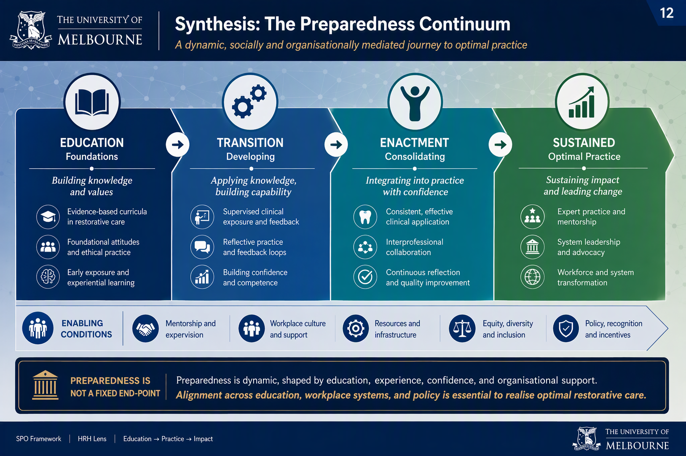
Notes:
One of the key conclusions of the research is that preparedness should be viewed as a continuum rather than an endpoint.
Education provides the foundation through knowledge, skills, values, and clinical exposure.
This is followed by a transition phase where mentoring, support, and workplace induction influence the development of confidence and professional identity.
Preparedness is then enacted through clinical practice, collaboration, reflection, and increasingly autonomous decision-making.
Finally, sustained practice depends on continued access to supportive environments, robust professional identity, opportunities to use the scope, and organisational recognition of practitioner capability
The central message is that preparedness is dynamic, socially mediated, and strongly influenced by workplace systems.
Education initiates preparedness, but practice environments determine whether it is sustained.

Slide 8
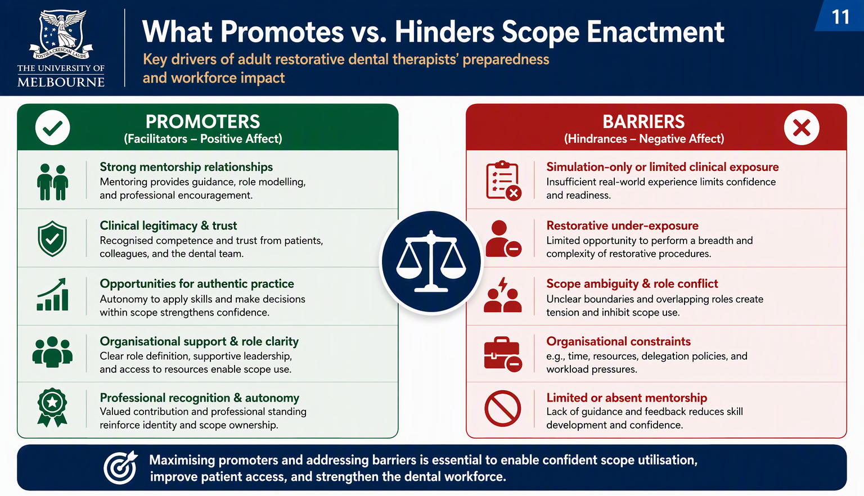
Notes:
The findings identify several practical implications.
For education providers, adult-scope programs should include authentic clinical exposure, structured mentoring, supported transitions into practice, and assessment approaches aligned with real-world care.
For employers, effective induction, mentorship, appropriate delegation, and access to adult restorative cases are crucial. These mechanisms activate workforce capability and enable practitioners to practise confidently.
For policymakers and regulators, the focus should move beyond authorisation alone and consider whether systems support enactment. Workforce planning should measure utilisation and capability, not simply practitioner numbers.

Slide 9
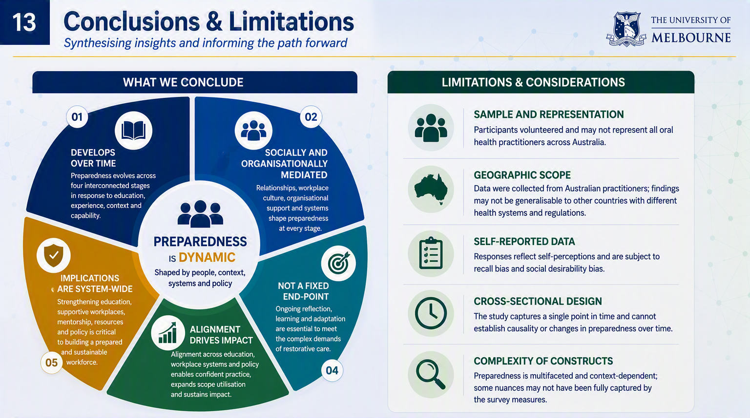
Notes:
In conclusion, adult-scope education significantly shapes preparedness, confidence and readiness to practise.
However, education does not operate independently. Experiential learning, mentorship, professional identity, workplace culture and organisational support influence whether preparedness becomes sustained scope enactment.
The findings demonstrate that expanding regulatory scope is necessary, but insufficient.
The benefits of legislation reform are realised only when education, practice systems and workforce policy are aligned.
For Australia, and potentially for other health systems expanding the roles of oral health practitioners, the priority should therefore move from scope authorisation alone to supported scope enactment.
Thank you

