Slide 1


Evaluating an Online Clinical Logbook in Work-Integrated Dental Education
Student and clinical mentor perspectives on a Clinical Assessment Learning (CAL) platform
Julie Satur, Brenda Ryan, Matt White
Melbourne Dental School, The University of Melbourne
Notes:
Good morning/afternoon. Today I am presenting our evaluation of Clinical Assessment Learning, or CAL, an online clinical logbook introduced to support recording of clinical experience, supervisor and mentor feedback and student reflection in authentic dental clinical settings – work-integrated learning envornoments.
Our central question was not simply whether users liked the platform. For work-integrated dental education, the more important question was whether a digital assessment tool can sit within real clinical workflows and sustain educationally meaningful use over time.
In the next quick 10mins I will briefly outline the implementation context, describe the survey evaluation, present student and mentor findings, and finish with implementation implications for digital assessment in dental education.

Slide 2
The implementation problem
Digital logbooks need to work where clinical learning actually takes place
Clinical care
Feedback
Reflection
Documentation must not disrupt patient care, appointment flow or local clinic routines.
Assessment should support timely mentor feedback and student learning, not become a compliance exercise.
Reflection must be feasible, purposeful and clearly connected to performance development.
Implementation premise
Acceptability is necessary — but sustainability depends on aligning the tool with assessment realities and everyday clinical workflow.
Notes:
Digital clinical logbooks are now common in dental education because they can capture clinical encounters, assessment data, feedback and reflective evidence in one place.
However, work-integrated learning creates particular implementation demands.
The learning environment is distributed, time pressured and shaped by real patient care.
Students and clinical mentors are often moving between patients, working on different devices, and balancing educational feedback with clinical responsibilities.
For our context, a postgraduate certificate program, educating dental and oral health therapists to expand their restorative skills across all ages of the population, primarily adults.
For that reason, our implementation premise was that CAL should be evaluated not just as a piece of software, but as an educational intervention located inside clinical workflow.
Therefore, our question was: “does CAL help learners and mentors record, assess and reflect in ways that are compatible with the clinical day”

Slide 3
Evaluation aim and design
A post-implementation survey of students and clinical mentors
11-item experience survey
Aim:
1
Five-point Likert items assessed usability, structure, functionality and perceived learning value.
To evaluate the acceptability, perceived educational value and workflow integration of CAL(v1) across work-integrated dental clinical settings.
Ordinal descriptive analysis
2
Medians and response distributions were used to preserve the ordinal nature of Likert data.
Respondent perspectives
S
Students
M
Clinical mentors
Workflow context
3
Additional items examined device choice and timing of completion.
Notes:
Our evaluation used a post-implementation cross-sectional survey at the conclusion of the program.
The survey asked students and clinical mentors to rate 11 statements about CAL(v1) using a five-point Likert scale from strongly disagree to strongly agree.
The items covered orientation, ease of use, formatting, prompts, feasibility, completion time, overall experience, feedback, rubrics, record keeping and reflection.
Because Likert responses are ordinal, we treated them descriptively. This presentation focuses on medians, response concentration and patterns of alignment between students and mentors, rather than over-interpreting small differences as inferential effects.
Two contextual questions asked how CAL was mostly completed — by device — and when it was mostly completed.
These items were important because workflow integration was a central part of the implementation question.

Slide 4
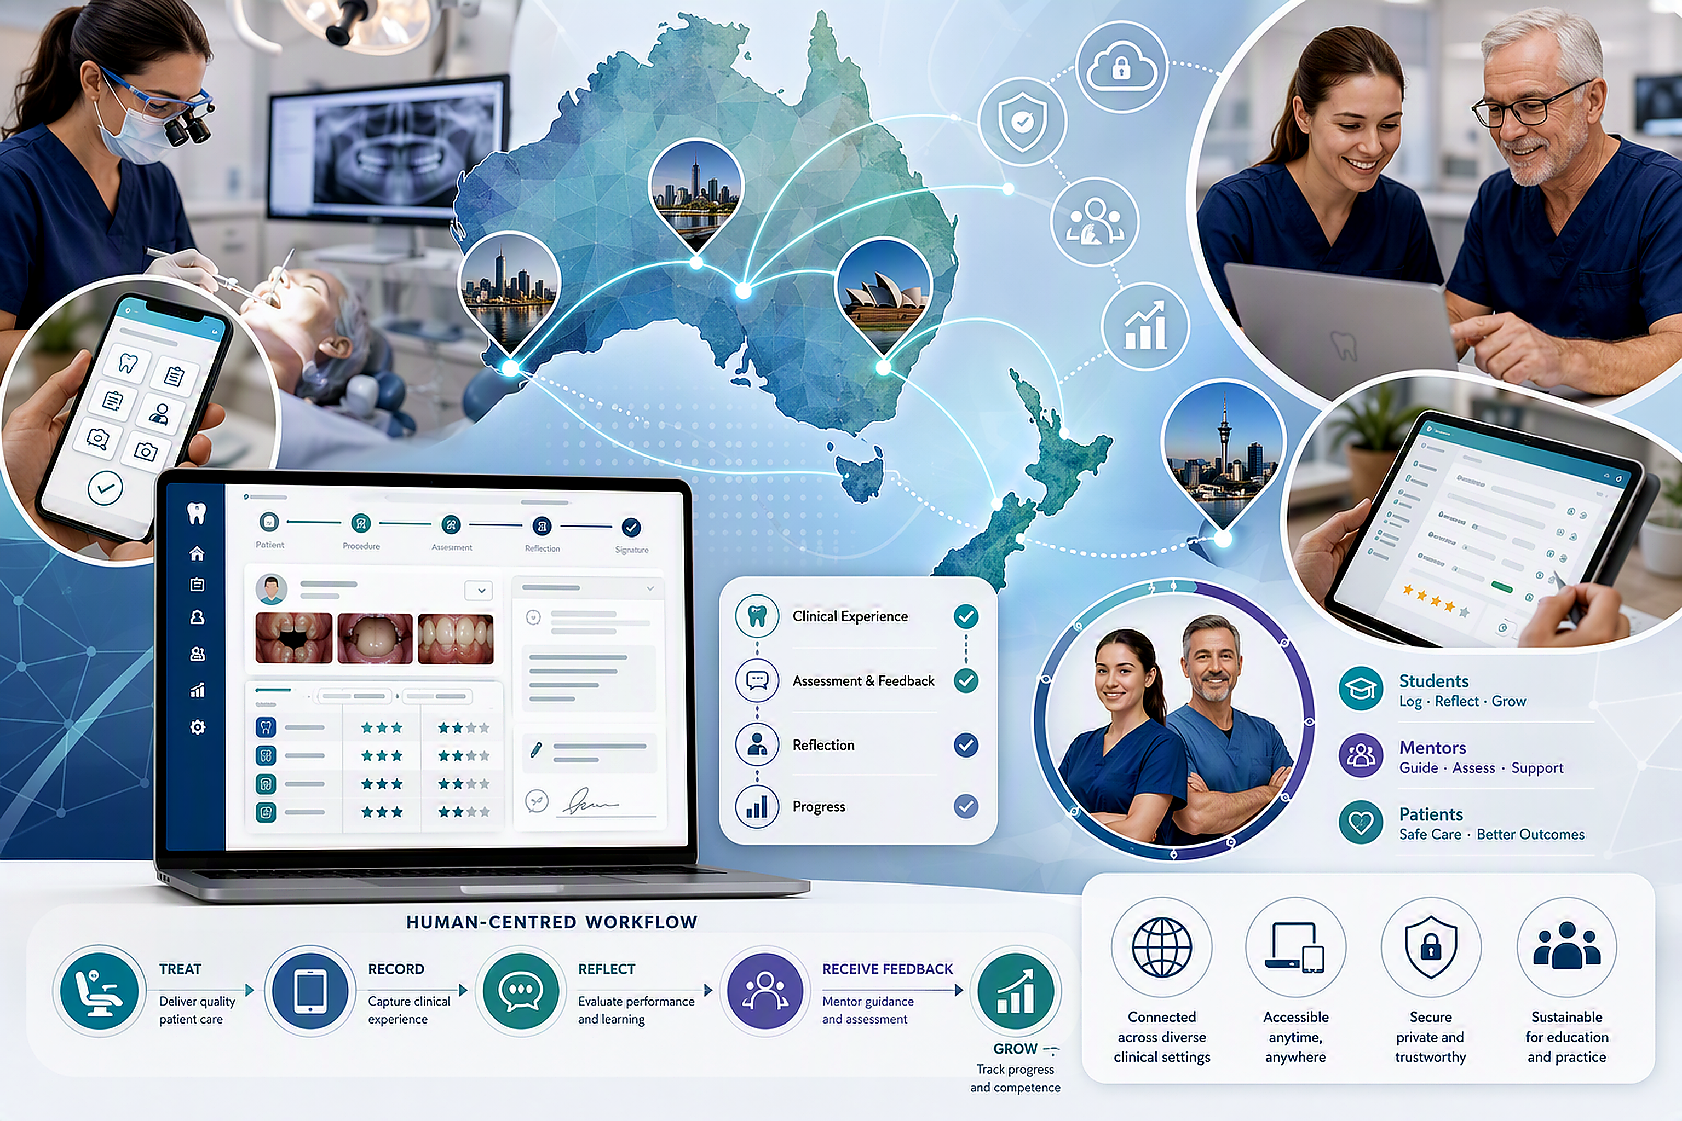
Participants and implementation context
A distributed, work-integrated learning environment across Australia and New Zealand
37
completed survey responses reported across students and mentor cohorts 2023 & 2024, nationally across Australia and New Zealand
Students: 25 (66%)
Mentors: 12 (32%)
Predominant respondent group; used CAL to record clinical experiences, self-assessment and reflections.
Clinical assessors used CAL to verify experience, give formative assessment and feedback to support learning.
Important analytical stance
Small sample; descriptive claims only. The contribution is implementation insight, not generalisable prevalence estimation
Notes:
37 completed responses from students and clinical mentors across 2 program cohorts in 2023 and 2024; equalling 25 students and 12 mentors.
The study context is important. CAL was implemented onsite, at the Dental Hospital University clinic and across varied work-integrated, private practice and public dental clinical settings, across Australia and New Zealand.
That makes the evaluation especially relevant for dental education programs where clinical learning happens outside a single university clinic and where local workflows differ.
- A key framing point for the audience is that we are not claiming population-level generalisability. Rather, the value is in understanding whether CAL was experienced as acceptable and educationally useful in authentic, distributed clinical practice.

Slide 5
Overall ratings: high agreement across CAL(v1) experience items
Strongest signals: ease of use, orientation and formatting. Greater variability: meaningful feedback and reflective learning items.
Item:
Agree (4) / Strongly Agree (5)
Orientation adequate
90%
Easy to use
92%
Median
Look & feel
92%
90%
4 – 5
Clear prompts
Achievable per patient
90%
across the 11 items
Quick to complete
82%
Positive experience
79%
Meaningful feedback
79%
Clear rubrics/domains
87%
User-friendly record
84%
Safe reflective space
90%
0
25
50
75
100
Notes:
The clearest quantitative finding is that CAL was experienced positively overall. Across the 11 items, median agreement scores were consistently in the positive range, between 4 and 5 on the five-point scale.
The evaluation data showed particularly strong positive responses for ease of use, orientation, look and feel, clear prompts, and record keeping.
This was important because these are the basic usability conditions required before a digital clinical logbook can achieve educational value.
The items showing some variability were not the technical interface items, but the educational process items: meaningful feedback and reflection.
That distinction mattered as it suggests the main implementation challenge is not resistance to digital assessment, but how the tool is embedded in the feedback and clinical reflection cycle.

Slide 6
Students and mentors were broadly aligned
Patterns of agreement were similar across roles, with modest variation in feedback/reflection items
Item:
Agree / strongly agree (%)
Orientation adequate
Students
Easy to use
Mentors
Look & feel
Clear prompts
Achievable per patient
Interpretation:
CAL was not seen differently by the two key user groups in any strongly divergent way.
Quick to complete
Positive experience
Meaningful feedback
This supports role alignment for implementation.
Clear rubrics/domains
User-friendly record
Safe reflective space
75%
100%
Notes:
This slide compares the proportion of student and mentor responses that were agree or strongly agree for each item in the evaluation data.
The overall pattern is one of role alignment. Students and mentors were generally moving in the same direction: positive ratings for usability, structure, feasibility and overall experience.
This is important because digital assessment platforms can fail if one user group sees value and another sees burden. Here, both groups appear to find CAL workable.
There are modest differences on some items, particularly around user-friendly record keeping, safe reflective space and feedback.
These are not unexpected because students and mentors interact with reflective and feedback functions differently.
For students, reflection is part of the learning record. For mentors, feedback is part of clinical assessment practice and must be actionable, timely and not overly burdensome.
- The takeaway for implementation is that CAL appears to have a shared acceptability foundation across the two key roles. The next phase should focus less on persuading users to use CAL and more on optimising how specific feedback and reflective prompts function in the clinical day.

Slide 7

Workflow context shaped user experience
Device and timing data point to flexible access — and to where friction can emerge.
Mostly completed on:
Desktop computer
15 (40%)
Mobile phone
11 (29%)
Laptop Computer
11 (29%)
iPad
1 (3%)
Mostly completed when:
End of the day
12 (32%)
After hours, at home
10 (26%)
After each patient
6 (16%)
Between patients
4 (11%)
Digital assessment must meet users at the point of care — and outside it.
At break times
4 (11%)
Notes:
The workflow items are particularly useful because they move the evaluation beyond sentiment about the platform. They show how CAL was actually being fitted into the clinical day.
Completion was distributed across desktop computers, laptops and mobile phones, with some iPad use. This confirms that flexible access is not a convenience feature; it is a core requirement for work-integrated clinical assessment.
Timing was also varied. Some respondents completed CAL after each patient or between patients, while others completed it at the end of the day, after hours at home.
This variation helped explain why some users perceived CAL as quick and straightforward, while others described issues such as repetition, burden, or the need for a back button and easier amendment.
Here we found that the implementation lesson is that usability cannot be separated from workflow. A platform may be easy to use in isolation, but still feel burdensome if the workflow expects completion at a clinically inconvenient time or if mentors receive too many prompts.

Slide 8
Open-text responses: what users valued — and what they wanted improved
The comments translated usability into implementation priorities
What users valued
What users wanted improved
Why this matters
“Easy to use”, “quick”, “straightforward”, “well structured”, accessible by link, and useful as a record of experience and reflection.
Visible hours/tally, back navigation, clearer feedback audience, more specific reflection prompts, more evidence upload options.
The requested changes are mostly workflow and learning-design refinements — not rejection of the platform.
Theme
Evidence in comments
Implementation response
Usability
Easy, quick, structured, simple to follow
Keep interface lean and mobile-responsive
Learning value
Reflection and feedback valued, but prompts need specificity
Design reflection around clinical decision-making
Assessment record
Record of experiences valued; users wanted visible progress
Add progress/tally dashboard and durable access
Clinical workflow
Timing varied; amendments and mentor prompt load mattered
Build for interrupted, time-constrained clinical work
Suggested adaptation: move from a “completed form” mindset to a “learning conversation capture” mindset
Notes:
The open-text responses were highly actionable. Users repeatedly described CAL as easy, quick, accessible, well structured and straightforward.
These comments reinforce the quantitative pattern of high acceptability.
The improvement suggestions were even more informative. Several students wanted a visible tally of hours or procedures, so they could monitor progress without keeping a separate record. Others wanted back navigation to correct forgotten entries, durable access to PDF responses, or the ability to upload more clinical evidence such as before-and-after clinical images.
Reflection and feedback comments were especially important. Some respondents valued the reflective element, while others found the self-assessment section difficult or repetitive.
There were also comments about needing clearer examples for satisfactory or unsatisfactory performance, and clearer understanding of who mentor feedback was for.
- These are not signs that users rejected CAL. They are signs of the next implementation task: refine the platform around clinical interruptions, user correction, visible progress, evidence capture and educationally specific feedback prompts.

Slide 9
Study limitations
Findings should be interpreted as implementation evidence, not definitive effectiveness evidence.
Sample size
Study design
Response bias
Small respondent group; descriptive analysis only, with no inferential claims about population-level effects.
Post-implementation cross-sectional survey captures perceptions at one point in time, not change over time.
Voluntary anonymous feedback may over-represent users with stronger positive or negative experiences.
Context specificity
Measurement scope
Platform maturity
Conducted within a postgraduate adult dental therapy work-integrated program; transferability requires local judgement.
Likert items and comments assess experience and perceived value, not direct learning outcomes or patient outcomes.
CAL was being piloted and refined; early glitches and evolving workflows may have influenced responses.
Implication: the results are best used to guide iterative implementation design —
particularly around workflow, feedback quality and reflective learning.
Notes:
Before moving to conclusions, it is important to frame the limitations clearly. This evaluation provides useful implementation evidence but was is not designed as a definitive effectiveness study.
First, the sample is small. 37 completed responses, and the role-coded raw files contain a small number of student and mentor responses. This means our analysis is intentionally descriptive and should avoid overstating small differences between groups.
Second, the design is post-implementation and cross-sectional. It captures user perceptions after implementation, but it does not show change over time, compare CAL with an alternative logbook, or establish causation.
Third, because the survey was voluntary and anonymous, there is potential response bias. Users with particularly positive or particularly difficult experiences may have been more motivated to respond.
Fourth, the context matters. The findings come from a postgraduate adult dental therapy work-integrated setting. The lessons are likely relevant to other distributed dental education programs, but transferability depends on local clinical workflows, assessment expectations and mentor roles.
Finally, the data focus on acceptability, perceived educational value and workflow integration. They do not directly measure learning outcomes, competence progression, feedback quality over time, or patient outcomes. The next phase, has these valuable areas for longitudinal follow-up.
So, the appropriate interpretation is that CAL appears acceptable and promising, and the findings identify specific design priorities for sustainable implementation.

Slide 10

Conclusions for sustainable digital clinical assessment
CAL was highly acceptable
1
Students and mentors reported positive experiences and similar patterns of agreement.
Educational value depends on use-in-context
2
Feedback and reflection are where workflow, timing and mentor practice shape the learning return.
Sustainability requires workflow-informed design
3
Progress visibility, easy amendments, evidence upload and clearer feedback prompts are implementation levers.
Key takeaway: acceptability will not translate into sustainability unless digital assessment logbooks are designed around the realities of work-integrated clinical practice.
Notes:
To conclude, CAL was highly acceptable to students and clinical mentors in a work-integrated dental education setting. The quantitative ratings were consistently positive, and the student and mentor patterns were broadly aligned.
The most important interpretation is that the platform itself was not the main barrier. Where variability appeared, it was mainly around feedback, reflection and workflow. That is exactly where digital assessment tools move from being usable software to being meaningful educational infrastructure.
The practical implications are clear. First, maintain the interface strengths: simple access, clear structure and quick completion. Second, strengthen the educational functions: make reflection prompts more specific, clarify mentor feedback expectations, and ensure feedback is visible and useful to the student. Third, design for the clinical day: include visible progress tracking, easy correction or back navigation, durable records, and flexible evidence upload.
The final message for dental education is that sustainable digital logbooks are not just assessment repositories. They are workflow-sensitive learning systems. If we design them with the realities of clinical placements in mind, they can support record keeping, feedback and reflection without becoming another administrative burden.

Slide 11


