Slide 1


‘Why aren’t dental students professional these days?’
Exploring the complexities of dental student professionalism
Isabelle Cunningham
Honorary Associate Professor in Dental Education Bristol Dental School, UK
Part-time Doctorate in Education student

Slide 2
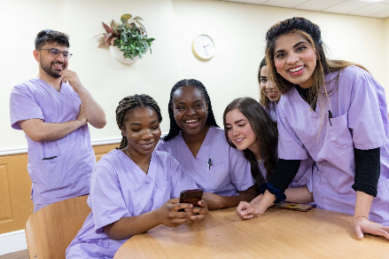

Background
“When I was a dental
student…”
“They don’t care about being late”
“They don’t prepare enough”
“They don’t accept feedback”
“They lack respect”
“They’re just not very professional”

Slide 3
Contemporary healthcare professionalism: theoretical concepts
Professionalism is complex & contested (Hafferty & Castellani, 2010)
It is context-dependent (Hodges et al., 2019)
Professional development is socially constructed and involves the formation of a professional identity (Cruess & Cruess, 2016)
The macro-perspective: the broader systems and structures that shape students, educators and practitioners (Hodges et al., 2019)

Slide 4
Research question
  According to dental students and teachers, what are the reasons for professionalism-related tensions between students and teachers on dental clinics?

Slide 5
Methodology
Qualitative, inductive practitioner research from an interpretivist & constructionist perspective.
Method | Rationale
8 individual, semi-structured interviews with clinical dental teachers. | To gain teacher perspectives
5 semi-structured group interviews with Year 3-5 students & recent graduates. 12 voices in total. | To gain student perspectives

Slide 6
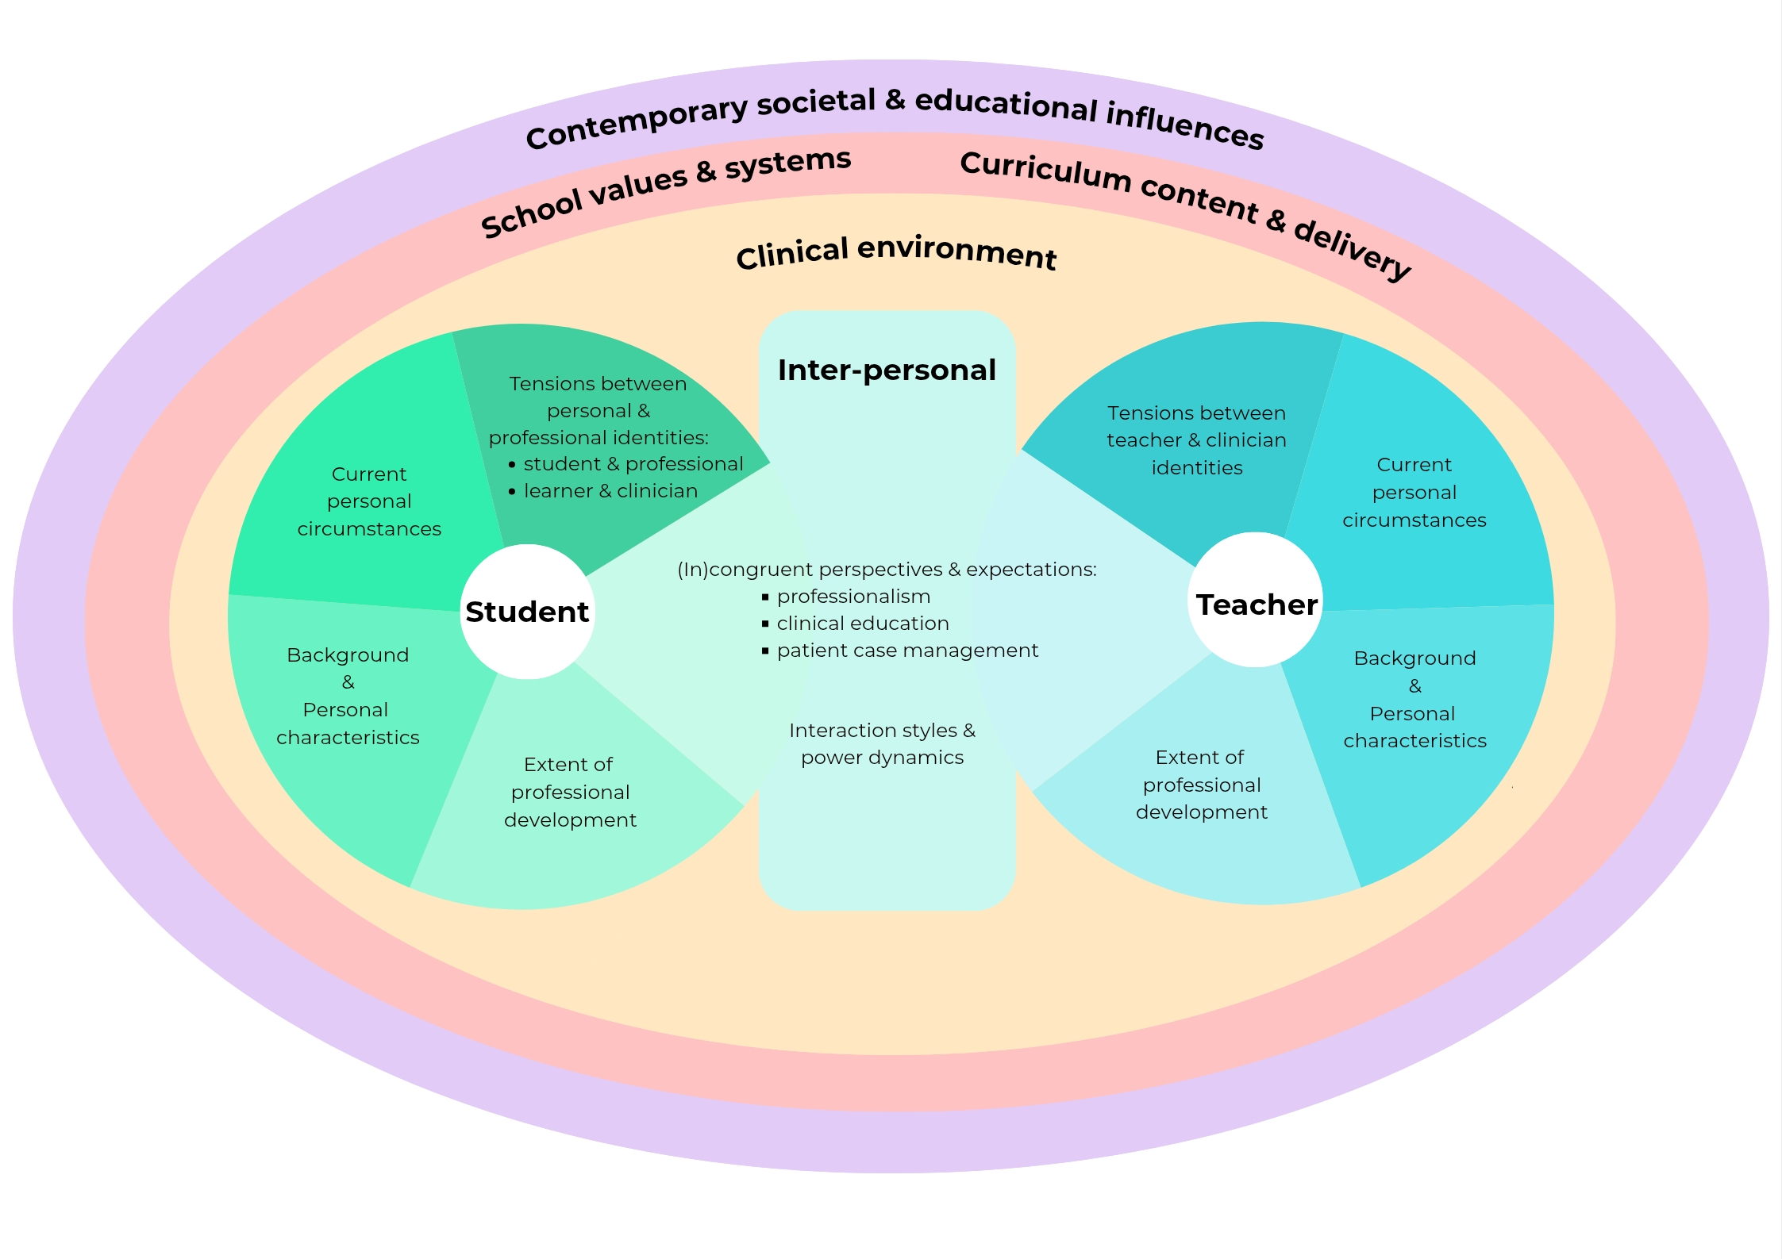
What are the reasons for professionalism-related tensions between students and teachers on dental clinics?

Slide 7
X

Slide 8
Tensions between clinician and learner identities
Dental students want to be seen as knowledgeable & capable by their patients (Chang-Colina, 2023)
Now I’m insisting on why I’m choosing the method I’m using. Back in 2nd and 3rd year I didn’t have the knowledge or the experience to argue with them and say, ‘I’m doing that for these reasons’.
Year 5 student
There is always going to be something that we don’t know. If a supervisor brings that up in front of a patient, I think it just makes you look unprofessional.
Year 3 student

Slide 9
Reasons for professionalism tensions
The personal and inter-personal
18 Text size

Slide 10
X

Slide 11
Incongruent perspectives & expectations
Professionalism
Clinical education
The supervisor gets frustrated, the student gets frustrated, because they’re not necessarily getting what they want.
Teacher
Patient case management

Slide 12
Professionalism example: dress standards
The students are casual,
they’re a bit scruffy.
Teacher
Sometimes the staff are a bit too nitpicky. I understand from the point of safety, but it’s like treating you like you’re back at school a bit, and not respecting you.
Year 5 student

Slide 13
Professionalism example: managing professionalism lapses
Developmental versus punitive approaches
There are so many different reasons that people can be late […]. Obviously, that’s where you need to just ask and understand, and find out what’s going on before jumping to a conclusion - which some supervisors do, some don’t.
Year 3 student
We’re a bit soft on them, they just get away with it.
If you give them an inch, they take a mile. Teacher

Slide 14
Incongruent perspectives & expectations of clinical education
If they don’t know the answer, what am I meant to do? ‘You’re here to teach me, you go find the answer, you go find someone who will know’ […] I feel like if they work here they should understand how it works.
Year 3 student
I was thinking ‘What, do you want me to wipe your backside for you? Put a bit of effort in yourself’. It’s not like going out and buying a McDonald’s or something, you’ve got to actually have a bit of input yourself and want to learn.
Teacher
Notes:
.

Slide 15
Incongruent perspectives & expectations of clinical education
To be allowed a bit more independence in decision making. But a lot of supervisors don’t like that happening, they’d rather know every single thing you’re doing, every step of the way.
Year 3 student

Slide 16
Incongruent perspectives & expectations of the patient case
Tensions are particularly likely if…
Teachers do not explain the reasons for patient case changes
Patient care is seen as compromised
The student-patient relationship is affected
The differences in clinical judgement between a supervisor and a student can sort of spark a professionalism issue.
Year 3 student

Slide 17
X

Slide 18
Interaction styles & power dynamics
Interview question to students and teachers:
“Do you think students should respect the authority of clinical teachers?”
Contentious topics:
Unconditional respect for supervisors?
Hierarchical learner-teacher relationships?
Collegial learner-teacher relationships?
Teachers can experience student incivility & disrespect
Students can experience supervisor
belittlement

Slide 19
Interaction styles & power dynamics
Some of our supervisors, we were terrified of them. I think that’s not necessarily a bad thing. You were scared of them, but you respected them.
Teacher
Amongst ourselves, after a clinic day, the only things we’d speak about, or would play on our minds, would be if a staff member made us look silly in front of a patient.
Recent graduate

Slide 20
X

Slide 21
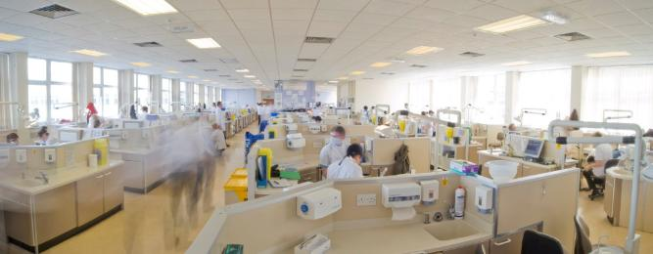
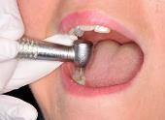
The teaching clinic environment
Unpredictable, high stakes, often pressurised
Low staff numbers
Lack of equipment or materials
Poor organisation
Room temperature
Professional lapses occur if professional development is insufficient
to navigate contextual demands (Levinson et al., 2014)

Slide 22
The dental curriculum and school
The intense, stressful dental programme
Curriculum topics that are perceived as non-relevant
Assessment systems: ‘chasing’ clinical procedure requirements
Towards later years, I found that we were chasing totals so much, that things that were not totals…[pause] seemed like a waste of time.
Recent graduate
The totals are causing stress, and I think they’re causing lapses of professionalism in some students - not really sticking to the treatment plan, doing things that wouldn’t be right.
Teacher

Slide 23
The positive influence of school values, systems & role models
If you see an environment which is professional, warm, welcoming, you are naturally going to feel like you have to behave like that in order to fit in. If all the staff around you and all the students around you, not just supervisors – nurses, technicians, whoever, behave in a professional yet still welcoming way, not a hostile professionalism, like you’re afraid to say anything…I think that would have the biggest influence on people.
Year 4 student

Slide 24
X

Slide 25
Contemporary societal & educational influences: some relevant literature
Contemporary higher education
High tuition fees raise students’ expectations:
‘The student as customer’ (Tomlinson, 2017)
‘Student entitlement’ (Lippmann et al., 2011)
Contemporary society and schooling/learning approaches
Reduced resilience, learning dependency (Fox, 2019)
Grade inflation: students may not accept feedback (Forsythe & Johnson, 2017)
Generational theory
‘Gen Z’ and the ‘generation gap’ (Twenge, 2009; Jauregui et al., 2020)

Slide 26
Contemporary societal & educational influences
Interview question to students & teachers:
“There is a general assertion in the public domain that today’s students are customers of universities. What are your thoughts about this?”
Interview question to teachers:
“With respect to professionalism, do you think dental students are different compared to when you were a student?”

Slide 27
Contemporary societal & educational influences
3 of 10 students strongly identified as university customers
6 of 8 teachers described its influence in contemporary dental education
We’re paying to be here, we’ve worked really hard to get here, to be put onto the course, to actually learn the trade. […] But if a supervisor teaches in a way ‘It’s my way or no way’, you’re not really learning
Year 3 student
There is an attitude among some of the students ‘I’m paying for this, you’re here to serve me’, rather than…the other way round really
Teacher

Slide 28
Contemporary societal & educational influences
All the teachers identified how contemporary factors were influencing their experiences with students.
Collectively, they described:
raised student expectations
an altered student-teacher relationship: student voice & agency
a lack of learning proactivity
generational differences in professional standards: mobile phones, acceptance of image diversity, communication styles

Slide 29
Raised student expectations and entitlement
Some sort of entitlement, that they are there to be given, fed it, led by the nose to something, all on a plate kind of thing. […]
And if it isn’t delivered to them and they fail their exams, it’s nothing to do with them, it’s obviously to do with the teaching.
Teacher

Slide 30
Student voice & agency
They are more self-assured, they will call out anyone who doesn’t treat them the right way.
Teacher
I got an email from one of the students [...]. She was basically saying, ‘How come I’ve got a C, why haven’t I got a B or an A?’
Teacher

Slide 31
The interview responses from three teachers suggested that their perspectives on contemporary society, education & current generations could contribute to professionalism tensions with students

Slide 32
X

Slide 33
Key take-home messages
Contemporary dental student professionalism is complex.
Key concepts: complexity is multi-layered; identity tensions; incongruent perspectives & expectations; power dynamics; shifting institutional, educational & societal landscapes; the student as customer.
If student-teacher interactions are problematic on clinic, there are many possible reasons. Could my schematic help?
The inter-personal layer is central. Students want to develop positive learning relationships with their teachers.
Most students don’t choose to be difficult. The best default position is to assume there are underlying reason(s) – explore, talk, understand.
Professionalism is experienced by students as a demanding developmental process.
The education and development of dental students is posing increasing challenges for educators.
Know what ‘pushes your buttons’ and why.
Being a positive role model is vital.

Slide 34
Comments & questions
What are your perspectives and experiences?
Will these findings influence your interactions with students?

Slide 35
References
Braun, V., & Clarke, V. (2021a). One size fits all? What counts as quality practice in (reflexive) thematic analysis? Qualitative Research in Psychology, 18(3), 328-352.
Chang-Colina, T. (2023). Dental student perceptions on clinic supervision: A qualitative study. Journal of Advances in Dental Practice and Research, 2(1), 24-27.
Cruess, R. L. & Cruess, S. R. (2016). Professionalism and professional identity formation: the cognitive base. In R. L. Cruess, S. R Cruess, & Y. Steinert (Eds.), Teaching medical professionalism: Supporting the development of a professional identity (2nd ed., pp. 5-25). Cambridge University Press.
Cunningham, I. M., Gormley, M., & Neville, P. (2024). Contemporary dental student professionalism: moving towards a macro-level perspective. British Dental Journal, 236(8), 631-636.
Forsythe, A., & Johnson, S. (2017). Thanks, but no-thanks for the feedback. Assessment & Evaluation in Higher Education, 42(6), 850-859.
Fox K. (2019). 'Climate of fear' in new graduates: the perfect storm? British Dental Journal, 227(5), 343-346.
Hafferty, F. W., & Castellani, B. (2010). The increasing complexities of professionalism. Academic Medicine, 85(2), 288-301.
Hodges, B., Paul, R., Ginsburg, S., & The Ottawa Consensus Group Members. (2019). Assessment of professionalism: From where have we come - to where are we going? An update from the Ottawa Consensus Group on the assessment of professionalism. Medical Teacher, 41(3), 249-255.
Jarvis-Selinger, S., MacNeil, K. A., Costello, G., Lee, K., & Holmes, C. L. (2019). Understanding professional identity formation in early clerkship: A novel framework. Academic Medicine, 94(10), 1574-1580.
Jauregui, J., Watsjold, B., Welsh, L., Ilgen, J. S., & Robins, L. (2020). Generational “othering”: The myth of the Millennial learner. Medical Education, 54(1), 60-65.

Slide 36
References
Levinson W., Ginsburg S., Hafferty, F. W., & Lucey C. R. (2014). Understanding medical professionalism. McGraw-Hill Education.
Lippmann, S., Bulanda, R., & Wagenaar, T. (2011). Student entitlement: Issues and strategies for confronting entitlement in the classroom and beyond. College Teaching, 57(4), 197-204.
Mak-van der Vossen, M., Teherani, A., van Mook, W., Croiset, G., & Kusurkar, R. A. (2020). How to identify, address and report students' unprofessional behaviour in medical school (AMEE guide). Medical Teacher, 42(4), 372-379.
Ranauta, A., Freeth, D., & Davenport, E. (2018). Developing understanding and enactment of professionalism: Undergraduate dental students' perceptions of influential experiences in this process. British Dental Journal, 225(7), 655-661.
Symonds, E. (2021). Reframing power relationships between undergraduates and academics in the current university climate. British Journal of Sociology of Education, 42(1), 127-142.
Tomlinson, M. (2017). Student perceptions of themselves as ‘consumers’ of higher education. British Journal of Sociology of Education, 38(4), 450-467.
Twenge, J. M. (2009). Generational changes and their impact in the classroom: Teaching Generation Me. Medical Education, 43(5), 398-405.

Slide 37
Spare slides for discussion if needed

Slide 38
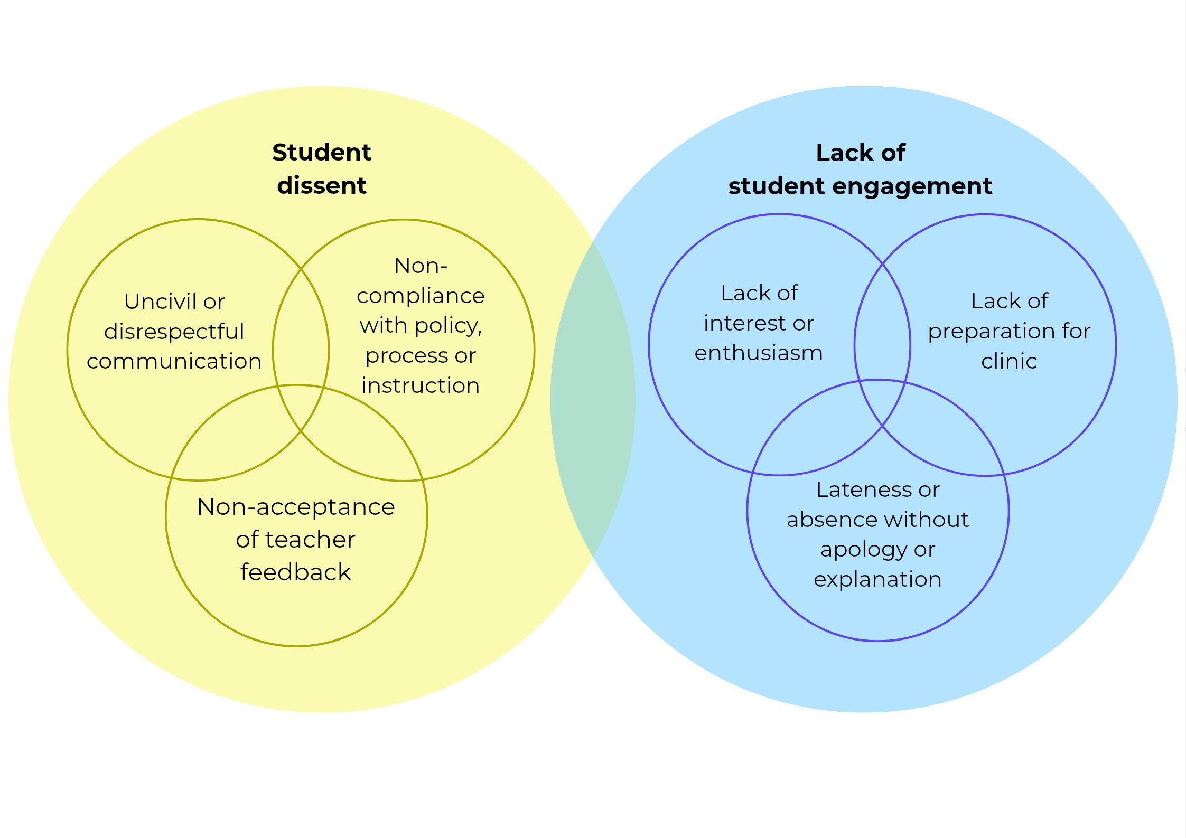
RQ1: According to clinical dental teachers, how do professionalism-related tensions manifest between students and teachers?

Slide 39
According to 8 clinical dental teachers, how do student-teacher professionalism-related tensions manifest on dental teaching clinics?
 | Professionalism Lapse Theme | Dental teachers T1-T8 |  |  |  |  |  |  |  | Number of teachers
 |  | T1 | T2 | T3 | T4 | T5 | T6 | T7 | T8
 | Uncivil or disrespectful student communication |  |  |  |  |  |  |  |  | 6
 | Non-compliance with policy, process or instruction |  |  |  |  |  |  |  |  | 6
 | Non-acceptance of teacher feedback |  |  |  |  |  |  |  |  | 4
4. Lack of student engagement | Lack of interest or enthusiasm |  |  |  |  |  |  |  |  | 5
 | Lack of preparation for clinic |  |  |  |  |  |  |  |  | 4
 | Lateness or absence with no apology or explanation |  |  |  |  |  |  |  |  | 5
Key:
Topic of their critical incident
Also featured
in the interview

Slide 40
PLs occur if professional development is insufficient to navigate contextual demands (Levinson et al., 2014)
Recommendations for change should
support professional development
and/or
optimise contextual circumstances

Slide 41
Recommendations to address professionalism-related tensions on dental student clinics
Level | Recommendations
Inter-personal | Employ humanistic teaching approaches and develop mutually respectful student-teacher learning relationships.
 | Seek the cause(s) of professionalism lapses (PLs) with open dialogue during PL management conversations.
 | Increase student exposure to teacher and senior peer role models.
Clinic | Develop clinic cultures that are welcoming and organised, with mutually respectful relationships.
 | Improve the teacher-student ratio on clinics and review the consistency of staffing.
 | Develop curriculum-aligned clinical procedure guidance.
 | Improve clinic resources & administrative support.

Slide 42
Recommendations to address professionalism-related tensions on dental student clinics
Level | Recommendations
Curriculum | Develop a curriculum that emphasises positive professionalism, incorporates multiple opportunities for students to explore their professional identity development, and includes clear descriptions and examples of (un)civil behaviour.
 | Review clinical assessment systems to reduce any unintended professional or educational impacts.
 | Review curriculum content to optimise and clarify its relevance.
 | Incorporate clinical teamworking opportunities that support students’ professionalism & communication skills.
 | Incorporate video scenarios of professionalism and clinician-patient interactions.
School | Collaborative school-level discussions to establish and prioritise the core professional and educational values that should underpin policies, behaviour codes and learning contracts.
 | Embed staff development and support, to include: complexity professionalism, professional identity formation, collaborative learning and mutual respect, role modelling, feedback conversations, the management of professionalism lapses (PLs).
 | Effectively identify and manage students with recurrent PLs.
 | Increase a sense of school community, including the recruitment of staff and students who align with the school’s professional values.

Slide 43
Interview question examples: clinical teachers
Tell me about the challenging teaching incident you have thought of.
With respect to student behaviours or demeanours, what particularly concerns you on clinic, and why?
What are your thoughts as to the reasons why students are not always professional on clinic?
Do you think student personality / background influences student professionalism?
Do you think students should respect the authority of clinical teaching staff?
With respect to professionalism, do you think dental students are different compared to when you were a student?
There is a general assertion in the public domain that today’s students are ‘customers’ of universities. What are your thoughts about this?
What would help to support the professional development of students, and why?

Slide 44
Interview question examples: students
With respect to how clinical teachers view what is professional and non-professional, in what ways have you experienced, or observed, differences in what they expect?
Thinking about either yourself or perhaps other students, tell me about some of the pressures that can make it difficult for students to meet the professional expectations of staff on clinic.
What are your thoughts on reasons why:
a student is late for clinic on a regular basis; appears to lack interest; appears unprepared.
Do you think students should respect the authority of clinical teaching staff? What makes it easy/difficult for you to respect a clinical teacher?
Do you think student personality / background influences student professionalism?
There is a general assertion in the public domain that today’s students are ‘customers’ of universities. What are your thoughts about this?
What would help to support the professional development of students, and why?

Slide 45
A perspective…
‘There may be professional challenges for dental students who have been raised in a society and education system which upholds agency and voice, but who are then subjected to being ‘moulded’ into professionals and required to meet the expectations of health care teachers from earlier generations.’
(Cunningham, Gormley & Neville, 2024)

Slide 46
Desirable characteristics of the dental clinical teacher (Chang-Colina, 2023; Fugill, 2005)
Approachability
Professional competence
Punctuality and availability
Patience
Consistency
Fairness
Respect for the student/patient relationship
Understanding of the limits of student knowledge

Slide 47
Is a supportive learning environment always realistic?
Some factors at play:
Teacher and learner personality and background
Teacher and learner perceptions of the teacher role
Teacher and learner perceptions of authority and hierarchy
Teacher experience
Teacher understanding of the complexities of clinical teaching
Not forgetting clinic factors, including staff:student ratio

Slide 48
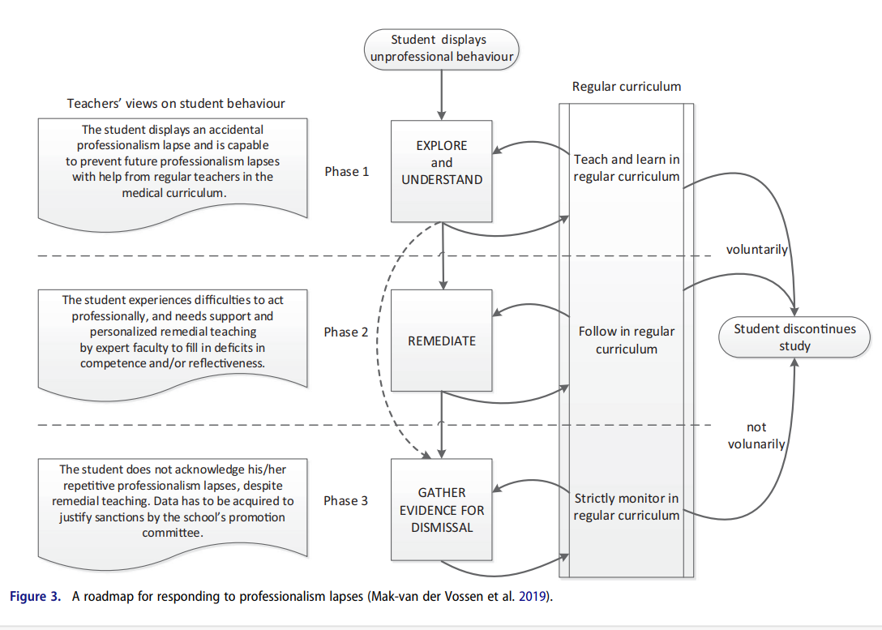

Slide 49
1. Students’ backgrounds & personal characteristics
‘Laid back’ or gregarious personalities
Parenting
Schooling
Life & work experiences

Slide 50
2. Students’ current personal circumstances
Personal or family-related issues
Low motivation
for a dental career
Struggling academically
Part-time work
& financial pressures

Slide 51
3. Extent of professional development
Aside from personal circumstances, most professionalism lapses arise when professional awareness or development is insufficient
to meet the demands of a specific situation
(Levinson et al., 2014)

Slide 52
3. Extent of professional development
It’s probably just maturity […], I think for the most part it’s subconscious, or there’s something going on for the student. […] There’s no benefit to being unprofessional on clinic, so why would a student want to be unprofessional?
Year 4 student
They have to be in a professional mode. […] I don’t think they understand that professionalism is a constant aura around them, rather than just when you step through the front doors.
Teacher
We never really got advice on how to approach a supervisor and how to ask a question, that sort of stuff.
Year 3 student

Slide 53
4. Tensions between personal and professional identities
Professional identity
‘A representation of self, achieved in stages over time, during which the characteristics, values, and norms of the [dental] profession are internalised, resulting in an individual thinking, acting, and feeling like a [dentist]’
(Cruess & Cruess, 2016)

Slide 54
4. Tensions between personal and professional identities
Personal Identity
Professional Identity
Dental students are still developing their sense of self
-as individuals
-as ‘uni’ students
-within friendship groups
From an early programme stage, dental students have patient care responsibilities and carry out invasive procedures
Students need to navigate and negotiate between their personal and professional identities

Slide 55
Personal identity and challenging the dress code
I think it’s really important for some students to have a bit of individuality. I know it sounds silly, but where they’ve looked at this pair of shoes for clinic, and they know they’re going to feel comfortable in them.
Or maybe wearing a necklace that brings them luck on clinic, because that’s what makes them more comfortable in quite a stressful environment.
Recent graduate
She is often very made up and has eyelash extensions, and you name it. I mean, she’s obviously into her appearance.
Teacher

Slide 56
Tensions between ‘uni’ student
& professional identity
The student being more laid back, fun, outgoing, and the dentistry being quite serious and professional – they do naturally conflict. Trying to balance both is difficult because they are so conflicting. Year 4 student

Slide 57
Navigating friendship groups
& professional identity
It’s hard to be professional on clinic, because I feel like I’ve made friendships within my clinical group. We have a laugh and joke, but we get the work done. But I sometimes feel ‘Oh, am I being professional or am I not?’
Year 3 student
As human beings we don’t want to be singled out, we always like being in groups. […] If the people around you are quite laid back, you think ‘Oh, I’ll go with them, I don’t want to be the person to leave early to go to clinic, I’d rather stay with my group’.
Year 4 student

